Slide 1
Build a Regression Model for Prediction of House Price in Ames
Jasper

Slide 2
Problem Statement
Identify features that are influential in predicting the Sale Price in Ames
Determine the best regression model for predicting Sale Price with the influential features
With a set of features, we are able to predict the price of a house

Slide 3
Workflow
Feature Selection using EDA
Data Cleaning
Model Evaluation

Slide 4
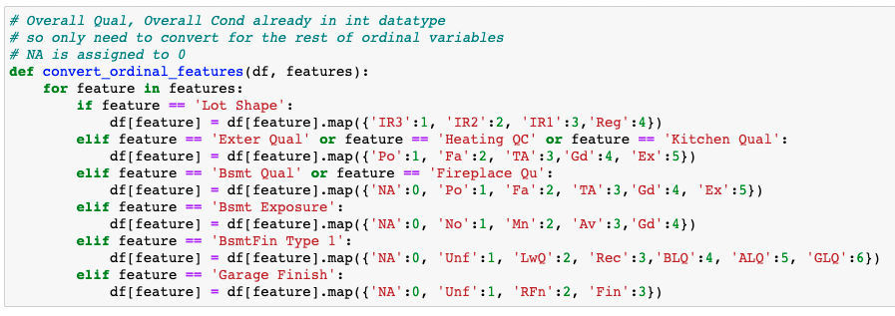
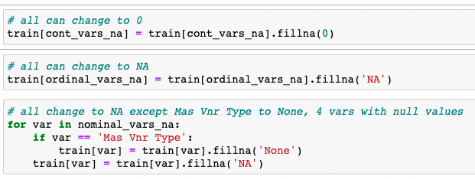
Data Cleaning
Fig.1. Code snippet that impute missing values
Fig.2. Code snippet that convert values of ordinal features to numerical
Impute the missing values for the continuous, nominal and ordinal features
Convert value of ordinal features to numerical values

Slide 5
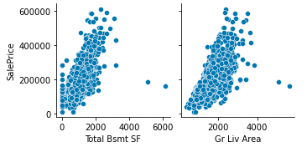
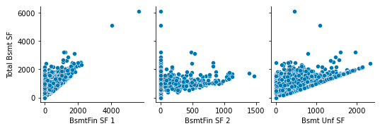
Feature Selection – Continuous/Discrete
Pair plots are used to find the correlation between continuous/discrete relationship
Collinearity between continuous features can be removed
Reduced down to 2 continuous features: Total Bsmt and Gr Liv Area
Fig.3. Continuous features that are correlated with Sale Price
Fig.4. Collinearity between Continuous features

Slide 6
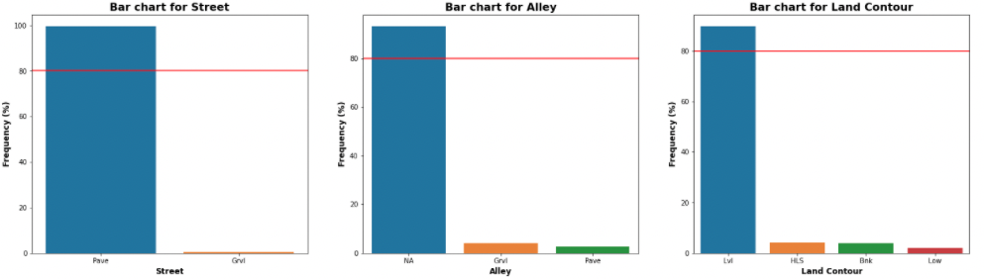
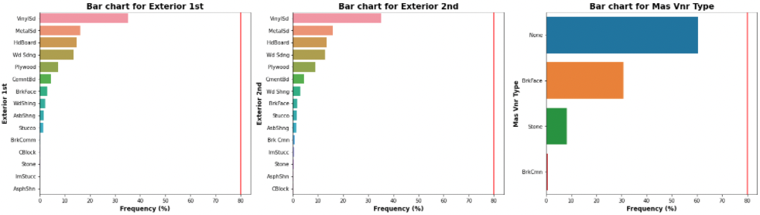
Feature Selection – Nominal Features
Bar charts used to visualize nominal features with a single category > 80% occurrence
Reduced to 11 nominal features
Fig.5. Nominal features with overwhelming occurrence of a single category
Fig.6. Nominal features without overwhelming occurrence of a single category

Slide 7
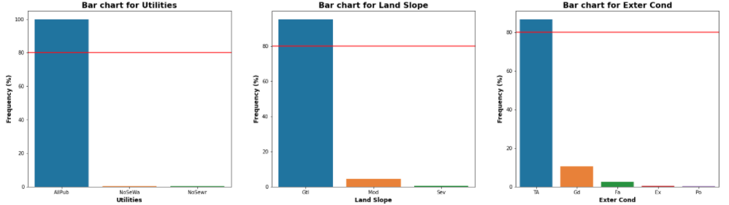
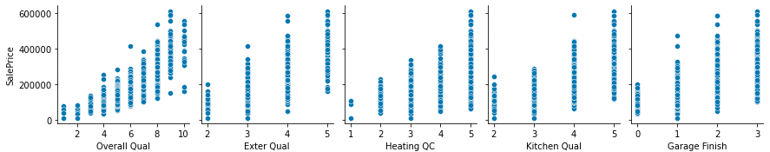
Feature Selection – Ordinal Features
Bar charts used to visualize ordinal features with a single category > 80% occurrence
Reduced to 11 ordinal features
Fig.7. Ordinal features with overwhelming occurrence of a single category
Pair plots are used to find the correlation for ordinal features after converted to numerical values
Further reduced to 5 ordinal features
Fig.8. Ordinal features that are correlated with Sale Price

Slide 8
Model Evaluation – Root Mean Square Error (RMSE)
Table 1. Table of comparison for different regression models
 | Description | Hyperparameter | Number of Features | CV RMSE | Kaggle RMSE
Model 1 | Linear Reg. | - | 2 | 49996.5 | 46816.5
Model 2 | Linear Reg. | - | 85 | 34992.9 | 35610.1
Model 3 | Ridge Reg. | alpha = 26 | 85 | 34541.8 | 34482.2
Model 4 | Lasso Reg. | alpha = 97.7 | 38 | 34328.9 | 34264.7
Model 5 | ElasticNet Reg. | alpha – 0.02, l1_ratio = 0.3 | 85 | 34546.9 | 34441.8
Lasso Regression model has the best predictive performance in terms of RMSE
Used lesser features than other models

Slide 9
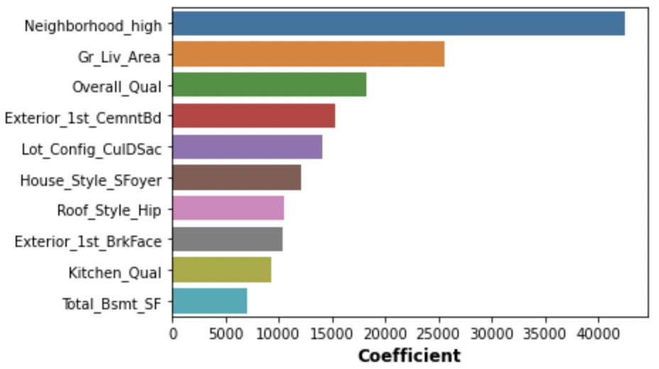
Model Evaluation – Top 10 features
Fig.9. Top 10 features that affect the Sale Price

Slide 10
Conclusion
Lasso regression has the best predictive performance among the models with 50% reduction in the number of features with RMSE of ~34K
The Lasso regression model produce a set of coefficients for the respective features
The top 3 features that will influence the price are location of the house, the total area of house and the overall quality of the house
With a set of features, the model is able to predict the price of a house

