Slide 1


Can we get more students to take the SAT?
Jasper Chew
Notes:
Welcome to this week’s lunchtime sharing 101:
Today I’m excited to share with you some of the insights from my research work regarding SAT participation rates…

Slide 2
Problem Statement
Students in the United States(U.S) either take the ACT or SAT as a requirement for college admission. Participation rate(%) in the SAT across states are not uniform. Through analysis of SAT historical data, this project aims to provide insights and recommendation for the College Board on improving SAT participation (%).
Notes:
We are one of the most popular test providers in the country. BUT we are not the only one.
I believe we are in constant competition with ACT for students…
As we do not have unlimited resources, after the next few slides I hope we get a clearer idea of where to devote our resources more efficiently.
When talking about improving SAT participation rate, naturally one would ask which state is the lowest????
Preliminary data showed that some states like Wyoming had one of the lowest SAT participation rate (%) and 100% ACT participation.
So this is an interesting initial finding, perhaps I we can explore this futher…

Slide 3
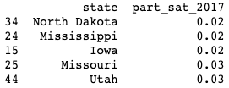
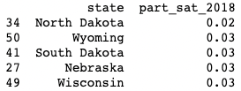
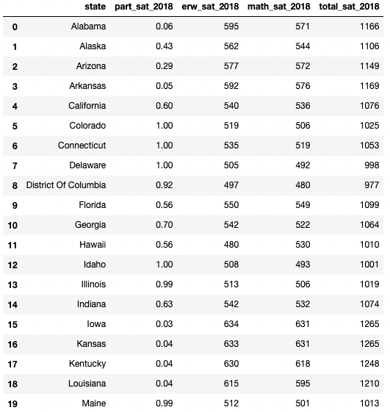
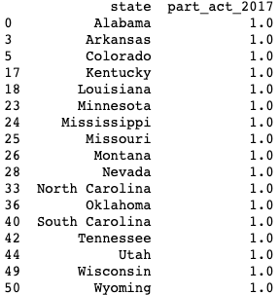
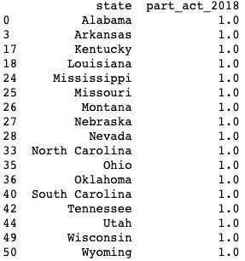
Preliminary Insights | Do you see it? | Where our resources matter | Recommendations
Historically, the other alternative for college admission is the ACT…
Datasets from official ACT and SAT websites:
ACT 2017, 2018
SAT 2017, 2018
Which states have the lowest SAT participation rate (normalized)?
Test components
Fig.2. SAT 2017, 2018 participation rates by states
Which states have the highest ACT participation rate (normalized?
States
Fig.3. ACT 2017, 2018 participation rates by states
Fig.1. SAT 2018 mean scores, by state, by component
Is there a useful link between ACT and SAT?
Notes:
We are one of the most popular test providers in the country. BUT we are not the only one.
I believe we are in constant competition with ACT for students…
As we do not have unlimited resources, after the next few slides I hope we get a clearer idea of where to devote our resources more efficiently.
When talking about improving SAT participation rate, naturally one would ask which state is the lowest????
Preliminary data showed that some states like Wyoming had one of the lowest SAT participation rate (%) and 100% ACT participation.
So this is an interesting initial finding, perhaps I we can explore this futher…

Slide 4
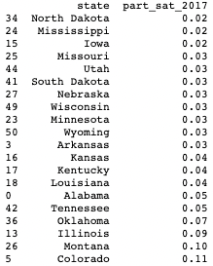
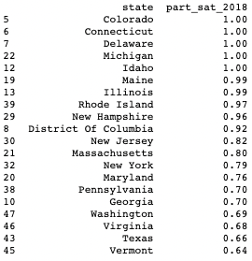
Preliminary Insights | Do you see it ? | Where our resources matter | Recommendations
It can be observed that there was a significant increment in the SAT participation rate for Illinois and Colorado by ~90% from 2017 to 2018
Due to change in policy, SAT is mandatory to all high schools juniors for college admissions from 2017
Fig.5. SAT 2017 lowest participation rate by states
Fig.6. SAT 2018 highest participation rate by states
1 - https://www.coloradokids.org/wp-content/uploads/2016/01/ACTvsSAT_FINAL.pdf
2 - https://testive.com/colorado-sat-change-2017/
3 - https://www.chicagotribune.com/news/ct-illinois-chooses-sat-met-20160211-story.html
4 - - https://testive.com/illinois/
Notes:
Let’s take a look at what else affects SAT participation.
As it turns out performance on ACT also correlates with SAT participation.

Slide 5
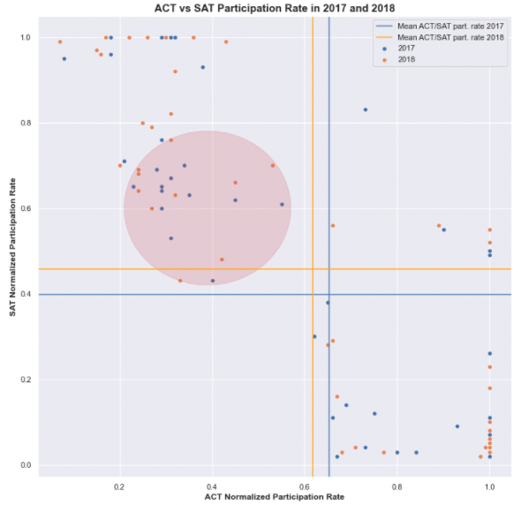
Preliminary Insights | Do you see it ? | Where our resources matter | Recommendations
If a state has higher than average SAT participation rate, there is a ~95% chance that it will have below average ACT participation rate. This trend is consistent for both 2017 and 2018.
Fig.4. SAT vs ACT participation rate by state 2017 and 2018
Notes:
From this scatter plot, where we show the participation rates of ACT and SAT for both 2017 and 2018 on a nice scatter plot.
We can see that generally a high participation in ACT would probably mean a low participation in SAT.
In fact there is a 85% chance…
For good reason, certain states have already won contracts with the ACT for the next few years. Focusing on those states may not be the best use of resources…

Slide 6
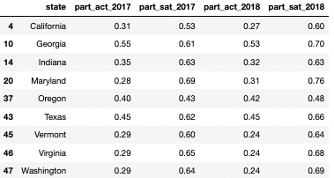
Myself: Approach | Do you see it ? | Where our resources matter | Recommendations
Fig.5. Targeted states that fall within the red circle
9 states that fall within the red circle
California, Georgia, Indiana, Maryland, Oregon, Texas, Vermont, Virginia snd Washington
Fig.4. SAT vs ACT participation rate by state 2017 and 2018
Notes:
So knowing

Slide 7
Myself: Approach | Do you see it ? | Do you see it ? | Recommendations
With the observation and analysis:
It is recommended that the resources should focus on the 9 states that have a slightly below average ACT participation rate where the College Board can have an agreement with the 9 states to have SAT mandatory for their college admissions to increase the SAT participation rate.
Notes:
For good reason, certain states have already won contracts with the ACT for the next few years. Focusing on those states may not be the best use of resources…

