Slide 1
Predicting HDB Resale Price
Jasper

Slide 2
Objectives
Data Visualization
To show the number of transactions and median price across the years at both national level and by HDB towns filtered by Flat Type
To be able to input budget as well as distance to important locations (MRT, primary/secondary schools) and suggest towns based on historical transactions
Data Modeling
To implement 3 models to predict the resale price in 2014 given ‘flat type’, ‘flat age’ and ‘town’ features and select the best model
Given a set of features and its resale price in 2017, assess if the resale price is reasonable
To create a model to predict ‘flat type’ using other features
Policy Analysis
Are Yishun flats cheapest in the country?
Are the flat sizes getting smaller over the years?

Slide 3
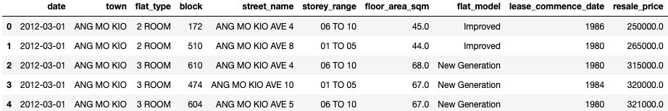
Data Visualization – Data Cleaning
Dataset
Taken from https://data.gov.sg/dataset/resale-flat-prices
Consists of 210180 data from 2012 to 2022
Consists of 11 features, dataset was quite clean and only drop ‘remaining lease’ feature due to many missing values

Slide 4
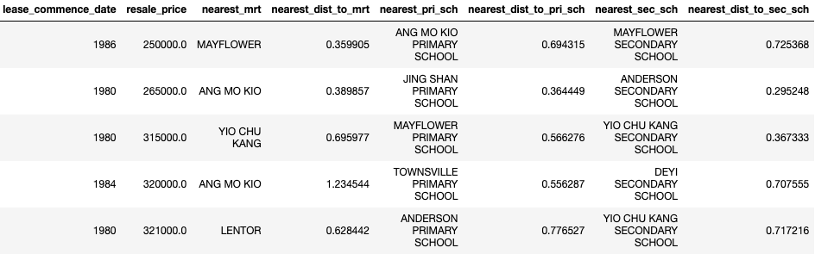
Data Visualization – Feature Engineering
Feature Engineering
Scrap in longitude and latitude data for HDB flats as well as nearest MRT, primary/secondary schools from OneMap API to compute the distance from the HDB flat

Slide 5
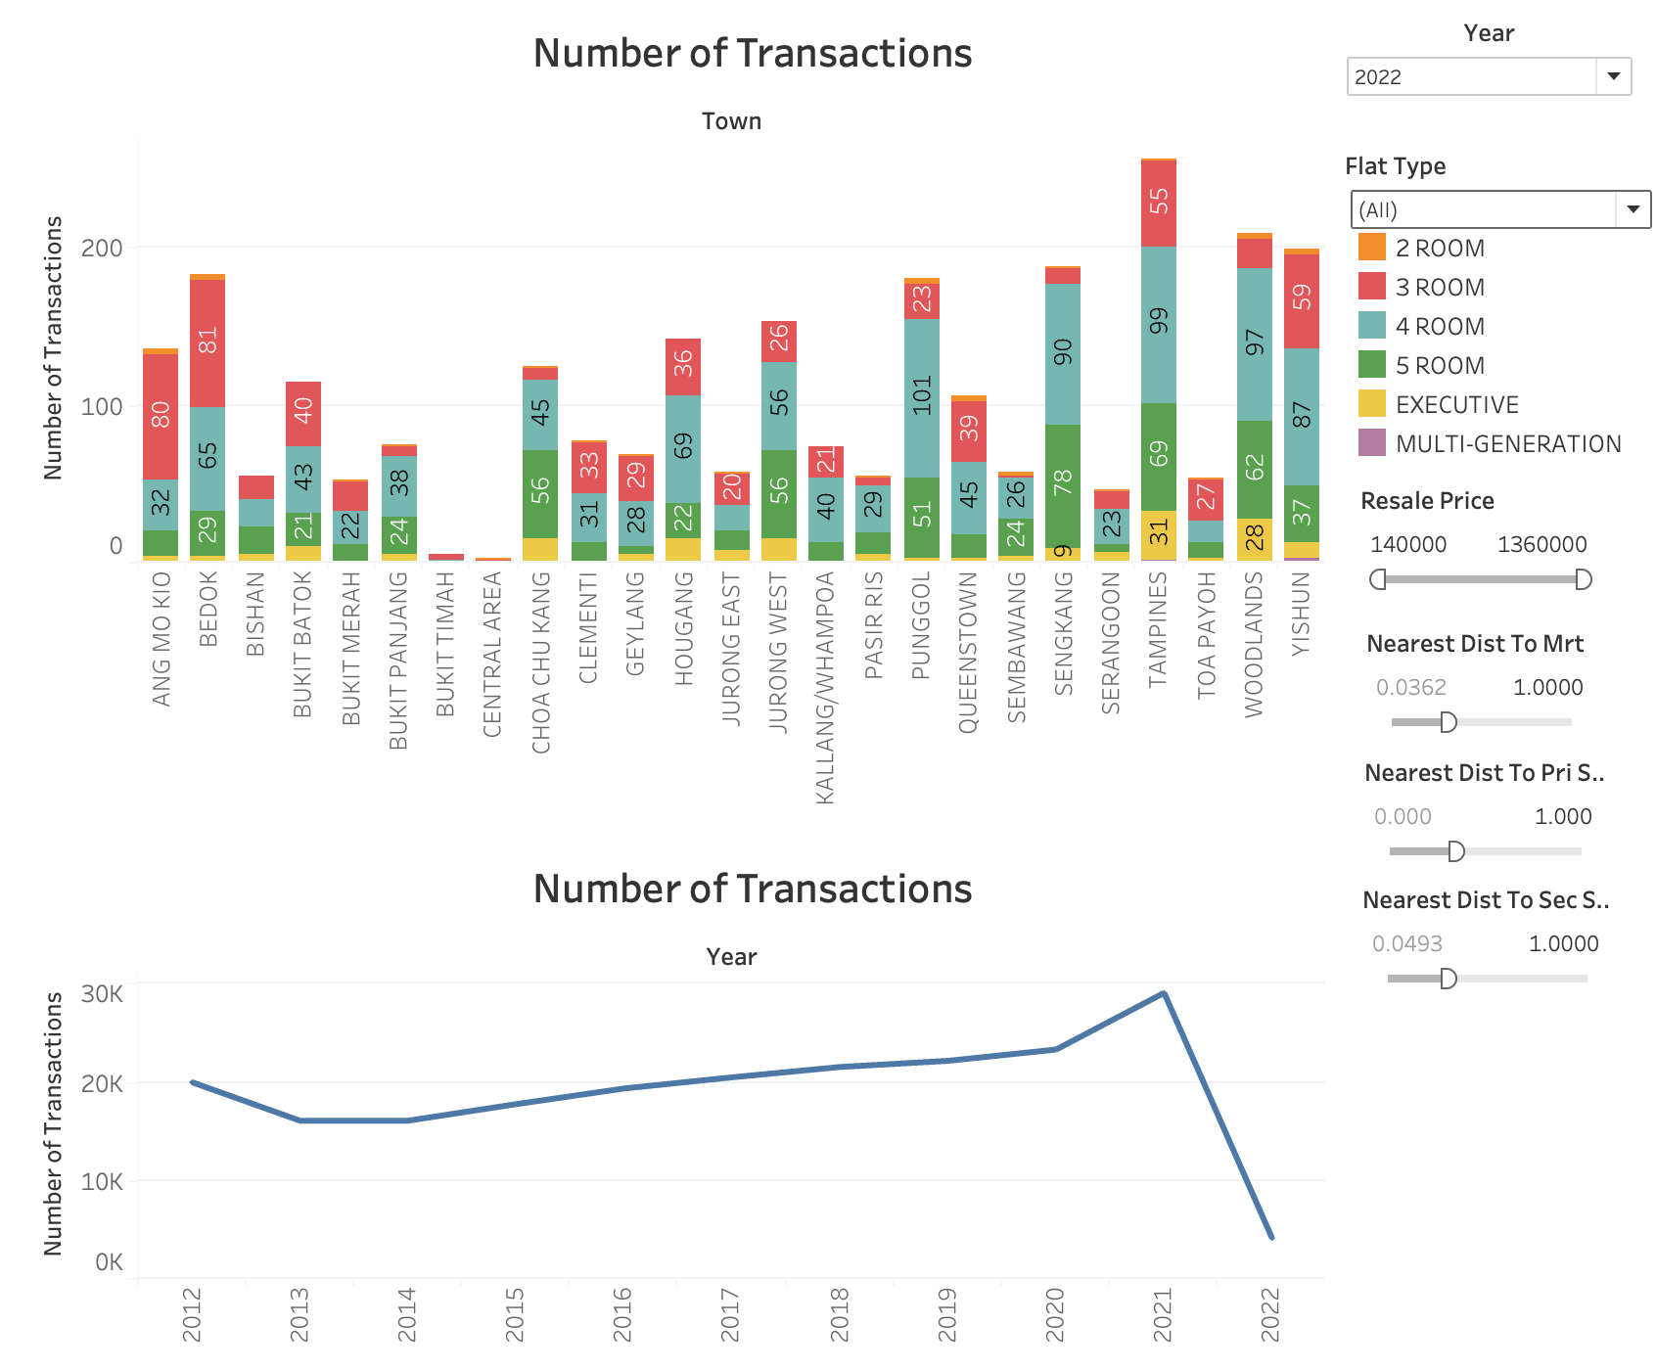
Data Visualization – Snapshot of Dashboard

Slide 6
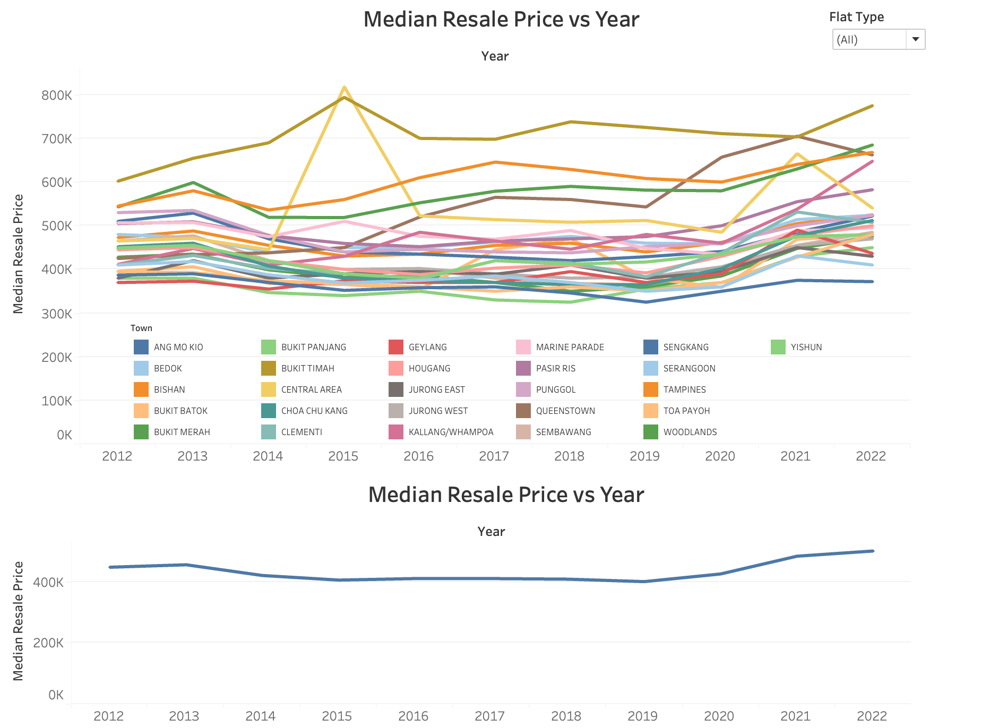
Data Visualization – Snapshot of Dashboard

Slide 7
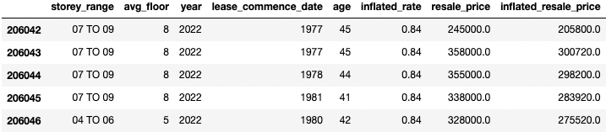
Data Modeling – Feature Engineering
Feature Engineering
‘Age’ feature by subtracting the ‘lease commence date’ from the transaction year
‘Avg floor’ feature by taking the average of the ‘storey range’ feature
‘Inflation rate’ feature based on year 2014 to convert all the resale price

Slide 8
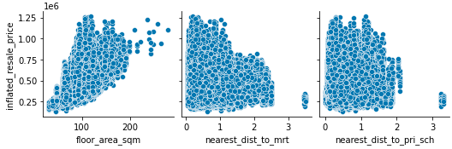
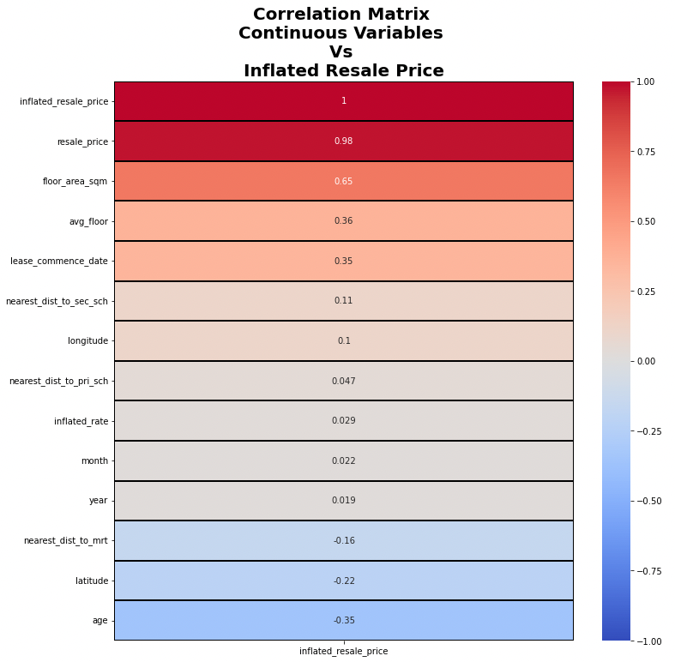
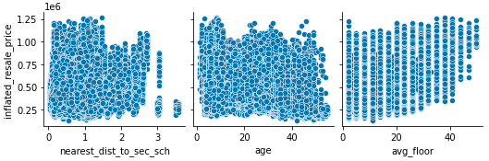
Data Modeling – EDA on Continuous Features
Pairplot
Heatmap

Slide 9
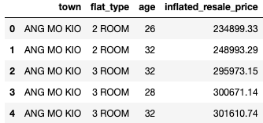
Data Modeling – Qns 2A Predict Resale Price in 2014
Predictor Variables
Flat type
Flat Age
Town
Response Variables
Inflated Resale Price based on year 2014

Slide 10
Data Modeling – Qns 2A Model Evaluation
Model | Train RSME | Train R2 | Test RSME | Test R2 | Fit Time (sec)
Linear Regression | 67476.189 | 0.776 | 67164.25 | 0.777 | 0.5
Ridge Regression | 67477.486 | 0.776 | 67160.808 | 0.778 | 40.5
Lasso Regression | 67597.058 | 0.776 | 67265.667 | 0.777 | 122.5
Linear Regression CHOSEN

Slide 11
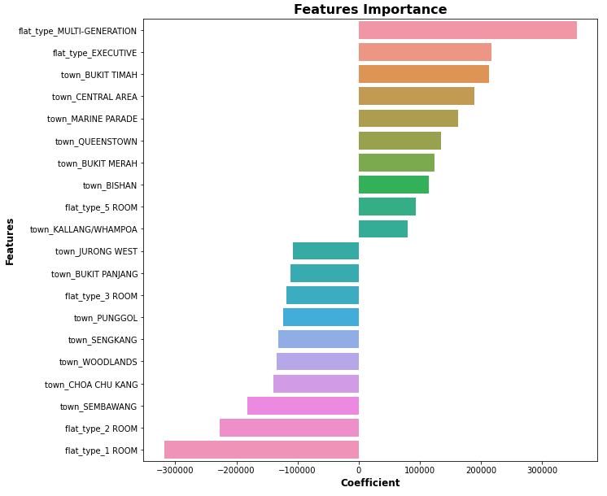
Data Modeling – Qns 2A Feature Importance

Slide 12
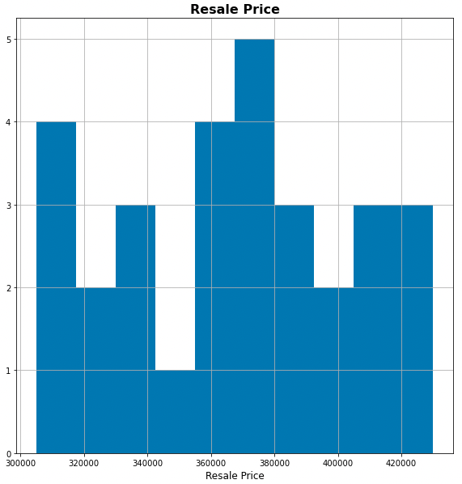
Data Modeling – Qns 2B
Given the following features of HDB sold in 2017:
Flat type: 4 ROOM
Town: Yishun
Flat Model: New Generation
Storey Range: 10 to 12
Floor Area (sqm): 91
Lease Commence Date: 1984
Resale Price: 550,800
Is the Resale Price
REASONABLE??

Slide 13
Data Modeling – Qns 2B
Given the following features of HDB sold in 2017:
Flat type: 4 ROOM
Town: Yishun
Flat Model: New Generation
Storey Range: 10 to 12
Floor Area (sqm): 91
Lease Commence Date: 1984
Resale Price: 550,800
NO!!!
Predicted: ~340K

Slide 14
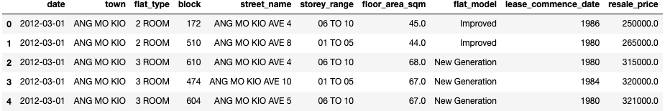
Data Modeling – Qns 2C Predict Flat Type given transactions other characteristics

Slide 15
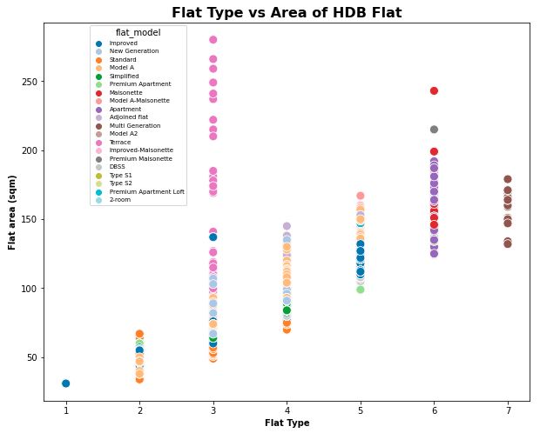
Data Modeling – Qns 2C Predict Flat Type given transactions other characteristics

Slide 16
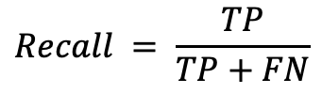
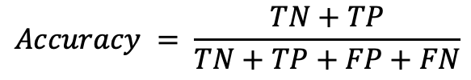
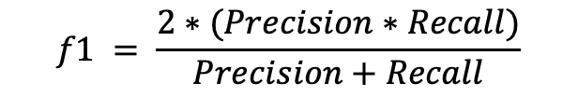
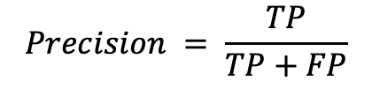
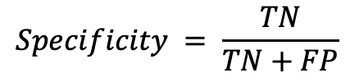
Data Modeling – Qns 2C Confusion Matrix (Binary vs Multi-class Classification)
Binary Classification
Confusion Matrix
 | Predicted -ve | Prediect +ve
Actual -ve | True Negative (TN) | False Positive (FP)
Actual +ve | False Negative (FN) | True Positive (TP)
Metrics
$$Accuracy = \frac{TN+TP}{TN+TP+FP+FN}$$
$$Recall = \frac{TP}{TP+FN}$$
$$Specificity = \frac{TN}{TN+FP}$$
$$Precision = \frac{TP}{TP+FP}$$
$$f1 = \frac{2∗(Precision∗Recall)}{Precision+Recall}$$

Slide 17
Data Modeling – Qns 2C Confusion Matrix (Binary vs Multi-class Classification)
Multi-class Classification (One vs Rest)
 | Predicted Class 1 | Predicted Class 2 | Predicted Class 3
Actual Class 1 | True Positive (TP) | False Negative (FN) | False Negative (FN)
Actual Class 2 | False Positive (FP)
Actual Class 3 | False Positive (FP)
 | Predicted Class 1 | Predicted Class 2 | Predicted Class 3
Actual Class 1 |  | False Positive (FP)
Actual Class 2 | False Negative (FN) | True Positive (TP) | False Negative (FN)
Actual Class 3 |  | False Positive (FP)
 | Predicted Class 1 | Predicted Class 2 | Predicted Class 3
Actual Class 1 |  |  | False Positive (FP)
Actual Class 2 |  |  | False Positive (FP)
Actual Class 3 | False Negative (FN) | False Negative (FN) | True Positive (TP)
Class 1 vs The Rest
Class 2 vs The Rest
Class 3 vs The Rest

Slide 18
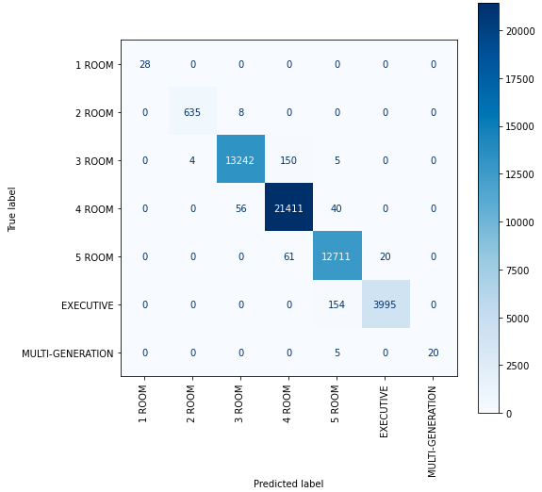
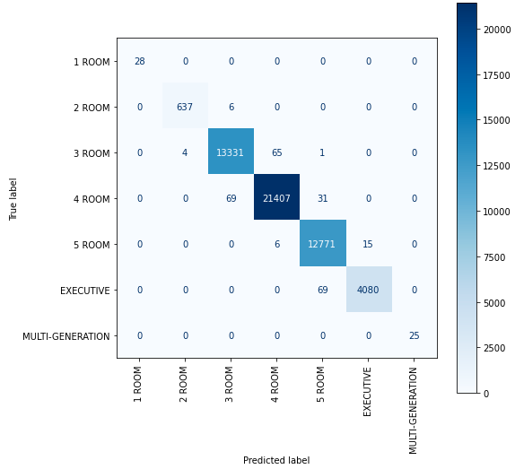
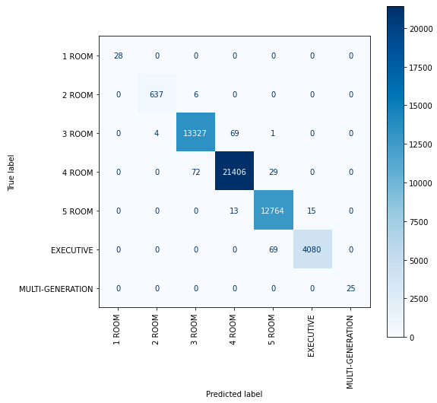
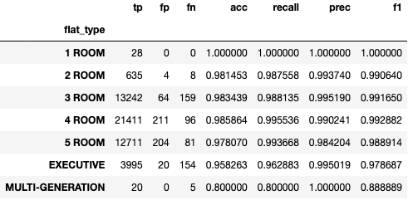
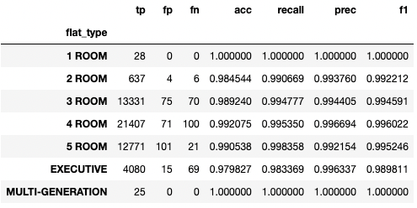
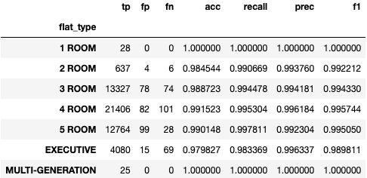
Data Modeling – Qns 2C Model Evaluation
Decision Tree
Random Forest
K-Nearest Neighbors

Slide 19
Data Modeling – Qns 2C Model Evaluation
Decision Tree
Random Forest
K-Nearest Neighbors

Slide 20
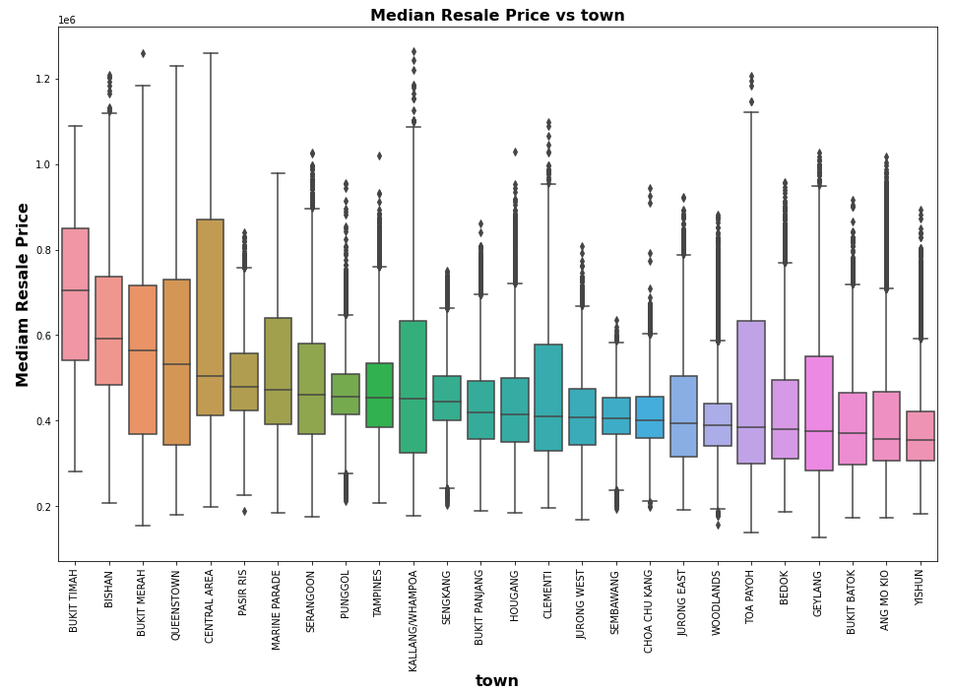
Policy Analysis – Qns 3A Are Yishun the cheapest flats?
YES!

Slide 21
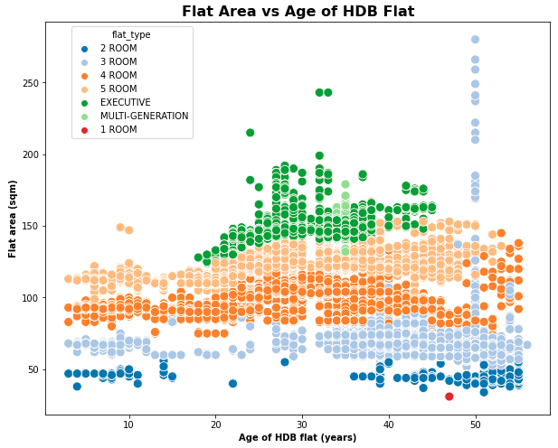
Policy Analysis – Qns 3B Are flat size getting smaller over the years?
YES!

Slide 22
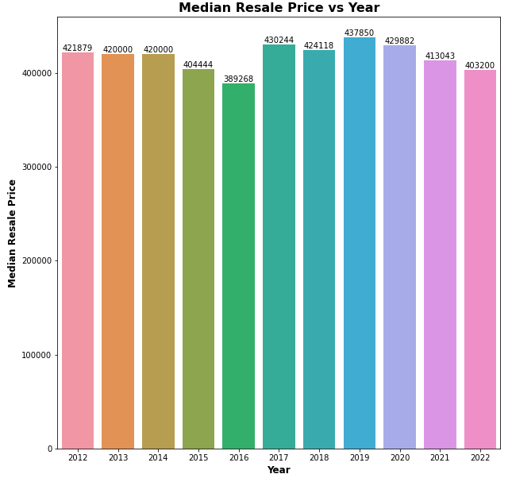
Policy Analysis – Qns 3C Have prices increased in Bukit Panjang after operation of Downtown line ?
Bukit Panjang DTL opened in 27 Dec 2015:
Split the dataset to before 2016 and after 2016
Plot the median resale price across the years
From 2016 onwards, there was a slight increase in the transaction price

Slide 23
Conclusion
Data visualization dashboard was created to show the number of transactions as well as the median price across the years filtered based on flat type
Users were able to input the budget and distance to amenities like mrt or schools for suggestion of towns based on historical transactions
Linear Regression model was implemented and chosen to predict the resale price of the HDB given ‘flat type’, ‘flat age’ and ‘town’ features with lowest RMSE and a faster fit time

Slide 24
Conclusion
KNN classifier was implemented and chosen to predict the ‘flat type’ given the area of the unit with good f1 score and also a faster fit time
Based on the data
Yishun is considered the cheapest towns in the country
The flat size is getting smaller over the years
There is a slight increase in the resale price after the DTL has connected Bukit Panjang to the city

Slide 25
THANK YOU!

