Slide 1

Unit01 Intro to node.js Part I
Ranken Technical College

Slide 2
Objectives
Go through installation instructions for Node.js
Build and run a simple Node.js application
Build and run a simple Node.js web server
Understand basic JavaScript asynchronous methods
Source
https://www.osradar.com/how-to-install-node-js-on-windows-10/

Slide 3
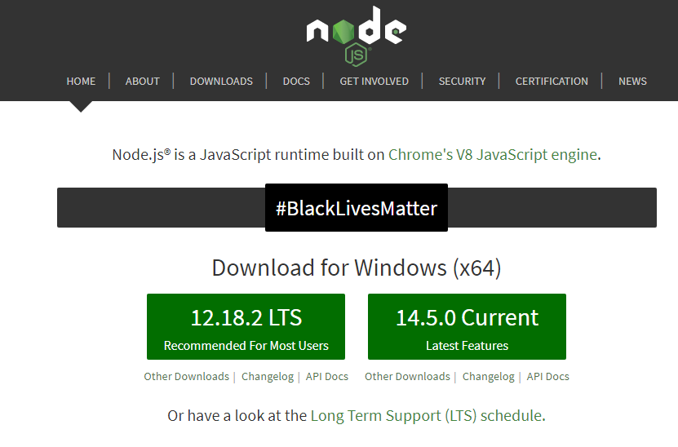
Node.js Installation
Go out to the official Node.js website and install Node.js LTS (long-term support) version
Source
https://nodejs.org/en/

Slide 4
Verifying Node.js/NPM Install
From command line, key in the following command to check Node.js install
node -v
From command line, key in the following command to check NPM install
npm -v
Source
https://www.npmjs.com/

Slide 5
Node.js Simple Command-Line App
From your desktop, create a new nodeone directory
Do a cd nodeone (change directory)
Right mouse-click on the folder and choose Git Bash Here
In Git, key in touch simple.js to create the simple.js file
Source
https://www.npmjs.com/

Slide 6
Node.js Simple Command-Line App
Open this file with Visual Studio Code (VS Code)
Enter the following line of code into the simple.js file:
console.log("My first Node.js Program!");
Save the file. From the Git Bash terminal, key in node simple.js and hit <enter> Your expected results are shown on the next page

Slide 7
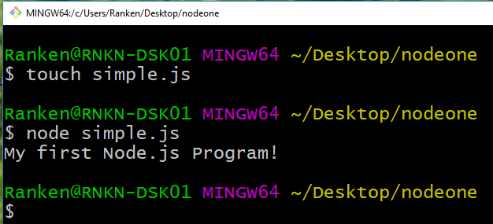
Node.js Simple Command-Line App

Slide 8
Node.js Simple Web Server
Close the simple.js file
Create a new JavaScript file via the command: touch main.js
Open this file up in VS code and add the code shown on the next page

Slide 9
Node.js Simple Web Server
const http = require("http");
const PORT = process.env.PORT || 3000;
const server = http.createServer(function (req, res) {
res.writeHead(200, {"Content-Type": "text/plain"});
res.end("Hello World!");
});
server.listen(PORT);
console.log(`App is up and running on Port ${PORT}`);

Slide 10
Node.js Simple Web Server
Save the main.js file
From the Git command line, enter in the following command and hit <enter>
node main.js
An associated screenshot of the terminal is shown on the next page, followed by a screenshot of the associated server up and running on the page after that

Slide 11
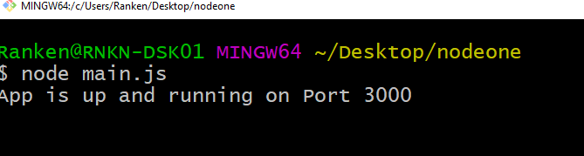
Node.js Simple Web Server

Slide 12
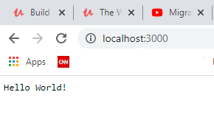
Node.js Simple Web Server

Slide 13
Node.js Simple Web Server (each statement explained)
const http = require("http");
Node.js has a built-in module called HTTP, which allows Node.js to transfer data over the Hyper Text Transfer Protocol (HTTP).
To include the HTTP module (i.e. make it program available), the require() method is used
Source
https://www.w3schools.com/nodejs/nodejs_http.asp

Slide 14
Node.js Simple Web Server (each statement explained)
const PORT = process.env.PORT || 3000;
In many environments, you can set the environment variable PORT to tell the web server what port to listen on
So, process.env.PORT || 3000 means set PORT to whatever is in the environment variable PORT, or use port 3000 if the environment variable has not been set
Source
https://stackoverflow.com/questions/18864677/what-is-process-env-port-in-node-js

Slide 15
Node.js Simple Web Server (each statement explained)
const server = http.createServer(function (req, res) {
res.writeHead(200, {"Content-Type": "text/plain"});
res.end("Hello World!");
});
This code actually creates the server. The server is told (via the writeHead) to return 200 (OK), expect plain text input, and output the text Hello World!

Slide 16
Node.js Simple Web Server (each statement explained)
console.log(`App is up and running on Port ${PORT}`);
This code will write the text App is up and running on the port number set by the process.env.PORT variable (if it has been set) or 3000 if it has not been set
Note the use of `` in this line of code. These represent Java ES6 template literals. These literals contain placeholders, which are indicated by the dollar sign and curly braces ($(expression})
When the program runs, this is replaced with the value of the variable
Source
https://www.javatpoint.com/es6-template-literals

Slide 17
Asynchronous JavaScript
Normally, program code runs straight along, with only one thing happening at once. If a function relies on the result of another function, it has to wait for the other function to finish and return, and until that happens, the entire program is essentially stopped from the perspective of the user. This is a.k.a. synchronous programming
Source
https://developer.mozilla.org/en-US/docs/Learn/JavaScript/Asynchronous/Concepts

Slide 18
Asynchronous JavaScript
This is not a good use of computer processing power. There's no sense waiting for something when you could let another task begin and let you know when it's done. This lets you get other work done in the meantime, which is the basis of asynchronous programming
It is up to the programming environment you are using (web browsers, in the case of web development) to provide APIs that allow tasks to run asynchronously
Source
https://developer.mozilla.org/en-US/docs/Learn/JavaScript/Asynchronous/Concepts

Slide 19
Asynchronous JavaScript
JavaScript provides three ways to program asynchronously:
Asynchronous JavaScript programming via the use of callbacks
Asynchronous JavaScript programming via the use of promises
Asynchronous JavaScript programming via the use of async-await

Slide 20
Asynchronous JS Via callbacks
Callbacks are simple functions which are used to notify the calling instance when an asynchronous code block has been executed and the result is available
Shown on the following page is a simple code example that uses a callback
Source
https://codingthesmartway.com/async-programming-with-javascript-callbacks-promises-and-async-await/

Slide 21
Asynchronous JS Via callbacks
const getTodo = callback => {
setTimeout(() => {
callback ({ text: 'Complete Code Example' })
}, 2000)
}
getTodo(todo => {
console.log(todo.text)
})

Slide 22
Asynchronous JS Via callbacks
The getTodo function is defined so that it takes a callback function as a parameter. Inside getTodo the getTimeout function is used to delay the execution of code for 2000 milliseconds (2 seconds). Instead of just returning the object now the callback function is run. As an argument the object which should be returned is passed in

Slide 23
Asynchronous JS Via callbacks
When calling getTodo you must make sure to pass in a callback function as a parameter. In the example this is being done using the fat arrow syntax (=>) to define an anonymous function. Inside that functions the todo.text is output. This function is invoked from inside of getTodo when the 2000 millisecond delay is passed

Slide 24
Asynchronous JS Via promises
Promises include:
Producing code that does something and takes time. For instance, some code that loads data over a network
Consuming code that wants the result of the producing code once it's ready. One or more functions may need this result
A promise is a special JavaScript object that links the producing code and the consuming code together
Source
https://javascript.info/promise-basics

Slide 25
Asynchronous JS Via promises
Promises are a built-in language feature of JavaScript that makes handling asynchronous code easier and more readable
Shown on the following page is the simple code example with the callback replaced by a promise
Source
https://codingthesmartway.com/async-programming-with-javascript-callbacks-promises-and-async-await/

Slide 26
Asynchronous JS Via promises
const getTodo = () => {
return new Promise((resolve, reject) => {
setTimeout(() => {
let error = false;
if(!error)
resolve({ text: 'Complete Code Example' })
else
reject()
}, 2000)
})
}
getTodo().then(todo => {
console.log(todo.text)
})

Slide 27
Asynchronous JS Via promises
This code is basically doing the same as seen before in the callback example but with Promises.
Inside the getTodo function a new Promise is returned. The constructor of the Promise class is expecting to get a function which contains the asynchronous code as a parameter

Slide 28
Asynchronous JS Via promises
The function is also expecting to get two parameters, resolve and reject, which contain the asynchronous code which needs to be executed.
If the asynchronous code executes successfully the resolve function is called
If the asynchronous code does not execute successfully the reject function is called

Slide 29
Asynchronous JS Via async-await
Async functions let the programmer write promise based code as if it were synchronous, but without blocking the execution thread. It operates asynchronously via the event-loop. Async functions will always return a value (promise)
The await operator is used to wait for a Promise. It can be used inside an Async block only. The keyword Await makes JavaScript wait until the promise returns a result
Shown on the following 2 pages is the simple code example with the callback replaced by async-await
Source
https://codingthesmartway.com/async-programming-with-javascript-callbacks-promises-and-async-await/

Slide 30
Asynchronous JS Via async-await
const getTodo = () => {
return new Promise((resolve, reject) => {
setTimeout(() => {
let error = false;
if(!error)
resolve({ text: 'Complete Code Example' })
else
reject()
}, 2000)
})
}

Slide 31
Asynchronous JS Via async-await
async function fetchTodo () {
const todo = await getTodo()
return todo
}
fetchTodo().then(todo => console.log(todo.text))

Slide 32
Asynchronous JS Via async-await
The implementation of the getTodo function has not changed. The Promise is still created and depending on the value of the error variable is resolved or rejected
What has changed is the way the getTodo function is called. A new function fetchTodo is being implemented. The async keyword is used to indicate that this function is executing asynchronous code based on a Promise

Slide 33
Asynchronous JS Via async-await
Inside of fetchTodo getTodo is called using the keyword await. This indicates that getTodo is returning a Promise and we have to wait for the Promise to be resolved (or rejected). The result of what is being returned from the promise is stored in todo
In the next line of code the todo object is being returned. This is possible because by using the keyword await we’re making sure the next line of code is being executed after the Promise (returned from getTodo) has been resolved

Slide 34
What We've Covered
The Node.js installation process
How to create and run a simple Node.js application
How to create and run a simple Node.js web server
Asynchronous JavaScript using callbacks
Asynchronous JavaScript using promises
Asynchronous JavaScript using async-await

