Slide 1

Unit01 Intro to node.js Part II
Ranken Technical College

Slide 2
Objectives
What is NPM
How to run NPM
How to use major NPM commands
How to use major NPM packages
Source
https://www.npmjs.com/

Slide 3
Node Package Manager (NPM)
The Node Package Manager (NPM) provides three main functionalities:
The Website, the place where users can browse packages, read the documentation and find general info on NPM
The Registry, the database that stores the information and the code for the packages
The NPM Client, the tool installed on the developer's machine to allow them to install, publish, and update packages. It also provides a command line utility to install Node.js packages, do version management and dependency management of Node.js packages
Source
https://dzone.com/articles/a-beginners-guide-to-npm-the-node-package-manager

Slide 4
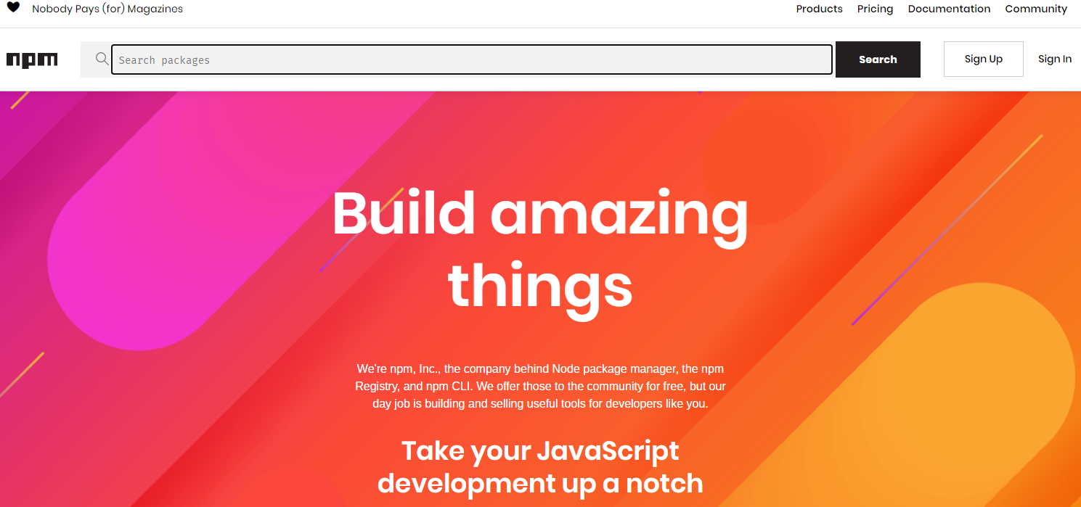
NPM Website
Source
https://www.npmjs.com/

Slide 5
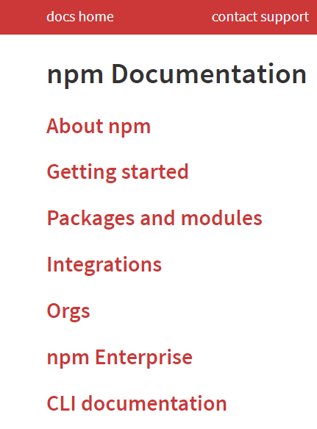
NPM Website Documentation
Source
https://docs.npmjs.com/

Slide 6
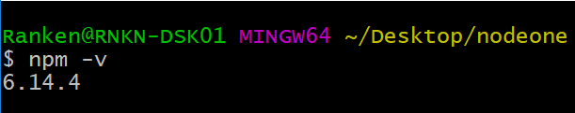
Current NPM Version You Are Running
Run the command npm –v to find out the version of NPM you are running

Slide 7
npm init
Run the command npm init to create a package.json file for your project. Adding the –y flag to the command accepts the defaults
Source
https://docs.npmjs.com/cli/init

Slide 8
package.json
The package.json file is kind of a manifest for your project. It can do a lot of things, completely unrelated. It's a central repository of configuration for tools, for example. It's also where npm and yarn store the names and versions for all the installed packages
The package.json file is created when the npm init command is run
Source
https://docs.npmjs.com/cli/init

Slide 9
package.json
Here is a sample package.json file:
{
"name": "nodeone",
"version": "1.0.0",
"description": "This project creates a simple node.js web server",
"main": "main.js",
"scripts": {
"test": "echo \"Error: no test specified\" && exit 1"
},
"author": "Jeff Scott",
"license": "ISC"
}

Slide 10
package.json
The package.json components (not all shown in previous slide):
name sets the application/package name
version indicates the current version
description is a brief description of the app/package
main set the entry point for the application
private if set to true prevents the app/package to be accidentally published on npm
Source
https://nodejs.dev/learn/the-package-json-guide

Slide 11
package.json
The package.json components (not all shown in previous slide):
scripts defines a set of node scripts you can run
dependencies sets a list of npm packages installed as dependencies
devDependencies sets a list of npm packages installed as development dependencies
engines sets which versions of Node.js this package/app works on
browserslist is used to tell which browsers (and their versions) you want to support
Source
https://nodejs.dev/learn/the-package-json-guide

Slide 12
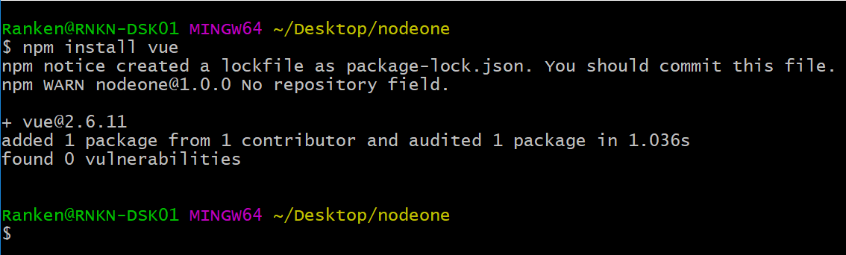
npm install
Use the npm install <package-name> (or “i” instead of install) to install <package-name> an npm package and declare it as a dependency in the package.json file
Source
https://nodejs.dev/learn/the-package-json-guide

Slide 13
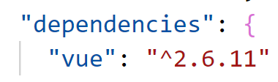
npm install
Use the npm install <package-name> (or “i” instead of install) to install <package-name> an npm package and declare it as a dependency in the package.json file After running the command on the previous page, the following dependency was added to the package.json file:.
Source
https://nodejs.dev/learn/the-package-json-guide

Slide 14
npm install with -g flag
-g is the global install flag, which makes the package available to all projects without having to do individual installs. Some "rules of thumb":
Install globally if the package provides command-line tools
Install locally if you're using the package as part of your application
Install globally and locally if both use-cases apply
Source
https://stackoverflow.com/questions/8909986/when-should-i-use-npm-with-g-flag-and-why

Slide 15
npm install with -D flag
-D is the development install flag, which means the package will be loaded as a development dependency and will not be included when the project goes live on a real server
Source
https://nodejs.dev/learn/the-package-json-guide

Slide 16
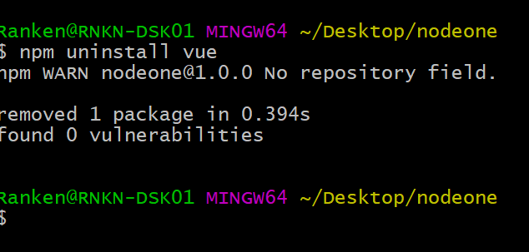
npm uninstall
The command npm uninstall <package-name> removes the package from the package.json file and makes it unavailable to the current project
Source
https://nodejs.dev/learn/the-package-json-guide

Slide 17
npm run
The command npm run sets the NODE environment variable to the node executable with which npm is executed
Source
https://docs.npmjs.com/cli/run-script#

Slide 18
npm install vs. npm ci
npm install, or npm i, is used to install dependencies:
It will install all the dependencies
If you use ^ or ~ when you specify the version of your dependency, npm may not install the exact version you specified
npm install can update your package-lock.json when there are changes such as when you install a new dependency
Source
https://medium.com/better-programming/npm-ci-vs-npm-install-which-should-you-use-in-your-node-js-projects-51e07cb71e26

Slide 19
npm install vs. npm ci
npm ci will do the following:
Delete your node_modules folder to ensure a clean state
Look in your package-lock.json to install all the dependencies with the exact version
Unlike npm install, npm ci will never modify your package-lock.json. It does however expect a package-lock.json file in your project — if you do not have this file, npm ci will not work and you have to use npm install instead
Source
https://medium.com/better-programming/npm-ci-vs-npm-install-which-should-you-use-in-your-node-js-projects-51e07cb71e26

Slide 20
npm install vs. npm ci – which to use?
If you are on npm v6 or higher:
Use npm install to install new dependencies, or to update existing dependencies (e.g. going from version 1 to version 2).
Use npm ci when running in continuous integration, or if you want to install dependencies without modifying the package-lock.json.
If you are on NPM v5 or lower:
You can only use npm install to install or update dependencies
Source
https://medium.com/better-programming/npm-ci-vs-npm-install-which-should-you-use-in-your-node-js-projects-51e07cb71e26

Slide 21
NPM nodemon Package
nodemon is a tool that helps develop node.js based applications by automatically restarting the node application when file changes in the directory are detected
nodemon does not require any additional changes to your code or method of development. nodemon is a replacement wrapper for node
Syntax: npm i -g nodemon
Source
https://www.npmjs.com/package/nodemon

Slide 22
NPM debug Package
debug is a JavaScript debugging utility modelled after Node.js core's debugging technique. Works in Node.js and web browsers
debug exposes a function. You pass this function the name of your module, and it will return a decorated version of console.error for you to pass debug statements to. This will allow you to toggle the debug output for different parts of your module as well
Syntax: npm i debug
Source
https://www.npmjs.com/package/debug

Slide 23
NPM dotenv Package
dotenv is a zero-dependency module that loads environment variables from a .env file into process.env
The process.env global variable is injected by the Node at runtime for the application to use. It represents the state of the system environment the application is in when it starts
Syntax: npm i dotenv
Source
https://www.npmjs.com/package/dotenv

Slide 24
NPM express Package
express is defined as a fast, unopinionated, minimalist web framework for node, syntax:
const express = require('express')
const app = express()
app.get('/', function (req, res) {
res.send('Hello World')
})
app.listen(3000)
Source
https://www.npmjs.com/package/express

Slide 25
NPM serve-favicon Package
The serve-favicon package is Node.js middleware for serving a favicon. A favicon is a visual cue that client software, like browsers, use to identify a site
Syntax: npm i serve-favicon
Source
https://www.npmjs.com/package/serve-favicon

Slide 26
NPM helmet Package
The helmet package helps secure Express apps by setting various HTTP headers
Helmet is a collection of 11 smaller middleware functions that set HTTP response headers
Syntax: npm i helmet --save
Source
https://www.npmjs.com/package/helmet

Slide 27
NPM @hapi/joy Package
The @hapi/joi package is advertised as the most powerful schema description language and data validator for JavaScript
Syntax: npm i @hapi/joi
Source
https://www.npmjs.com/package/helmet

Slide 28
NPM eslint Package
The eslint package is a tool for identifying and reporting on patterns found in ECMAScript/JavaScript code
Syntax: npm i eslint
Source
https://www.npmjs.com/package/eslint

Slide 29
What We've Covered
What Node.js Package Manager (NPM) is and how to run NPM
Major NPM commands, including: npm -v, npm init, npm install, npm install -g, npm install -D, npm uninstall, and npm run
Major NPM packages, including: nodemon, debug, dotenv, express, serve-favicon, helmet, @hapi/joi, eslint

