Slide 1

Unit01 Intro to node.js Part III
Ranken Technical College

Slide 2
Objectives
Using express.js in a node.js application (Part I)
Source
http://expressjs.com/

Slide 3
Using express with Node.js
The express framework is the most common framework used for developing Node js applications
Routes are used to divert users to different parts of the web applications based on the request made
Templates can be used to inject content in an efficient manner
Source
https://www.guru99.com/node-js-express.html#

Slide 4
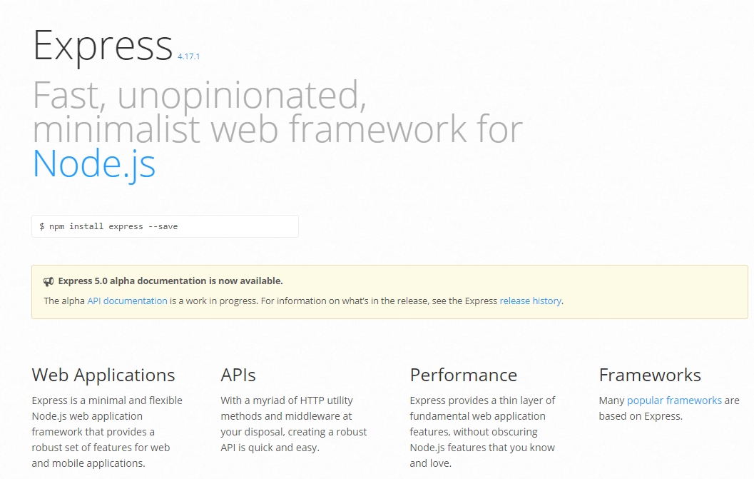
The express.js Website
Source
https://www.npmjs.com/

Slide 5
Our First express.js application
First close the open main.js file in the nodeone folder if still open
Next, install express via the command npm install express --save
Then create a new JavaScript file called originalExpress.js with the code shown on the next page:
Source
https://www.guru99.com/node-js-express.html#

Slide 6
Our First express.js application
const port = 3000;
const express = require("express");
const app = express();
app.get("/", (req, res) => {
res.send("Hello from node.js and express!");
})
.listen(port, () => {
console.log(`The server is listening on port ${port}`);
});

Slide 7
Our First express.js application
Finally, run the program via the command node originalExpress.js

Slide 8
Our First express.js application (each statement explained)
const port = 3000;
To keep the example simple, I hard-coded the port to be 3000

Slide 9
Our First express.js application (each statement explained)
const express = require('express');
Express was previously installed for the project. This line makes it available to the project

Slide 10
Our First express.js application (each statement explained)
const app = express();
It is a standard convention to instantiate the express class and call the object app

Slide 11
Our First express.js application (each statement explained)
app.get("/", (req, res) => {
res.send("Hello from node.js and express!");
})
When the user goes to localhost:3000 ("/"), show the message Hello from node.js and express on screen

Slide 12
Our First express.js application (each statement explained)
}).listen(port, () => {
console.log(`The server is listening on ${port}`);
Listen on port 3000 and send a corresponding message back to the terminal

Slide 13
Serving Static Files with express.js
Express provides a built-in middleware (express.static) to serve static files, such as images, CSS, and client-side JavaScript
You simply need to pass the name of the directory where you keep your static assets, to the express.static middleware to start serving the files directly. For example, if you keep your images, CSS, and JavaScript files in a directory named public, you can do this −
app.use(express.static('public'));
Source
https://www.tutorialspoint.com/nodejs/nodejs_express_framework.htm

Slide 14
Serving Static Files with express.js
Create a new directory (folder) called public Under the public folder create another directory (folder) called images
Go to Google Images, key in puppy 540 x 540 in the search box. Grab the upper-left image (for me a Golder Retriever eating a bone with Thank you! below it). Save the image as puppy.jpg in the public/images folder
Source
https://www.tutorialspoint.com/nodejs/nodejs_express_framework.htm

Slide 15
Serving Static Files with express.js
After the const app = express; and before the app.get("/", (req, res) => { … block add this:
app.use(express.static('public'));
app.get('/images', function (req, res) {
res.sendFile( __dirname + "/public/images/" + "puppy.jpg" );
});
Source
https://www.tutorialspoint.com/nodejs/nodejs_express_framework.htm

Slide 16
Serving Static Files with express.js (each new statement explained)
app.use(express.static('public'));
This makes the contents of the public folder known to express
Source
https://www.tutorialspoint.com/nodejs/nodejs_express_framework.htm

Slide 17
Serving Static Files with express.js (each new statement explained)
app.get('/images', function (req, res) {
res.sendFile( __dirname + "/public/images/" + "puppy.jpg" );
});
This sets up the route to the puppy.js file. Run the program, in browser enter localhost:3000/images/ See the next page for the results
Source
https://www.tutorialspoint.com/nodejs/nodejs_express_framework.htm

Slide 18

Serving Static Files with express.js (each new statement explained)
Source
https://www.tutorialspoint.com/nodejs/nodejs_express_framework.htm

Slide 19
Routing
Routing refers to how an application's endpoints (a.k.a. URI or Uniform Resource Identifier) respond to client requests
One can define routing using methods of the Express app object that correspond to HTTP methods. For example, app.get() to handle GET requests and app.post to handle POST requests
Source
http://expressjs.com/en/guide/routing.html

Slide 20
Routing
Routing methods specify a callback function (a.k.a. a "handler function"), which is called when the application receives a request to the specified route (endpoint) and HTTP method. In other words, the application "listens" for requests that match the specified route(s) and method(s), and when it detects a match, it calls the specified callback function
Source
http://expressjs.com/en/guide/routing.html

Slide 21
Routing
Routing methods can have more than one callback function as arguments. With multiple callback functions, it is important to provide next as an argument to the callback function and then call next() within the body of the function to hand off control to the next callback
Source
http://expressjs.com/en/guide/routing.html

Slide 22
Routing
Route paths, in combination with a request method, define the endpoints at which requests can be made. Route paths can be strings, string patterns, or regular expressions
Route parameters are named URL segments that are used to capture the values specified at their position in the URL. The captured values are populated in the req.params object, with the name of the route parameter specified in the path as their respective keys
Source
http://expressjs.com/en/guide/routing.html

Slide 23
Routing
The methods on the response object (res) in the following table can send a response to the client, and terminate the request-response cycle. If none of these methods are called from a route handler, the client request will be left hanging
See the chart on the next page for the associated methods and descriptions
Source
http://expressjs.com/en/guide/routing.html

Slide 24
Routing
Method Description
res.download() Prompt for a file to be downloaded
res.end() End the response process
res.json() Send a JSON response
res.jsonp() Send a JSON response with JSONP support
res.redirect() Redirect a request
Source
http://expressjs.com/en/guide/routing.html

Slide 25
Routing
Method Description
res.render() Render a view template
res.send() Send a response of various types
res.sendFile() Send a file as an octet stream
res.sendStatus() Set the response status code and send its string representation as the response body.
app.route()
Source
http://expressjs.com/en/guide/routing.html

Slide 26
express.Router
The express.Router class is used to create modular, mountable route handlers. A Router instance is a complete middleware and routing system; for this reason, it is often referred to as a "mini-app"
The following example creates myRouter.js, a router as a module. It loads a middleware function in it, defines some routes, and mounts the router module on a path in the main app
NOTE: This is a simple example that should be updated as we get further along in the class
Source
http://expressjs.com/en/guide/routing.html

Slide 27
express.Router Example (myRouter.js)
var express = require('express');
var router = express.Router();
// define the home page route
router.get('/public/', function (req, res) {
res.send('index.html');
})
Source
http://expressjs.com/en/guide/routing.html

Slide 28
express.Router Example (myRouter.js)
// define the contact route
router.get('/public/contact', function (req, res) {
res.send('contact.html')
});
// define the registration route
router.get('/public/registration', function (req, res) {
res.send('registration.html')
});
module.exports = router;
Source
http://expressjs.com/en/guide/routing.html

Slide 29
express.Router Example (revised express.js)
Here is the revised express.js file:
const port = 3000;
const express = require('express');
const app = express();
app.use(express.static('public'));
var myRouter = require('./myRouter')
app.use('/myRouter', myRouter);
app.listen(port, () => {
console.log(`The Express.js server is listening on port ${port}`);
});
Source
http://expressjs.com/en/guide/routing.html

Slide 30
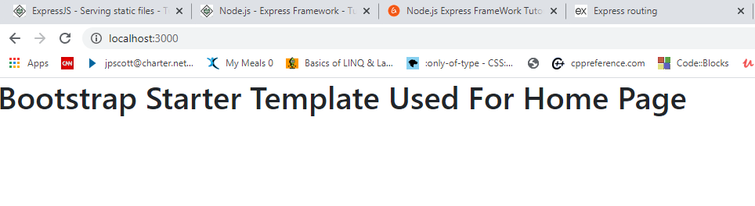
Home Page (localhost:3000)
Source
https://www.tutorialspoint.com/nodejs/nodejs_express_framework.htm

Slide 31
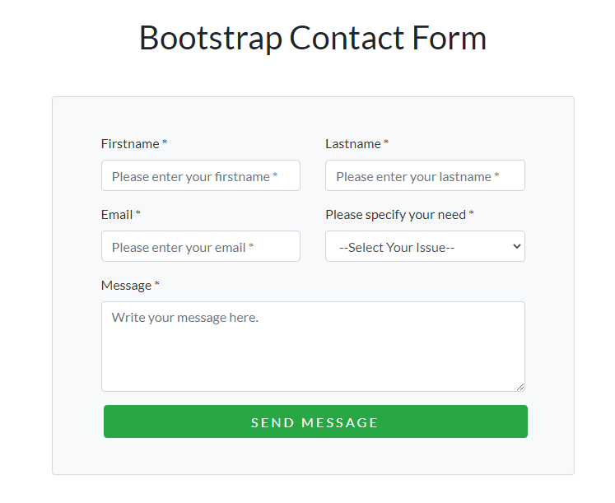
Home Page (localhost:3000/contact.html)
Source
https://www.tutorialspoint.com/nodejs/nodejs_express_framework.htm

Slide 32
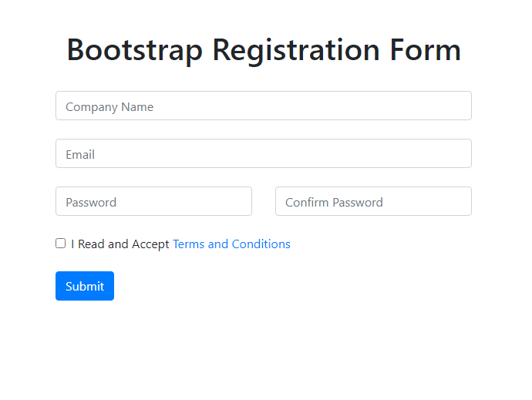
Home Page (localhost:3000/registration.html)
Source
https://www.tutorialspoint.com/nodejs/nodejs_express_framework.htm

Slide 33
What We've Covered
How to use express.js in a node.js application

