Slide 1

Unit02 node.js & Mysql Part I
Ranken Technical College

Slide 2
Objectives
Review additional NPM packages
Review additional Express functionality
Source
https://www.osradar.com/how-to-install-node-js-on-windows-10/

Slide 3
npm config package
Node-config organizes hierarchical configurations for Node.js app deployments. It lets you define a set of default parameters, and extend them for different deployment environments (development, production, etc.).
Configurations are stored in configuration files within your application and can be overridden and extended by environment variables, command line parameters, or external sources
Install: npm install config
Source
https://www.npmjs.com/package/config

Slide 4
npm @hapi/joy config package
@hapi/joy is advertised as the most powerful schema description language and data validator for JavaScript. joi lets you describe your data using a simple, intuitive, and readable language. joi allows you to describe your data for both input and output validation, as part of a hapi HTTP server or standalone
Install: npm install @hapi/joi
Source
https://www.npmjs.com/package/@hapi/joi

Slide 5
npm knex package
knex is advertised as a SQL query builder that is flexible, portable, and fun to use. It features both traditional node style callbacks as well as a promise interface for cleaner async flow control, a stream interface, full featured query and schema builders, transaction support (with savepoints), connection pooling and standardized responses between different query clients and dialects
Install: npm install knex --save
Source
https://www.npmjs.com/package/knex

Slide 6
npm mysql package
The mysql package is a node.js driver for mysql. It is written in JavaScript, does not require compiling, and is 100% MIT licensed
Install: npm install mysql
Source
https://www.npmjs.com/package/mysql

Slide 7
npm express-handlebars package
The express-handlebars package is advertised as a Handlebars view engine for Express which doesn't suck
Handlebars is an extension for the popular Mustache template language. It is logic-less and keeps the views and logic separated.
Install: npm install express-handlebars
Source
https://www.npmjs.com/package/express-handlebars

Slide 8
npm lodash package
Lodash is a JavaScript library that helps programmers write more concise and maintainable JavaScript
It can be broken down into several main areas, including:
Utilities for simplifying common programming tasks such as determining type
Functions. lodash simplifies binding, decorating, constraining, etc.
String conversion functions for performing basic string operations
Array operatons such as creating, splitting, combining, and modifying
Collection operations such as iterating, sorting, filtering and building
Object operations such as accessing, extending, merging, and transforming
Install: npm i --save lodash
Source
https://www.npmjs.com/package/lodash

Slide 9
npm morgan package
Morgan is a popular HTTP request middleware logger for Node.js and basically used as a logger. For example, morgan can be used with node.js winston package to consolidate HTTP request data logs with other information
Install: npm i morgan
Source
https://www.npmjs.com/package/morgan

Slide 10
Express router
Express is a popular web framework for Node.js. It provides a wrapper to useful functionality such as rendering and routing
Express router is a class which helps create router handlers. A router handler does not just provide routing to a Node.js app. It can also extend this routing to handle validation, HTTP 404 errors, and other errors
Source
https://codeforgeek.com/expressjs-router-tutorial/

Slide 11
Express router
Create a new folder called expressRouterDemo
Change to this folder (directory). Right-click on it and choose Git Bash Here
Open this folder with VS Code and add an app.js file
Create a package.json file by entering in npm init at the Git Bash terminal. Accept all defaults. Add Express Router Demo for the description and your name for the author
Install express via the command install i express --save
Source
https://codeforgeek.com/expressjs-router-tutorial/

Slide 12
Express router (my package.json file)
{
"name": "expressrouterdemo",
"version": "1.0.0",
"description": "Express Router Demo",
"main": "app.js",
"scripts": {
"test": "echo \"Error: no test specified\" && exit 1"
},
"author": "Jeff Scott",
"license": "ISC",
"dependencies": {
"express": "^4.17.1"
}
}
Source
https://codeforgeek.com/expressjs-router-tutorial/

Slide 13
Express router (add to app.js file)
const express = require("express");
const app = express();
// Create the Router() object
const router = express.Router();
// Provide all routes here, starting with the Home page.
router.get("/",function(req,res) {
res.json({"message" : "Hello World"});
});
Source
https://codeforgeek.com/expressjs-router-tutorial/

Slide 14
Express router (add to app.js file)
// Tell express to use this router with /api before.
// You can put just '/' if you don't want any sub path before routes.
app.use("/api", router);
// Listen to this Port
app.listen(3000,function() {
console.log("Live at Port 3000");
});
Source
https://codeforgeek.com/expressjs-router-tutorial/

Slide 15
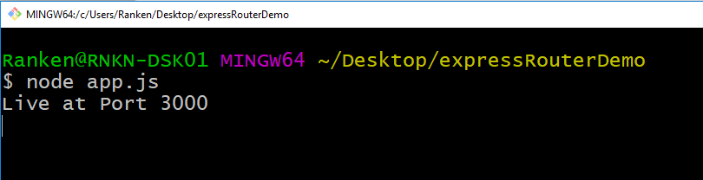
Express router
Run the program from the terminal via the command node app.js
See the following message at the terminal:
Source
https://codeforgeek.com/expressjs-router-tutorial/

Slide 16
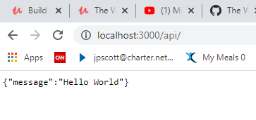
Express router
Run the program from the terminal via the command node app.js
See the following message entering localhost:3000/api/ in the browser window:
Source
https://codeforgeek.com/expressjs-router-tutorial/

Slide 17
Express request logging middleware
Middleware functions are functions that have access to the request object (req), the response object (res), and the next function in a Node.js application's request-response cycle
The next function is a function in the Express router which, when invoked, executes the middleware succeeding the current middleware. If the current middleware function does not end the request-response cycle, it must call next() to pass control to the next middleware function. Otherwise, the request will be left hanging.
Source
https://expressjs.com/en/guide/writing-middleware.html

Slide 18
Express request logging middleware
Middleware functions can perform the following tasks:
Execute code
Make changes to the request and the response objects
End the request-response cycle
Call the next middleware in the stack
Source
https://expressjs.com/en/guide/writing-middleware.html

Slide 19
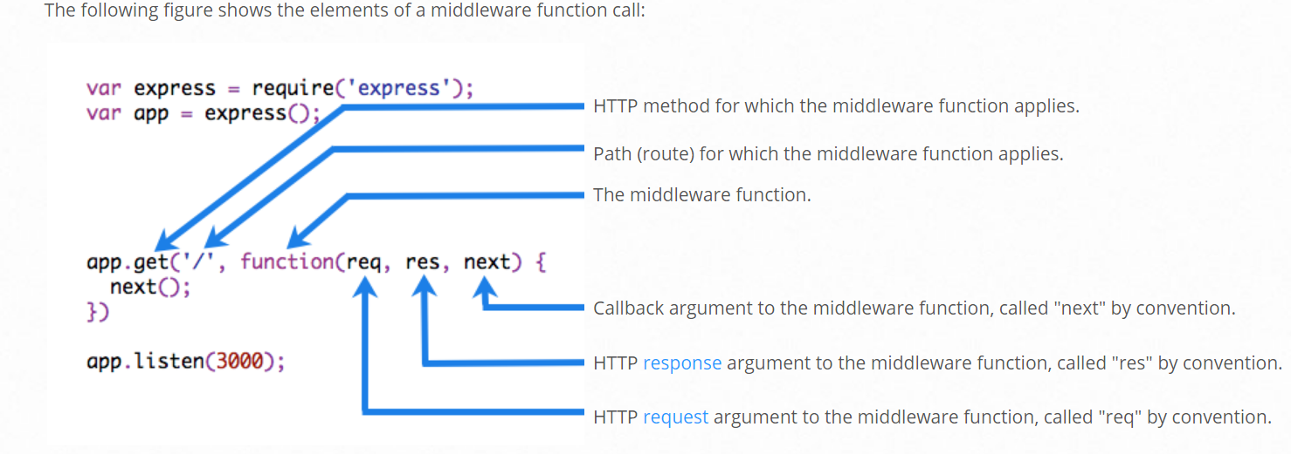
Express request logging middleware
Source
https://expressjs.com/en/guide/writing-middleware.html

Slide 20
Express router (add to app.js file)
// Add the code below after const router = express.Router();
router.use(function(req, res, next) {
console.log("/" + req.method);
next();
});
Source
https://codeforgeek.com/expressjs-router-tutorial/

Slide 21
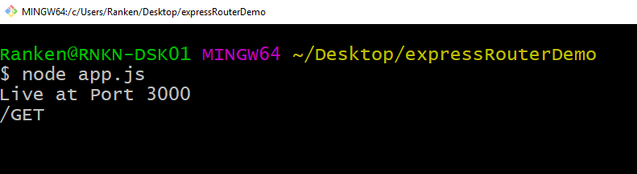
Express router
Run the program from the terminal via the command node app.js
After entering localhost:3000/api/ in the browser window, see the following message at the terminal (/GET):
Source
https://codeforgeek.com/expressjs-router-tutorial/

Slide 22
Express error handling middleware
Error Handling refers to how Express catches and processes errors that occur both synchronously and asynchronously. Express comes with a default error handler so you don't need to write your own to get started.
It's important to ensure that Express catches all errors that occur while running route handlers and middleware.
Errors that occur in synchronous code inside route handlers and middleware require no extra work. If synchronous code throws an error, Express will catch and process it.
Source
https://www.npmjs.com/package/morgan

Slide 23
Express router (add to app.js file)
// Add the code below after previous middleware code
router.use("/user/:id", function(req, res, next) {
console.log(req.params.id)
try
{
if(req.params.id == 0) {
throw new Error({"message" : "You must pass an ID other than 0"});
}
res.json({"message" : "Hello User: " + req.params.id});
next();
}
Source
https://codeforgeek.com/expressjs-router-tutorial/

Slide 24
Express router (add to app.js file)
// Add the code below after previous middleware code
catch(err) {
next(err);
}
});
Source
https://codeforgeek.com/expressjs-router-tutorial/

Slide 25
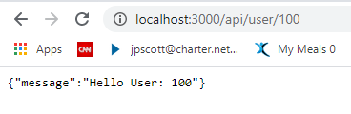
Express router
Run the program from the terminal via the command node app.js
Enter localhost:3000/api/100 in the browser window, see the following message
Source
https://codeforgeek.com/expressjs-router-tutorial/

Slide 26
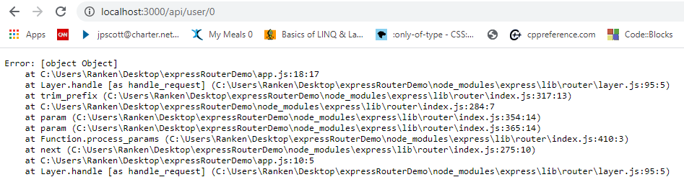
Express router
Run the program from the terminal via the command node app.js
Enter localhost:3000/api/100 in the browser window, see the following message
Source
https://codeforgeek.com/expressjs-router-tutorial/

Slide 27
Express request logging middleware
Stop the server if it is currently running with Ctrl + C
Add the morgan logging module via the command npm install morgan --save
Add the following new constant near the top of the app.js file
const morgan = require('morgan');
Source
https://www.npmjs.com/package/morgan

Slide 28
Express router (add to app.js file)
// Add the code below after previous middleware code
logVar = morgan(function (tokens, req, res) {
return [
tokens.method(req, res),
tokens.url(req, res),
tokens.status(req, res),
tokens.res(req, res, 'content-length'), '-',
tokens['response-time'](req, res), 'ms'
].join(' ')
});
console.log("The following has been logged: " + logVar);
Source
https://codeforgeek.com/expressjs-router-tutorial/

Slide 29
Express router
Run the program from the terminal via the command node app.js
I entered localhost:3000/api/100 in the browser window, followed by localhost:3000/api/100 in the browser window
See the terminal message that was returned on the next three slides
Source
https://codeforgeek.com/expressjs-router-tutorial/

Slide 30
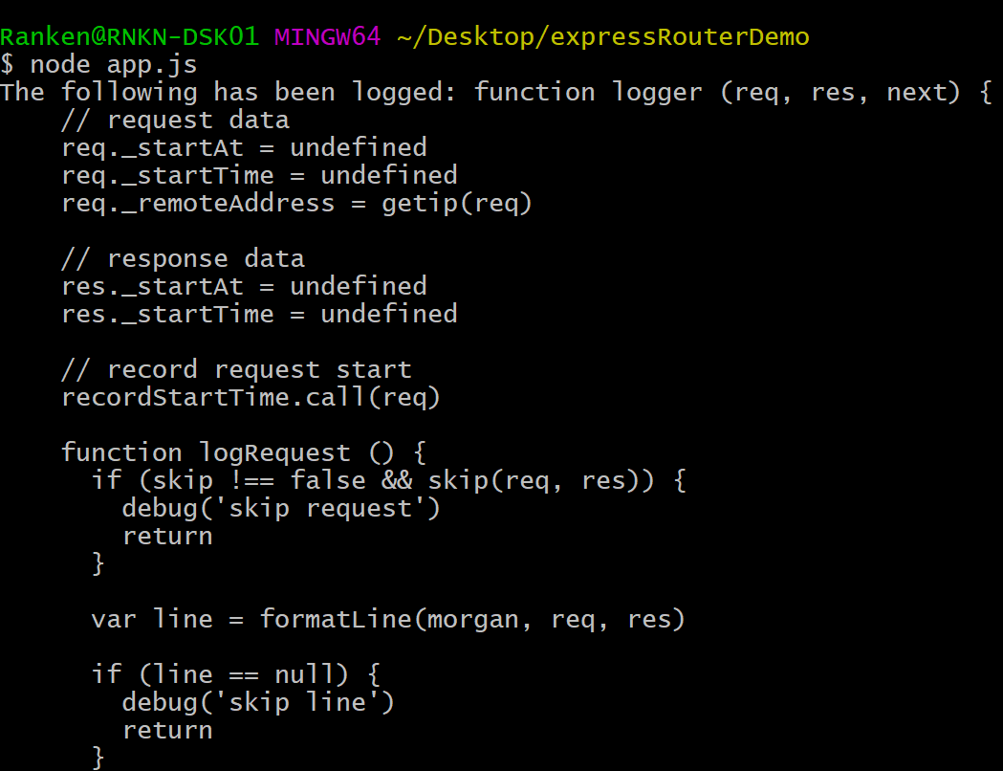
Express router
Source
https://codeforgeek.com/expressjs-router-tutorial/

Slide 31
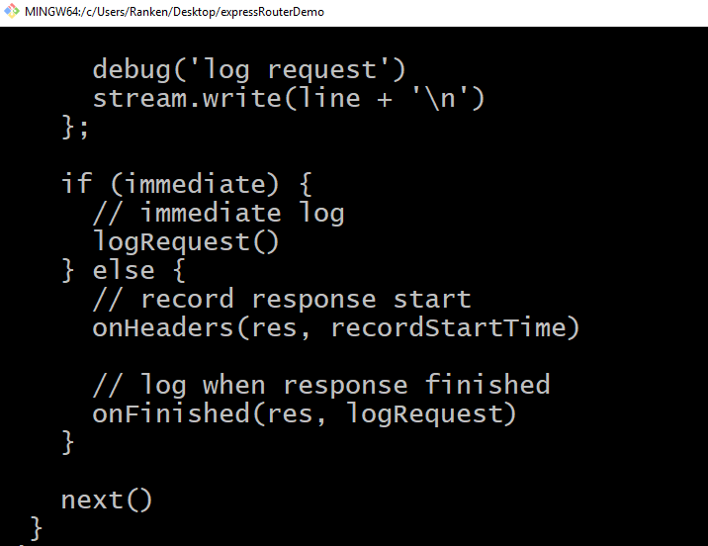
Express router
Source
https://codeforgeek.com/expressjs-router-tutorial/

Slide 32
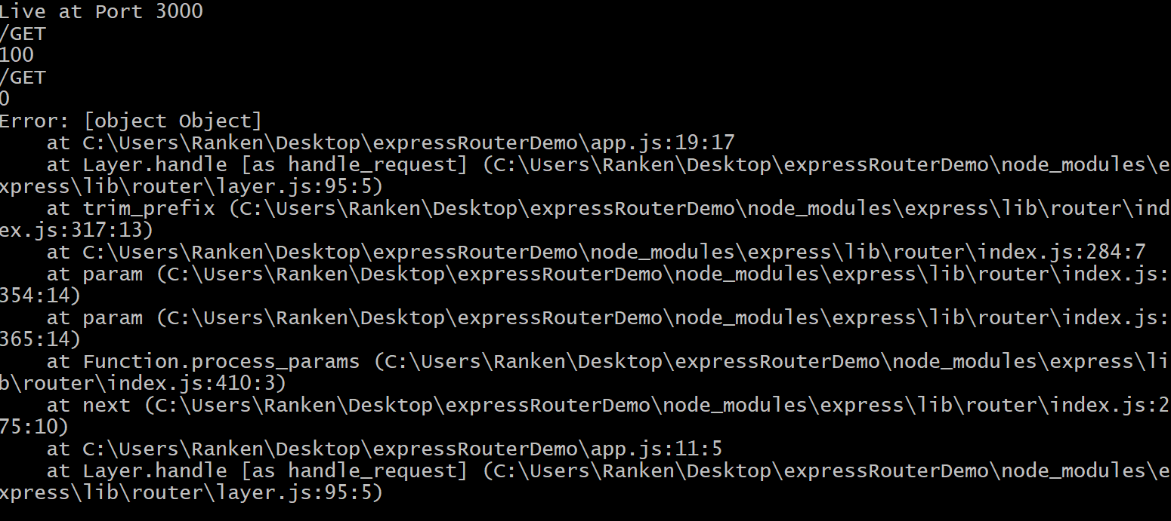
Express router
Source
https://codeforgeek.com/expressjs-router-tutorial/

Slide 33
What We've Covered
Additional NPM packages
Additional Express functionality

