Slide 1

Unit02 node.js & Mysql Part II
Ranken Technical College

Slide 2
Objectives
Review Express-Handlebars functionality
Review fundamental database terminology

Slide 3
Templating Engines
Recall that a template engine enables you to use static template files in a Node.js application. At runtime, the template engine replaces variables in a template file with actual values, and transforms the template into an HTML file sent to the client. This approach makes it easier to design an HTML page
Popular template engines that work with Express include: Handlebars (the focus of this section), EJS (embedded JavaScript. Discussed/used in our text), Mustache and Pug (formerly known as Jade)
Source
https://expressjs.com/en/guide/using-template-engines.html

Slide 4
Templating Engines
To render template files, set the following application setting properties, in app.js:
views, the directory where the template files are located, e.g. app.set('views', './views'). This defaults to the views directory in the application root directory.
view engine, the template engine to use. For example, to use the Handlebars template engine: app.set('view engine', 'handlebars')
Then install the corresponding template engine npm package; for example: npm install handlebars --save
Source
https://expressjs.com/en/guide/using-template-engines.html

Slide 5
Templating Engines
After the view engine is set, you don’t have to specify the engine or load the template engine module in your app; Express loads the module internally, as shown below (for the above example).
app.set('view engine', 'handlebars')
Source
https://expressjs.com/en/guide/using-template-engines.html

Slide 6
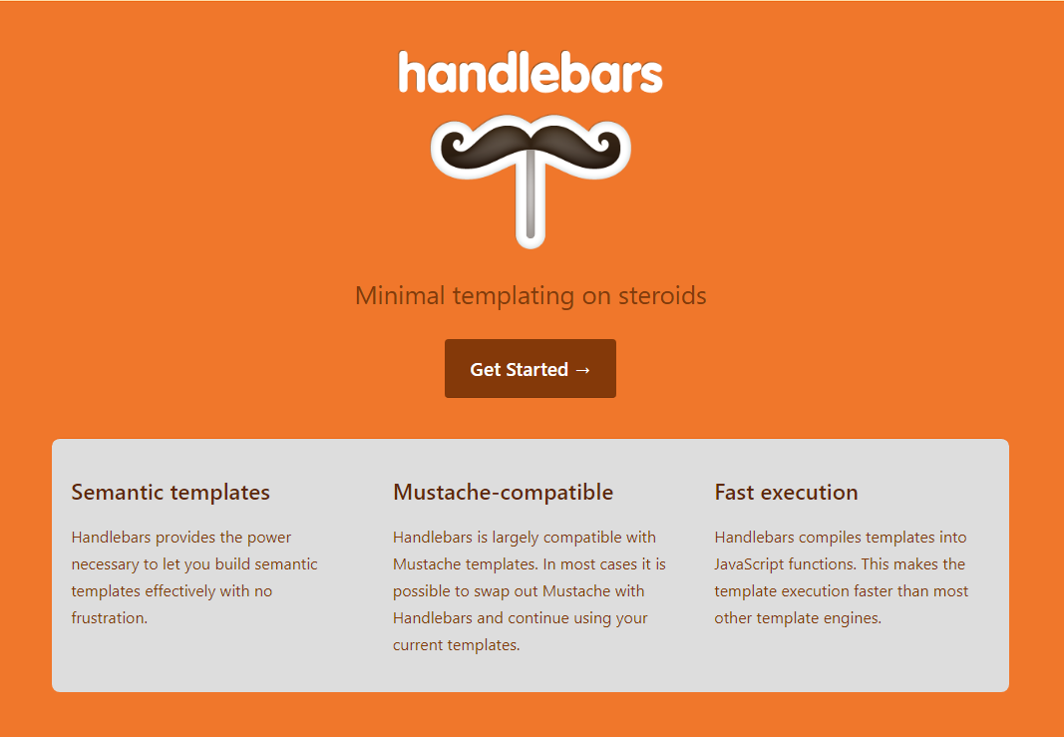
Handlebars Templating Engine (official website)
Source
https://handlebarsjs.com/

Slide 7
Handlebars Templating Engine (official website)
Handlebars is popular for both back-end and front-end templating. For example, the popular front-end framework Ember uses Handlebars as the templating engine
Handlebars is an extension of the Mustache template language, which is mostly focused on simplicity and minimal templating
See URL: https://www.youtube.com/watch?v=1srD3Mdvf50 for a video on Node.js and the Handlebars Templating Engine
Source
https://handlebarsjs.com/

Slide 8
Handlebars Example
Create a new folder called handlebarsDemo
Change to this folder (directory). Right-click on it and choose Git Bash Here
Open this folder with VS Code and add an app.js file
From the terminal, create a package.json file by entering in npm init at the Git Bash terminal. Accept all defaults. Add Handlebars Templating Engine Demo for the description and your name for the author
Install express and express-handlebars via the command npm install express express-handlebars --save
Source
https://stackabuse.com/guide-to-handlebars-templating-engine-for-node/

Slide 9
Handlebars Example
{
"name": "handlebarsdemo",
"version": "1.0.0",
"description": "Handlebars Templating Engine Demo",
"main": "app.js",
"scripts": {
"test": "echo \"Error: no test specified\" && exit 1"
},
"author": "Jeff Scott",
"license": "ISC",
"dependencies": {
"express": "^4.17.1",
"express-handlebars": "^5.0.0"
}
}
Source
https://stackabuse.com/guide-to-handlebars-templating-engine-for-node/

Slide 10
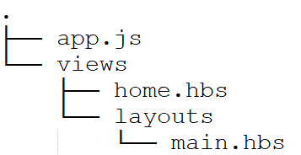
Handlebars Example
Next we will create the default Handlebars directory structure. The views folder contains all Handlebars templates:
Source
https://stackabuse.com/guide-to-handlebars-templating-engine-for-node/

Slide 11
Handlebars Example
The layouts folder inside the views folder will contain the layouts or the template wrappers. Those layouts will contain the HTML structure, style sheets, and scripts that are shared between templates
The main.hbs file is the main layout. The home.hbs file is an example Handlebars template that we can build upon
In our example we'll be using one script to keep this simple. Add the required libraries to the app.js file:
Source
https://stackabuse.com/guide-to-handlebars-templating-engine-for-node/

Slide 12
Handlebars Example
The layouts folder inside the views folder will contain the layouts or the template wrappers. Those layouts will contain the HTML structure, style sheets, and scripts that are shared between templates
The main.hbs file is the main layout. The home.hbs file is an example Handlebars template that we are going to build upon
Source
https://stackabuse.com/guide-to-handlebars-templating-engine-for-node/

Slide 13
Handlebars Example
const express = require('express');
const exphbs = require('express-handlebars');
const app = express();
// Next configure express-handlebars as our view engine:
app.engine('hbs', exphbs({
defaultLayout: 'main', // Default layout file will be main.hbs
extname: '.hbs‘ // The default extension for Handlebars templates is // .handlebars. In the settings, we changed it to .hbs via // the extname flag
}));
app.set('view engine', 'hbs');
Source
https://stackabuse.com/guide-to-handlebars-templating-engine-for-node/

Slide 14
Handlebars Example
// Open main.hbs and add the following Bootstrap scripts and styles
<html lang="en">
<head>
<link rel="stylesheet" href="https://stackpath.bootstrapcdn.com/bootstrap/4.4.1/css/bootstrap.min.css">
<title>Handlebars Demo</title>
</head>
<body>
<div class="container">
{{{body}}} <!-- // Where the handlebars "magic" happens
</div>
<script src="https://code.jquery.com/jquery-3.4.1.slim.min.js"></script>
<script src="https://cdn.jsdelivr.net/npm/popper.js@1.16.0/dist/umd/popper.min.js"></script>
<script src="https://stackpath.bootstrapcdn.com/bootstrap/4.4.1/js/bootstrap.min.js"></script>
</body>
</html>
Source
https://stackabuse.com/guide-to-handlebars-templating-engine-for-node/

Slide 15
Handlebars Example
First add the following line of code to the home.hbs file:
<h1>Hello World from the Handlebars Home Page!</h1>
Source
https://stackabuse.com/guide-to-handlebars-templating-engine-for-node/

Slide 16
Handlebars Example
To be able to reach this page, we need to configure a request handler. set it at the root path by adding the following code to app.js after the app.set statement::
app.get('/', (req, res) => {
res.render('home');
});
We also need to start listening on a port for requests. Add this under the code above:
app.listen(3000, () => {
console.log('The web server has started on port 3000');
});
Source
https://stackabuse.com/guide-to-handlebars-templating-engine-for-node/

Slide 17
Handlebars Example
We can run the app with node app.js in the console. However, we can also opt to use nodemon so we don't need to restart the server each time we make a change, i.e. when we change the code, nodemon will refresh the server
First install nodemon from the terminal via the command npm i -g nodemon
Then run the app with nodemon via the command: nodemon app.js
Source
https://stackabuse.com/guide-to-handlebars-templating-engine-for-node/

Slide 18
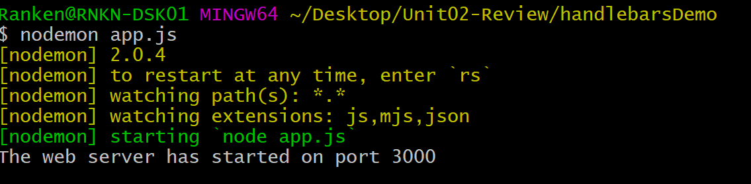
Handlebars Example
From the command line (terminal), you should see the following:
Source
https://stackabuse.com/guide-to-handlebars-templating-engine-for-node/

Slide 19
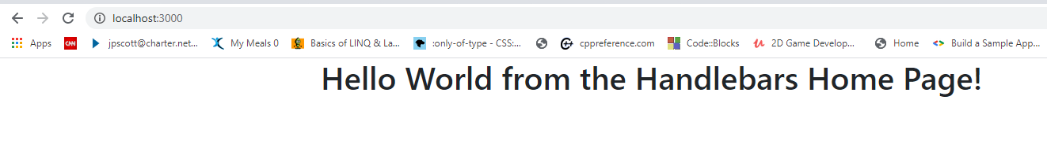
Handlebars Example
Open the browser window, key in localhost:3000 and you should see the following:
Source
https://stackabuse.com/guide-to-handlebars-templating-engine-for-node/

Slide 20
Fundamental Database terminology
The majority of the following definitions were taken from the URL shown in the Source below and thus were not repeated on each page
Also, the majority of our work concerning databases will center around CRUD. CRUD is an acronym for Create (Insert), Read (Select), Update, and Delete
Source
http://etutorials.org/SQL/Postgresql/Part+I+General+PostgreSQL+Use/Chapter+1.+Introduction+to+PostgreSQL+and+SQL/Basic+Database+Terminology/

Slide 21
Fundamental Database terminology
Relational Database - A relational database refers to a database that stores data in a structured format, using rows and columns. This makes it easy to locate and access specific values within the database. Relational databases utilize the Structured Query Language (a.k.a. SQL or sequel)

Slide 22
Fundamental Database terminology
RDBMS – A relational database management system or RDBMS is a database engine/system based on the relational model specified by Edgar F. Codd--the father of modern relational database design--in 1970

Slide 23
Fundamental Database terminology
Database schema - A database schema is a visual and logical architecture of a database created on a database management system. It provides a graphical view of the entire database architecture and structure. It provides a means for logically grouping and displaying database objects such as tables, fields, functions and relations

Slide 24
Fundamental Database terminology
Database - A database is a named collection of tables. (see table). A database can also contain views, indexes, sequences, data types, operators, and functions. Other relational database products use the term catalog. A database contains 1 or more tables

Slide 25
Fundamental Database terminology
Table - A table (a.k.a. a relation) is a collection of rows. A table usually has a name, although some tables are temporary and exist only to carry out a command. All the rows in a table have the same shape (in other words, every row in a table contains the same set of columns). Each table consists of one or more records

Slide 26
Fundamental Database terminology
Record - A record (a.k.a. a record or tuple) is a collection of column values. Every row in a table has the same shape (in other words, every row is composed of the same set of columns). Each record contains one or more columns. Ideally each record has a primary key

Slide 27
Fundamental Database terminology
Column - A column (a.k.a. a field or attribute) is the smallest unit of storage in a relational database. A column represents one piece of information about an object. Every column is one or more characters and has a name and a data type. Columns are grouped into rows, and rows are grouped into tables and tables are grouped into databases

Slide 28
Fundamental Database terminology
Primary key - A primary key is a unique record identifier. Primary keys cannot be null (unknown). They should also be unintelligible. They often an int field called ID.

Slide 29
Fundamental Database terminology
Unique constraint - A unique constraint is a field that could have been chosen as a primary key but wasn't. Unlike a primary key, unique constraint can be null.

Slide 30
Fundamental Database terminology
Foreign key constraint - A foreign key is a key used to link two tables together. It is one or more fields in one table that refers to the primary in another table. The table containing the foreign key is called the child table, and the table containing the candidate key is called the referenced or parent table

Slide 31
Fundamental Database terminology
Index - An index is a data structure that a database uses to reduce the amount of time it takes to perform certain operations. An index can also be used to ensure that duplicate values don't appear where they aren't wanted

Slide 32
Fundamental Database terminology
Query - A query is a type of command that retrieves data from the server. A query is either a Select (Read), Insert (Create), Update, or Delete statement, used to read information from a database or write information to a database

Slide 33
Fundamental Database terminology
Result set - When you issue a query to a database, you get back a result set. The result set contains all the rows that satisfy your query. A result set may be empty, meaning that the query was valid but matched no existing information

Slide 34
Fundamental Database terminology
View - A view is an alternative way to present a table (or tables). You might think of a view as a "virtual" table. A view is (usually) defined in terms of one or more tables. When you create a view, you are not storing more data, you are instead creating a different way of looking at existing data. A view is a useful way to give a name to a complex query that you may have to use repeatedly

Slide 35
Fundamental Database terminology
Transaction - A transaction is a collection of database operations that are treated as a unit. This property ensures that if something goes wrong in the middle of a transaction, changes made before the point of failure will not be reflected in the database, i.e. it either all succeeds or it all fails. A transaction usually starts with a BEGIN command and ends with a COMMIT or ROLLBACK (see the next entries)

Slide 36
Fundamental Database terminology
Commit - A commit marks the successful end of a transaction. When you perform a commit, you are telling the RDBMS that you have completed a unit of operation and that all the changes that you made to the database should become permanent

Slide 37
Fundamental Database terminology
Rollback - A rollback marks the unsuccessful end of a transaction. When you roll back a transaction, you are telling the RDBMS to discard any changes that have been made to the database since the beginning of the transaction)

Slide 38
Fundamental Database terminology
Database Normalization - In relational database design, the process of organizing data to minimize redundancy is known as normalization. Normalization usually involves dividing a database into two or more tables and defining relationships between the tables. The objective is to isolate data so that additions, deletions, and modifications of a field can be made in just one table and then propagated through the rest of the database via the defined relationships

Slide 39
Fundamental Database terminology
There are three main normal forms, each with increasing levels of normalization:
First Normal Form (1NF): Each field in a table contains different information. For example, in an employee list, each table would contain only one birthdate field.
Second Normal Form (2NF): Each field in a table that is not a determiner of the contents of another field must itself be a function of the other fields in the table.
Third Normal Form (3NF): No duplicate information is permitted. So, for example, if two tables both require a birthdate field, the birthdate information would be separated into a separate table, and the two other tables would then access the birthdate information via an index field in the birthdate table. Any change to a birthdate would automatically be reflect in all tables that link to the birthdate table.

Slide 40
Fundamental Database terminology
There are higher order forms of normalization, e.g. 4NF – 7NF and Boyce-Codd Normal Form (BCNF), but they are not as often used in industry
A database that is in 3NF must already have been in 2NF. A database that is in 2NF must already have been in 1NF, etc.
The act of going from a higher level of database normalization to a lower lever (e.g. going from 3NF to 2NF) is known as denormalization

Slide 41
Fundamental Database terminology
ERD - An Entity Relationship Diagram or ERD is not actually a database term. Rather, an ERD is a data modeling technique that graphically illustrates an information system’s entities and the relationships between those entities. An ERD is a conceptual and representational model of data used to represent the entity framework infrastructure

Slide 42
What We've Covered
Express-Handlebars functionality
Fundamental database terminology

