Slide 1

Unit02 node.js & Mysql Part III
Ranken Technical College

Slide 2
Objectives
Review MySQL database terminology
Create MySQL CRUD-related examples

Slide 3
MySQL
MySQL is a relational database management system (RDBMS). A relational database organizes data into one or more data tables in which data types may be related to each other. These relations help structure the data. SQL is a language programmers use to create, modify and extract data from the relational database, as well as control user access to the database
MySQL is free and open-source software owned by the Oracle Corporation)
Source
https://en.wikipedia.org/wiki/MySQL

Slide 4
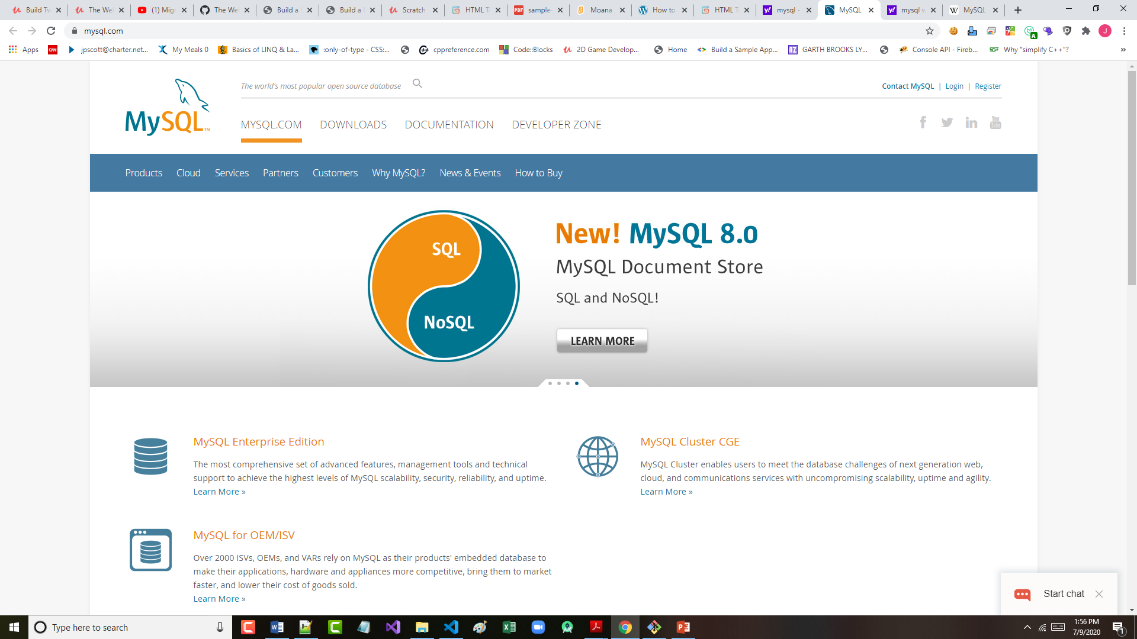
MySQL Website
Source
https://www.mysql.com/

Slide 5
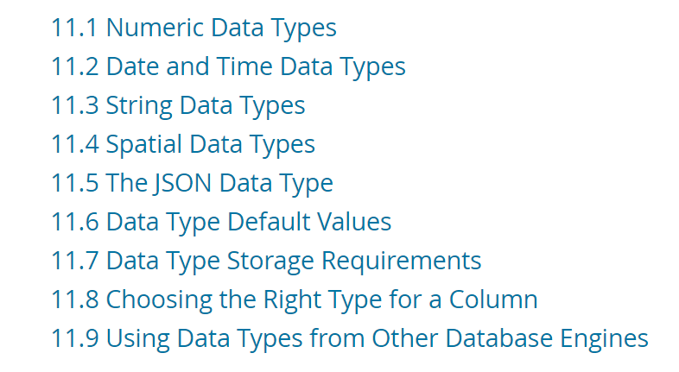
MySQL Data Types
Source
https://dev.mysql.com/doc/refman/8.0/en/data-types.html

Slide 6
MySQL TABLE
Assume a database called Ranken with 2 tables:
Table 1 is called employees. It has fields: a) id, b) firstName, c) lastName, d) deptID e) salary and it has 4 records
Record 1: id = 1, firstName = Charles, lastName = Corrigan, deptID = 1, salary = 100000
Record 2: id = 2, firstName = Evan, lastName = Gudmestad, deptID = 2,, salary = 90000
Record 3: id = 3, firstName = Paul, lastName = Smith, deptID = 2, salary = 80000
Record 4: id = 4, firstName = Jeff, lastName = Scott, deptID = 2, salary = 70000

Slide 7
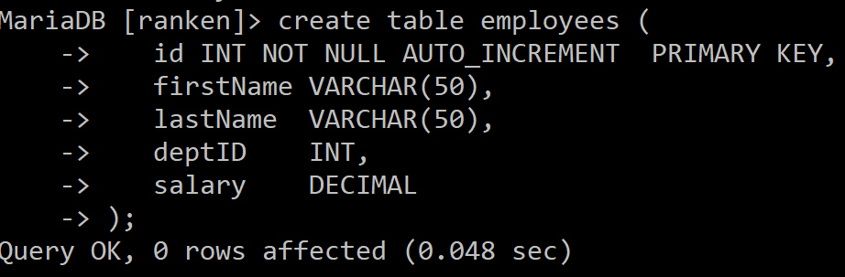
MySQL CREATE TABLE SCHEMA
Here is the MySQL to create the employees table schema:

Slide 8
MySQL TABLE
Assume a database called Ranken with 2 tables:
Table 2 is called departments. It has fields: a) id, b) deptName, c) deptAcronym
Record 1: id = 1, deptName = Information Technology, deptAcronym = IT
Record 2: id = 2, deptName = Application Website Development, deptAcronym = AWD
Record 3: id = 3, deptName = General Education, deptAcronym = GENED

Slide 9
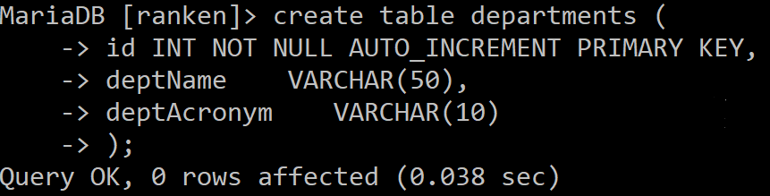
MySQL CREATE TABLE SCHEMA
Here is the MySQL to create the departments table schema:

Slide 10
MySQL SELECT
A MySQL SELECT statement displays data. It cannot change existing data:
Example 1 displays all records in the employee table
SELECT * FROM employees;
Example 2 displays only the last names of all employees that start with "S" in alphabetical order
SELECT lastName FROM employees WHERE lastName LIKE "S%" ORDER BY lastName;

Slide 11
MySQL SELECT
The syntax for a MySQL SELECT statement:
SELECT field(s)
FROM table(s)
WHERE criteria
ORDER BY [ASC] DESC;

Slide 12
MySQL EQUIJOIN
The query to show all employees firstName, lastName, and deptAcronym only:
select firstname, lastname, deptacronym
from employees
join departments
on employees.deptid = departments.id;
This equijoin (here also an inner join) matches all records that have a deptID/id match

Slide 13
MySQL EQUIJOIN
The query to show all employees firstName, lastName, and deptAcronym only:
select firstname, lastname, deptacronym
from employees, departments
where employees.deptid = departments.id;
Note: This is older syntax, and the example on the previous page is the preferred way
This equijoin (here also an inner join) matches all records that have a deptID/id match

Slide 14
MySQL CROSS JOIN
The query to show all 12 employees table/departments table combinations:
SELECT *
FROM employees
CROSS JOIN departments;
A cross join like this produces what is known as a Cartesian Product

Slide 15
MySQL LEFT JOIN
The query to show employees and their deptAcronym, even if there are no employees:
SELECT e.firstName, e.lastName, d.deptAcronym
FROM departments d
LEFT JOIN employees e
ON e.deptid = d.id;
A left join like this produces null for firstName and lastName for deptAcronum GENED

Slide 16
MySQL RIGHT JOIN
The query to show employees and their deptAcronym, even if there are no employees:
SELECT e.firstName, e.lastName, d.deptAcronym
FROM employees e
RIGHT JOIN departments d
ON e.deptid = d.id;
A right join like this produces null for firstName and lastName for deptAcronum GENED

Slide 17
MySQL GROUP BY
The query to show the total # of employees in each department, grouped by deptID:
SELECT d.deptName, COUNT(e.deptid) AS "TOTAL EMPS THIS DEPT"
FROM employees e
JOIN departments d
ON e.deptID = d.id
GROUP BY e.deptid;

Slide 18
MySQL GROUP BY HAVING
The query to show total # of employees in each department (> 1), grouped by deptID:
SELECT d.deptName, COUNT(e.deptid) AS "TOTAL EMPS THIS DEPT"
FROM employees e
JOIN departments d
ON e.deptID = d.id
GROUP BY e.deptid
HAVING COUNT(*) > 1;

Slide 19
MySQL AGGREGATE COUNT()
The query to show the number of employees in the AWD department:
SELECT COUNT(*)
FROM employees
WHERE deptid = 1;

Slide 20
MySQL AGGREGATE SUM()
The query to show the sum salary of all employees in the AWD Division:
SELECT SUM(salary)
FROM employees
WHERE deptid = 1;

Slide 21
MySQL AGGREGATE MIN()
The query to show the lowest salary of employees in the AWD Division:
SELECT MIN(salary)
FROM employees
WHERE deptid = 1;

Slide 22
MySQL AGGREGATE MAX()
The query to show the highest salary of employees in the AWD Division:
SELECT MAX(salary)
FROM employees
WHERE deptid = 1;

Slide 23
MySQL AGGREGATE AVG()
The query to show the average salary of employees in the AWD Division:
SELECT AVG(salary)
FROM employees
WHERE deptid = 1;

Slide 24
MySQL CRUD INSERT QUERY
Add new employee Paul Knott into the IT Division:
INSERT INTO employees
(firstName, lastName, deptID, salary)
VALUES ('Paul', 'Knott', 1, 70000);

Slide 25
MySQL CRUD UPDATE QUERY
Update new employee Paul Knott salary:
UPDATE employees
SET SALARY = 80000
WHERE id = 5;

Slide 26
MySQL CRUD DELETE QUERY
Delete employee Paul Knott:
DELETE FROM employees
WHERE id = 5;

Slide 27
MySQL NESTED QUERY
The following nested query selects the employee in the AWD department with the largest salary:
SELECT * FROM employees
WHERE salary = (SELECT MAX(salary)
FROM employees
WHERE deptid = 1);

Slide 28
What We've Covered
MySQL database terminology
MySQL CRUD-related examples

