Slide 1

Unit02 node.js & Mysql Part IV
Ranken Technical College

Slide 2
Objectives
Use the config package to read connection settings
Use knex to connect to a database
Use knex to execute SELECT queries
Use knex to execute INSERT statements
Use knex to execute UPDATE statements
Use knex to execute DELETE statements

Slide 3
Knex.js
Knex.js is advertised as: "a 'batteries included' SQL query builder for relational databases such as MySQL. It is designed to be flexible, portable, and fun to use"
Knex.js features both traditional node style callbacks as well as a promise interface for cleaner async flow control, a stream interface, full featured query and schema builders, transaction support (with savepoints), connection pooling and standardized responses between different query clients and dialects
Source
https://knexjs.org/

Slide 4
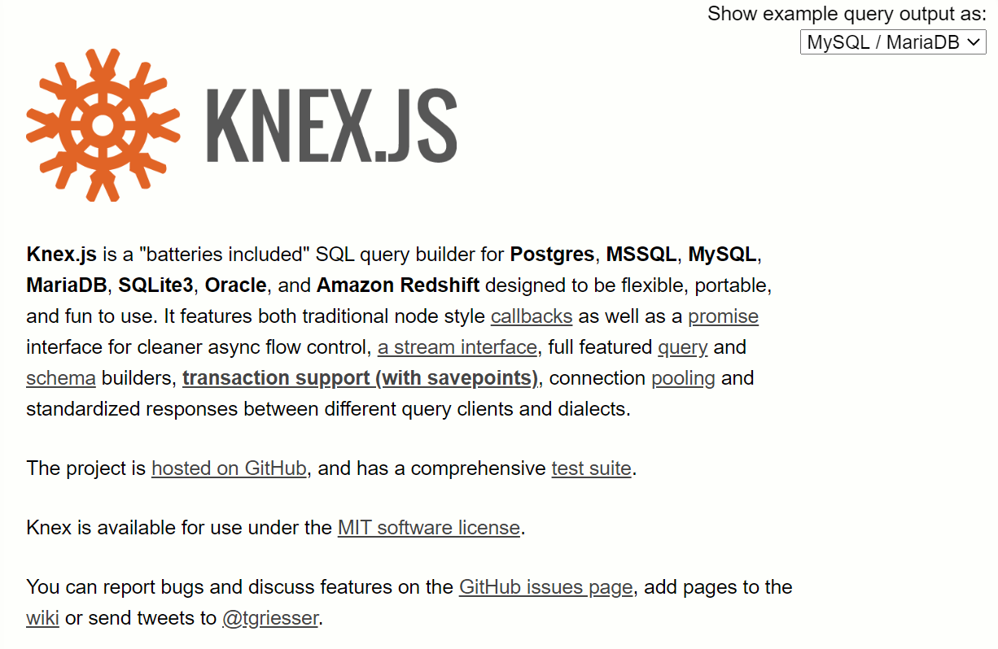
Knex Website
Source
https://knexjs.org/

Slide 5
Knex.js
Knex can be used as an SQL query builder in both Node.JS and the browser, limited to WebSQL's constraints (like the inability to drop tables or read schemas). Composing SQL queries in the browser for execution on the server is highly discouraged, as this can be the cause of serious security vulnerabilities
Source
https://knexjs.org/

Slide 6
Knex.js Installation
First install Knex and the Knex Command Line Tool globally on your local computer, via the following command:
npm install knex -g
This will allow us to use knex as a command line tool that helps you create and manage knex files
Source
https://gist.github.com/NigelEarle/80150ff1c50031e59b872baf0e474977

Slide 7
Knex.js Installation
Next, install the knex module locally to use in your project via the command:
npm install knex --save
Next you need to connect to a MySQL database via the command
npm install mysql --save
Source
https://gist.github.com/NigelEarle/80150ff1c50031e59b872baf0e474977

Slide 8
Knex.js Installation
The knex module is itself a function which takes a configuration object for Knex, accepting a few parameters. The client parameter is required and determines which client adapter will be used with the library
Source
https://gist.github.com/NigelEarle/80150ff1c50031e59b872baf0e474977

Slide 9
Knex.js Installation
For example:
var knex = require('knex')({
client: 'mysql',
connection: {
host : '127.0.0.1',
user : 'database_username',
password : 'database_password',
database : 'database_name'
}
Source
https://gist.github.com/NigelEarle/80150ff1c50031e59b872baf0e474977

Slide 10
Knex.js Installation
The connection options are passed directly to the appropriate database client to create the connection, and may be either an object, a connection string, or a function returning an object
By default, the configuration object received via a function is cached and reused for all connections
Source
http://knexjs.org/

Slide 11
Knex.js Installation
A function can be used to determine the connection configuration dynamically. This function receives no parameters, and returns either a configuration object or a promise for a configuration object
Source
http://knexjs.org

Slide 12
Knex.js Installation
For example:
var knex = require('knex')({
client: ‘mysql',
connection: () => ({
filename: process.env.MYSQL_FILENAME
})
});
Source
http://knexjs.org

Slide 13
Knex.js Query Builder
The heart of the library, the knex query builder is the interface used for building and executing standard SQL queries for basic CRUD operations, such as select (Read), insert (Create), update, and delete
Source
http://knexjs.org

Slide 14
Knex.js Query Builder
The query builder starts off either by specifying a tableName to query against, or by calling any method directly on the knex object. This kicks off a jQuery-like chain, with which one can call additional query builder methods as needed to construct the query, eventually calling any of the interface methods, to either convert toString, or execute the query with a promise, callback, or stream
Source
http://knexjs.org

Slide 15
Knex.js Query Builder – Select Example 1
A SELECT example is shown below:
knex({ a: 'table', b: 'table' })
.select({
aTitle: 'a.title',
bTitle: 'b.title'
})
.whereRaw('?? = ??', ['a.column_1', 'b.column_2'])
Source
http://knexjs.org

Slide 16
Knex.js Query Builder – Select Example 1
This results in the following SQL query:
select `a`.`title` as `aTitle`, `b`.`title` as `bTitle`
from `table` as `a`, `table` as `b`
where `a`.`column_1` = `b`.`column_2`
Source
http://knexjs.org

Slide 17
Knex.js Query Builder – Select Example 2
This knex SELECT statement includes a WHERE clause:
knex('users').where({
first_name: 'Test',
last_name: 'User'
}).select('id')
Source
http://knexjs.org

Slide 18
Knex.js Query Builder – Select Example 2
This results in the following SQL query:
select `id`
from `users`
where `first_name` = 'Test'
and `last_name` = 'User'
Source
http://knexjs.org

Slide 19
Knex.js Query Builder – Select Example 3
This knex SELECT statement includes a WHERE clause, key/value pairs and an or:
knex('users').where('id', 1)
.orWhere({votes: 100, user: 'knex'})
Source
http://knexjs.org

Slide 20
Knex.js Query Builder – Select Example 3
This results in the following SQL query:
select *
from `users`
where `id` = 1
or (`votes` = 100 and `user` = 'knex')
Source
http://knexjs.org

Slide 21
Knex.js Query Builder – Select Example 3
There are several derivatives of the .where clause, including:
.where, andWhere, .whereNot, .whereIn, .whereNotIn, .whereNull, .whereNotNull, .whereExists, .whereNotExists, .whereBetween, .whereNotBetween, .whereRaw
Source
http://knexjs.org

Slide 22
Knex.js Query Builder – Joins
There are several methods provided which assist in building joins, e.g.:
.join, .innerJoin, .leftJoin, .rightJoin, .fullOuterJoin, .crossJoin, .joinRaw
Source
http://knexjs.org

Slide 23
Knex.js Query Builder – Inner Join Example
Here is a knex inner join example:
knex.from('users')
.innerJoin('accounts',
'users.id',
'accounts.user_id')
Source
http://knexjs.org

Slide 24
Knex.js Query Builder – Inner Join Example
This results in the following SQL query:
select *
from `users`
inner join `accounts`
on `users`.`id` = `accounts`.`user_id`
Source
http://knexjs.org

Slide 25
Knex.js Query Builder – Insert
The .insert creates an insert query, taking either a hash of properties to be inserted into the row, or an array of inserts, to be executed as a single insert command. If returning array is passed e.g. ['id', 'title'], it resolves the promise / fulfills the callback with an array of all the added rows with specified columns. It's a shortcut for returning method
Source
http://knexjs.org

Slide 26
Knex.js Query Builder – Insert Example
This is a knex insert query example:
knex('books').insert({title: 'Slaughterhouse Five'})
Source
http://knexjs.org

Slide 27
Knex.js Query Builder – Insert Example
This results in the following SQL query:
insert into `books` (`title`)
values ('Slaughterhouse Five')
Source
http://knexjs.org

Slide 28
Knex.js Query Builder – Update
The .update creates an update query, taking a hash of properties or a key/value pair to be updated based on the other query constraints. If returning array is passed e.g. ['id', 'title'], it resolves the promise / fulfills the callback with an array of all the updated rows with specified columns. It's a shortcut for returning method
Source
http://knexjs.org

Slide 29
Knex.js Query Builder – Update Example
This is a knex update query example:
knex('books')
.where('published_date', '<', 2000)
.update({
status: 'archived',
thisKeyIsSkipped: undefined
})
Source
http://knexjs.org

Slide 30
Knex.js Query Builder – Update Example
This results in the following SQL query:
update `books`
set `status` = 'archived'
where `published_date` < 2000
Source
http://knexjs.org

Slide 31
Knex.js Query Builder – Delete
Aliased to del as delete is a reserved word in JavaScript, this method deletes one or more rows, based on other conditions specified in the query. Resolves the promise / fulfills the callback with the number of affected rows for the query
Source
http://knexjs.org

Slide 32
Knex.js Query Builder – Delete Example
This is a knex delete query example:
knex('accounts')
.where('activated', false)
.del()
Source
http://knexjs.org

Slide 33
Knex.js Query Builder – Delete Example
This results in the following SQL query:
delete from `accounts`
where `activated` = false
Source
http://knexjs.org

Slide 34
Knex Pros & Cons
Pros:
Helps the programmer write fewer SQL queries as Knex knows which database system you’re connecting to and will change the SQL it writes to match
Feels more like programming with JavaScript
Migrations and seeding are much simpler
Source
https://blog.logrocket.com/querying-databases-with-knex-js/

Slide 35
Knex Pros & Cons
Cons:
You should still take time to learn database manipulations at a deeper level
Knex requires a learning curve. It is a library itself, and the developer should know their way inside out to use Knex
If you’re a beginner trying to build APIs, it is better to choose the hard path than the happy path. Writing queries yourself will make you more proficient and comfortable with databases than using a query builder like Knex
Source
https://blog.logrocket.com/querying-databases-with-knex-js/

Slide 36
What We've Covered
An intro to setting up knex in Node.js
An intro to using knex with CRUD
Pros and Cons of using knex

