Slide 1

Unit02 node.js & Mysql Part VI
Ranken Technical College

Slide 2
Objectives
Identify some major jQuery Search Entities
Identify some major jQuery Filter Entities

Slide 3
jQuery Search Entities .find() Method
Description: Gets the descendants of each element in the current set of matched elements, filtered by a selector, jQuery object, or element. Syntax:
.find(selector)
Given a jQuery object that represents a set of DOM elements, the .find() method allows a search through the descendants of these elements in the DOM tree and construct a new jQuery object from the matching elements
Source
https://api.jquery.com/find/

Slide 4
jQuery Search Entities .find() Method
This example returns all <span> elements that are descendants of a <ul> element:
$(document).ready(function(){
$("ul").find("span").css({"color": "red", "border": "2px solid red"});
});
Source
https://www.w3schools.com/jquery/traversing_find.asp

Slide 5
jQuery Search Entities .filter() Method
Description: Reduces the set of matched elements to those that match the selector or pass the function's test. Syntax:
.filter(selector)
Given a jQuery object that represents a set of DOM elements, the .filter() method constructs a new jQuery object from a subset of the matching elements. The supplied selector is tested against each element; all elements matching the selector will be included in the result
Source
https://api.jquery.com/filter/

Slide 6
jQuery Search Entities .filter() Method
This example assumes the following unordered list:
<ul>
<li>list item 1</li>
<li>list item 2</li>
<li>list item 3</li>
<li>list item 4</li>
</ul>
Source
https://api.jquery.com/filter/

Slide 7
jQuery Search Entities .filter() Method
Apply the following code:
$("li").filter(":nth-child(2n)").css("background-color", "red");
The result of this call is a red background for items 2 and 4, as they match the selector
Source
https://api.jquery.com/filter/

Slide 8
jQuery Search Entities .contains() Method
Description: Selects all elements that contain the specified text. Syntax:
jQuery(":contains(text)")
The matching text can appear directly within the selected element, in any of that element's descendants, or a combination thereof. The text must have matching case to be selected
Source
https://api.jquery.com/contains/

Slide 9
jQuery Search Entities .contains() Method
The following example finds all divs containing "John" and underlines them"
<body>
<div>John Resig</div>
<div>George Martin</div>
<div>Malcom John Sinclair</div>
<div>J. Ohn</div>
</body>
Source
https://api.jquery.com/contains/

Slide 10
jQuery Search Entities .filter() Method
Apply the following code:
$("div:contains('John')").css("text-decoration", "underline");
The result of this call is:
John Resig
Malcom John Sinclair
Source
https://api.jquery.com/filter/

Slide 11
jQuery Filter Entities * (all selector) Method
Description: Selects all elements. Syntax:
jQuery("*")
Caution: The all, or universal, selector is extremely slow, except when used by itself
Source
https://api.jquery.com/all-selector/

Slide 12
jQuery Filter Entities * (all selector) Method
The following example finds all elements within document.body so elements like head, script, etc. are excluded
<body>
<div>DIV</div>
<span>SPAN</span>
<p>P <button>Button</button></p>
</body>
Source
https://api.jquery.com/all-selector/

Slide 13
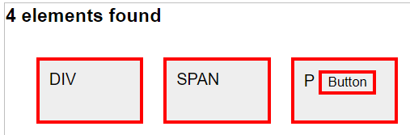
jQuery Filter Entities * (all selector) Method
Entering the following commands:
var elementCount = $("*").css("border", "3px solid red").length;
$("body").prepend("<h3>" + elementCount + " elements found</h3>")
Gives the following results:
Source
https://api.jquery.com/all-selector/

Slide 14
jQuery Filter Entities .first() Method
Description: Reduces the set of matched elements to the first in the set. Syntax:
.first()
This method does not accept any arguments. Given a jQuery object that represents a set of DOM elements, the .first() method constructs a new jQuery object from the first element in that set
Source
https://api.jquery.com/first/

Slide 15
jQuery Filter Entities .first() Method
The following creates a page with a simple list in it:
<ul>
<li>list item 1</li>
<li>list item 2</li>
<li>list item 3</li>
<li>list item 4</li>
<li>list item 5</li>
</ul>
Source
https://api.jquery.com/first/

Slide 16
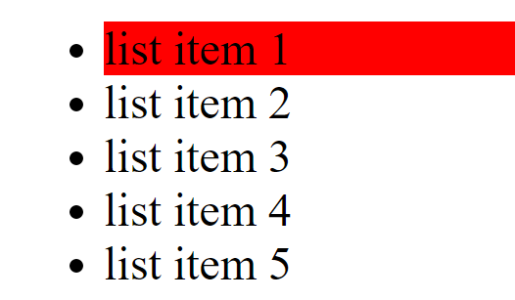
jQuery Filter Entities .first() Method
Entering the following commands:
$( "li" ).first().css( "background-color", "red" );
Gives the following results:
Source
https://api.jquery.com/first/

Slide 17
jQuery Filter Entities .data() Method
Description: Stores arbitrary data associated with matched elements or returns the value at the named data store for first element in the set of matched elements. Syntax:
.data()
The .data() method lets you attach data of any type to DOM elements in a way that is safe from circular references and therefore from memory leaks
Source
https://api.jquery.com/data/

Slide 18
jQuery Filter Entities .data() Method
The following creates a page with a <div> and <span>s in it:
<body>
<div>
The values stored were
<span></span>
and
<span></span>
</div>
</body>
Source
https://api.jquery.com/data/

Slide 19

jQuery Filter Entities .data() Method
Entering the following commands:
$( "div" ).data( "test", { first: 16, last: "pizza!" } );
$( "span" ).first().text( $( "div" ).data( "test" ).first );
$( "span" ).last().text( $( "div" ).data( "test" ).last );
Gives the following results:
Source
https://api.jquery.com/first/

Slide 20
jQuery Filter Entities .get() Method
Description: Retrieves the DOM elements matched by the jQuery object. Syntax:
.get()
With an index specified, .get(index) retrieves a single element
Source
https://api.jquery.com/get/

Slide 21
jQuery Filter Entities .get() Method
The following creates a simple unordered list:
<body>
<ul>
<li id="foo">foo</li>
<li id="bar">bar</li>
</ul>
</body>
Source
https://api.jquery.com/get/

Slide 22
jQuery Filter Entities .get() Method
Entering the following command:
console.log( $( "li" ).get( 0 ) );
Since the index is zero-based, the first list item is returned, i.e. it gives the following results:
<li id="foo">
Source
https://api.jquery.com/get/

Slide 23
jQuery Filter Entities .eq() Method
Description: Reduces the set of matched elements to the one at the specified index. Syntax:
.eq()
An integer indicating the position of the element, counting backwards from the last element in the set
Source
https://api.jquery.com/eq/

Slide 24
jQuery Filter Entities .eq() Method
The following creates a simple unordered list:
<body>
<ul>
<li>list item 1</li>
<li>list item 2</li>
</ul>
</body>
Source
https://api.jquery.com/eq/

Slide 25
jQuery Filter Entities .eq() Method
Entering the following command:
$("li").eq(1).css( "background-color", "red" );
The result of this call is a red background for list item 2, as this is zero-based
Source
https://api.jquery.com/eq/

Slide 26
What We've Covered
Some major jQuery Search Entities
Some major jQuery Filter Entities

