Slide 1
Mastering PowerShell Debugging Techniques
Because code is rarely perfect!

Slide 2
Today’s Agenda
11:30 to 12:40 Lunch and Networking
Grab lunch, meet the Recast team, and connect with fellow IT pros before the session begins.
12:40 to 1:30 PowerShell Tips, Tricks & Debugging
Hands-on demos and live discussions focused on scripts, shortcuts, and security workflows.
1:30 to 2:15 Roundtable Discussions
Join small-group conversations on automation, patching, and modern management best practices.
2:15 to 3:00 Open Q&A and Wrap Up
Informal, social time. Snacks and beverages provided.

Slide 3
Agenda
What is Code Debugging?
Tips for logging and tracing
Why use the debugger?
Using the debugger
ISE
VSCode
CommandLine
Tips and tricks with debugging
Remote debugging

Slide 4
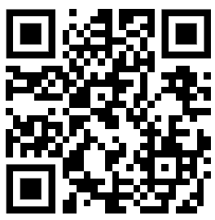
Download Examples
https://github.com/jpscripter/PowershellDebugging

Slide 5
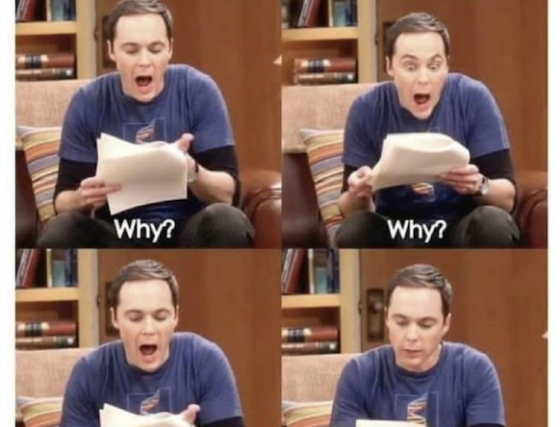
What is Code Debugging?
Code debugging is just the practice of isolating code to make it easier to find the part of your code causing issues.
There are several techniques:
  Running code in segments
  Break code into smaller chunks
  Logging
  Write targeted tests
  Debugger
This Photo by Unknown Author is licensed under CC BY-SA

Slide 6
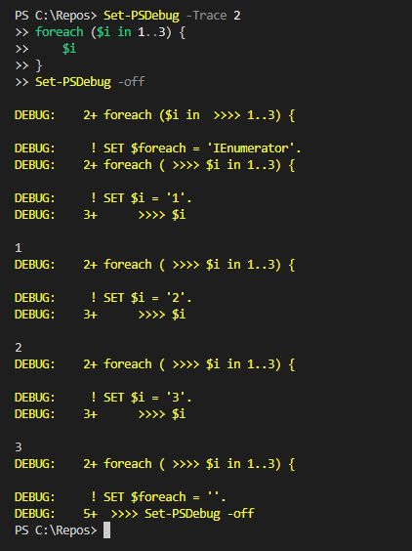
Logging and Tracing
Start-Transcript
  The easiest way to do logging.
Set-PSDebug
  Great for watching what PowerShell is doing at every step.

Slide 7
Logging and Tracing
LIVE DEMO!!
Notes:
#Transcript example
Start-Transcript -Path "$env:temp\DebugTranscript.log" -force
foreach ($i in 1..3) {
Write-Output $i
Write-verbose -message "Verbose $i"
Write-Debug -Message "Debug $i"
Write-Warning -Message "Warning $i"
Write-Error -Message "Error $i" -erroraction Continue
# Debug and Verbose Have to be enabled to log in transcripts
$VerbosePreference = 'Continue'
$DebugPreference = 'Continue'
}
Stop-Transcript
start-process -FilePath (Where.exe notepad)[0] -ArgumentList "$env:temp\DebugTranscript.log"
#Trace Example
Set-PSDebug –Trace 2
$MaxLoops = 10
$BreakPoint = 3
:LoopName For ($Counter = 0; $Counter -LT $Maxloops; $Counter++){
If ($Counter = $BreakPoint){
Break LoopName
}
"Sleeping $Counter"
#Inspect Module
start-sleep –seconds 1
}

Slide 8
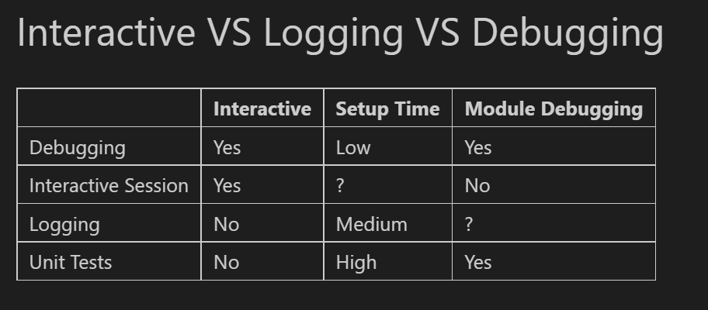
Why use the debugger?
It lets you interact with the code while running!
Shows you the status of variables.
Stop at the commands, specific lines or Variable updates you want.
Dive into a module context and other hard to reach contexts

Slide 9
Ways to Use the debugger?
PowerShell_ISE
Built in and ready to go
Hovering over variables shows value
highlights the step
VSCode
Built in but needs some configuration
  Attach
  Interactive
  Launch
Shows ALL variables
List and edit breakpoints
CommandLine
The most amount of control
Useful anywhere you can be interactive
  Wait-Debugger
  Set-PSBreakpoint
  Debug-Job
  Get-PSCallstack

Slide 10
How to use the debugger?
ISE and VSCode
LIVE DEMO!!
Notes:
#VSCode Demo
# Jypter Notebooks dont do well with Debug. Copy and paste this outside.
# Script with logic bug we need to step through
Set-Location "C:\Repos\PoshDebugging"
$Folders = Get-ChildItem -Recurse -Directory
Foreach ($FOlder in $Folders){
$Files = Get-ChildItem -Path $Folder.Fullanme
if ($Files.Extension.Where({$PSitem -Like '*PS*'}) -NE $Null){
Write-Output -InputObject "$Folder contains Powershell Files"
}
}

Slide 11

Tips and Tricks
Try Catch for finding Intermittent issues
  Try{YourCode}Catch{Wait-Debugger}
Conditional Triggers
Set-PSBreakpoint -Variable counter -Action {If ($Counter -eq 1){Break}}
Interactive warning
Set-PSBreakpoint -Variable 'Counter' -Action {Write-Warning -Message "Counter = $Counter"}
Notes:
# Easy Try Catch Demo
$Scriptblock = {
$Variable = 'test'
try{
Write-Error "testError" -Erroraction Stop
}Catch{
Wait-Debugger
}
Start-UDFSleep
}
invoke-command $Scriptblock
# Conditional Trigger
Set-PSBreakpoint -Variable 'Counter' -Action {if($Counter -eq 5){Wait-Debugger}}
$Counter = 2
$Counter = 5

Slide 12
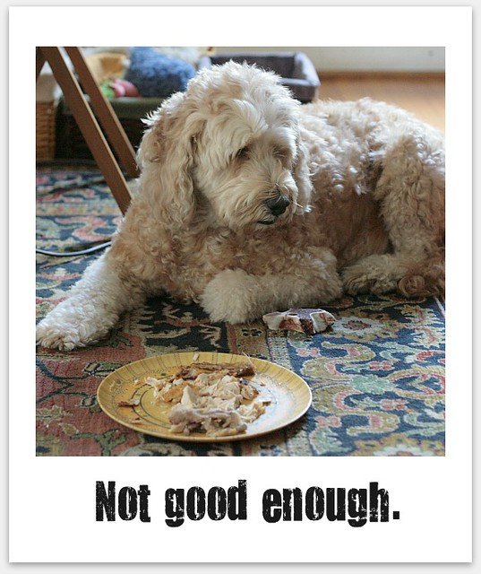
Remote Debugging
Useful when troubleshooting scripts running non-interactively.
Can debug on remote system.
Can debug processes running under different accounts like system.
Key Commands
Get-PSHostProcessInfo
Enter-PSHostProcess
get-Runspace
Debug-Runspace
This Photo by Unknown Author is licensed under CC BY
Notes:
# Easy Try Catch Demo
$Scriptblock = {
$Variable = 'test'
try{
Write-Error "testError" -Erroraction Stop
}Catch{
Wait-Debugger
}
Start-UDFSleep
}
invoke-command $Scriptblock
# Conditional Trigger
Set-PSBreakpoint -Variable 'Counter' -Action {if($Counter -eq 5){Wait-Debugger}}
$Counter = 2
$Counter = 5

Slide 13
Remote Debugging: Remote Scripts
LIVE DEMO!!
Notes:
$RunSpaceData = @{
Computername = $ENV:COMPUTERNAME
PID = $PID
RunSpace = [Runspace]::DefaultRunspace.id
}
Out-File -FilePath $FilePath -InputObject (Convertto-json $RunSpaceData)
#Wait
$Seconds = 300
For ($Counter = 0; $Counter -lt $Seconds; $Counter++){
Start-Sleep -Seconds 1
}
#Run from your IDE such as the ISE
# Entering The Runspace
whoami.exe
$FilePath = "C:\RunSpaceData.txt"
$Content = Get-Content -Path $FilePath -Raw
$RunSpaceData = ConvertFrom-Json -InputObject $content
If ($RunSpaceData.ComputerName -NE $ENV:COMPUTERNAME){
$PSSession = Enter-PSSession -ComputerName $RunSpaceData.ComputerName
Invoke-Command -ScriptBlock {Enter-PSHostProcess -ID $args} -ArgumentList $RunSpaceData.PID -Session $PSSession
"Debug-Runspace -id $($RunSpaceData.RunSpace)"|clip
}Else{
$RunSpaceData
Enter-PSHostProcess -ID $RunSpaceData.PID
#get-Runspace
"Debug-Runspace -ID $($RunSpaceData.RunSpace)"|clip
}
# ? or h for help

Slide 14

A few last Things
You must be an admin or the same user to enter the HostProcess
Holds the remote runspace up until you detach
Errors Easily. Be patient!
Integrated consoles are your friend
This Photo by Unknown Author is licensed under CC BY-SA-NC

Slide 15

Concerned?
You need to have admin access
This is hard to automate
Timing is super difficult
You can disable debugging
$Host.Runspace.Debugger.SetDebugMode([System.Management.Automation.DebugModes]::None)
This Photo by Unknown Author is licensed under CC BY
Notes:
$Host.Runspace.Debugger.SetDebugMode([System.Management.Automation.DebugModes]::None)

Slide 16
Q & A

