Slide 1
Module 16: Troubleshoot Static and Default Routes
Instructor Materials
Switching, Routing and Wireless Essentials v7.0 (SRWE)
Notes:
Cisco Networking Academy Program
Switching, Routing and Wireless Essentials v7.0 (SRWE)
Module 16: Troubleshoot Static and Default Routes

Slide 2
Module 16: Troubleshoot Static and Default Routes
Switching, Routing and Wireless Essentials v7.0 (SRWE)
Notes:
Cisco Networking Academy Program
Switching, Routing and Wireless Essentials v7.0 (SRWE)
Module 16: Troubleshoot Static and Default Routes

Slide 3
Module Objectives
Module Title: Troubleshoot Static and Default Routes
Module Objective: Troubleshoot static and default route configurations.
Topic Title | Topic Objective
Packet Processing with Static Routes | Explain how a router processes packets when a static route is configured.
Troubleshoot IPv4 Static and Default Route Configuration | Troubleshoot common static and default route configuration issues.
Notes:
3
16 – Troubleshoot Static and Default Routes
16.0 – Introduction
16.0.2 – What will I learn to do in this module?

Slide 4
16.1 Packet Processing with Static Routes
Notes:
16 – Troubleshoot Static and Default Routes
16.1 – Packet Processing with Static Routes

Slide 5
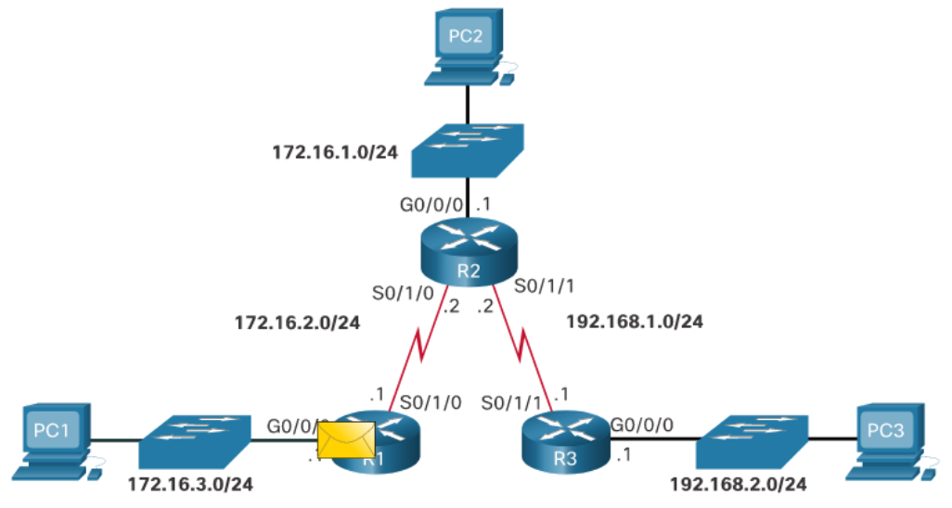
Packet Processing with Static Routes
Static Routes and Packet Forwarding
PC1 addresses a packet to PC3 and sends it to the default gateway address.
When the packet arrives on the R1 G0/0/0 interface, R1 decapsulates the packet and searches the routing table for a matching destination network entry.
If the destination IP address:
  Matches a static route entry, R1 will use the static route to identify the next-hop IP address or exit interface.
  Does not match a specific route to the destination network, then R1 will use the default static route (if configured).
  Does not match a route table entry, then R1 will drop the packet and send an ICMP message back to the source (i.e., PC1).
Notes:
16 – Troubleshoot Static and Default Routes
16.1 – Packet Processing with Static Routes
16.1.1 – Static Routes and Packet Forwarding

Slide 6
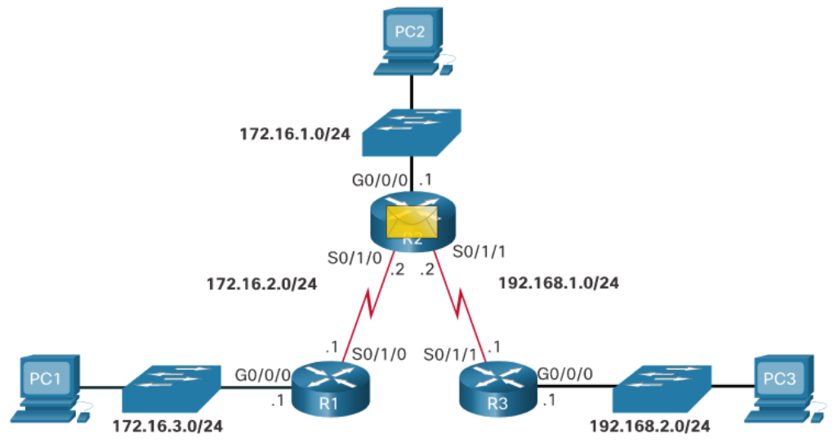
Packet Processing with Static Routes
Static Routes and Packet Forwarding (Cont.)
Assuming R1 matched a routing table entry, it encapsulates the packet in a new frame and forwards it out of interface S0/1/0 to R2.
R2 receives the packet on its S0/1/0 interface.
It decapsulates and processes the packet the same way R1 did.
When R2 finds a match in the routing table, it uses the identified next-hop IP address or exit interface and sends the packet out of its interface S0/1/1 towards R3.
Notes:
16 – Troubleshoot Static and Default Routes
16.1 – Packet Processing with Static Routes
16.1.1 – Static Routes and Packet Forwarding (Cont.)

Slide 7
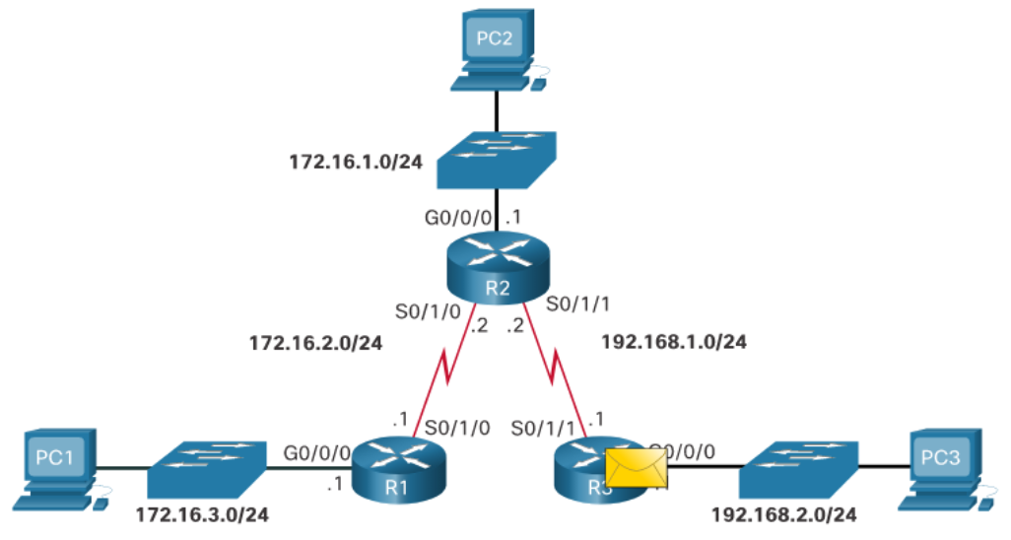
Packet Processing with Static Routes
Static Routes and Packet Forwarding (Cont.)
R3 receives the packet, decapsulates it, and searches the routing table for a match.
The destination IP address of PC3 matches the directly connected G0/0/0 interface. Therefore, R3 searches the ARP table for the Layer 2 MAC address of PC3.
If no ARP entry exists, then R3 sends an ARP request out of the G0/0/0 interface.
PC3 responds with an ARP reply containing its MAC address.
R3 encapsulates the packet in a new frame and uses the PC3 MAC address as the destination MAC address and the G0/0/0 MAC address as the source MAC address.
The frame is forwarded out of interface G0/0/0 and PC3 receives and processes it accordingly.
Notes:
16 – Troubleshoot Static and Default Routes
16.1 – Packet Processing with Static Routes
16.1.1 – Static Routes and Packet Forwarding (Cont.)
16.1.2 – Check Your Understanding - Packet Processing with Static Routes

Slide 8
16.2 Troubleshoot IPv4 Static and Default Route Configuration
Notes:
16 – Troubleshoot Static and Default Routes
16.2 – Troubleshoot IPv4 Static and Default Route Configuration

Slide 9
Troubleshoot IPv4 Static and Default Route Configuration
Network Changes
Networks fail for a number of reasons:
An interface can fail
A service provider drops a connection
Links can become oversaturated
An administrator may enter a wrong configuration.
Network administrators are responsible for pinpointing and solving the problem.
To efficiently find and solve these issues, it is advantageous to be intimately familiar with tools to help isolate routing problems quickly.
Notes:
16 – Troubleshoot Static and Default Routes
16.2 – Troubleshoot IPv4 Static and Default Route Configuration
16.2.1 – Network Changes

Slide 10
Troubleshoot IPv4 Static and Default Route Configuration
Common Troubleshooting Commands
Command | Description
ping | Verify Layer 3 connectivity to destination. Extended pings provide additional options.
traceroute | Verify path to destination network. It uses ICMP echo reply messages to determine the hops to the destination.
show ip route | Displays the routing table. Used to verify route entries for destination IP addresses.
show ip interface brief | Displays the status of device interfaces. Used to verify the operational status and IP address of an interface.
show cdp neighbors | Displays a list of directly connected Cisco devices. Also used to validate Layer 1 and 2 connectivity.
Notes:
16 – Troubleshoot Static and Default Routes
16.2 – Troubleshoot IPv4 Static and Default Route Configuration
16.2.2 – Common Troubleshooting Commands

Slide 11
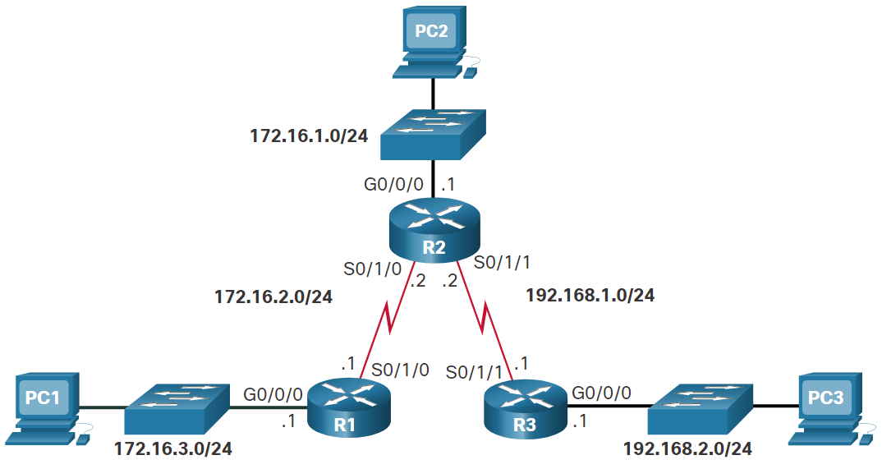
Troubleshoot IPv4 Static and Default Route Configuration
Solve a Connectivity Problem
Connectivity from PC1 to PC3 fails.
Extended pings from the R1 G0/0/0 interface to PC3 fail.
Pings from R1 (i.e., S0/1/0 interface) to R2 are successful.
Pings from R1 (i.e., S0/1/0 interface) to R3 are successful.
R2 routing table reveals the problem and the incorrect static route is removed.
A new static route solves the problem.
  ip route 172.16.3.0 255.255.255.0 172.16.2.1
R2# show ip route | begin Gateway
Gateway of last resort is not set
172.16.0.0/16 is variably subnetted, 5 subnets, 2 masks
C 172.16.1.0/24 is directly connected, GigabitEthernet0/0/0
L 172.16.1.1/32 is directly connected, GigabitEthernet0/0/0
C 172.16.2.0/24 is directly connected, Serial0/l/0
L 172.16.2.2/32 is directly connected, Serial0/l/0
S 172.16.3.0/24 [1/0] via 192.168.1.1
192.168.1.0/24 is variably subnetted, 2 subnets, 2 masks
C 192.168.1.0/24 is directly connected, Serial0/1/1
L 192.168.1.2/32 is directly connected, Serial0/1/1
S 192.168.2.0/24 [1/0] via 192.168.1.1
R2#
Notes:
16 – Troubleshoot Static and Default Routes
16.2 – Troubleshoot IPv4 Static and Default Route Configuration
16.2.3 –Solve a Connectivity Problem
16.2.4 – Syntax Checker - Troubleshoot IPv4 Static and Default Routes

Slide 12
16.3 Module Practice and Quiz
Notes:
16 – Troubleshoot Static and Default Routes
16.3 - Module Practice and Quiz

Slide 13
Structured Design
Packet Tracer – Troubleshoot Static and Default Routes
In this activity you will troubleshoot and static and default routes and repair any errors that you find.
  Troubleshoot IPv4 static routes.
  Troubleshoot IPv6 static routes.
  Configure IPv4 static routes.
  Configure IPv4 default routes.
  Configure IPv6 static routes.
Notes:
16 – Troubleshoot Static and Default Routes
16.3 - Module Practice and Quiz
16.3.1 – Packet Tracer – Troubleshoot Static and Default Routes

Slide 14
Structured Design
Lab - Troubleshoot Static and Default Routes
In this lab, you will complete the following objectives:
  Evaluate Network Operation.
  Gather information, create an action plan, and implement corrections.
Notes:
16 – Troubleshoot Static and Default Routes
16.3 - Module Practice and Quiz
16.3.2 – Lab - Troubleshoot Static and Default Routes

Slide 15
Module Practice and Quiz
What did I learn in this module?
A host sends a packet to another host and sends it to the default gateway address.
When the packet arrives on a router interface, it decapsulates the packet and searches the routing table for a matching destination network entry.
If the destination IP address:
  Matches a static route entry, the router will use the static route to identify the next hop IP address or exit interface.
  Does not match a specific route to the destination network, then the router will use the default static route (if configured).
  Does not match a route table entry, then the router will drop the packet and send an ICMP message back to the source.
If the router matched a routing table entry, then the router encapsulates the packet and forwards it out of the appropriate interface.
The packet is forwarded from router to router until it reaches its destination network.
Notes:
16 – Troubleshoot Static and Default Routes
16.3 - Module Practice and Quiz
16.3.3 – What did I learn in this module?

Slide 16
Module Practice and Quiz
What did I learn in this module? (Cont.)
When the packet reaches the destination network, that router will search the routing table for a match.
When the destination IP address matches a directly connected Ethernet interface, the router searches the ARP table for the Layer 2 MAC address of the destination IP address.
If no ARP entry exists, the router sends an ARP request out of the Ethernet interface
The destination host responds with an ARP reply containing its MAC address.
The router then encapsulates the packet in a new frame. It uses the MAC address of the destination host as the frame destination MAC address, and the MAC address of the router Ethernet interface as the source MAC address in the frame.
The frame is forwarded out of the appropriate interface.
The packet arrives on the network interface card (NIC) interface of destination host and is processed accordingly.
Notes:
16 – Troubleshoot Static and Default Routes
16.3 - Module Practice and Quiz
16.3.3 – What did I learn in this module? (Cont.)

Slide 17
Module Practice and Quiz
What did I learn in this module? (Cont.)
Common IOS troubleshooting commands to troubleshoot IPv4 Static and default routes include:
ping
traceroute
show ip route
show ip interface brief
show cdp neighbors detail
Notes:
16 – Troubleshoot Static and Default Routes
16.3 - Module Practice and Quiz
16.3.3 – What did I learn in this module? (Cont.)
16.3.4 – Module Quiz – Troubleshoot Static and Default Routes

