Slide 1
Chapter 8:
Implementing Virtual Private Networks
CCNA Security v2.0
Daniel Valente
Fev 2016

Slide 2
Chapter Outline
8.0 Introduction
8.1 VPNs
8.2 IPsec VPN Components and Operations
8.3 Implementing Site-to-Site IPsec VPNs with CLI
8.4 Summary

Slide 3
Section 8.1:
VPNs
Upon completion of this section, you should be able to:
Describe VPNs and their benefits.
Compare site-to-site and remote-access VPNs.

Slide 4
Topic 8.1.1:
VPN Overview

Slide 5
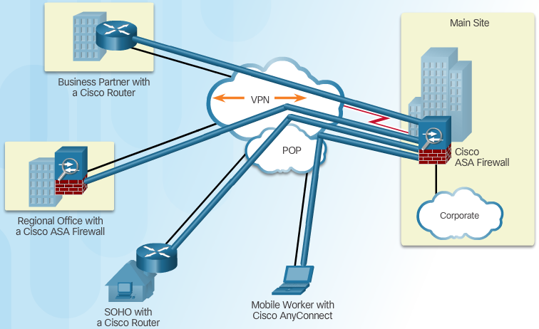
Introducing VPNs
VPN Benefits:
Cost Savings
Security
Scalability
Compatibility
Notes:
8.1.1.1 Introducing VPNs

Slide 6
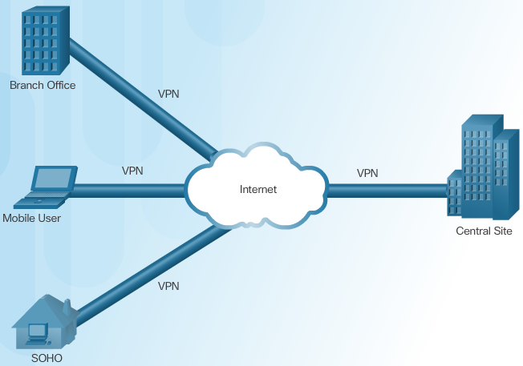
Layer 3 IPsec VPNs
Notes:
8.1.1.2 Layer 3 IPsec VPNs

Slide 7
Topic 8.1.2:
VPN Technologies

Slide 8
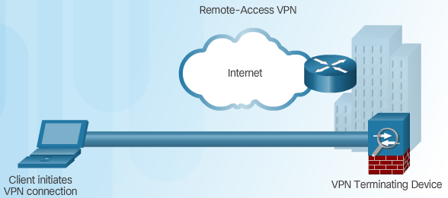
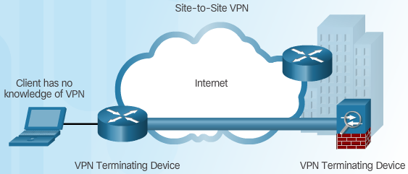
Two Types of VPNs
Remote-Access VPN
Site-to-Site VPN Access
Notes:
8.1.2.1 Two Types of VPNs

Slide 9
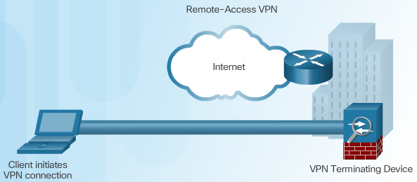
Components of Remote-Access VPNs
Notes:
8.1.2.2 Components of Remote-Access VPNs

Slide 10

Components of Site-to-Site VPNs
Notes:
8.1.2.3 Components of Site-to-Site VPNs
8.1.2.4 Activity – Compare Remote-Access and Site-to-Site VPNs

Slide 11
Section 8.2:
IPsec VPN Components and Operation
Upon completion of this section, you should be able to:
Describe the IPsec protocol and its basic functions.
Compare AH and ESP protocols.
Describe the IKE protocol.

Slide 12
Topic 8.2.1:
Introducing IPsec

Slide 13
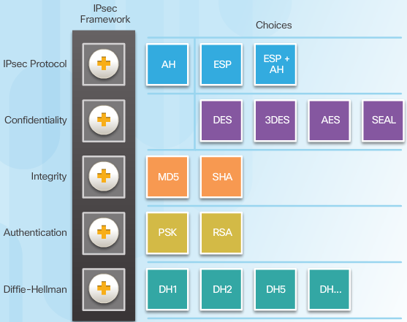
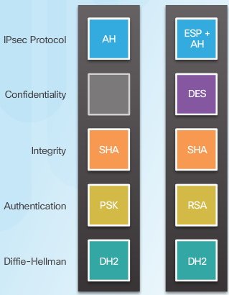
IPsec Technologies
IPsec Implementation Examples
IPsec Framework
Notes:
8.2.1.1 IPsec Technologies

Slide 14
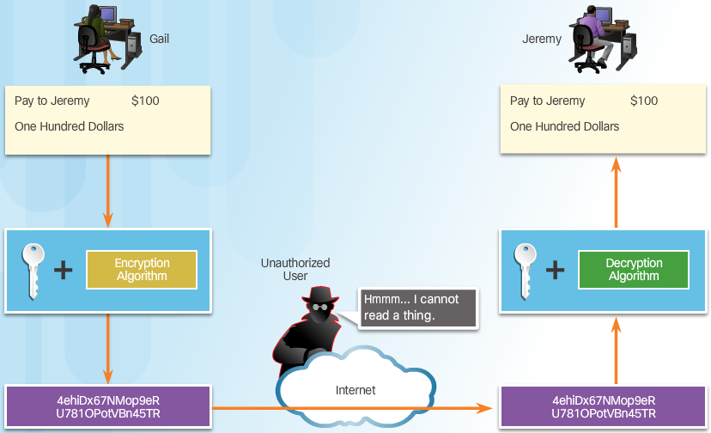
Confidentiality
Confidentiality with Encryption:
Notes:
8.2.1.2 Confidentiality

Slide 15
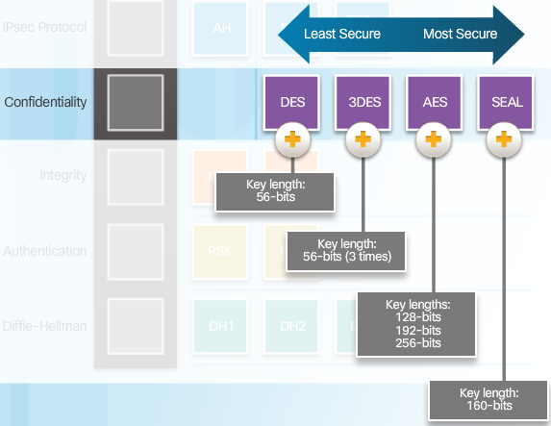
Confidentiality (Cont.)
Encryption Algorithms:
Notes:
8.2.1.2 Confidentiality (Cont.)

Slide 16
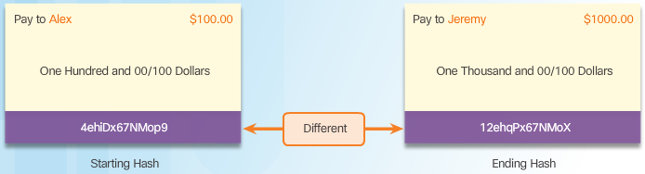
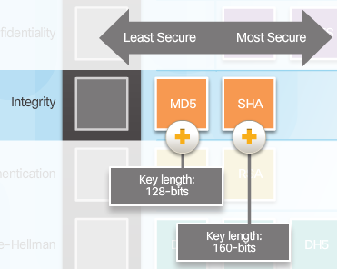
Integrity
Hash Algorithms
Security of Hash Algorithms
Notes:
8.2.1.3 Integrity

Slide 17
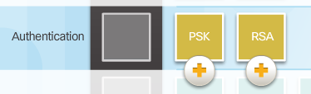
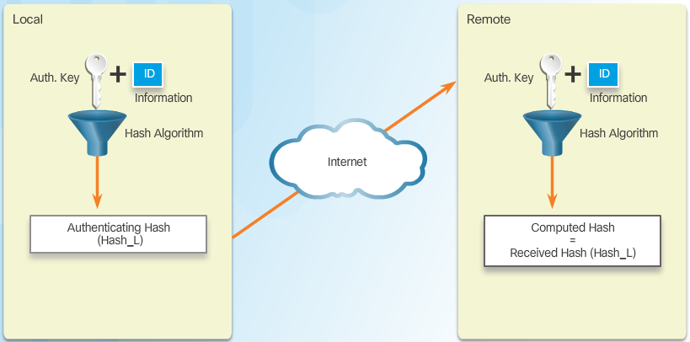
Authentication
Peer Authentication Methods
PSK
Notes:
8.2.1.4 Authentication

Slide 18
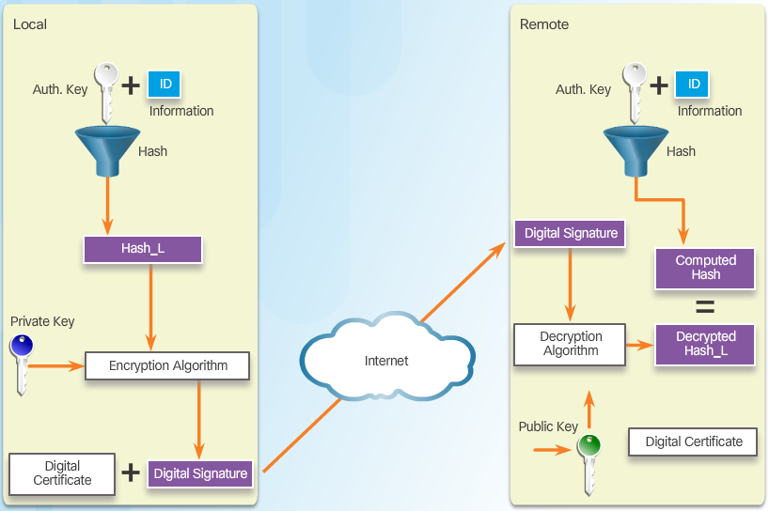
Authentication (Cont.)
RSA
Notes:
8.2.1.4 Authentication (Cont.)

Slide 19
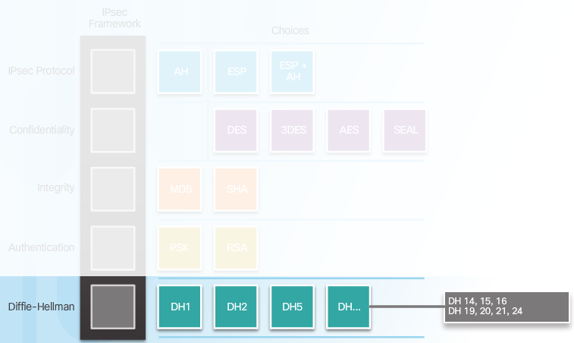
Secure Key Exchange
Diffie-Hellman Key Exchange
Notes:
http://www.watchguard.com/help/docs/wsm/xtm_11/en-US/index.html#cshid=en-US/bovpn/manual/diffie_hellman_c.html
Diffie-Hellman (DH) groups determine the strength of the key used in the key exchange process. Higher group numbers are more secure, but require additional time to compute the key.
DH Group 1: 768-bit group
DH Group 2: 1024-bit group
DH Group 5: 1536-bit group

Slide 20
Topic 8.2.2:
IPsec Protocols

Slide 21
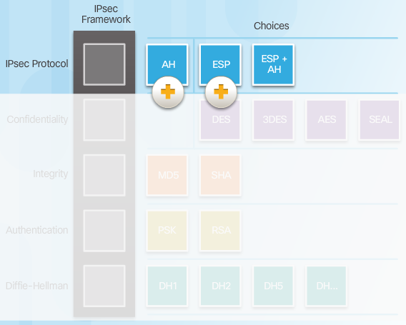
IPsec Protocol Overview
Notes:
8.2.2.1 IPsec Protocol Overview

Slide 22
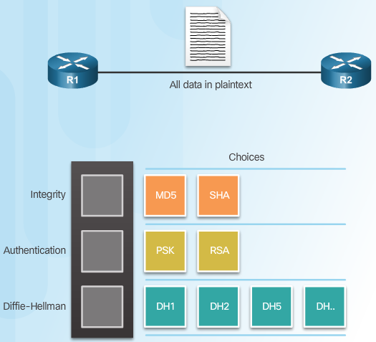
Authentication Header
AH Protocols
Notes:
8.2.2.2 Authentication Header

Slide 23
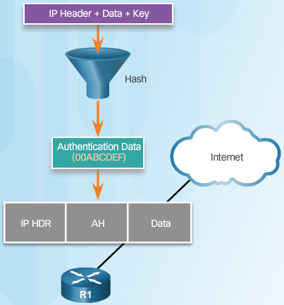
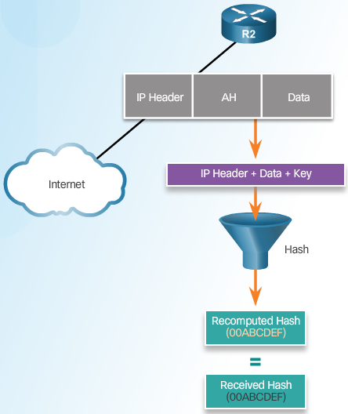
Authentication Header (Cont.)
Router Creates Hash and Transmits to Peer
Peer Router Compares Recomputed Hash to Received Hash
Notes:
8.2.2.2 Authentication Header (Cont.)

Slide 24
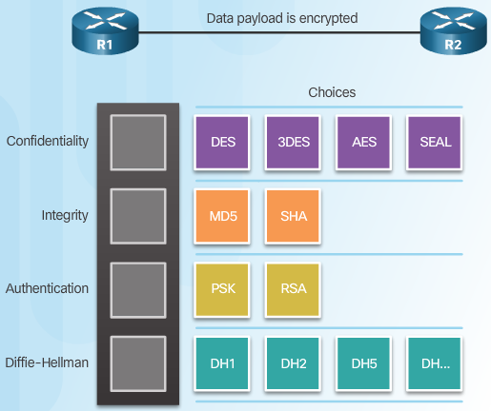
ESP (Encapsulation Security Payload)
Notes:
8.2.2.3 ESP

Slide 25
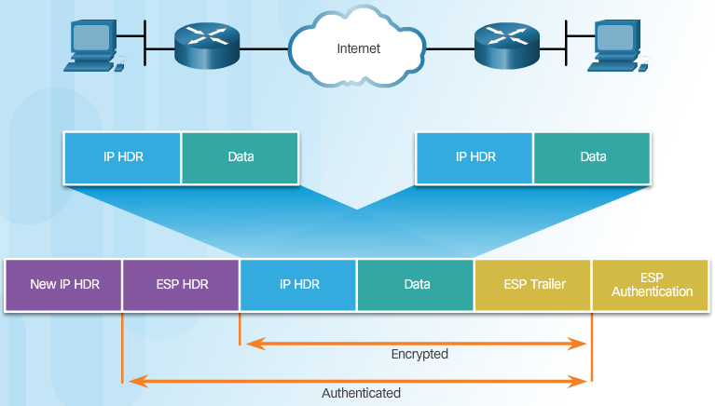
ESP Encrypts and Authenticates
Notes:
8.2.2.4 ESP Encrypts and Authenticates

Slide 26
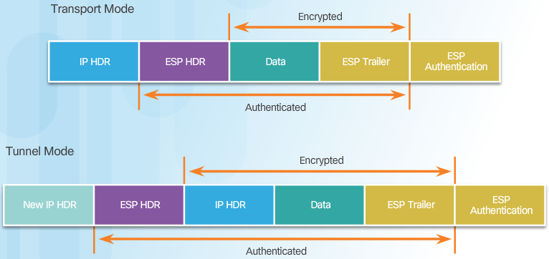
Transport and Tunnel Modes
Apply ESP and AH in Two Modes
Notes:
Transport mode provides the protection of our data, also known as IP Payload, and consists of TCP/UDP header + Data, through an AH or ESP header. The payload is encapsulated by the IPSec headers and trailers. The original IP headers remain intact, except that the IP protocol field is changed to ESP (50) or AH (51), and the original protocol value is saved in the IPsec trailer to be restored when the packet is decrypted.
IPSec transport mode is usually used when another tunneling protocol (like GRE) is used to first encapsulate the IP data packet, then IPSec is used to protect the GRE tunnel packets. IPSec protects the GRE tunnel traffic in transport mode.

Slide 27
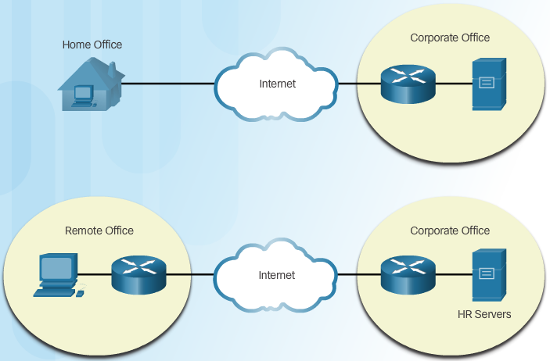
Transport and Tunnel Modes (Cont.)
ESP Tunnel Mode
Notes:
8.2.2.5 Transport and Tunnel Modes (Cont.)
8.2.2.6 Activity – Compare AH and ESP

Slide 28
Topic 8.2.3:
Internet Key Exchange

Slide 29
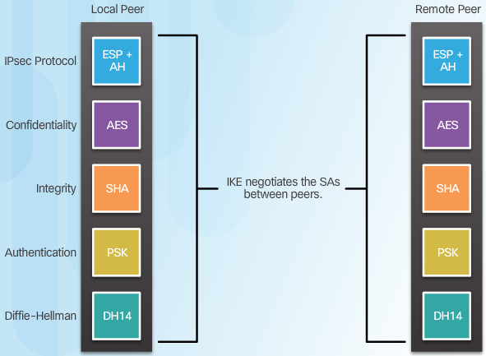
The IKE Protocol
Notes:
8.2.3.1 The IKE Protocol

Slide 30
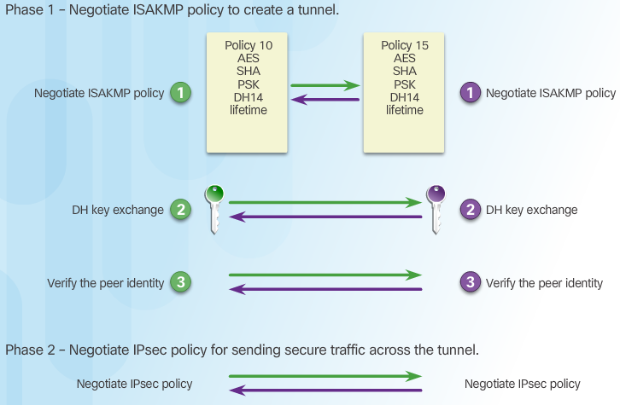
Phase 1 and 2 Key Negotiation
Notes:
ISAKMP - Internet Security Association and Key Management Protocol

Slide 31
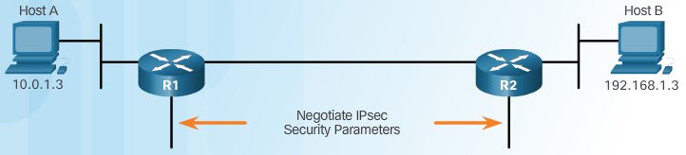
Phase 2: Negotiating SAs
Notes:
8.2.3.3 Phase 2: Negotiating Sas
8.2.3.4 Video Tutorial – IKE Phase 1 and Phase 2

Slide 32
Section 8.3:
Implementing Site-to-Site IPsec VPNs with CLI
Upon completion of this section, you should be able to:
Describe IPsec negotiation and the five steps of IPsec configuration.
Configure the ISAKMP policy.
Configure the IPsec policy.
Configure and apply a crypto map.
Verify the IPsec VPN.

Slide 33
Topic 8.3.1:
Configuring a Site-to-Site IPsec VPN

Slide 34
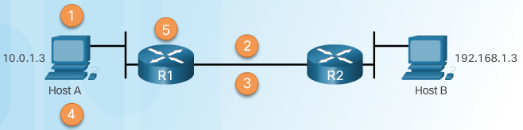
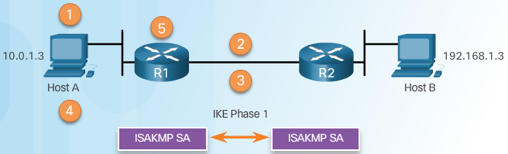
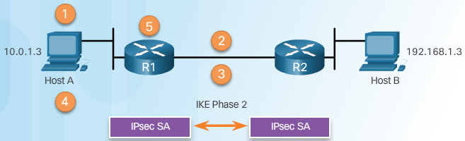
IPsec Negotiation
IPsec VPN Negotiation: Step 1 - Host A sends interesting traffic to Host B.
IPsec VPN Negotiation: Step 2 - R1 and R2 negotiate an IKE Phase 1 session.
IPsec VPN Negotiation: Step 3 - R1 and R2 negotiate an IKE Phase 2 session.
Notes:
8.3.1.1 IPsec Negotiation

Slide 35
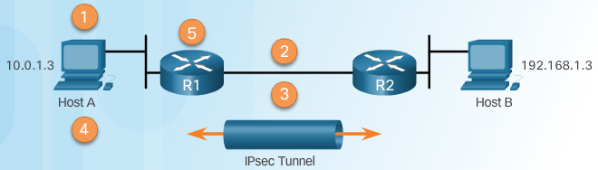
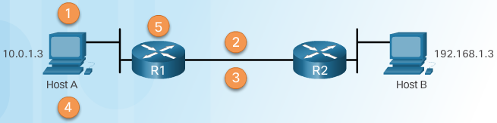
IPsec Negotiation (Cont.)
IPsec VPN Negotiation: Step 4 - Information is exchanged via IPsec tunnel.
IPsec VPN Negotiation: Step 5 - The IPsec tunnel is terminated.
Notes:
8.3.1.1 IPsec Negotiation (Cont.)

Slide 36
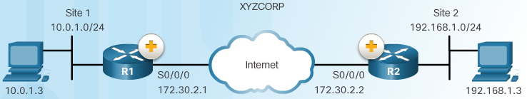
Site-to-Site IPsec VPN Topology
Notes:
8.3.1.2 Site-to-Site IPsec VPN Topology

Slide 37
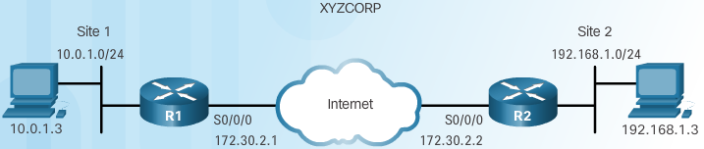
IPsec VPN Configuration Tasks
XYZCORP Security Policy | Configuration Tasks
Encrypt traffic with AES 256 and SHA | 1. Configure the ISAKMP policy for IKE Phase 1
Authentication with PSK | 2. Configure the IPsec policy for IKE Phase 2
Exchange keys with group 24 | 3. Configure the crypto map for IPsec policy
ISAKMP tunnel lifetime is 1 hour | 4. Apply the IPsec policy
IPsec tunnel uses ESP with a 15-min. lifetime | 5. Verify the IPsec tunnel is operational
Notes:
8.3.1.3 IPsec VPN Configuration Tasks

Slide 38
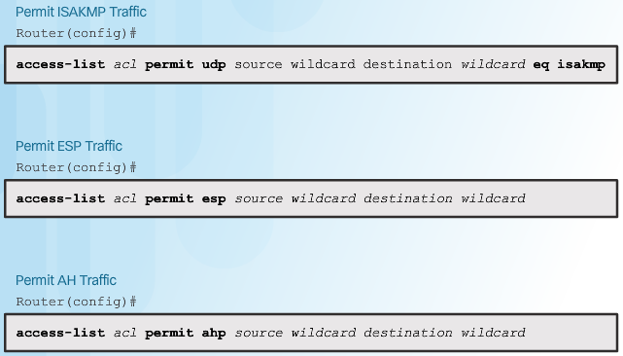
Existing ACL Configurations
ACL Syntax for IPsec Traffic
Notes:
8.3.1.4 Existing ACL Configurations

Slide 39
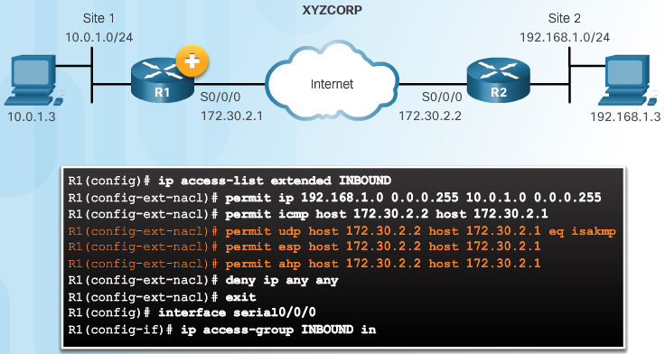
Existing ACL Configurations (Cont.)
Permitting Traffic for IPsec Negotiations
Notes:
8.3.1.4 Existing ACL Configurations (Cont.)

Slide 40
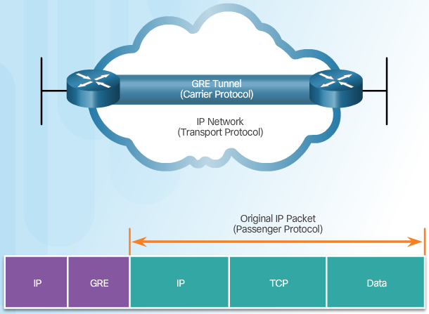
Introduction to GRE Tunnels
Notes:
8.3.1.5 Introduction to GRE Tunnels
8.3.1.6 Activity – Order the IPsec Negotiation Steps

Slide 41
Topic 8.3.2:
ISAKMP Policy

Slide 42
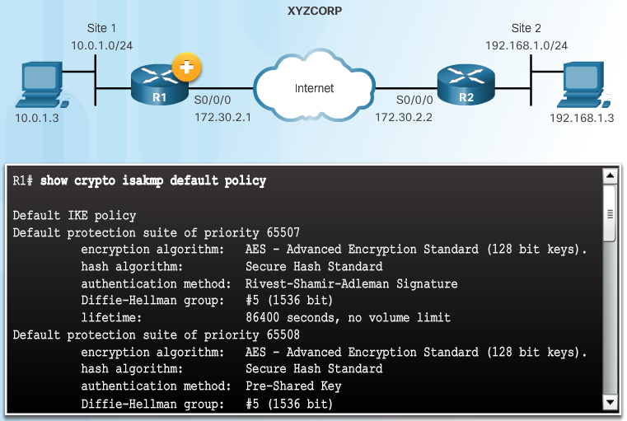
The Default ISAKMP Policies
Notes:
8.3.2.1 The Default ISAKMP Policies

Slide 43
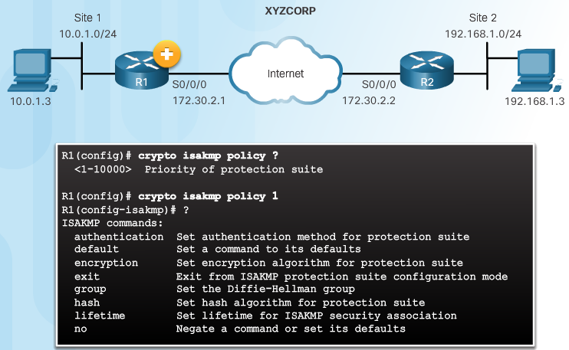
Syntax to Configure a New ISAKMP Policy
Notes:
8.3.2.2 Syntax to Configure a New ISAKMP Policy

Slide 44
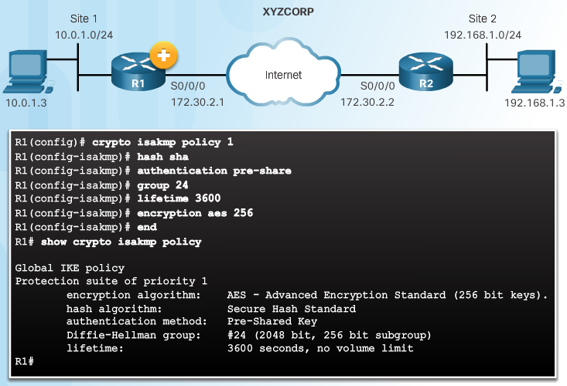
XYZCORP ISAKMP Policy Configuration
Notes:
8.3.2.3 XYZCORP ISAKMP Policy Configuration

Slide 45
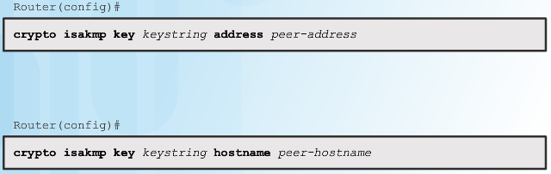
Configuring a Pre-Shared Key
The crypto isakmp key Command
Notes:
8.3.2.4 Configuring a Pre-Shared Key

Slide 46
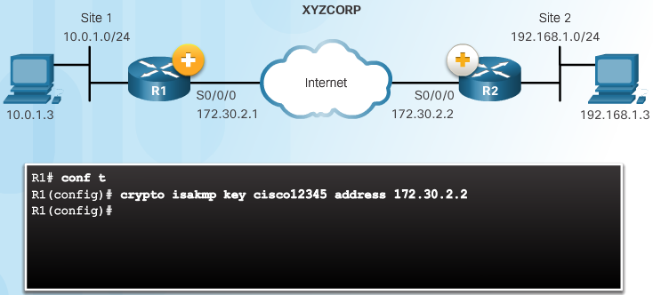
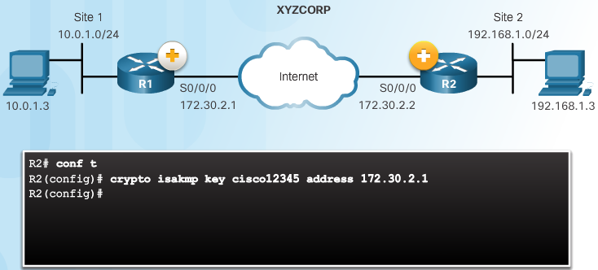
Configuring a Pre-Shared Key (Cont.)
Pre-Shared Key Configuration
Notes:
8.3.2.4 Configuring a Pre-shared Key (Cont.)

Slide 47
Topic 8.3.3:
IPsec Policy

Slide 48
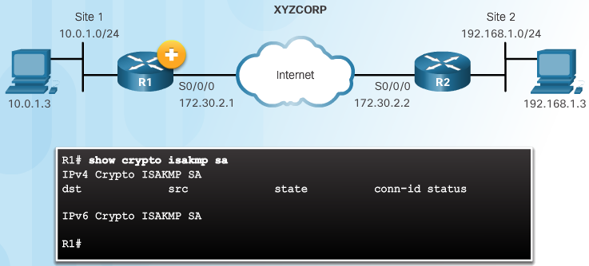
Define Interesting Traffic
The IKE Phase 1 Tunnel Does Not Exist Yet
Notes:
8.3.3.1 Define Interesting Traffic

Slide 49
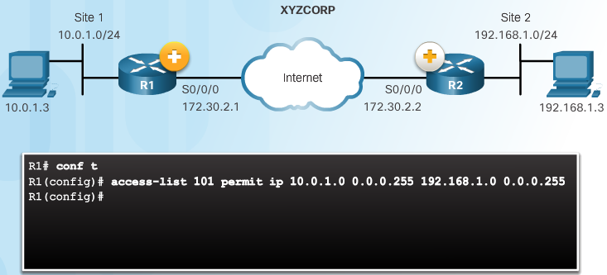
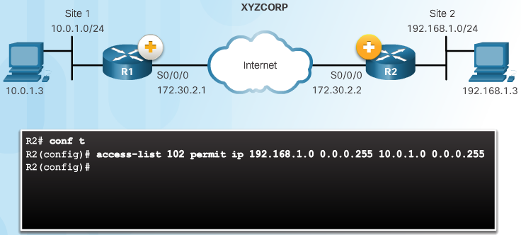
Define Interesting Traffic (Cont.)
Configure an ACL to Define Interesting Traffic
Notes:
8.3.3.1 Define Interesting Traffic (Cont.)

Slide 50
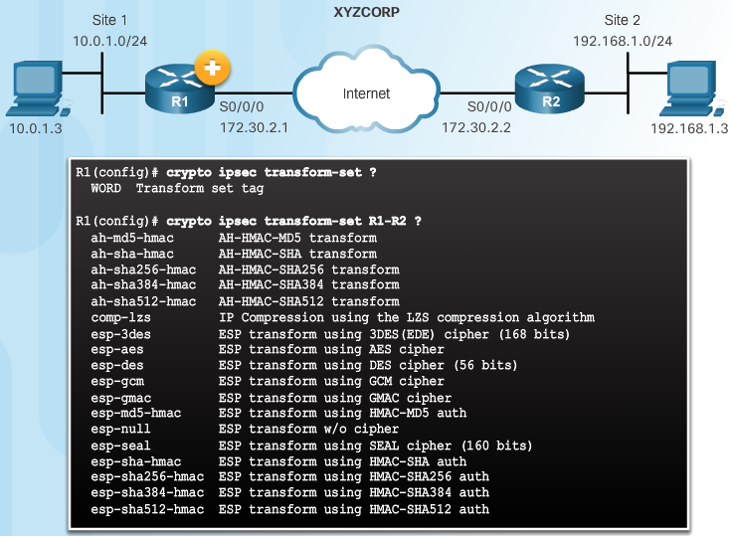
Configure IPsec Transform Set
The crypto ipsec transform-set Command
Notes:
8.3.3.2 Configure IPsec Transform Set

Slide 51
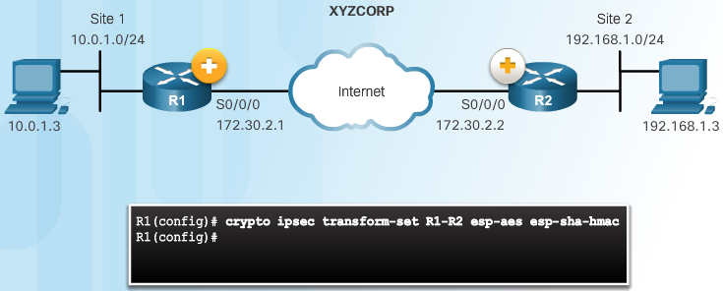
Configure IPsec Transform Set (Cont.)
The crypto ipsec transform-set Command
Notes:
8.3.3.2 Configure IPsec Transform Set (Cont.)

Slide 52
Topic 8.3.4:
Crypto Map

Slide 53
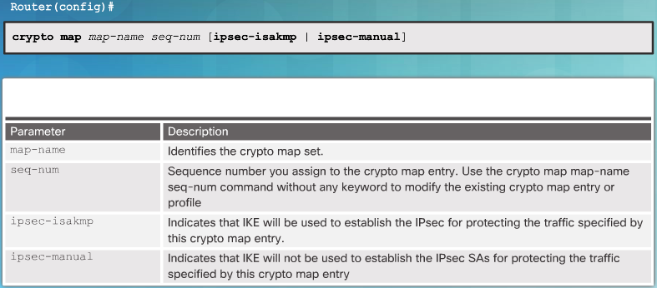
Syntax to Configure a Crypto Map
Notes:
8.3.4.1 Syntax to Configure a Crypto Map

Slide 54
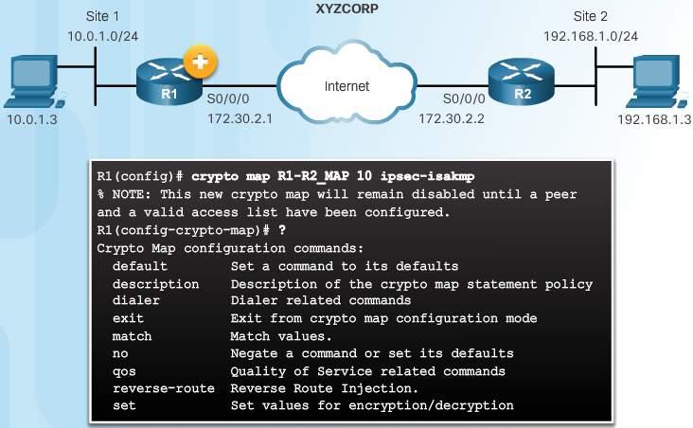
Syntax to Configure a Crypto Map (Cont.)
Crypto Map Configuration Commands
Notes:
8.3.4.1 Syntax to Configure a Crypto Map (Cont.)

Slide 55
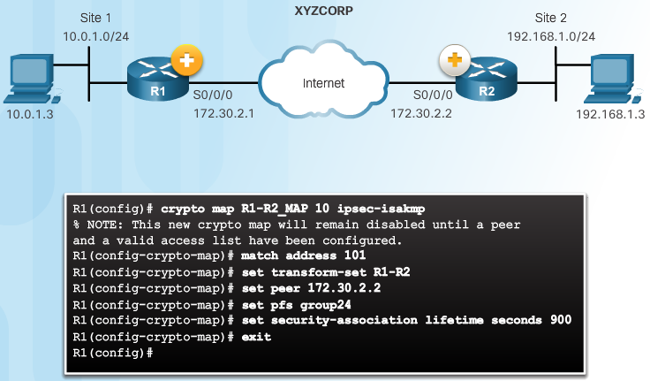

XYZCORP Crypto Map Configuration
Crypto Map Configuration:
Notes:
8.3.4.2 XYZCORP Crypto Map Configuration

Slide 56

XYZCORP Crypto Map Configuration (Cont.)
Crypto Map Configuration:
Notes:
8.3.4.2 XYZCORP Crypto Map Configuration (Cont.)

Slide 57

Apply the Crypto Map
Notes:
8.3.4.3 Apply the Crypto Map

Slide 58
Topic 8.3.5:
IPsec VPN

Slide 59

Send Interesting Traffic
Use Extended Ping to Send Interesting Traffic
Notes:
8.3.5.1 Send Interesting Traffic
8.3.5.2 Verify ISAKMP and IPsec Tunnels

Slide 60

Verify ISAKMP and IPsec Tunnels
Verify the ISAKMP Tunnel is Established
Notes:
8.3.5.2 Verify ISAKMP and IPsec Tunnels

Slide 61

Verify ISAKMP and IPsec Tunnels (Cont.)
Verify the IPsec Tunnel is Established
Notes:
8.3.5.2 Verify ISAKMP and IPsec Tunnels (Cont.)

Slide 62
Section 8.4:
Summary
Chapter Objectives:
Explain the purpose of VPNs.
Explain how IPsec VPNs operate.
Configure a site-to-site IPsec VPN, with pre-shared key authentication,
using the CLI.
Notes:
8.4.1.1 Video Demonstration – Site-to-Site IPsec VPN Configuration
8.4.1.2 Packet Tracer – Configure and Verify a Site-to-Site IPsec VPN
8.4.1.3 Lab – Configuring a Site-to-Site VPN
8.4.1.4 Chapter 8: Implementing Virtual Private Networks

