Slide 2
PowerCLI 101 Getting Started with the Shell

Slide 3
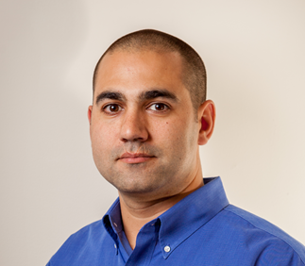
Justin P. Sider
Chief Information Officer – Belay Technologies
https://belaytech.com
Personal Blog
https://invoke-automation.blog
Github
https://github.com/jpsider
Twitter (X)/Slack
Jpsider
Vmware Community
vExpert, VMUG Leader, Code Coach, VMUG BOD (2024
Husband
Father
Golfer
Soccer Referee

Slide 4
Agenda
Basic PowerShell Concepts
Installing PowerCLI
Connecting to a vCenter
Getting data from vCenter
PowerShell things
Objects
Pipeline
Comment based help
Toggling the PowerState
The Demo Environment
Live Demo & VMware code Website

Slide 5
PowerShell Basics
Verb-Noun
Examples:
Get-Process
Stop-Process
Write-Output
Approved Verbs
Get-Verb
Comments
#Comments

Slide 6
Installing PowerCLI Module
The PowerShell Gallery
Commands:
Get-PSRepository
Find-Module –Name VMware.PowerCLI
Install-Module –Name VMware.PowerCLI
Import-Module –Name VMware.PowerCLI
Get-Command –Module VMware.PowerCLI

Slide 7
Connect to a vCenter
Commands:
Connect-VIServer –name myvcenter –Username “administrator” –Password “VMware1!”
$global:DefaultVIServer

Slide 8
Getting Data from vCenter
Verb-Noun
Get-VM
Get-VMHost
Get-Cluster
Get-DataStore
Get-Snapshot

Slide 9
PowerShell Things
Objects
Arrays vs. Hashtables
Pipeline
Comment Based Help

Slide 10
Objects

Slide 11
Arrays vs. Hashtables
Objects
Arrays vs. Hashtables
Pipeline
Comment Based Help

Slide 12
Pipeline

Slide 13
Comment Based Help
Objects
Arrays vs. Hashtables
Pipeline
Comment Based Help

Slide 14
Toggling the PowerState

Slide 15
The Demo Environment
Objects
Arrays vs. Hashtables
Pipeline
Comment Based Help

Slide 16
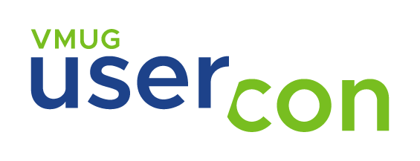



Thank you!
Where to get help:
VMware {Code} Slack
VMNT Community

