Slide 2
PowerCLI 101 Getting Started with the Shell

Slide 3
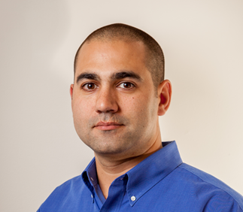
Justin P. Sider
Chief Information Officer – Belay Technologies
https://belaytech.com
Personal Blog
https://invoke-automation.blog
Github
https://github.com/jpsider
Twitter (X)/Slack
Jpsider
Vmware Community
vExpert, VMUG Leader, Code Coach, VMUG BOD (2024
Husband
Father
Golfer
Soccer Referee

Slide 4
Agenda
Basic PowerShell Concepts
Installing PowerCLI
Connecting to a vCenter
Getting data from vCenter
PowerShell things
Objects
Pipeline
Comment based help
Toggling the PowerState
The Demo Environment
Live Demo & VMware code Website

Slide 7
In this session we will head back to the basics to give users an indepth overview on how to get
started with PowerCLI. It will cover installing the module, connecting to a vSphere instance, and simple
tasks such as toggling the Virtual machine powerstate. Additional topics will include; understanding the
PowerShell Pipeline, Using an IDE (integrated development environment), and how to navigate the VMware
Code website.

Slide 8
