Slide 2
PowerCLI 101 Getting Started with the Shell

Slide 3
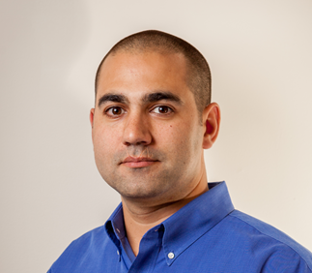
Justin P. Sider
Chief Information Officer – Belay Technologies
https://belaytech.com
Personal Blog
https://invoke-automation.blog
GitHub
https://github.com/jpsider
Twitter (X)/Slack
jpsider
VMware Community
vExpert, VMUG Co-Leader, Code Coach, VMUG BOD (2024)
Husband
Father
Golfer
Soccer Referee

Slide 4
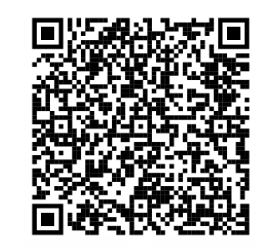
Agenda
Basic PowerShell Concepts
Installing PowerCLI
Connecting to a vCenter
Getting data from vCenter
PowerShell things
Toggling the PowerState
The Demo Environment
Live Demo & VMware code Website
Today’s Code and presentation

Slide 5
Takeaways
PowerShell basics
Getting Started with PowerCLI
Where to go for help or assistance
Today’s Code and presentation

Slide 6
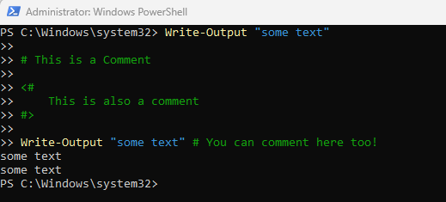
PowerShell Basics
Verb-Noun (Functions)
Examples:
Get-Process
Write-Output
Approved Verbs
Get-Verb
Comments
#Comments

Slide 7
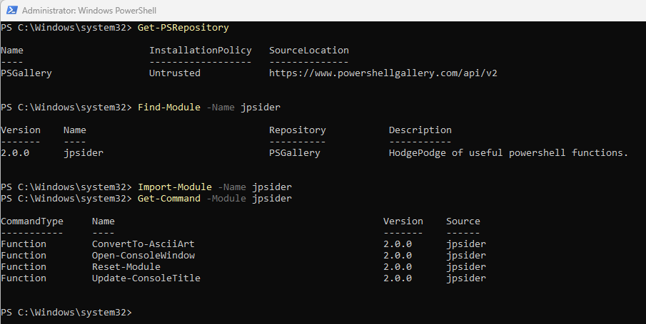
Installing PowerCLI Module
The PowerShell Gallery
Get-PSRepository
Find-Module –Name VMware.PowerCLI
Install-Module –Name VMware.PowerCLI
Import-Module –Name VMware.PowerCLI
Get-Command –Module jpsider
Save-Module –Name jpsider –Path c:\temp

Slide 8
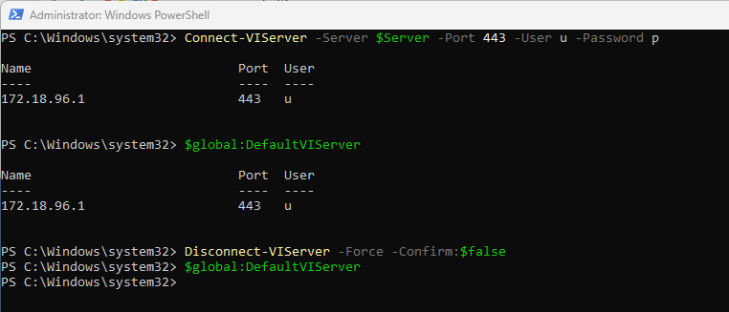
Connect to a vCenter
Commands:
Connect-VIServer –name myvcenter –Username “administrator” –Password “VMware1!”
$global:DefaultVIServer
Disconnect-VIServer –Force –Confirm:$false

Slide 9
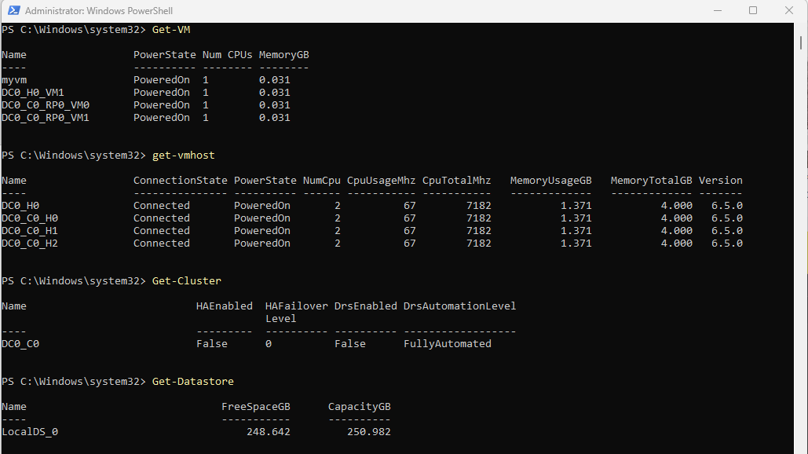
Getting Data from vCenter
Verb-Noun
Get-VM
Get-VMHost
Get-Cluster
Get-DataStore

Slide 10
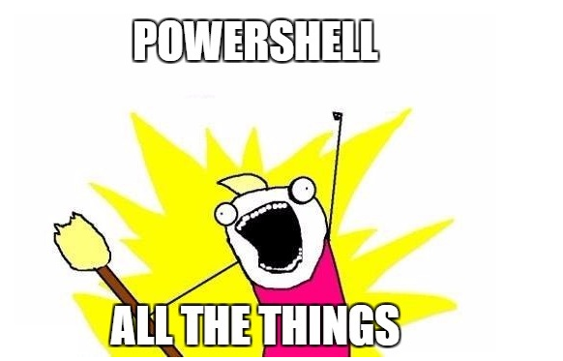
PowerShell Things
Functions & Parameters
Objects
Pipeline
Comment Based Help

Slide 11
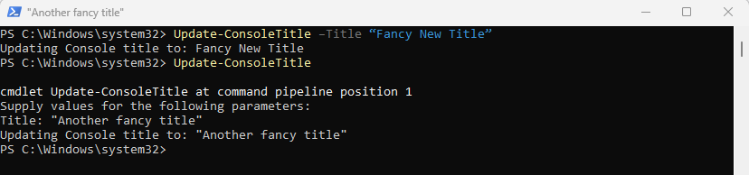
Functions & Parameters
<Function Name> <Parameter name> <Parameter Value>
Get-VM -Name “myvm”
<Function Name> <Parameter name> <Parameter Value>
Update-ConsoleTitle –Title “Fancy New Title”
If a Parameter is required – PowerShell will ask you
for it!

Slide 12

Objects
An object, then, is a collection of data that represents an item.
An object is made up of three types of data: the object type, its methods, and its properties.
$vm = Get-VM "myvm"
Get-Member -InputObject $vm
$vmlist = Get-VM
Get-Member -InputObject $vmlist

Slide 13
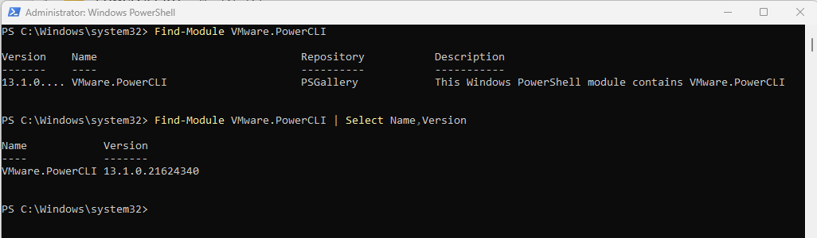
The PowerShell Pipeline
The PowerShell pipeline allows you to chain together commands to build a single ‘pipeline’ which simplifies code and allows parallel processing.
Get-VM | Select-Object –Property Name
Get-VM | Where-Object {$_.Name –like “*myvm*”}
Find-Module –Name VMware.PowerCLI
Find-Module VMware.PowerCLI | Select-Object Name,Version
The input to a command must accept the output of the previous command.

Slide 14
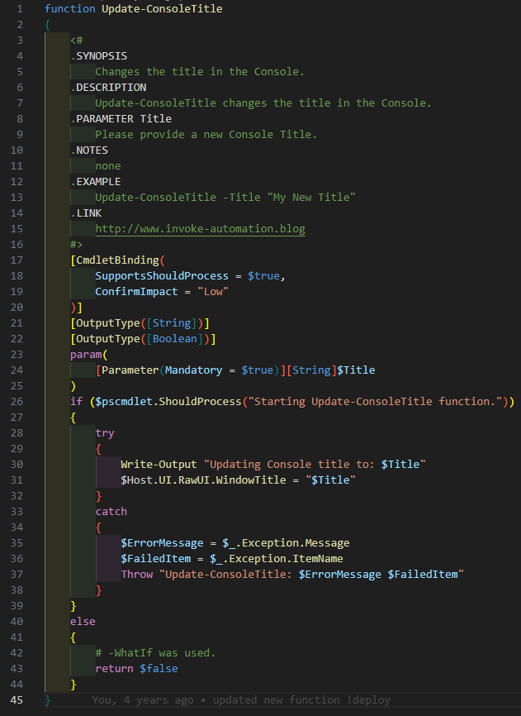
Comment Based Help
Get-Help Get-VM –Full
Get-Help Update-ConsoleTitle -Full

Slide 15
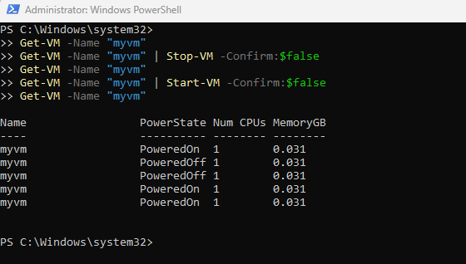
Toggling the PowerState
Get-VM -Name "myvm"
Get-VM -Name "myvm" | Stop-VM -Confirm:$false
Get-VM -Name "myvm" | Start-VM -Confirm:$false
Get-VM -Name "myvm"

Slide 16
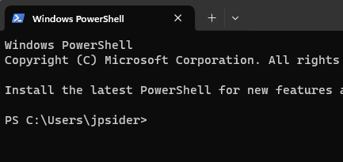
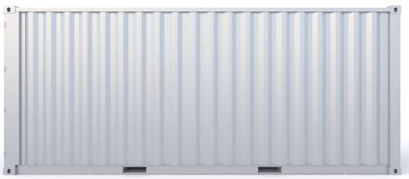
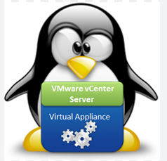

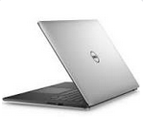
The Demo Environment

Slide 17
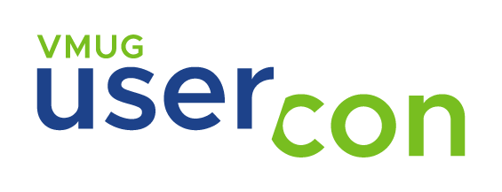



Thank you!
Today’s Code and presentation
Where to get help
VMware {code} Slack
https://developer.vmware.com/home
VMNT Community
https://communities.vmware.com/

