Slide 1
Getting Started with
GitHub for PowerCLI Users
[VMTN5605U]
Justin Sider #vExpert
CIO - Belay Technologies Inc.
@jpsider
Invoke-Automation.blog

Slide 2
Agenda
What is GitHub?
The GitHub Language
Tools
Typical Scenarios / Use Cases
Public and Private Repositories
Internal Repositories
The CI/CD Pipeline

Slide 3

What is GitHub?
GitHub is a version control system.
Okay… what’s that mean?
It manages changes to code over time.
Git What?
Git - The software that does the magic.
GitHub - Service folks can consume
GitLab - Open Source version of GitHub

Slide 4
The Github Language
Getting Stuff (Downloading)
Clone
Fork
Pull
Saving Stuff
Commit
Push
Branches, Changes, Code Reviews
Master (Trunk)
Feature Branch
Merge
Pull Request
Git Docs - https://git-scm.com/docs
https://hackernoon.com/understanding-git-fcffd87c15a3

Slide 5
NEVER EVER
Save Passwords in GitHub
Save Plain Text Keys
Save Proprietary Company information in GitHub
Run a script without inspecting it first

Slide 6
Getting Stuff (Downloading)
Clone
GitHub
Cloning a Repository downloads it from a central repository (GitHub) to your local machine. This is for New Repositories that do not exist on your local machine.
jpsider/VMworld_2018
New Repo
Your Computer
Example:
PS C:\ git clone "https://github.com/jpsider/VMworld_2018"
https://git-scm.com/docs/git-clone
jpsider/VMworld_2018

Slide 7
Getting Stuff (Downloading) cont.
Note:
Forking does not download any files to your local machine
Jpsider
Account
VMworld_2018
Fork
Clones a repository from another account to your account in GitHub “Stays in the cloud”
Your
Account
VMworld_2018

Slide 8

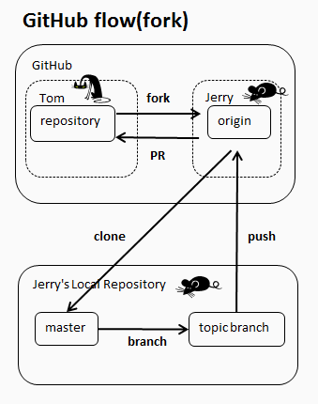

Getting Stuff (Downloading) cont.
Clone vs. Fork
Fork- Copies and links Toms Repository to Jerry’s account.
Clone - Copies Jerry’s new repository to Jerry’s local machine.
You CAN do this!

Slide 9
Getting Stuff (Downloading)
Pull
GitHub
Pull - Downloads changes to a repository or Branch from GitHub to your local Repository. The repository MUST exist!
jpsider/VMworld_2018
Changes
Your Computer
Note:
There are a lot of options when using the git ‘pull’ command.
https://git-scm.com/docs/git-pull
jpsider/VMworld_2018

Slide 10
Saving Stuff
Commit (Check-in)
Records changes to the repository on your local machine.
Local Process:
Open File
Make Changes
Save File
Commit Changes
These two things are not the same!
Your Computer
jpsider/VMworld_2018
Base
Change Something
jpsider/VMworld_2018
With Change
commit 7b4a9a0d142ce73129fab12f55b616fd13b7065c
Same folder, Same File, different Hash.

Slide 11
Uploading Stuff
Push
GitHub
jpsider/VMworld_2018
With commits
Push- Upload changes from your local repository to a Remote repository on GitHub. The repository MUST exist!
Changes
Your Computer
Note:
There are a lot of options when using the git push command.
https://git-scm.com/docs/git-push
jpsider/VMworld_2018
With Changes
commit 7b4a9a0d142ce73129fab12f55b616fd13b7065c

Slide 12
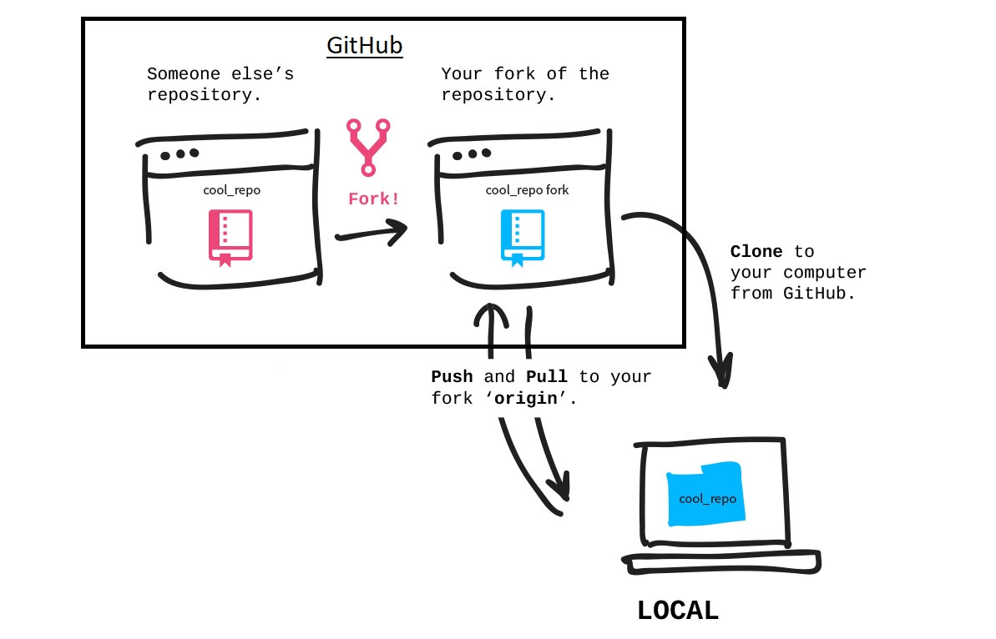
Let’s Review
Fork
Clone
Make Changes
Commit
Push

Slide 13
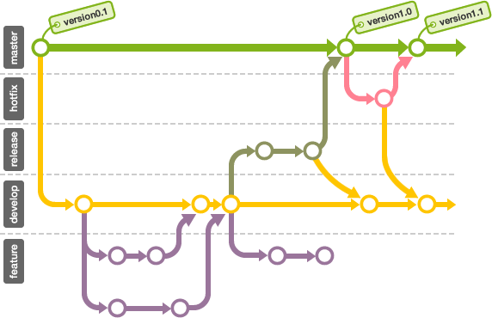
Branches, Changes, Code Reviews
Master(Trunk)
Gold copy. Only update master with ‘good’ code.
That means create a branch for all changes. Hotfixes, new features, releases, etc.
I am horrible at this. I like working in the Master.

Slide 14
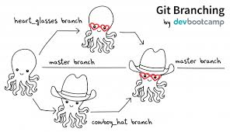
Branches, Changes, Code Reviews
Feature Branch
Where new features are developed! Duh.
Branches allow multiple people to work on the same project without stepping on each other or overwriting their work.

Slide 15
Branches, Changes, Code Reviews
Merge
Adding Branches to Branches
Or
Adding Branches to Master
Git will help you identify any conflicts with the code. Generally a conflict is a change on the same line of the same file.

Slide 16
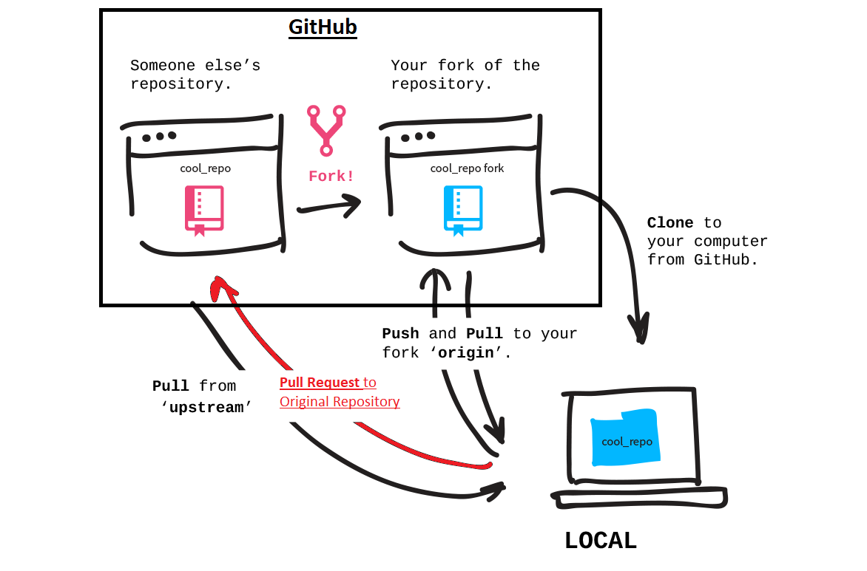
Branches, Changes, Code Reviews
Pull Request
So… You want to make changes to a remote Repository?
First, you must have a branch.
The submission of your changes is a called a Pull Request. It’s kinda like a Code Review...

Slide 17
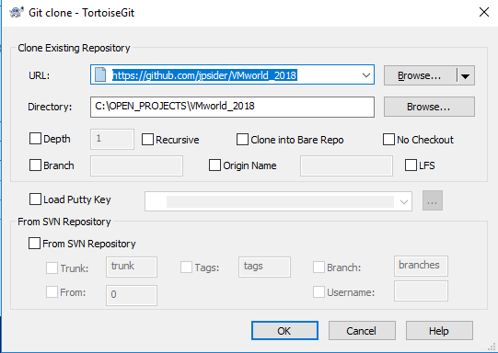
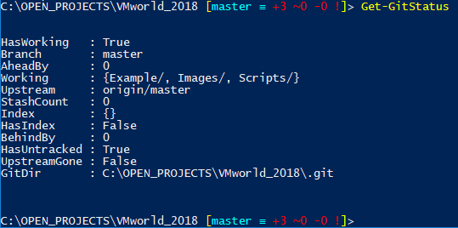
Git Related Tools
Graphical Tools:
Tortoisegit
GitKraken
GitHub Desktop (GUI)
Command Line tools:
git
Posh-git
Psgit

Slide 18
Why Git?
To avoid a mess.
Manage changes with less overhead.
Share and review changes with others.
Now……
Prepare yourself, for what you are about to see.

Slide 19
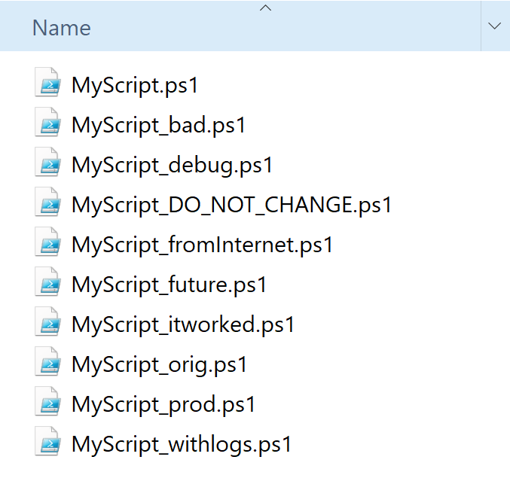
Scenarios / Use Cases
Same script, with a note in the name:
Script roulette!
Why did you save the bad one?
FYI, I still kinda do this while I am testing something BRAND NEW.
Once you establish a script, then you should utilize a version control system to maintain it.

Slide 20
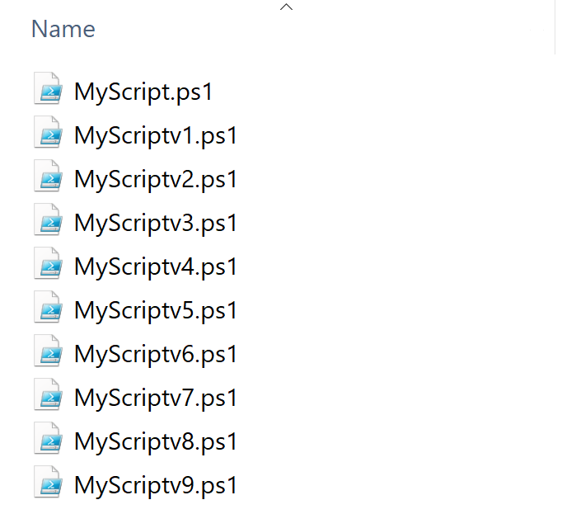
Scenarios / Use Cases
Same script, with a bunch of different versions:
Which one works?
Are they date stamped?
What compare tool do you have to see what has changed?

Slide 21
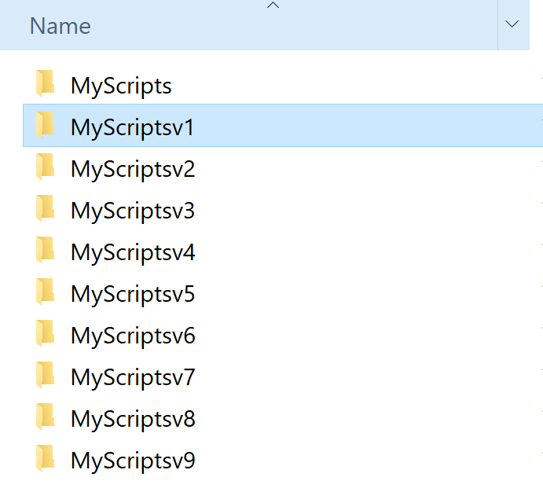
Scenarios / Use Cases con’t.
Same script(s), all in a different directory:
1st is the worst!
If you have more than 2-3 versions, are the older ones even relevant?
Less is more!
Even worse, is this on a share? Or your local machine?

Slide 22
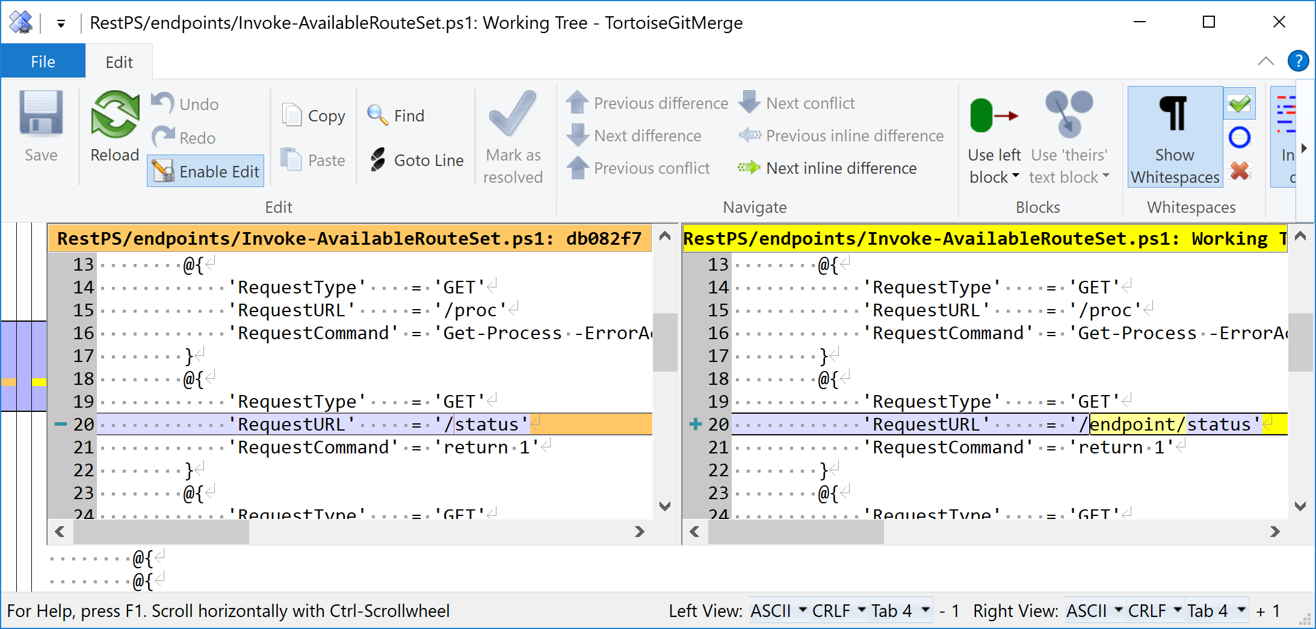
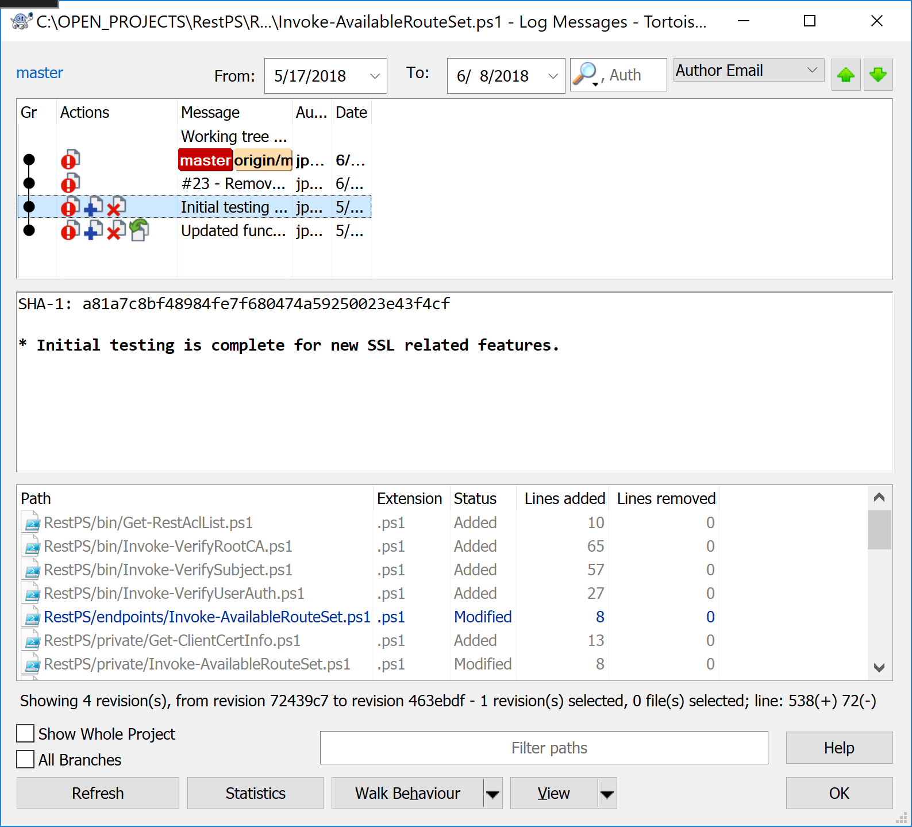
With Git:
A Single file, that’s it!
In line File Diff’s
Revision History (Show log)

Slide 23
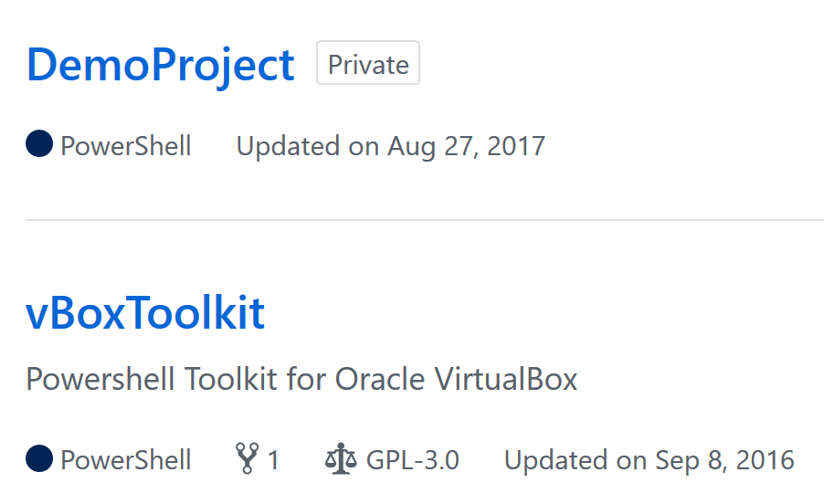
Public and Private Repositories
Public
Free for all to see!
Share Responsibility
Private
Only you or your org can see.
Costs Money
Add Collaborators (Internal and External to the GitHub Organization)

Slide 24
Internal Repositories
Build
Test
Deploy
Manage Source Code
GitLab (Open Source)
Free version
Enterprise version $$
Distribute Source Code
PowerShell Gallery
Nexus
File Shares

Slide 25

CI/CD Pipeline
1 & 2
4
5
7
Make Changes
Commit Locally
Push
Review Code
Test
Deploy
Profit
3
6
Small defined changes
Test Locally
Use Branches
Review code
Unit Test (Pester)
Lint Test (PSScriptAnalyzer)
AppVeyor
Travis CI
Jenkins
Deploy to Production
PS Gallery
Nexus

Slide 26
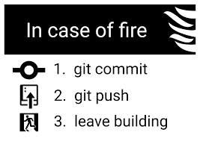
Do you Git it yet?
Feel free to reach out to me directly.
Jpsider - (Twitter, GitHub, Slack, pretty much have this name everywhere)
http://invoke-automation.blog
http://belaytech.com
https://leanpub.com/powershell-conference-book
Special thanks to the vBrownBag & VMTN teams for their hard work putting on such a valuable and rewarding event for the community.
Code for this presentation available here:
https://github.com/jpsider/VMworld_2018

