Slide 1
PowerRestCLI
CODE5550U
A Community Module
Justin P. Sider
@jpsider
http://www.invoke-automation.blog
Chief Information Officer – Belay Technologies
#vmworld #code5550u

Slide 2
Agenda
What is the PowerRestCLI Module?
VMware API Explorer
Creating a Function by calling the VMware REST API
Generating a Token
Performing a Rest call with PowerShell
Formatting the output
Refactoring the PowerShell code
CI/CD Pipeline for the PowerRestCLI Module

Slide 3
PowerRestCLI
A PowerShell Module created to be a tool for VMware system administrators to learn how to interact with RESTful api’s.
Contributing to this project will familiarize folks with:
VMware RESTful interfaces
PowerShell best practices
Pester
PSScriptAnalyzer
PSCodeHealth
CI/CD Pipelines
GitHub
Publishing to the PowerShell Gallery
https://www.powershellgallery.com/packages/PowerRestCLI/
https://github.com/jpsider/PowerRestCLI

Slide 4
VMware API Explorer
What is it?
A web-based application that allows you to explore the available VMware REST api’s for vSphere and related products.
How do you get to it?
Internet:
https://code.vmware.com/apis#product=&programming-language=REST
vCenter 6.5+ Server:
https://<IP_of_VCSA>/apiexplorer
How do I use it?
https://www.vladan.fr/vmware-api-explorer-built-utility-vcsa/

Slide 5
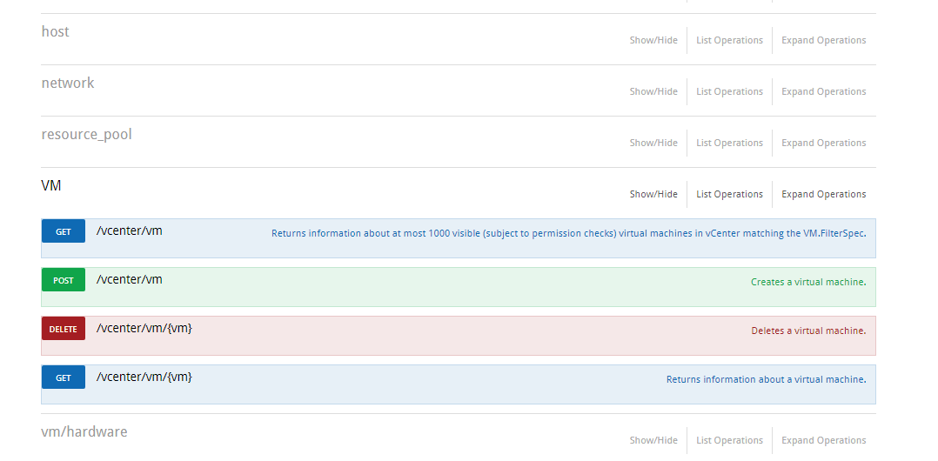
VMware API Explorer
Method - The type of action performed by the endpoint. Standard methods are GET, PUT, POST, DELETE
Route - Also called ‘Path/URI, URL’, These link to the code needed to execute the requested action.

Slide 6
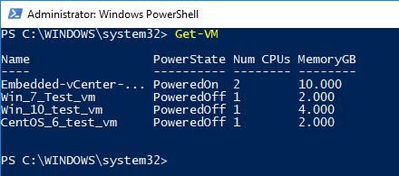
Creating a PowerShell Function
What’s your favorite PowerCLI command?
Mine?
Get-VM
We will replicate this using the VMware API, then turn it into a PowerShell Function!

Slide 7


Get-VM via the VMware API Explorer
Located in the top right of the screen
Ensure you are logged in.
Scroll to the ‘VM’ section
Select the ‘GET’ next to ‘/vcenter/vm’
Select the ‘Try it Out’ button
When running RESTful commands, be aware, ALL SALES ARE FINAL, there is no ‘-WhatIf’

Slide 8
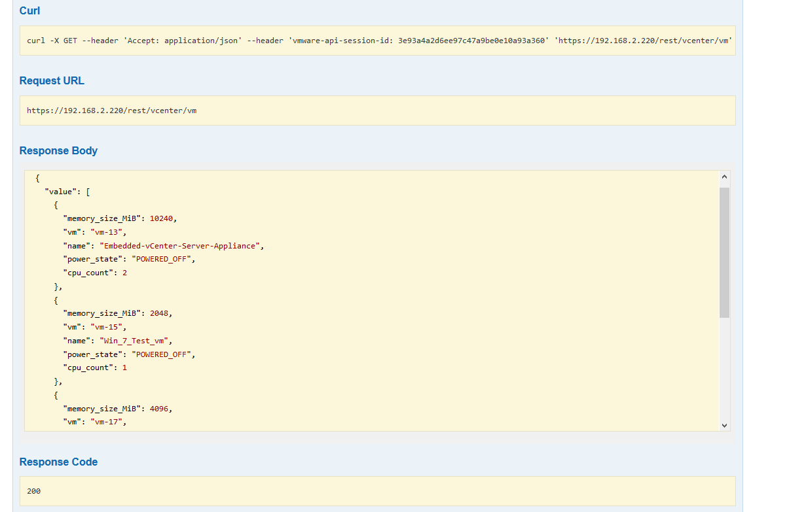
The Response
Remember this!
What did we get?
The URL used for the call
VM Information
A Response code
The Data matches PowerCLI (kinda)

Slide 9
Generating a Token
Web tokens are used to Authenticate with RESTful services. In order to communicate with the RESTful server, you must:
Request a Web token
Capture the Web token
Use the Web token on subsequent commands
Not using a ‘Trusted SSL certificate on your vCenter? Check out the ‘Disable-SSLValidation’ Function
https://github.com/jpsider/PowerRestCLI/blob/master/PowerRestCLI/private/Disable-SSLValidation.ps1

Slide 10

Requesting a Token
1 - Encode Credentials
1
$auth = [System.Convert]::ToBase64String([System.Text.Encoding]::UTF8.GetBytes("administrator" + ':' + "VMware1!"))
$headers = @{
'Authorization' = "Basic $auth"
}
$Token = (Invoke-RestMethod -Uri https://$vCenter/rest/com/vmware/cis/session -Method Post -Headers $headers -UseBasicParsing).value
$Token
$Headers = @{'vmware-api-session-id' = $Token}
2
2 - Embed Creds in Header
3
3 - Request Token from vCenter
4
4 - Capture Token
5
5 - Replace the Creds with the Token in Header

Slide 11
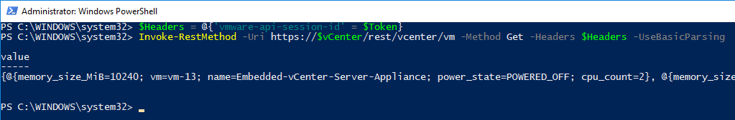
Performing a Restful call with PowerShell
Now that we have a token, lets execute our RESTful VM call:
Invoke-RestMethod -Uri https://$vCenter/rest/vcenter/vm -Method Get -Headers $Headers -UseBasicParsing
That is NOT what we expected. We can do better than this!

Slide 12
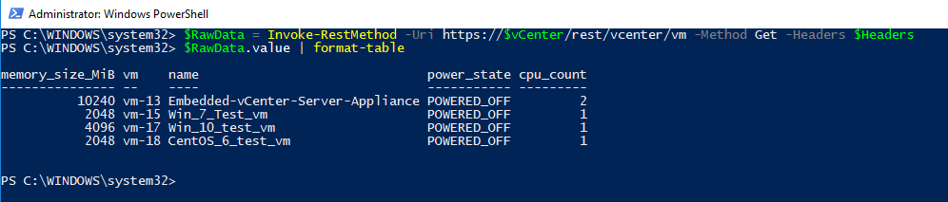
Formatting the Output
Ok, just a few minor adjustments:
$RawData = Invoke-RestMethod -Uri https://$vCenter/rest/vcenter/vm -Method Get -Headers $Headers
$RawData.value | format-table
Phew!
(Invoke-RestMethod -Uri https://$vCenter/rest/vcenter/vm -Method Get -Headers $Headers).value | format-table

Slide 13
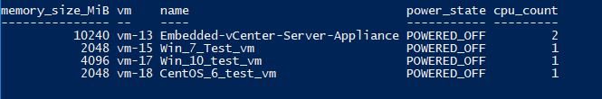

But you said it was just like PowerCLI
Ok, I lied!
But can we do better? … YES!
VMware API
PowerCLI

Slide 14
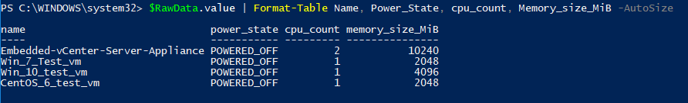
Never Give up!
Specify the order
So we can reorder the data:
$RawData.value | Format-Table Name, Power_State, cpu_count, Memory_size_MiB -AutoSize
VMware API
PowerCLI
Notice the case of the letters, and the column headers. Example: PowerState vs. power_state

Slide 15
Why PowerRestCLI
You will learn new things!
You can contribute back to the Community!
All of the examples today are included in the Module. It’s this easy:
Install-Module -Name PowerRestCLI
Import-Module -Name PowerRestCLI
$vcenter = "192.168.2.220"
# This will prompt you for Credentials
Connect-rVIServer -vCenter $vCenter
Get-rVM -vCenter $vcenter
https://www.powershellgallery.com/packages/PowerRestCLI/
https://github.com/jpsider/PowerRestCLI

Slide 16
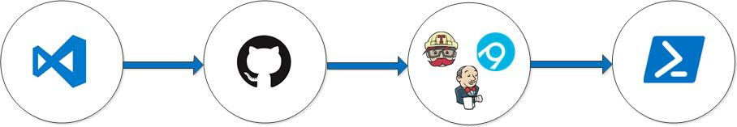
CI/CD Pipeline
1 & 2
4
5
7
Make Changes
Commit Locally
Push
Review Code
Test
Deploy
Profit
3
6
Small defined changes
Test Locally
Use Branches
Review code
Unit Test (Pester)
Lint Test (PSScriptAnalyzer)
AppVeyor
Travis CI
Jenkins
Deploy to Production
PS Gallery
Nexus
Commands from this deck can be found here:
https://github.com/jpsider/VMworld_2018/blob/master/PowerRestCLI_Presentation.ps1

Slide 17
That’s a Wrap!
Code for this presentation available here:
https://github.com/jpsider/PowerRestCLI
Feel free to Reach out to me directly.
Jpsider - (Twitter, GitHub, Slack, pretty much have this name everywhere)
http://invoke-automation.blog
http://belaytech.com
https://leanpub.com/powershell-conference-book
Special thanks to the VMware {Code} team for their hard work
putting on such a valuable and rewarding event for the community.

Slide 18
PLEASE FILL OUT YOUR SURVEY.
Take a survey and enter a drawing for a VMware company store gift card.

Slide 19
THANK YOU!

