Slide 1
Using dplyr and creating a Table 1
CRISP R Mini-Course
2026
Day 4

Slide 2
Review from last time
What does the code below do? Explain to your neighbor!
library(dplyr)
df <- read.csv(“data.csv”)
df_new <- df %>%
mutate(age_months = age * 12) %>%
filter(tx == 1 & age_months > 100) %>%
select(id, tx, sex, age_months, bmi, educyrs)

Slide 3
Last week, we…
Step 0:
Setup R
Organize folders
Install packages
Step 2:
Clean/process your dataset
Filter rows
Select columns
Create new columns
# use base R
# use package
Step 1:
Read in dataset
library(dplyr)
df_new <- df %>%
filter(age > 30) %>%
mutate(tx_factor = factor(tx),
htn_factor = factor(htn))
df <- read.csv(“data.csv”)

Slide 4
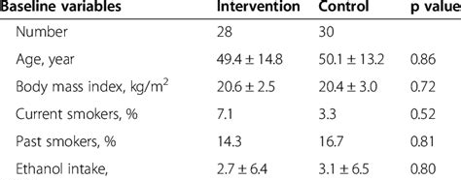
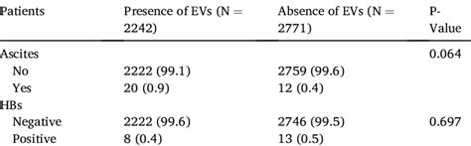
The next few weeks
This week: We will learn how to
Create a “Table 1”
Perform hypothesis tests of comparisons between groups
Run and interpret linear regression
Next week: Logistic regression, creating graphs, using AI tools
Q: What is the null hypothesis for the p-values displayed on these tables?

Slide 5
Homework 1 due today
Optional but encouraged!
Should take ~15-30 minutes
bit.ly/crisp2026
Email me the saved RMD file at jpspeng@uw.edu

Slide 6
Guided tutorial
Today, we will learn the basics of dataset processing.
Go to bit.ly/crisp2026.
Download Rmd file for today into your CRISP R notes folder.
We will go through the tutorial (until the exercises) together! Try to follow along, and type and run the code as I do it.
We’ll save 10 minutes at the end for the independent exercises.

