Slide 1
Logistic regression (running + interpreting)
CRISP R Mini-Course
Day 7

Slide 2
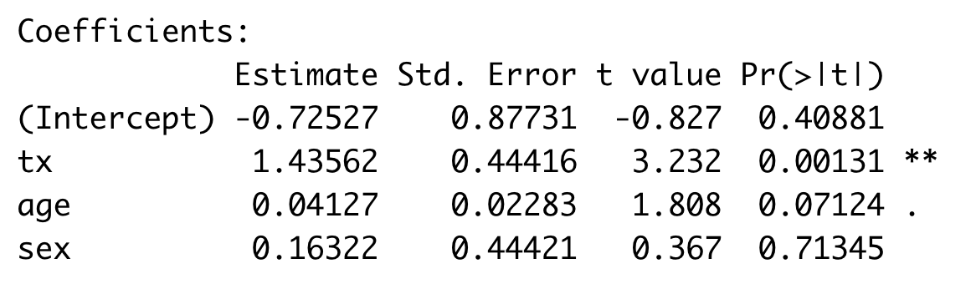
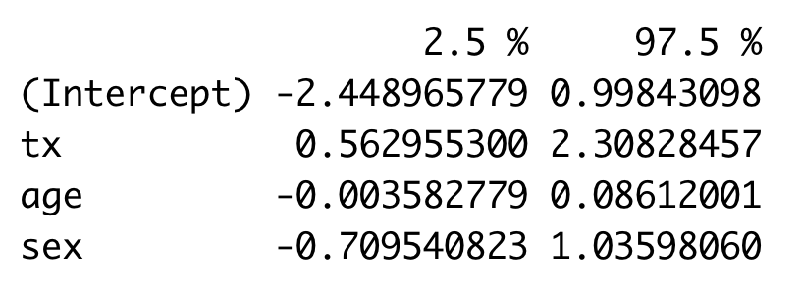
Review from last time
We wish to determine the association between disease severity score and treatment status, adjusted by age and sex. We run the following code in R, and obtain the output shown.
Explain what we are doing and how to interpret the results.
# df is a dataframe with age, tx (0/1), sex (0/1), disease_severity
mod <- lm(disease_severity ~ tx + age + sex, data = df)
summary(mod)
confint(mod)

Slide 3
This week’s schedule and next steps
This week’s schedule:
Today: Logistic regression
Wednesday: Plotting using ggplot2 + tips for next steps
Additional tutorials available on website
R stuff: lists, loops, functions
Risk differences, risk ratios, odds ratios
Adding interaction terms in linear regression
Survival analysis

Slide 4
Today’s agenda
Logistic regression – conceptual tutorial
Running and interpreting logistic regression in R

Slide 5
Review: Risk difference, risk ratio, odds ratio
We run a randomized control trial testing the efficacy of a vaccine in preventing a disease. We obtain the following results:
In the vaccine arm: 20/100 developed the disease
In the placebo arm: 50/100 developed the disease
Calculate the following:
Risk of disease in the placebo arm:
Risk of disease in the vaccine arm:
Risk difference (vaccine vs placebo):
Risk ratio
(vaccine vs placebo):
Odds ratio
(vaccine vs placebo):
Odds of disease in the placebo arm:
Odds of disease in the vaccine arm:

Slide 6
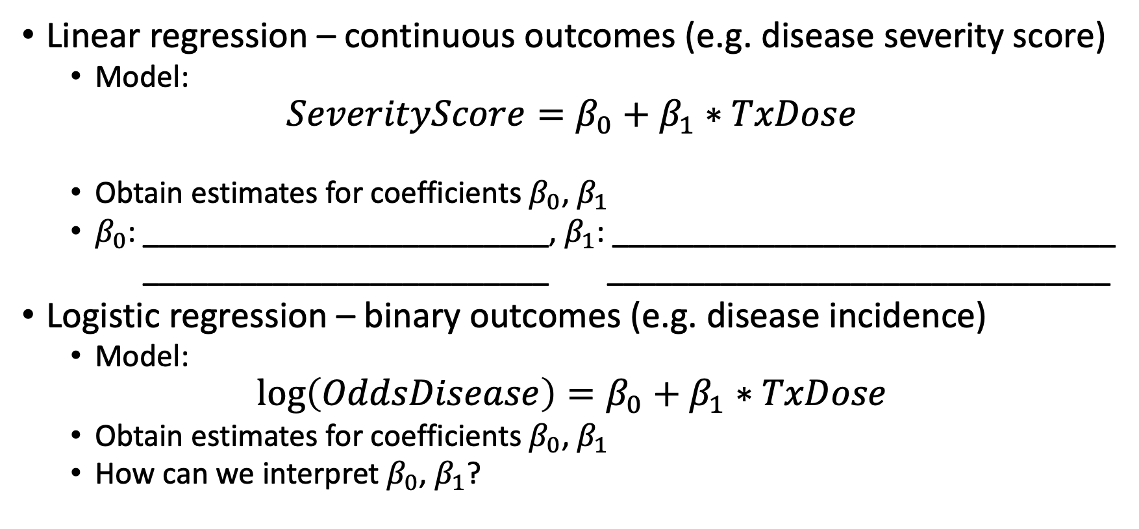
Logistic regression overview
Linear regression – continuous outcomes (e.g. disease severity score)
Model:
$$SeverityScore=β_{0}+β_{1}∗TxDose$$
Obtain estimates for coefficients $β_{0}$, $β_{1}$
$β_{0}$: _________________________, $β_{1}$: _______________________________
_________________________ _______________________________
Logistic regression – binary outcomes (e.g. disease incidence)
Model:
$$\log\left(OddsDisease\right)=β_{0}+β_{1}∗TxDose$$
Obtain estimates for coefficients $β_{0}$, $β_{1}$
How can we interpret $β_{0}$, $β_{1}$?

Slide 7
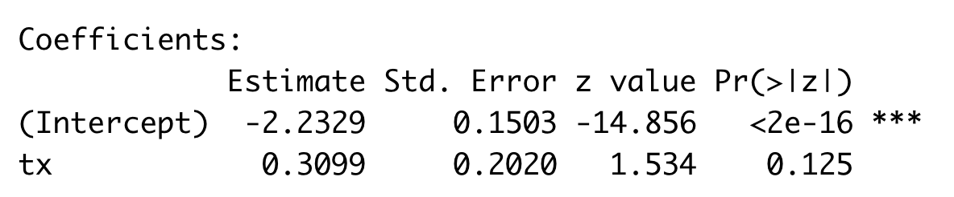
Logistic regression w/ binary variable (1)
We are trying to determine if a hypertension is associated with treatment status. We obtain data from an observational study with both variables.
We can analyze this using logistic regression:
Outcome: Hypertension (binary)
Exposure: Treatment status
We do this in R and obtain the following output:

Slide 8
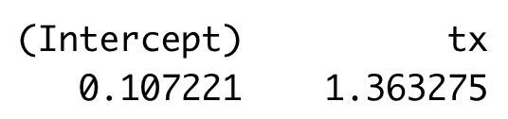
Logistic regression w/ binary variable (2)
Logistic regression:
Outcome: Hypertension (binary)
Exposure: Treatment status
Exponentiated coefficients:

Slide 9
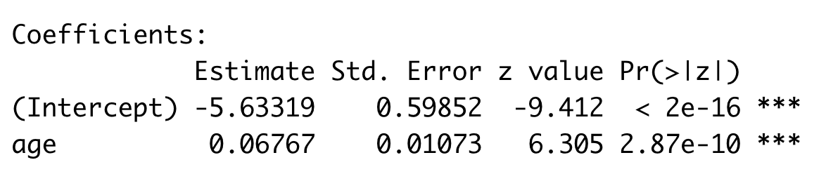
Logistic regression w/ continuous variable (1)
We are trying to determine if a odds of hypertension is associated with age. We obtain data from an observational study with both variables.
We answer this question using logistic regression:
Outcome: Hypertension (binary)
Exposure: Age
We do this in R and obtain the following output:
How can we interpret this output?

Slide 10
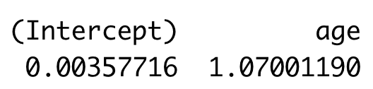
Logistic regression w/ continuous variable (2)
Logistic regression:
Outcome: Hypertension (binary)
Exposure: Age
Exponentiated coefficients:

Slide 11
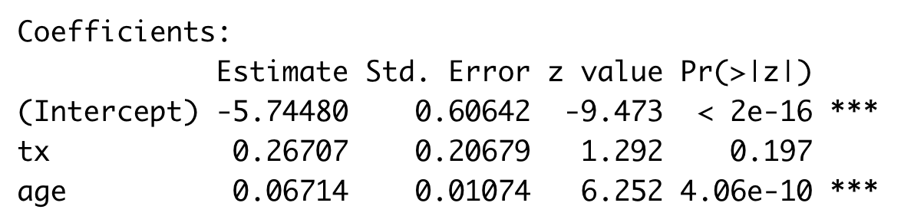
Logistic regression w/ adjustment variable (1)
We are trying to determine if a odds of hypertension is associated with treatment status adjusting for age. We obtain data from an observational study with all variables.
We answer this question using logistic regression:
Outcome: Hypertension (binary)
Exposure: Treatment status
Adjustment covariate: Age
We do this in R and obtain the following output:

Slide 12
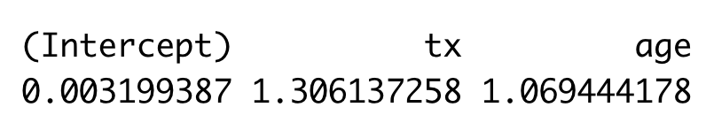
Logistic regression w/ adjustment variable (2)
Logistic regression:
Outcome: Hypertension (binary)
Exposure: Treatment status
Adjustment covariate: Age
Exponentiated coefficients:

Slide 13
Guided tutorial
Today, we will learn the basics of dataset processing.
Go to bit.ly/crisp2025.
Download Rmd file for today into your CRISP R notes folder.
We will go through the tutorial (until the exercises) together! Try to follow along, and type and run the code as I do it.

