Slide 1
Introduction to course and using R + RStudio
CRISP R Mini-Course
Day 1

Slide 2
Agenda
Describe the goals and format of the R mini course
Download and install R and RStudio
Install packages needed for this course
Set up folder for course
Read in a dataset

Slide 3
Introduction – who am I?
4th -> 5th year PhD student in biostatistics at University of Washington
Research interests: vaccine research, infectious disease, survival analysis, causal inference
Previously: middle school math teacher, data scientist on infectious disease research team

Slide 4
Mini-course goals
By the end of the course, you will be able to:
Read in a dataset into R
Learn about basic syntax in R (objects, functions, etc.)
Perform basic data processing and manipulation
Create basic data summaries and create a “Table 1”
Perform linear and logistic regression
Other potential topics: more syntax (lists, loops, functions), plotting using ggplot2, survival analysis using Cox regression, using ChatGPT for coding
The goal of this course is to get a taste for how to code in R; it is not meant to be comprehensive!

Slide 5
Mini-course structure
Daily schedule:
30 minutes “mini lesson”
20 minutes coding activity
10 minutes debrief
Course website: All materials will be posted here:
https://jpspeng.github.io/crisp_notes/
Homework (optional):
The coding activities will generally take more than 20 minutes! It is recommended that you complete the rest for homework.
Support:
Biostats office hours (typically after the hour)
By appointment

Slide 6
Coding is tough!
If you’ve never coded before, then learning R might be tough
This is normal
The best way to learn is to try it yourself, struggle through it, and make mistakes along the way

Slide 7
Using ChatGPT
ChatGPT is excellent at coding
But for this course, I’d encourage you NOT to use it, or use it in a very limited capacity
If you use it, please use it in a targeted way
Don’t paste the question (e.g. “[Paste question]. How do I do this?”)
Instead: “Give some examples of how to use the [function_name] in R.”

Slide 8

What is R?
R is a programming language used for statistical computing, used for data analysis and data visualization
It is a flexible coding language (compared to STATA / SAS), but there are also tons of R packages which implement functionality out-of-the box

Slide 9
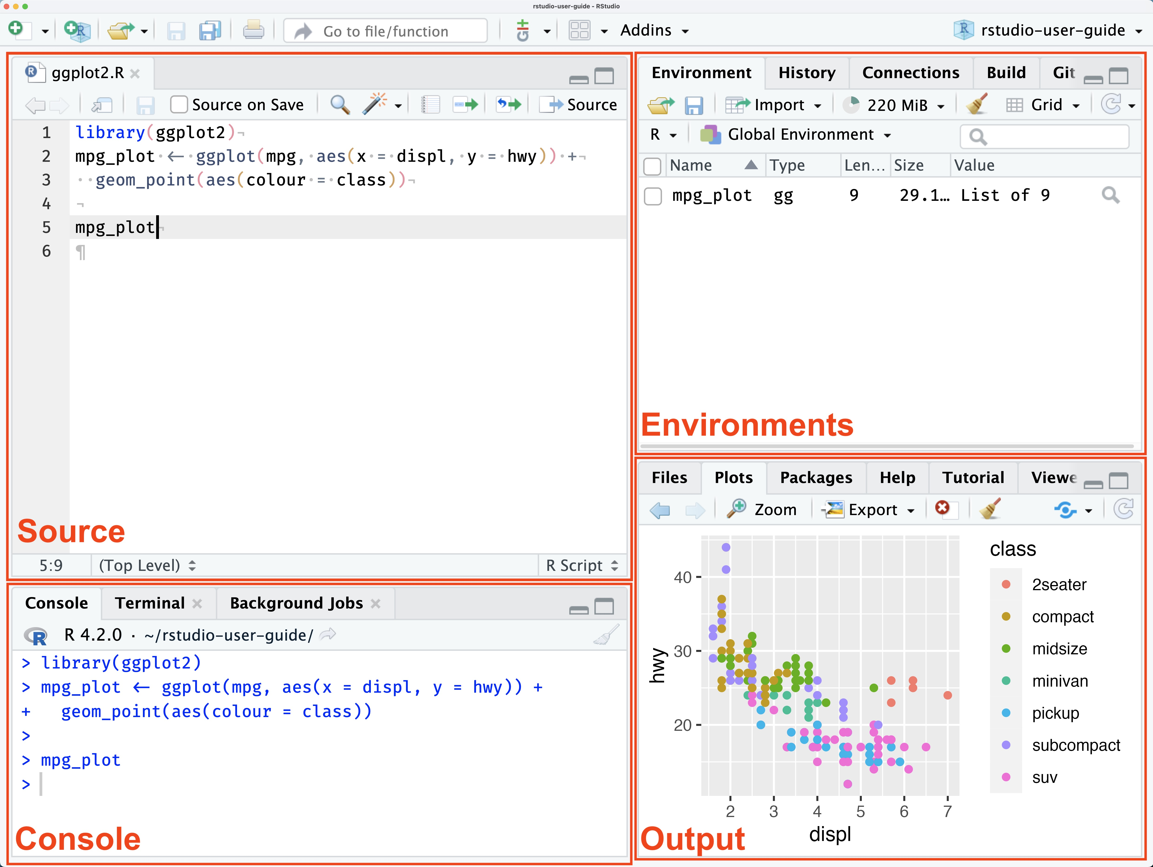
What is RStudio?
RStudio provides a user-friendly interface to write and run R code
Four panes
Script editor
Console
Environment
Files/plots/packages, etc.
Photo credit: RStudio User Guide 2025.05.1

Slide 10
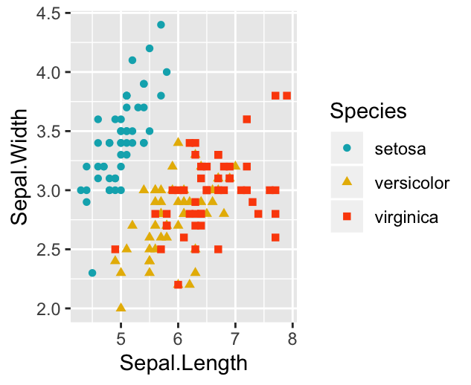
What are packages?
R packages are collections of functions, data, and documentation which extend the R programming language
Instead of writing code from scratch, you can usually find an R package that does it for you
R packages that we will use in this R course
dplyr: for easy data manipulation
table1: for creating publication-ready Table 1’s
ggplot2: for creating graphs
A plot created using the ggplot2 package (Photo credit: Datanovia)

Slide 11
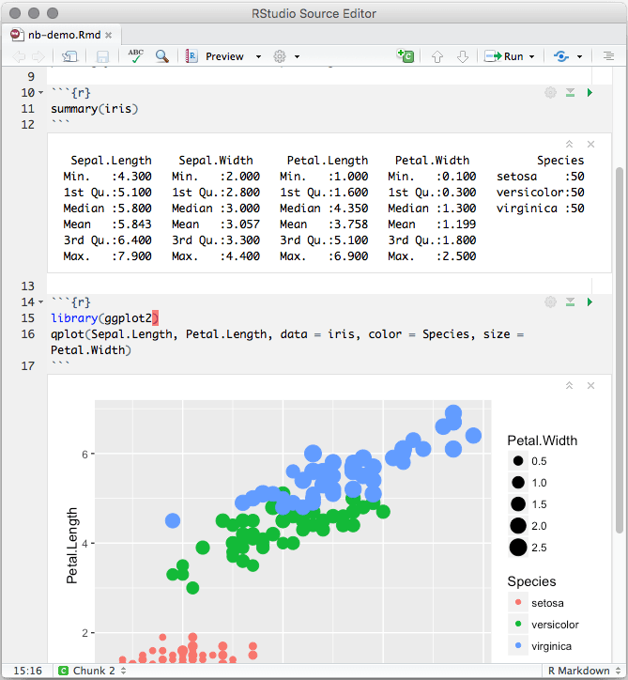
R versus R Markdown
The usual way of writing an R code is an R script (.R)
An R Markdown notebook (.Rmd) is a special file type that allows you to write text, code chunks, and output
Two advantages of R notebooks:
You can run code chunks one at a time
You can integrate your code and comments in a nicely formatted document
We will use these in our lessons!
An example R notebook

Slide 12
Task for today (20 minutes) bit.ly/crisp2025
Step 1: Install R/R Studio and packages
Step 2: Folder setup
Step 3: Download Rmd and CSV file and save it to the folder
Step 4: Open Rmd file – read data file and perform basic operations

Slide 13
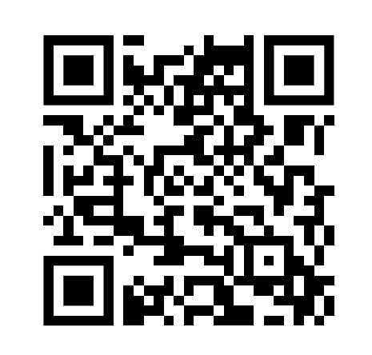
Exit survey
bit.ly/crispsurvey

