Slide 1
Using dplyr and creating a Table 1
CRISP R Mini-Course
Day 4

Slide 2
Review from last time
What does the code below do? Explain to your neighbor!
df <- read.csv(“data.csv”)
df_new <- df[df$age > 30, ]
# treatment is a variable 1/0 corresponding to treatment/placebo
table(df_new$treatment, useNA = “always”)

Slide 3
Last week, we learned…
How to run R and R Studio
Basic syntax in base R
Variables, vectors, dataframes
Basic functions for analysis (e.g. mean(), median(), sd())
Manipulating and subsetting dataframes

Slide 4
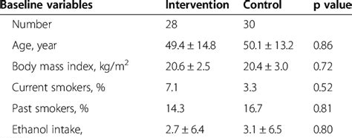
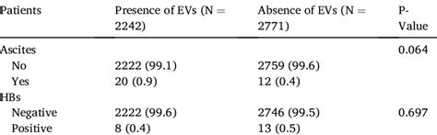
The next few weeks
This week: We will learn how to
Create a “Table 1”
Perform hypothesis tests of comparisons between groups
Calculate risk ratios, odds ratios, and risk differences with confidence intervals
Next week: Linear/logistic regression and (if time) basic plotting with ggplot2
Highly encouraged: spend 15-20 minutes on exercises in between classes!
Q: What is the null hypothesis for the p-values displayed on these tables?

Slide 5
Today’s agenda
Using dplyr
Factor variables
Creating a Table 1 using the table1 package

Slide 6
Guided tutorial
Today, we will learn the basics of dataset processing.
Go to bit.ly/crisp2025.
Download Rmd file for today into your CRISP R notes folder.
We will go through the tutorial (until the exercises) together! Try to follow along, and type and run the code as I do it.

Slide 7
Our target Table 1
 | BUP-NX (treatment = 0) | XR-NTX (treatment = 1)
Number in each arm
Age (sd)
Sex – Male (%)
BMI (sd)
etc…

