Slide 1
R syntax
CRISP R Mini-Course
Day 2

Slide 2
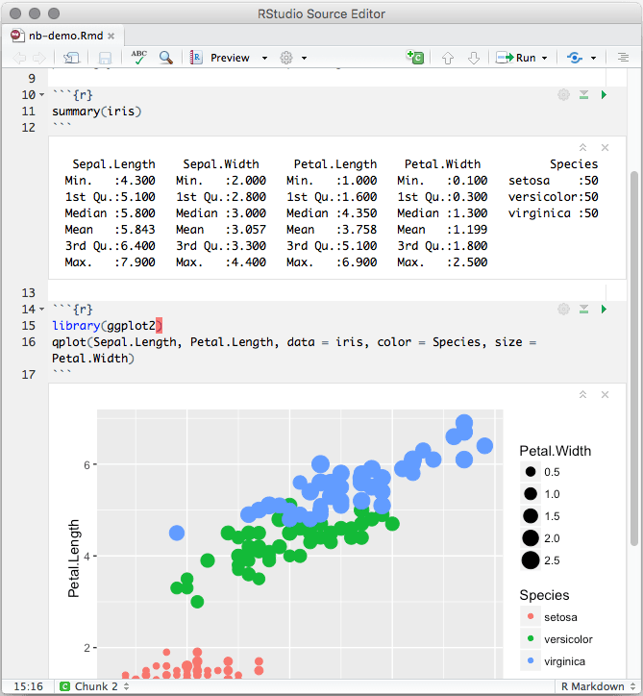
Review from last time
Last time, we learned about R (programming language) and R Studio (application for writing R code)
We learned how to use R notebooks (.Rmd), which allow us to combine text and code chunks into a single document
We learned some basic functionality:
Comments
Installing packages
Loading packages
Loading a dataset
Doing arithmetic operations

Slide 3
Agenda
Errors versus warnings
Learn about basic R syntax
Expressions
Variables
Vector
Function
Dataframe
Common functions for dataframe operations

Slide 4
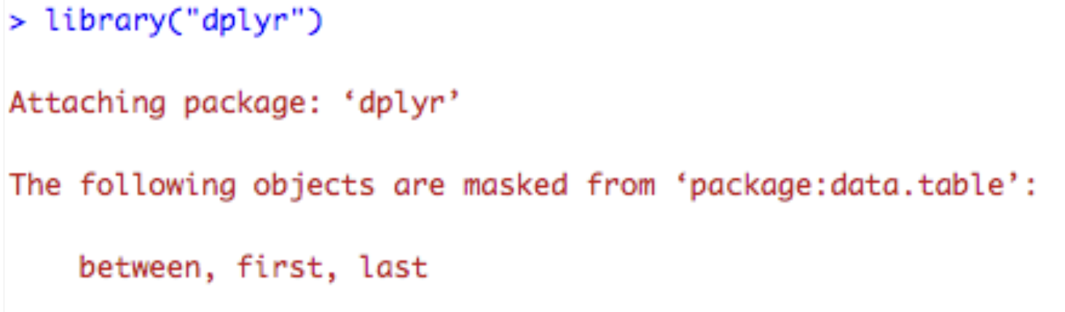
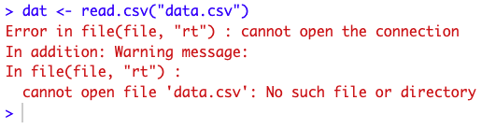
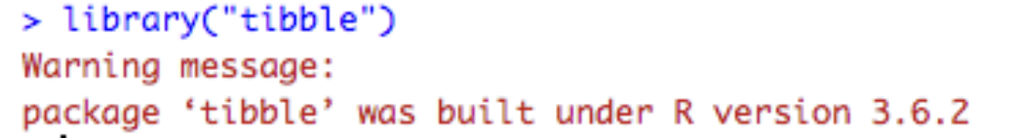
Messages versus Error versus Warning
Message:
Messages: Everything is normal. These are for informational purposes
Error: Something is wrong. If there is an error, the code will not run!
Warning: Something might be wrong. If there is a warning, the code will still run
How to debug:
Read the message and double check your code
Google (or use ChatGPT) to figure out the error
Error:
Warning:

Slide 5
Guided tutorial (30 minutes)
Today, we will learn the basics of R syntax.
Go to bit.ly/crisp2025.
Download Rmd file for today into your CRISP R notes folder.
We will go through the tutorial (until the exercises) together! Try to follow along, and type and run the code as I do it.
Notes:
Expressions: 5+10
Variables: Choose a variable name, try to make it descriptive. Assign variable with = or <-. If you assign a variable in R, it doesn’t print the variable.
a <- 1 + 2
b <- 5 + 5
Vector: Use the c(1,2,3,4) notation. Not 1,2,3,4! This will cause an error. Need to put c() around it.
Loops:
for (num in c(1,2,3,4)){
}
Functions: Looks like function_name(arguments). Can look up notation to see order of arguments. Named arguments.
Give a few example functions, look them up
Writing your own function
add_two_numbers <- function(num1, num2){
sum_two_num <- num1 + num2
return(sum_two_num)
}

Slide 6
Self-guided exercises (20 minutes)
Complete the exercises!

