Slide 1
Graphing with ggplot2 and wrap-up
CRISP R Mini-Course
2026
Day 8

Slide 2
Today’s agenda
Kahoot game!
Summarize what we’ve learned during this course
Make basic plots with the ggplot2 package
Talk about additional resources for learning R (including how to use ChatGPT)

Slide 3
Announcements
HW #3 is due tomorrow!

Slide 4
CRISP R course roadmap
Step 0:
Setup R
Organize folders
Install packages
# use base R
# use package

Slide 5
CRISP R course roadmap
Step 0:
Setup R
Organize folders
Install packages
# use base R
# use package
Step 1:
Read in dataset
df <- read.csv(“data.csv”)

Slide 6
CRISP R course roadmap
Step 0:
Setup R
Organize folders
Install packages
Step 2:
Clean/process your dataset
Filter rows
Select columns
Create new columns
Convert categorical variables to factors
# use base R
# use package
Step 1:
Read in dataset
library(dplyr)
df_new <- df %>%
filter(age > 30) %>%
mutate(tx_factor = factor(tx),
htn_factor = factor(htn))
df <- read.csv(“data.csv”)

Slide 7
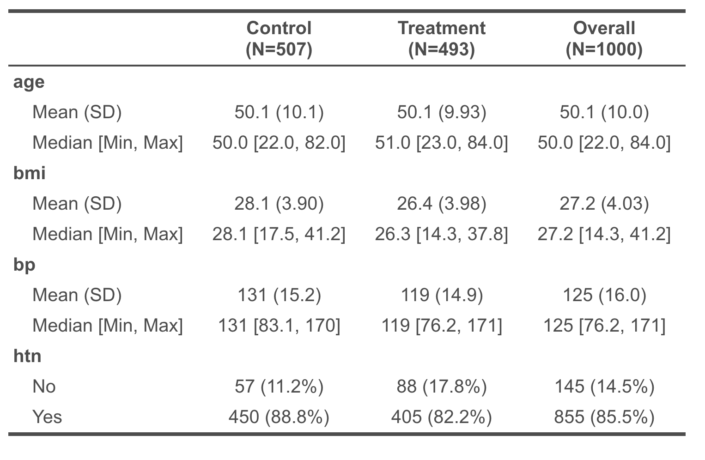
CRISP R course roadmap
Step 0:
Setup R
Organize folders
Install packages
Step 2:
Clean/process your dataset
Filter rows
Select columns
Create new columns
Convert categorical variables to factors
Step 3:
Obtain descriptive statistics
mean(df$age, na.rm = T)
sd(df$age, na.rm = T)
summary(df$age)
table(df$tx, useNA = “always”)
# use base R
# use package
library(table1)
table1(~ age + bmi + bp + htn | tx,
data = df)
Step 1:
Read in dataset
library(dplyr)
df_new <- df %>%
filter(age > 30) %>%
mutate(tx_factor = factor(tx),
htn_factor = factor(htn))
df <- read.csv(“data.csv”)

Slide 8
CRISP R course roadmap
Step 4:
Perform statistical analyses

Slide 9
CRISP R course roadmap
Is [variable] different between two groups?
Step 4:
Perform statistical analyses

Slide 10
CRISP R course roadmap
Is [variable] different between two groups?
Continuous variable:
T-test
Binary/categorical variable:
Two sample z-test or chi-squared test
t.test(age ~ tx,
data = df)
chisq.test(htn_tbl)
Step 4:
Perform statistical analyses

Slide 11
CRISP R course roadmap
Is [variable] different between two groups?
Continuous variable:
T-test
Binary/categorical variable:
Two sample z-test or chi-squared test
t.test(age ~ tx,
data = df)
chisq.test(htn_tbl)
Step 4:
Perform statistical analyses
How much is [variable] different between two groups?

Slide 12
CRISP R course roadmap
Is [variable] different between two groups?
Continuous variable:
T-test
Binary/categorical variable:
Two sample z-test or chi-squared test
t.test(age ~ tx,
data = df)
chisq.test(htn_tbl)
Step 4:
Perform statistical analyses
Continuous [variable]:
Linear regression
Output: Estimated difference and p-values
How much is [variable] different between two groups?
mod1 <- lm(bp ~ tx,
data = df)
summary(mod1)
confint(mod1)
library(broom)
tidy(mod1)

Slide 13
CRISP R course roadmap
Is [variable] different between two groups?
Continuous variable:
T-test
Binary/categorical variable:
Two sample z-test or chi-squared test
t.test(age ~ tx,
data = df)
chisq.test(htn_tbl)
Step 4:
Perform statistical analyses
Binary [variable]:
Logistic regression
Output: Odds ratio and p-values
Continuous [variable]:
Linear regression
Output: Estimated difference and p-values
How much is [variable] different between two groups?
mod1 <- lm(bp ~ tx,
data = df)
summary(mod1)
confint(mod1)
mod2 <- glm(htn ~ tx,
data = df,
family = binomial)
exp(coef(mod2))
exp(confint(mod2))
library(broom)
tidy(mod1)
library(broom)
tidy(mod2, exponentiate = TRUE)

Slide 14
CRISP R course roadmap
Is [variable] different between two groups?
Continuous variable:
T-test
Binary/categorical variable:
Two sample z-test or chi-squared test
t.test(age ~ tx,
data = df)
chisq.test(htn_tbl)
Step 4:
Perform statistical analyses
Binary [variable]:
Logistic regression
Output: Odds ratio and p-values
Continuous [variable]:
Linear regression
Output: Estimated difference and p-values
How much is [variable] different between two groups?
mod1 <- lm(bp ~ tx,
data = df)
summary(mod1)
confint(mod1)
mod2 <- glm(htn ~ tx,
data = df,
family = binomial)
exp(coef(mod2))
exp(confint(mod2))
You can also have a continuous predictor!
library(broom)
tidy(mod1)
library(broom)
tidy(mod2, exponentiate = TRUE)
You can also adjust for covariates!

Slide 15
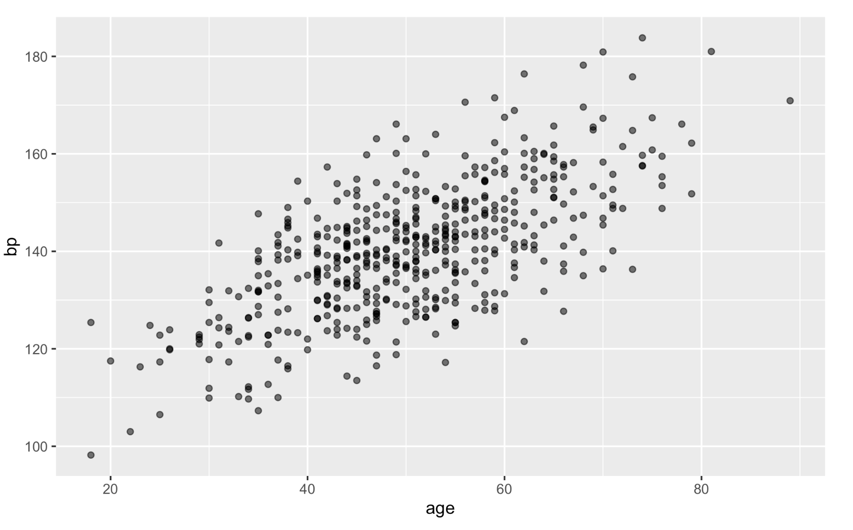
CRISP R course roadmap
Step 5:
Present data in graphs and tables
library(ggplot2)
ggplot(df, aes(x = age, y = bp)) +
geom_point()
We will learn the basics of how to do this today!
bit.ly/crisp2026

Slide 16
Tips for using AI tools
Why use it?
Learning
Implementation / efficiency

Slide 17
Demo for using AI tools (1)
1) Read in your dataset and inspect it in R Studio.
2) Tell ChatGPT the structure of your dataset, including variable types and coding.
I have a dataset which I’ve read into R into a dataframe variable called chatgpt_demo_df. It has four columns: (1) id: numeric id of the individual, (2) age: numeric age of the individual, (3) smoke: a binary variable coded as 0/1, and (4) disease_score: a score for disease severity. I want to ask you how to write R code to process and analyze this dataset.

Slide 18
Demo for using AI tools (2)
3) Be very specific with your asks. If you want to use familiar tools, ask it to use libraries that you are used to.
I’d first like to process the dataset. I want to create a new dataframe, saved in the my_data_processed variable, which has age_month = age * 12, converts smoke to a factor with levels labelled “Non-Smoker” and “Smoker”, and remove all rows that have a missing age. I’d like to use the dplyr package. Can you help me write code to do this?
I’d like to run a linear regression, with disease severity as the outcome and smoking status and age as the predictors. I’d also like confidence intervals for the coefficients. Can you help me write code to do this?

Slide 19
Demo for using AI tools (3)
4) Check the code. Ask it to explain lines of code that you don’t understand. This is how you learn and ensure that it’s not making a mistake!
I don’t understand the line of code filter(!is.na(age)). Can you explain it?
5) If you are asking it to debug, paste both the code and the error message!
I’m getting an error. Here is my code and error:
model <- lm(disease_score | smoke + age, data = my_data_processed)
Error in eval(mf, parent.frame()) : object 'disease_score' not found

Slide 20
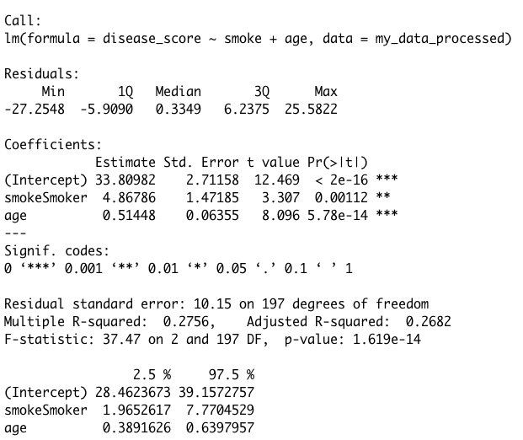
Demo for using AI tools (4)
6) Interpret it yourself, but you can also use ChatGPT for help.
Warning: ChatGPT makes mistakes and is over-confident. Double check the code and make sure you understand what it does!
Also, do not put any sensitive data into ChatGPT!
Can you help me interpret this linear regression output?

Slide 21
Codex Demo (Claude code is similar)

Slide 22
Congrats on finishing the R mini course!
This was a barebones survey course and is not comprehensive. You will probably come across something new when you analyze your own data which we have not covered.
What do I do if I get stuck?
ChatGPT
Free online courses:
edX: Data Science: R Basics
CodeAcademy: Learn R
Written resources:
Tutorials: https://r-statistics.co/
ggplot2: https://ggplot2-book.org/
R for Data Science book (dplyr): https://r4ds.had.co.nz/
UW Statistical Consulting: https://stat.uw.edu/research/consulting

