Slide 1
Adjusting for confounders in linear regression and logistic regression
CRISP R Mini-Course
2026
Day 7

Slide 2
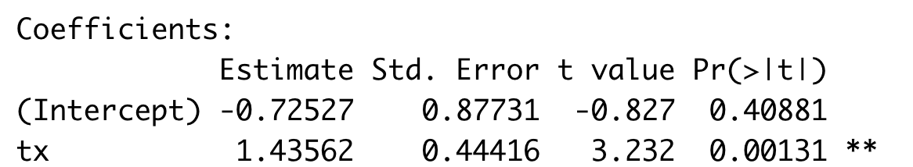
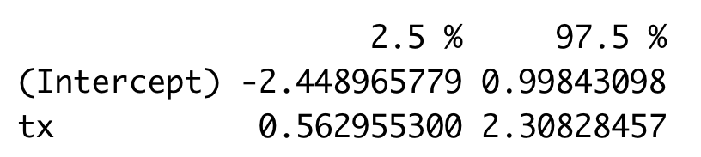
Review from last time
We wish to determine the association between disease severity score and treatment status (binary: treated/untreated). We run the following code in R, and obtain the output shown.
Explain what this code does and how to interpret the results.
# df is a dataframe with age, tx (treated/untreated)
mod <- lm(disease_severity ~ tx, data = df)
summary(mod)
confint(mod)
txTreated
txTreated

Slide 3
Announcements
Friday’s tutorial updated with linear regression with categorical variables (including how to reorder factor variables)
Homework 3 (final exam) due on Thursday, July 23
This week’s schedule:
Today: Logistic regression
Wednesday: Plotting using ggplot2, using AI tools, and review
Will post additional tutorials on website on Wednesday

Slide 4
Today’s agenda
Adding adjustment variables in linear regression
Logistic regression – conceptual tutorial
Running and interpreting logistic regression in R

Slide 5
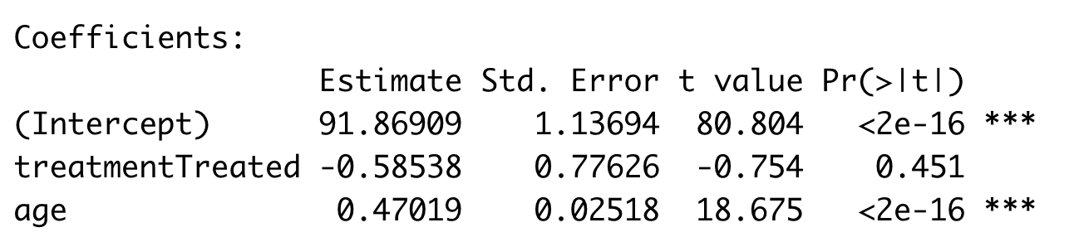
Linear regression w/ adjustment variable (1)
We are trying to determine if a disease severity score is associated with treatment status adjusting for age. We obtain data from an observational study with all variables.
We answer this question using linear regression:
Outcome: Blood pressure
Exposure: Treatment status
Adjustment covariate: Age
We do this in R and obtain the following output:

Slide 6
Linear regression w/ adjustment variable (2)
Linear regression:
Outcome: Blood pressure
Exposure: Treatment status
Adjustment covariate: Age

Slide 7
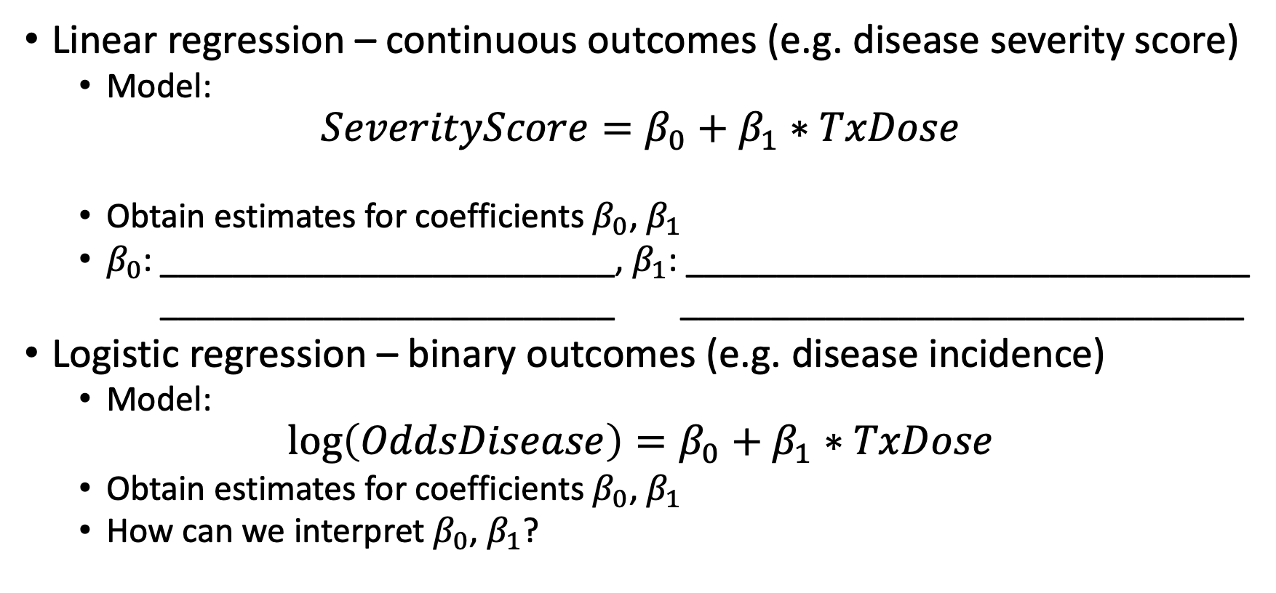
Logistic regression overview
Linear regression – continuous outcomes (e.g. disease severity score)
Model:
$$SeverityScore=β_{0}+β_{1}∗TxDose$$
Obtain estimates for coefficients $β_{0}$, $β_{1}$
$β_{0}$: _________________________, $β_{1}$: _______________________________
_________________________ _______________________________
Logistic regression – binary outcomes (e.g. disease incidence)
Model:
$$\log\left(OddsDisease\right)=β_{0}+β_{1}∗TxDose$$
Obtain estimates for coefficients $β_{0}$, $β_{1}$
How can we interpret $β_{0}$, $β_{1}$?

Slide 8
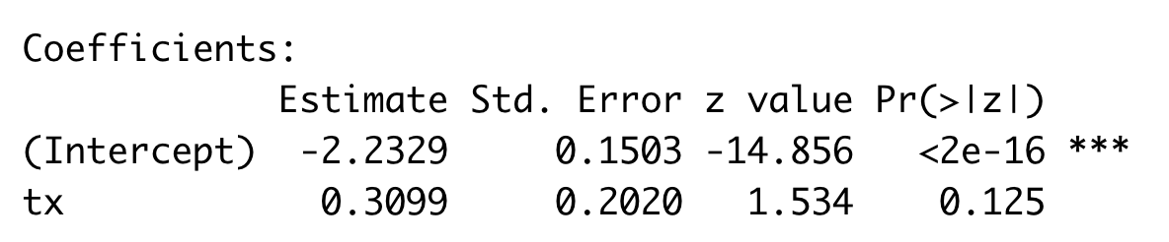
Logistic regression w/ binary variable (1)
We are trying to determine if a hypertension is associated with treatment status. We obtain data from an observational study with both variables.
We can analyze this using logistic regression:
Outcome: Hypertension (binary)
Exposure: Treatment status
We do this in R and obtain the following output:

Slide 9
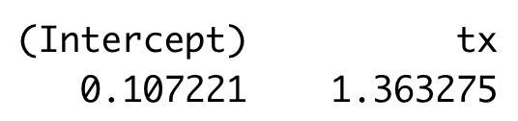
Logistic regression w/ binary variable (2)
Logistic regression:
Outcome: Hypertension (binary)
Exposure: Treatment status
Exponentiated coefficients:

Slide 10
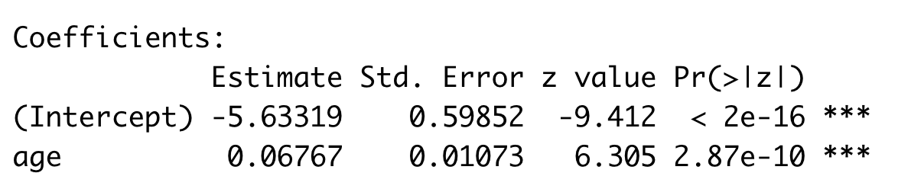
Logistic regression w/ continuous variable (1)
We are trying to determine if a odds of hypertension is associated with age. We obtain data from an observational study with both variables.
We answer this question using logistic regression:
Outcome: Hypertension (binary)
Exposure: Age
We do this in R and obtain the following output:
How can we interpret this output?

Slide 11
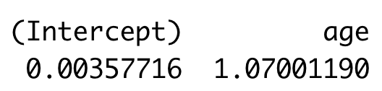
Logistic regression w/ continuous variable (2)
Logistic regression:
Outcome: Hypertension (binary)
Exposure: Age
Exponentiated coefficients:

Slide 12
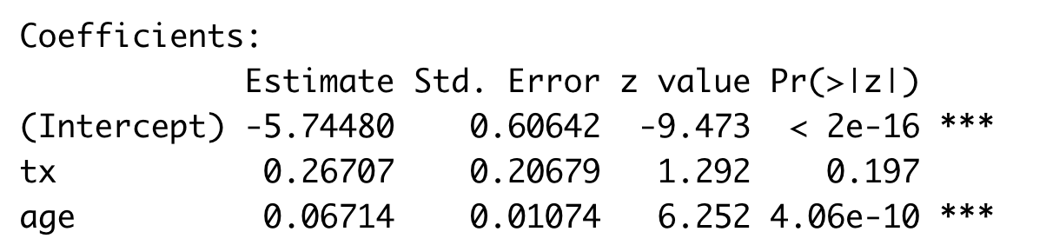
Logistic regression w/ adjustment variable (1)
We are trying to determine if a odds of hypertension is associated with treatment status adjusting for age. We obtain data from an observational study with all variables.
We answer this question using logistic regression:
Outcome: Hypertension (binary)
Exposure: Treatment status
Adjustment covariate: Age
We do this in R and obtain the following output:

Slide 13
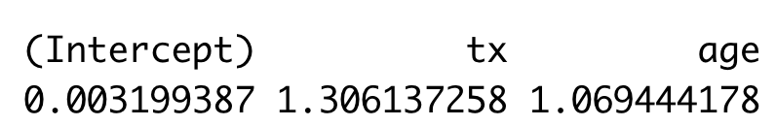
Logistic regression w/ adjustment variable (2)
Logistic regression:
Outcome: Hypertension (binary)
Exposure: Treatment status
Adjustment covariate: Age
Exponentiated coefficients:

