Slide 1
Factor variables and comparing means/proportions
CRISP R Mini-Course
Day 5

Slide 2
Review from last time
What does the code below do? Explain to your neighbor!
Library(dplyr)
df <- read.csv(“data.csv”)
df_new <- df %>%
mutate(age_months = age * 12) %>%
filter(tx == 1 & age_months > 100) %>%
select(id, tx, sex, age_months, bmi, educyrs)
table1(~ bmi + educyrs | sex, data = df_new)

Slide 3
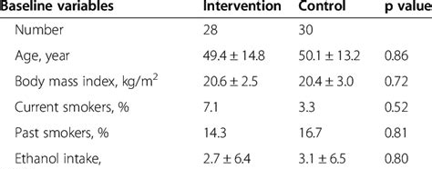
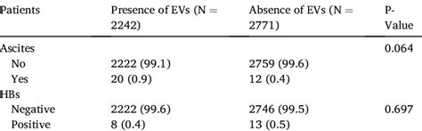
Today’s agenda
Factor variables, finishing up creating “Table 1”
Hypothesis testing comparing means and proportions
Midterm practicum
We will learn how to obtain these p-values!

Slide 4
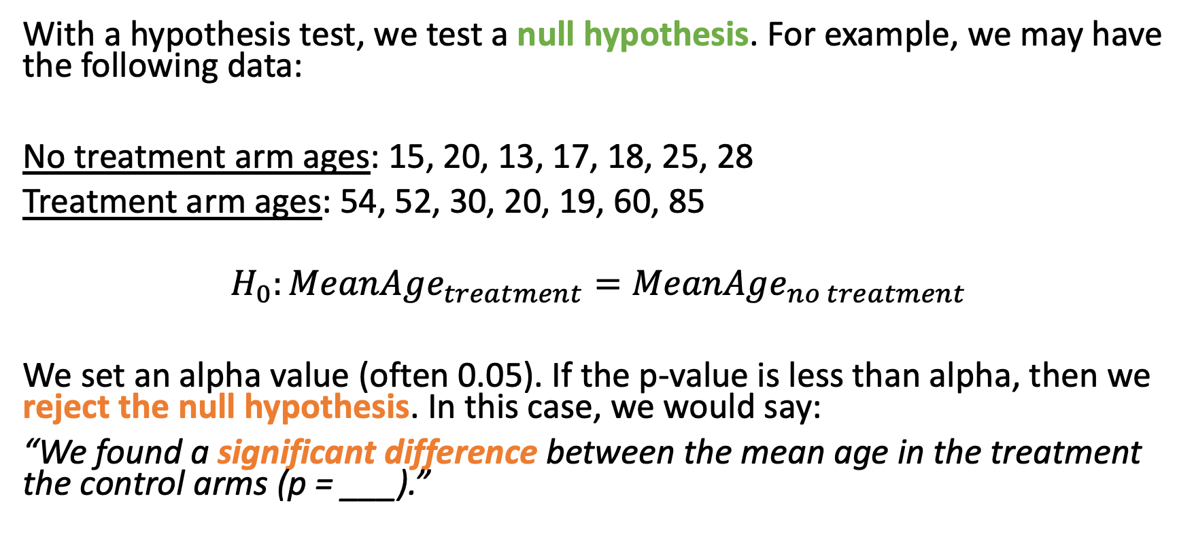
Hypothesis testing
With a hypothesis test, we test a null hypothesis. For example, we may have the following data:
No treatment arm ages: 15, 20, 13, 17, 18, 25, 28
Treatment arm ages: 54, 52, 30, 20, 19, 60, 85
$$H_{0}:MeanAge_{treatment}=MeanAge_{no treatment}$$
We set an alpha value (often 0.05). If the p-value is less than alpha, then we reject the null hypothesis. In this case, we would say:
“We found a significant difference between the mean age in the treatment the control arms (p = ___).”

Slide 5
Hypothesis testing in Table 1’s
 | Placebo (N= 1000) | Treatment (N = 1000) | p-value | Test | Null Hypothesis | Interpretation
Age [Mean (sd)] | 28.4 (10.5) | 28.6 (9.4) | 0.65 | T-test
Sex – Male [n (%)] | 490 (49%) | 520 (52%) | 0.20 | Z-test or Chi-squared
Female [n (%)] | 510 (51%) | 480 (48%)
Severity – No [n (%)] | 200 (20%) | 500 (50%) | <0.01 | Chi-squared
Medium [n (%)] | 400 (40%) | 300 (30%)
High [n (%)] | 400 (40%) | 200 (20%)
Disease Score [Mean (sd)] | 45.2 (10.4) | 30.2 (12.5) | <0.01 | T-test

Slide 6
Guided tutorial
Today, we will learn the basics of dataset processing.
Go to bit.ly/crisp2025.
Download Rmd file for today into your CRISP R notes folder.
We will go through the tutorial (until the exercises) together! Try to follow along, and type and run the code as I do it.

