Slide 1
JAVA
An overview for C++ programmers

Slide 2

C++
Unit 01_Java for C++ programmers

Slide 3

… Java
Unit 01_Java for C++ programmers

Slide 4
The early history
James Gosling, Sun Microsystems
Not the usual start for a prog. language
  Consumer electronics, 1991
  Mosaic and the Internet, 1994
  The revolution: applets, 1995
Since then, many improvements and additions have been made to the language
Unit 01_Java for C++ programmers

Slide 5
Why is Java so appealing ?
Platform independent
Safe
Easy to learn
Powerful, well-documented, and easy-to-use libraries to perform many complicated tasks
During this presentation, we’ll look into each of these qualities, and more
  Comparison to C++
  Hands-on activities
Unit 01_Java for C++ programmers

Slide 6
Platform independence
Sun’s motto for Java:
  write once, run anywhere
It’s a great idea, but…
  how’s it done ?
  what are the drawbacks ?
Unit 01_Java for C++ programmers

Slide 7
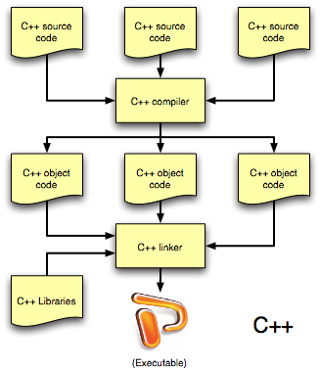
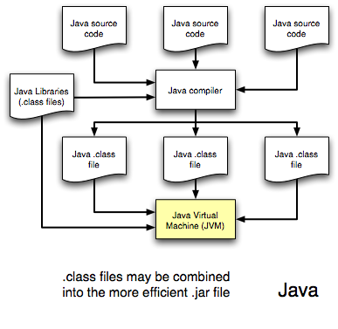
Platform independence
Unit 01_Java for C++ programmers

Slide 8
Platform independence
Wait… so does it mean that Java is an interpreted language ? Yes, source is compiled into bytecodes.
Aren’t interpreted languages inherently slower than compiled ones ? Yes.
Why you should not care so much, though:
  Java trades speed for
    platform independence
    safety (more on this later)
  Java compilers are pretty darn good anyway
Still, if you’re really worried about speed, you may always use the so-called just-in-time (JIT) compilers.
Unit 01_Java for C++ programmers

Slide 9
Safe and easy to learn
The first thing to note here is that these are relative terms
In this class, we’ll compare Java and C++
The general consensus is that Java is easier to learn and use than C++, but I’ll let you be the judge of that.
Is Java safer than C++ ?
Unit 01_Java for C++ programmers

Slide 10
Safer than C++ ?
What do we mean by “safe” anyway ?
  Less prone to programmer mistakes
Java achieves better safety than C++ by
  providing sandboxes (won’t talk much about them here)
  checking every array access for out-of-bounds errors
  eliminating direct access to pointer operations
  automatically reclaiming any (heap) memory space not in use (automatic garbage collection)
  having a less fragile approach to multiple inheritance
  making every function virtual
  providing, generally speaking, a simpler syntax than C++
Unit 01_Java for C++ programmers

Slide 11
No pointers ?
Some people claim that Java has no pointers… Not true!
  All objects are accessed through references, which are automatically de-referenced pointers
  However, the pointer nature of these references is hidden from the programmer. Why ?
    Reduced number of pointer-related errors
Unit 01_Java for C++ programmers

Slide 12
Automatic garbage collection
Objects are always allocated in the heap, using new, as in
Foo f = new Foo();
  f itself is always allocated in the stack
  the object referenced by f is allocated in the heap
  recall that memory allocation in C++ is not so simple
Java keeps track of how many valid references exist for each object – when an object has no more references to it, the memory space it occupies in the heap gets reclaimed
No, it doesn’t mean that you may be sloppy
Automatic garbage collection has pros and cons
  Pro: prevents many common memory allocation bugs
  Con: has a negative impact on your program’s efficiency
Unit 01_Java for C++ programmers

Slide 13
No multiple inheritance ?
C++ inheritance forces the inheritance of both data and behavior (code)
  That’s a very fragile approach – in order to inherit some behavior your class may have to gain some data as well, even if it’s not really needed
Java solves that problem and at the same time eliminates the need for multiple inheritance by defining something called an interface
  Interfaces only define the expected behavior of a set of functions, like a contract – no data and no implementation
  A class may implement as many interfaces as needed
Of course, regular inheritance between classes is still allowed, but a class may inherit from only one other class - no multiple class inheritance in Java
Unit 01_Java for C++ programmers

Slide 14
Functions are always virtual
All (non-static) functions in Java follow a late-binding process
  Which function code is actually executed depends on the actual run-time type of the object on which the function is being called, not on the object’s declared type at compile time
In C++, unless one declares a function to be virtual, the code to be executed is decided at compile time
Thus, in Java, all (non-static) functions are virtual
Late-binding is a little slower but prevents common hard-to-find bugs
Unit 01_Java for C++ programmers

Slide 15
Other differences between Java & C++
(Almost) everything is an object
  Only primitive types (boolean, char, int, long, float, double) are not objects
Function arguments are always passed by value
  Objects are not copied – only their references are
Neat solution to name collisions (packages)
No separation between header and implementation
No operator overloading
No structs
Generics (templates) and enums (constant enumerations) appeared later (Java 2)
Unit 01_Java for C++ programmers

Slide 16
A few other nice things about Java
Inherently multi-threaded
  Threads are supported at the language level and are also objects
Much nicer compiler and run-time error messages than C++
Exception handling is idiomatic – every Sun-written library uses it and does so consistently
Powerful and easy-to-use libraries for data structures, multi-threading, networking, I/O, graphics, GUI
Unit 01_Java for C++ programmers

Slide 17
Other cool stuff
Javadoc
  Auto-documenting your code
    Your comments are nicely formatted into a set of HTML pages
  C++ has something similar: Doxygen
Swing
  Dynamically pluggable look-and-feel (plaf)
  Powerful, easy-to-use GUI toolkit
Unit 01_Java for C++ programmers

Slide 18
Hot from Oracle…
Current release version: Java 8 Changes since Java 5
Support for generics (called templates in C++ )
Autoboxing
Enhanced for loop
Enumerated types
Static import
C-style formatted input/output
Variable arguments
Most importantly…. lambdas
http://www.oracle.com/technetwork/index.html
Unit 01_Java for C++ programmers

Slide 19
References – online
The owners of Java
  http://www.oracle.com/technetwork/java/index.html
  The Java Developer Connection is a must. In particular, their Tech Tips free mailing list is awesome
  http://www.oracle.com/technetwork/java/index.html
  A cool site to keep in touch with Java news
  http://www.ibiblio.org/java/javafaq.html
  This site's free subscription mailing lists are excellent
  http://www.javaworld.com/
Unit 01_Java for C++ programmers

Slide 20






References – books I (basics)
The Java Tutorial: A Short Course on the Basics
Thinking in Java (http://www.mindview.net/Books/TIJ/)
The JFC Swing Tutorial
Java in a Nutshell
Java Cookbook
The Elements of Java Style
Unit 01_Java for C++ programmers

Slide 21


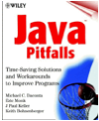


References – books II (intermediate)
Practical Java Programming Language Guide
Effective Java Programming Language Guide
Java Pitfalls: Time-Saving Solutions and Workarounds to Improve Programs
Design Patterns Java Workbook
GoF’s Design Patterns (C++)
Unit 01_Java for C++ programmers

Slide 22

Questions ?
Unit 01_Java for C++ programmers

