Slide 1
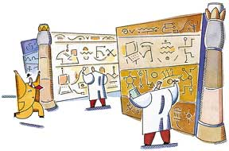
CS321
Advanced Programming Techniques
A tiny intro to UML class diagrams

Slide 2
What Is UML?
It is a Graphical Language for Object Oriented Software
Design
  Graphical
  It uses icons and diagrams
  Language
  It is meant to communicate
  Software Design
  The elements of the language represent software entities and their relationships
It is NOT ...
  Process/Methodology
  Magic Wand

Slide 3
History
Developed by ...
Grady Booch
  Booch Notation
  Good Design Notation
James Rumbaugh
  OMT - Object Modelling Technique
  Good Analysis Notation
Ivar Jacobson
  Objectory Process
  An Iterative/Incremental Development Process

Slide 4
UML has 9 kinds of diagrams
Class Diagram
Object Diagram
Component Diagram
Deployment Diagram
Use Case Diagram
Sequence Diagram
Collaboration Diagram
Statechart Diagram
Activity Diagram
Structural Diagrams
Behavioral Diagrams

Slide 5
Static VS Dynamic
Static Diagrams
  show the relationships between classes and objects in the design
  have no time element
  Static Diagrams
    Class Diagram
    Object Diagram
    Deployment Diagram
Dynamic Diagrams
  show how the elements of the system interact with each other
  have a time dependency
  Dynamic Diagrams
    Sequence Diagram
    Collaboration Diagram
    State Diagram
    Activity Diagram

Slide 6
Perspectives on Classes
conceptual (domain analysis)
  shows concepts of the domain
  implementation-independent
specification (design)
  general structure of the system
  interfaces (types, not classes)
  used in high-level design
implementation (programming)
  structure of the implementation
  most often used
Always try to draw from a single perspective!

Slide 7
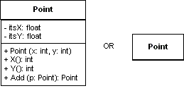
Class Icon
3 Compartments
Name (plus stereotype and properties)
Attributes
Methods
Attribute and Method declarations use a Pascal-like notation
class Point {
public Point (int x, int y) { ... }
public int X() { return itsX; }
public int Y() { return itsY; }
public Point Add (Point p) {
return new Point (itsX + p.itsX, itsY + p.itsY);
}
private float itsX;
private float itsY;
}

Slide 8
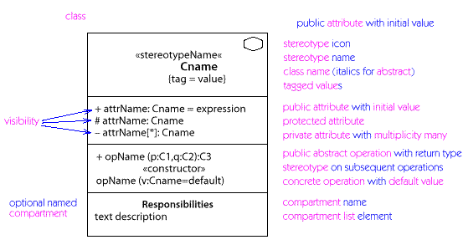
Full class notation

Slide 9
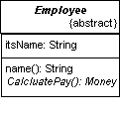
Abstract Class
Abstract classes names are italicized
The {abstract} property may be used as well
Abstract methods are also in italics
abstract class Employee {
public name() { return itsName; }
public abstract Money calculatePay();
private String itsName;
}

Slide 10
UML syntax for operations
( Pascal, Delphi, Ada, Eiffel style)
visibility name (parameter list) : return-type-expression
+ assignAgent (a : Agent) : Boolean
  visibility: public (+), protected (#), private (-)
    Interpretation is language dependent
    Not needed on conceptual level
  name: string
  parameter list: arguments (syntax as in attributes)
  return-type-expression: language-dependent specification

Slide 11
Interfaces
Interfaces have the <<interface>> (or <<type>>) stereotype.
Interfaces
have no attributes
have no concrete methods only abstract methods
interface Command { void DoIt ();
}
Doit ( ) : void
Command
<< interface>>

Slide 12
Class versus type
Type
  protocol understood by an object
  set of operations that are used
Class
  implementation oriented construct
  implements one or more types
In Java a type is an interface, in C++ a type is an abstract class
UML 1.3 has the <<interface>> stereotype and the lollipop

Slide 13
Overview of UML Relationships
dependency “A uses B”
  a change in the specification of B may affect A
  dashed arrow, with optional name
generalization “B inherits from A”
  B is a general thing, A is a more specific thing
  solid directed line, large open arrow head
association “B is part of A”
  structural relationships
  solid line, with optional name, direction indicator

Slide 14

Associations
An association exists between any two classes that can send messages to each other.
Unless otherwise specified, associations are bidirectional
class Employer { // ... private Employee itsWorker;
}
class Employee {
// ... private Employer }

Slide 15

Association Annotation
Additional annotations are available for associations
association name identifies the relationship between the classes
a direction may be given to the association name
role names identify how each class fits into the role
role names are attached to an endpoint of an association
role names are assumed to be the attribute name of class at the opposite
endpoint
class Employer { // ... private Employee itsWorker;
}
class Employee {
// ... private Employer }

Slide 16

Navigable Associations
Navigable associations can only be traversed in one direction.
An arrow on the association identifies the direction of navigability.
class Employee {
// ... private BenefitsPackage itsBenefits;
}
class BenefitsPackage {
// ... No reference to the owning employee
}

Slide 17
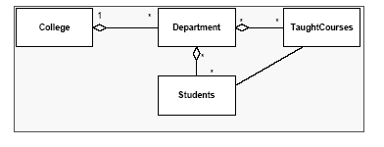
Aggregation
An aggregation is a kind of association denoting
a ‘part of’ (or 'has-a' ) relationship between
the objects of the respective classes.
Aggregation may be shared

Slide 18
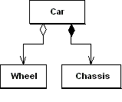
Aggregation
Has-a relationship but..
No ownership implied
No cycles in the object graph .
class Car {
Wheel getWheel (int n)
{ return itsWheels[n];}
// ...
private Wheel [] itsWheels;
private Chassis itsChassis;
}

Slide 19
Aggregation
Specifies a whole/part relationship between the aggregate (whole) and component part.
This relationship between the aggregate and component is a weak “has a” relationship The component object may be accessed through other objects without going through the aggregate object.
The aggregate object does not take part in the lifecycle of the component object, meaning the component object may outlive the aggregate object. The state of the component object still forms part of the aggregate object.
Example: CSC121-Class object contains zero or more Student objects. The state of each Student object is part of the state of the History-Class object. If the History-Class object is destroyed, the Student objects may continue to exist.

Slide 20
Composition
Composition is a type of aggregation which links the
lifetimes of the aggregate and its parts.
In other words:
The parts cannot exist if the aggregate no longer exists
An entity can exist as part of only one aggregate
This is the “strong” has-a association

Slide 21
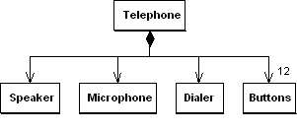
Composition
Composition Means ...
the contained item is part of the containing item
the contained item's lifetime is controlled by the containing item
the containing item is responsible for deleting the contained item (i.e. ownership)
class Telephone {
// …
private Speaker itsSpeaker;
private Microphone itsMic;
private Dialer itsDialer;
private Button itsButtons[];
} } }

Slide 22
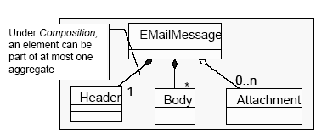
Composition

Slide 23
Composition
a kind of association very similar to aggregation except where the composite object has sole responsibility for the disposition of the component parts.
The relationship between the composite and the component is a strong “has a” relationship, as the composite object takes ownership of the component.
the composite is responsible for the creation and destruction of the component parts.
An object may only be part of one composite. If the composite object is destroyed, all the component parts must be destroyed, or the reference and responsibility of the component part must be handed over to another object.
Composition enforces encapsulation as the component parts usually are members of the composite object.
An example of composition is a House object contains zero or more Room objects. The state of each Room object has an influence on the House object. If the House object is destroyed, the Room objects will also be destroyed.

Slide 24

Multiplicity
Possible mulitiplicity annotations are:
1 - Exactly One
* or 0..* - Zero or More
1..* - One or More
2..10 - 2 to 10 (an exact range)
.
class HourlyEmployee {
// ...
private TimeCard itsCards[];
}

Slide 25
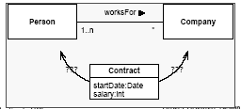
Association Classes
Associations may have their own properties.
An association class is an element that has both association and class properties.
Occurs frequently in many-to-many associations because it is difficult to position the property at either end of the association.
The employment is
subject to a contract
specifying start date,
salary, etc.

Slide 26
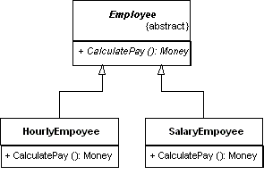
Inheritance
Denoted by an arrow
Java Terminology: “extends “
abstract class Employee {
public String name() { return itsName; }
public abstract Money CalculatePay();
private String itsName;
}
class HourlyEmployee extends Employee {
public Money CalculatePay() {
// Sum up all the timecards
// to calculate pay
}
}
class SalaryEmployee extends Employee {
public Money CalculatePay() {
return itsFixedSalary;
}
}

Slide 27

Interface Inheritance (Realization)
Java Terminology: implements
Similar to Class Inheritance
often the solid inheritance arrow is used as well “
interface Command {
void DoIt ();
}
class PrintCommand implements Command {
public void DoIt () {
// send a document to the printer
}
}

Slide 28
Interfaces in UML (1)
Stereotype <<interface>>
<<interface>>
DataInput
InputStream
{abstract}
OrderReader
close()
Generalization
Dependency
DataInputStream
Realization

Slide 29
Interfaces in UML (2)
Lollipops (“short-hand notation”)
DataInput
OrderReader
Interface
DataInputStream
Dependency

Slide 30
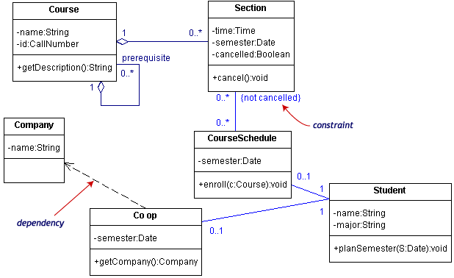
Class diagram example

Slide 31

Object Icon
Object Icons are like class icons, except ...
they have their name underlined
the object name is identified with the class (objName: ClassName)
The class name may be omitted if it is unimportant (e.g. objName)
The object name may be omitted if it is unimportant (e.g. : ClassName)
Make sure you include the colon!
The attribute and method compartments are usually omitted
although current state may be given in an attribute compartment
Employee betty = new HourlyEmployee (”Betty”, 25.00);B

Slide 32
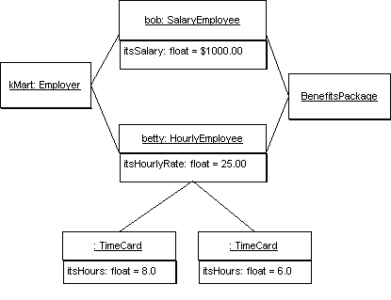
Object Diagram
Object diagrams are good for capturing the state of the system at a given point in time.
Associations in class diagrams become links in object diagrams

Slide 33
public static void main (String args[]) {
Employer kMart = new Employer ("KMart");
Employee bob = new SalaryEmployee("Bob", 1000.00);
Employee betty = new HourlyEmployee ("Betty", 25.00);
kMart.hire (bob, StandardBenefits.instance());
kMart.hire (betty, StandardBenefits.instance());
betty.submits (new TimeCard(8.0));
betty.submits (new TimeCard(6.0));
// Take a Snapshot of the system! NOW!
kMart.doPayroll();
}

Slide 34
Question
What is the class diagram for the following?

Slide 35
interface Command {
void DoIt();
void UnDoIt();
}
interface Document {
void insert (String text, int position);
void delete (int position, int length);
}
class InsertTextCommand implements Command {
InsertTextCommand (String t, int pos, Document doc) {
itsNewText = t;
itsPosition = pos;
itsDoc = doc;
}
public void DoIt () {
itsDoc.insert (itsNewText, itsPosition);
}
public void UnDoIt () {
itsDoc.delete (itsPosition, itsNewText.length());
}
private String itsNewText
private int itsPosition;
private Document itsDoc;
}
class CommandInterpretor {
public void DoCommand (Command c) {
c.DoIt();
pushHistory(c);
}
public void UndoCommand () {
if (itsCommandDepth > 0) {
Command c = popHistory());
c.UnDoIt();
}
}
private void pushHistory (Command c) { ... }
private Command popHistory () { ... }
private int itsCommandDepth;
private CommandStack itsCommandHistory[];
}

