Slide 1
Chapter 2:
Input, Processing, and Output
Starting Out with Programming Logic & Design
Third Edition
by Tony Gaddis

Slide 2
Chapter Topics
2.1 Designing a Program
2.2 Output, Input, and Variables
2.3 Variable Assignment and Calculations
2.4 Variable Declarations and Data Types
2.5 Named Constants
2.6 Hand Tracing a Program
2.7 Documenting a Program
2.8 Designing Your First Program
1-<number>

Slide 3
2.1 Designing a Program
The first step in programming is designing – flowcharts and pseudocode help with this process.
Next, the code is written.
All code must be cleared of all syntax errors.
After the executable is created, it can be checked for logic errors.
If logic errors exist, the program must be debugged.
1-<number>

Slide 4

2.1 Designing a Program
The purpose of Programming Logic and Design is to focus on Flowcharts and Pseudocode.
The design is the foundation of a good program.
Figure 2-1 The program development cycle
1-<number>

Slide 5
2.1 Designing a Program
Two steps in designing a program
Understand the tasks that the program is to perform.
  Learning what the customer wants.
Determine the steps that must be taken to perform the task.
  Create an algorithm, or step-by-step directions to solve the problem.
  Use flowcharts and/or pseudocode to solve.
1-<number>

Slide 6
Designing Your Algorithm
Begin backward…..
What OUTPUT are we looking for?
What INPUTS are we “given”..
What are the PROCESSES that will get us from the INPUT that we have to the OUTPUT that we need?
I-P-O
1-<number>

Slide 7
Algorithm Steps
1)Identify the OUTPUT/INPUT/Process
2)Put instructions in the logical order to get from the input to the output.
Dave wants to buy a car. He has saved $3000 toward the purchase. He found a car he would like to buy. The price of the car is $4500. How much more money does he need to save?
What is the output ? How much more money Dave needs to save.
What is the input? *what do we already know? Dave has saved $3000 so far. And the final cost of the car is $4500.
What is the process? To calculate how much more money Dave needs to save. ( Subtract what Dave has from the total to determine the amount he needs to save.
1-<number>

Slide 8
Algorithm -
Algorithm
Input the price of the car
Input the amount that Dave has saved
Calculate the difference by subtracting the amount Dave has saved from the price of the car.
Display the how much more money Dave needs to save to purchase the car.
1-<number>

Slide 9
2.1 Designing a Program
Pseudocode
Fake code used as a model for programs
No syntax rules
Well written pseudocode can be easily translated to actual code
      Display “Enter the number of hours”
      Input hours
      Display “Enter the hourly pay rate”
      Input payRate
      Set grossPay = hours * payRate
      Display “The gross pay is $”, grossPay
1-<number>

Slide 10
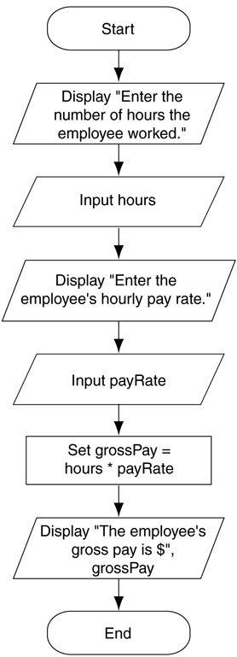
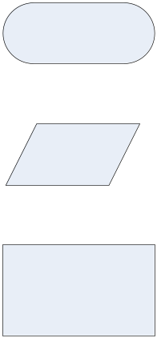
2.1 Designing a Program
Figure 2.2 Flowchart for the
pay calculating program
Flowcharts
A diagram that graphically depicts the steps that take place in a program
Terminator used for start and stop
Parallelogram used for input and output
_{Rectangle used for processes}
1-<number>

Slide 11
2.2 Output, Input, and Variables
Output – data that is generated and displayed
Input – data that a program receives
Variables – storage locations in memory for data
Computer programs typically follow 3 steps
  Input is received
  Some process is performed on the input
  Output is produced
1-<number>

Slide 12
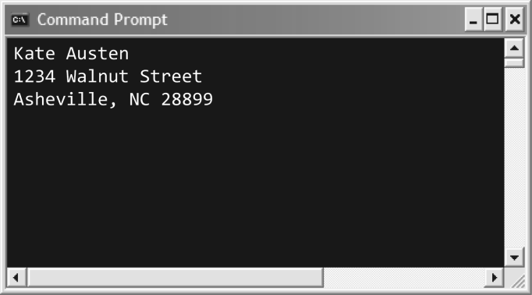
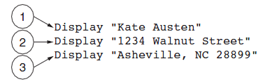
2.2 Output, Input, and Variables
Display is the keyword to show output to the screen
Sequence – lines execute in the order they appear
String Literals – a sequence of characters
Figure 2-4 The statements execute in order
Figure 2-5 Output of Program 2-1
1-<number>

Slide 13
Display Statements
DISPLAY is a RESERVED or KEYWORD we use in our pseudocode.
The keyword DISPLAY implies that the output will be shown on the console.
Surround EXACTLY what you would like to see on the console(screen) with double quotes “
Example Sourcecode (pseudocode)
  DISPLAY “ Hello class. It is 2014. “
  Output on console will be
  Hello class. It is 2014.
1-<number>

Slide 14
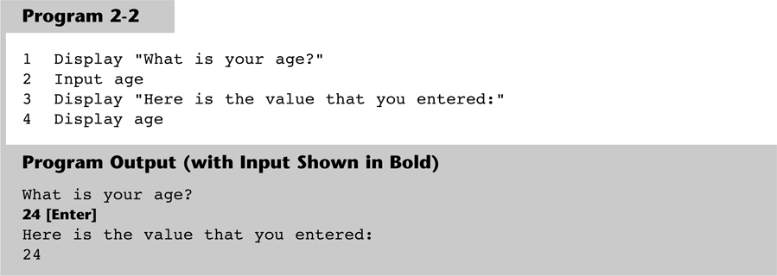
2.2 Output, Input, and Variables
Input is the keyword to take values from the user of the program
That value is usually stored in a variable
1-<number>

Slide 15
2.2 Output, Input, and Variables
Programmers can define variable names following certain rules
  Must be one word, no spaces
  Generally, punctuation characters are avoided
  Generally, the first character cannot be a number
  Name a variable something that indicates what may be stored in it
camelCase is popular naming convention
1-<number>

Slide 16
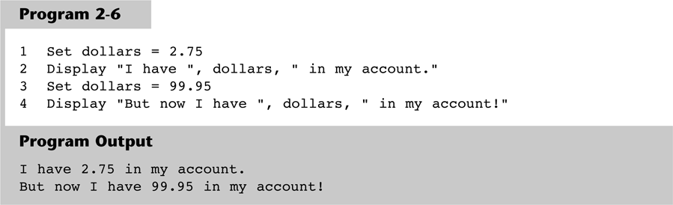
2.3 Variable Assignment & Calculations
Variable assignment does not always have to come from user input, it can also be set through an assignment statement
Set price = 20
1-<number>

Slide 17
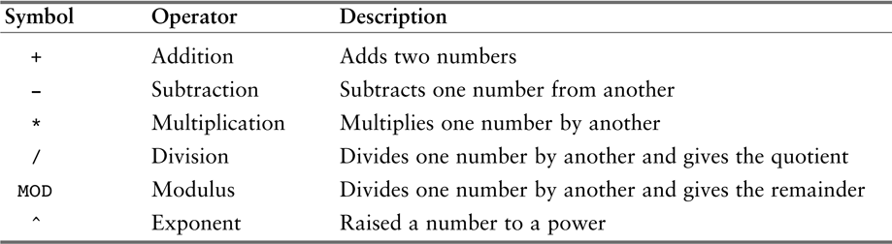
2.3 Variable Assignment & Calculations
Calculations are performed using math operators
The expression is normally stored in variables
Set sale = price – discount
Table 2-1 Common math operators
1-<number>

Slide 18

1-<number>

Slide 19
2.4 Variable Declarations & Data Types
A variable declaration includes a variable’s name and a variable’s data type
Data Type – defines the type of data you intend to store in a variable
  Integer – stores only whole numbers
  Real – stores whole or decimal numbers
  String – any series of characters
Declare Real grossPay
1-<number>

Slide 20
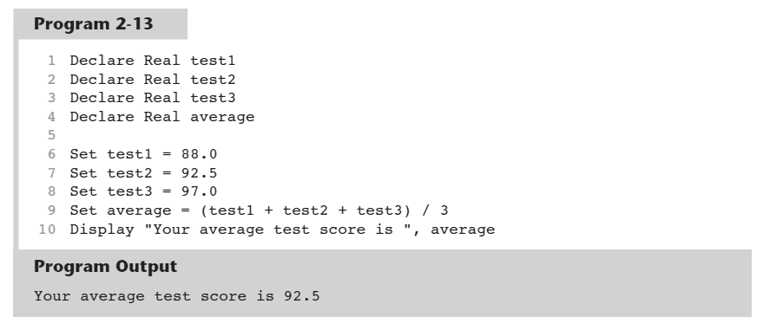
2.4 Variable Declarations & Data Types
For safety and to avoid logic errors, variables should be initialized to 0 or some other value
1-<number>

Slide 21
2.5 Named Constants
A named constant is a name that represents a value that cannot be changed
  Makes programs more self explanatory
  If a change to the value occurs, it only has to be modified in one place
Constant Real INTEREST_RATE = 0.069
1-<number>

Slide 22
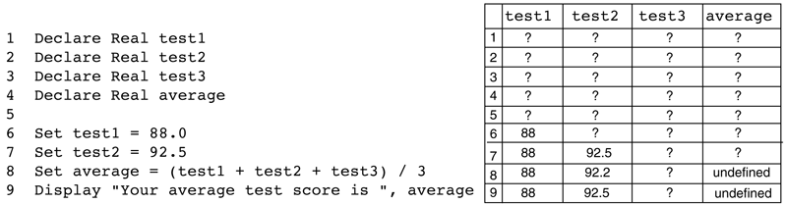
2.6 Hand Tracing a Program
Hand tracing is a simple debugging process for locating hard to find errors in a program
Involves creating a chart with a column for each variable, and a row for each line of code
Figure 2-15 Program with the hand trace chart completed
1-<number>

Slide 23
2.7 Documenting a Program
External documentation describes aspects of the program for the user, sometimes written by a technical writer
Internal documentation explains how parts of the program works for the programmer, also known as comments
// comments are often distinguished within
// the program with line comments
1-<number>

Slide 24
2.8 Designing Your First Program
Calculate the batting average for any player
Batting Average = Hits ÷ Times at Bat
Determine what is required for each phase of the program:
What must be read as input?
What will be done with the input?
What will be the output?
1-<number>

Slide 25
2.8 Designing Your First Program
Input is received.
  The number of hits
  The number of times at bat
Some process is performed on the input.
  Calculate the batting average
  Divide the number of hits by the number of times at bat
Output is produced.
  The player’s batting average
1-<number>

Slide 26
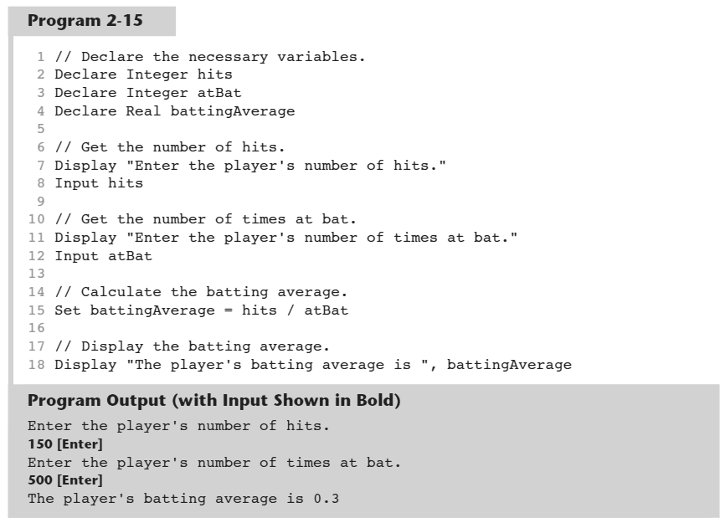
2.8 Designing Your First Program
1-<number>

Slide 27
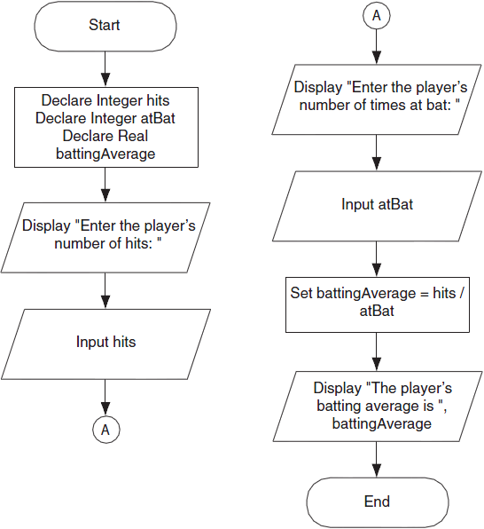
2.8 Designing Your First Program
Figure 2-17 Flowchart for program 2-15
1-<number>

Slide 28
2.8 Designing Your First Program
Summary
  Input
    Determine data needed for input
    Choose variables to store the input
  Process
    Determine calculations to be performed
    Choose variables to store the calculations
  Output
    Determine what output the program will display
    Usually the results of the program’s calculations
1-<number>

