Slide 1
SharePoint and Claims
John Ptacek
Senior Portal Engineer
@Jptacek
Skyline Technologies, Inc.
August 13, 2012

Slide 2
Agenda
Claims Overview
Membership Provider
Windows Identity Foundation(WIF)
Trusted Identity Provider
Azure Claims Service
Notes:
Scrum most popular.

Slide 3
Claims Overview
Claims – A piece of information about a user
Security Asset Markup Language (SAML) – XML based standard for authentication\
Claims Provider – Entity that provides claims
Security Token Service (STS) – Responsible for issuing/managing tokens
Relying Party – Relies on a provider of identity

Slide 4
Claims
Authentication is NOT an application issue
Authorization is an application issue
SharePoint has never had Authentication
STS is NOT an application issue, Enterprise
Claims have won. Get on board

Slide 5
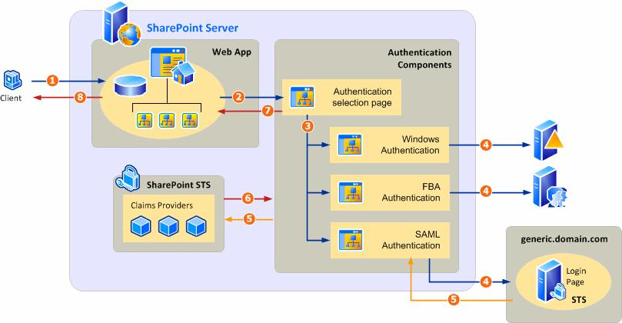
SharePoint Claims Processing

Slide 6
Membership Provider
ASP.NET Provider model
Default SharePoint 2007 forms based authentication
Still useable with SharePoint 2010
Update Web App, Central Admin app, STS app

Slide 7
Windows Identity Foundation
New authentication model
Claims based implementation
Can be consumed by other applications
Enterprise solution

Slide 8
Trusted Identity Provider
Create WIF app that is consumed by SP and ASP.NET
Consumed by ASP.NET Webforms and/or MVC
Can be consumed by Azure web app
Be careful with web.config

Slide 9
SharePoint Claims Processing

Slide 10
Azure Access Control Services (ACS)
Easy way to authenticate and authorize users
Integrates with Windows Identity Foundation (WIF)
Cost is ~ $2/100,000 transactions

Slide 11
WIF vs ACS
WIF is a technology
ACS is a product (that uses WIF)
ACS is a Cloud Service
WIF is part of .NET Stack
ACS does heavy lifting for managing protocols
OAUTH, OpenID, WS-*, Facebook
WIF is token parsing and tooling

Slide 12
Questions?!
Thank You!
John Ptacek
@Jptacek
http://www.SkylineTechnologies.com
http://www.TenThousandWords.net

