Slide 1
Hacking Your Day TO Health
John Ptacek/@jptacek
jptacek@SkylineTechnologies.com
That Conference

Slide 2



Slide 3












Slide 4
Introduction
Why Me
Why Health
Food
Exercise

Slide 5
Introduction – Why me
I am a dummy
Why not me?
I like to eat

Slide 6
Introduction – Why Health
Obesity
More than one third of Adults are obese
Obesity related conditions
Heart Disease
Stroke
Cancer
Leading causes of preventable deaths
http://www.cdc.gov/obesity/data/adult.html - 6 ft Male, 220 lbs = BMI 30

Slide 7
Introduction – Why Health
One out of 13 Americans has diabetes
Main causes of Type 2 Diabetes
Obesity
Lack of physical activity
Heart disease kills one out of every three Americans

Slide 8
Introduction – Why Health
Reduce health risks early
Quality of Life

Slide 9
Eating – Nutrition basics
Macronutrients
Carbohydrates
Fats
Protein
Fiber
Micronutrients
Vitamins
Minerals

Slide 10
Eating – Nutrition: Carbs
Carbohydrates
Main source of energy for the body
Create energy stores
Found in grains, vegetables, fruits, milk
Fiber

Slide 11
Eating – Nutrition:Fats
Provides energy during exercise, between meals
Not bad!
Essential for cell membranes
Unsaturated fats reduce heart risk
Omega 3 assist in brain function

Slide 12
Eating – Nutrition:Fats
Unsaturated(the good) – Olive and canola oils, salmon
Lower LDL cholesterol
Increase HDL
Saturated (the bad) – Dairy, pork, beef
Raise LDL cholesterol
Lower HDL
TransFat (the ugly) – hydrogenated, margarines, fried foods

Slide 13
Eating – Nutrition:Protein
Builds and maintains muscles
Assists in metabolism
Food Sources
Meat
Seeds
Legumes
Nuts
Spinach

Slide 14
Eating – Nutrition:fiber
Lowers blood cholesterol
Decreases risk of heart disease, diabetes
Food Sources
Whole Grains (brown rice, oatmeal)
Whole grain products like cereal, bread
Vegetables, Legumes

Slide 15
Eating – micronutrients
Vitamins – Organic, broken down by air, water soluble
Minerals – Inorganic, easily find way to body
Raw materials for your body
Your body does not produce
Hundreds of roles
Bones
Wounds
Antioxidants

Slide 16
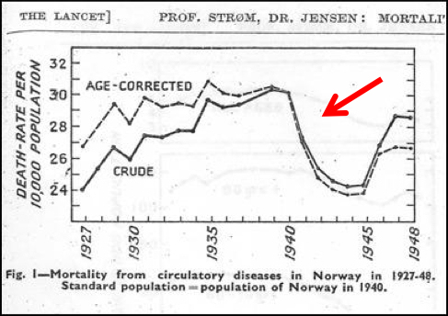
Eating – The western diet
Norway Heart disease during 1940s

Slide 17
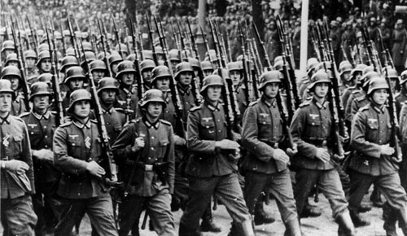
Eating – the western diet
What is this magical drug?
The German Army

Slide 18
Eating – the western diet
During WW II, Germany confiscated livestock
Norway, and others, diet changed
Whole grains, legumes, vegetables, fruit
Heart attack and strokes plummet
After end of war in 1945, livestock back
Deaths raise to pre WWII levels

Slide 19
Eating – the western diet
Western Diet, also called meat-sweet
Red meat
Sugary desserts
High-fat food
Refined Grains
Typical American diet
50% carbs, 15% protein, 35% fat
Recommended
55% carbs, 15% protein, 30% fat

Slide 20
Eating – the western diet
Epidemiological studies direct correlation with:
Obesity
Death from heart attack
Cancer

Slide 21
Eating – the China study
Study in 83 from Chinese, Cornell and Oxford Researchers
Examined diets, exercise and disease of 6500 Chinese
65 Rural counties in China
Obesity Related to what people eat
Chinese consume 20% more calories
Americans 25% fatter
Chinese eat 1/3 of fat and twice the starch
Body easily stores fat, more work to rid carbs

Slide 22
Eating – the China study
Recommend that 10-15% of calories come from fat
70% of American proteins comes from animals, only 7% of Chinese
More meat Chinese eat; more heart disease, cancer, diabetes

Slide 23

Eating

Slide 24
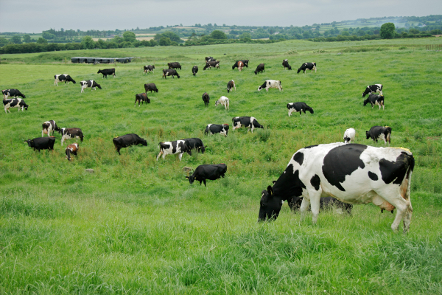
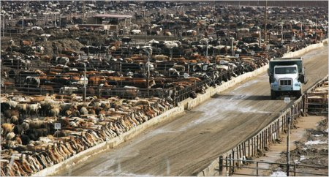
Eating - Beef
What we picture
What we eat

Slide 25
Eating – beef
Cattles are ruminants
Grass eaters. Highly specialized digestive system
Majority of cattle go through Concentrated Animal Feeding Operation (CAFO)
1000 head cattle, close proximity
Fattened up with corn
Corn diet makes cattle sick
80% of the US Antibiotics used on animal

Slide 26
Eating – beef
Corn fed beef
More saturated fat
Less omega-3 fatty acids

Slide 27
Eating – chicken/pork
Same story, some different words
Right now, porcine epidemic diarrhea (PEDv) wiping out 100,000 piglets and young hogs each week
Concern about groundwater in states

Slide 28
Eating – meat
I AM SORRY!
Reality is, vast majority of meat is raised in unhealthy conditions
Excessive meat eating is not healthy

Slide 29
Eating – I like meat
Daytime vegetarian
Try to only eat meat in evenings
Reduce meat intake
A few non meat dinners a week
Smaller portions of meat at dinner

Slide 30
Eating – I like meat
We are consumers
Industry listens to dollars
Buy grass fed beef
Corn fed leads to marbling/saturated fat
Grass fed beef similar Omega 3 benefits as Salmon
Make your ground beef
1700 cows in 1 lb hamburger
Free range chickens
Buy local

Slide 31
Eating – Processed foods
Scientists, not chefs, are doing our cooking
Bliss Point, Bell Curve
Vanishing Caloric density
Food in a box or bag with an 8 year shelf life
This is more chemistry than food
To make chemistry taste good, LOTS of salt, LOTS of sugar
Corn Flakes without the salt
McDonald’s burger

Slide 32
Eating – Processed foods
Sugar
Things that end in OSE
Glucose, Maltose, Dextrose, Maltose Dextrose, Fructose
High Fructose Corn Syrup
Average American consumes 22 tsps/day
This is NOT fruit. Added sugar (aka processed)
Heart Association – Woman 6tsp/24 grams, men 9/36 grams

Slide 33
Eating – Processed foods
Sugar is everywhere
Stonyfield organic peach yogurt – 21 grams
Light and Fit Greek Non fat yogurt – 7 grams
Starbucks Blueberry Muffin – 29 grams
Vitamin water – 31 grams
Snickers bar – 27 grams

Slide 34
Eating – Processed foods
Eat non-processed foods (or whole foods)
Whole wheat
Brown rice
Rice
Brown rice. Two servings per week, 10% reduction in type 2 diabetes
Five or more servings white rice per week, 20 percent more likely type 2 diabetes

Slide 35
Eating – Glycemic index
Ranking of zero to 100 – lower is better
High GI foods are rapidly digested raising blood sugar
Low GI foods gradually digested with slower blood sugar
Low GI diets recommended for diabetes

Slide 36
Eating
Eat your vegetables ☺
Eat fruit
Eat non processed foods
Eat low GI foods, especially for sugar
Tip: Shop for work. Bring vegetables and fruit with you
Tip: Join a Community Supported Ag Program (CSA)
Vegetable variety
Forced eating

Slide 37
Eating
Drink water, lots of water
Start your day with a cup of water
Save money!
Drink tea, green tea
Start day with coffee, have tea after cup at work

Slide 38
Moving
Not exercise, just need to move

Slide 39
Moving - Sitting
Sitting is SOOOO Unhealthy
Right After Sitting
Electrical activity slows, calorie burn rate is 1/minute (1/3 of walking)
Two weeks of more than 6 hours/day
Body creates triglycerides, LDL (bad) and insulin resistance
Muscles start to atrophy

Slide 40
Moving - Sitting
One Year of more than 6 hours/day
Weight gain, cholesterol increase
Woman can lose up to 1% bone mass
20-20 years
Lose seven quality adjusted life
Risk of death from heart disease up 64%
Prostate or breast cancer up 30%
http://lifehacker.com/5879536/how-sitting-all-day-is-damaging-your-body-and-how-you-can-counteract-it

Slide 41
Moving - Sitting
So, don’t sit
Tip: Stand during your standup
Tip: Stand during your phone calls
Tip: Stand during meetings (I do this, people think you are odd)
Tip: Standing desk
Standing all day is also NOT the answer

Slide 42
Moving - Walking
Walking is awesome
HUGE health benefits by just moving
Average American, 5K steps/day
~34% obesity rate
Average Swiss, 9500 steps/day
~8% obesity rate

Slide 43
Moving - Walking
Metabolic Equivalent Task = MET
The amount of energy a person uses at rest
Walking 3 MPH = 3.3 MET
Running 6 MPH = 10 MET
500 MET of activity/week = 20% reduction in dying prematurely
500 MET/3.3 = ~150 minutes/week
150 minutes/week = 20 minutes/day

Slide 44
Moving - Walking
20 minutes of walking/day = 20% reduction in premature death!
Tripling MET to 1500, reduces risk, but only another 4%
Cumulative during the week, doesn’t need to happen at once

Slide 45
Moving - Walking
Tip: Walk to work
Tip: Park far, far away
Tip: Stairs (especially at Kalahari)
Tip: Walk to Dinner
Tip: Walk to kids school
Tip: Have walking meetings

Slide 46
Moving - Walking
Walking will reduce mortality chance, but WON’T make you fitter
You have to overload, term to increase resistance
Study
3-4 miles brisk walking
3-4 miles brisk walking, with intervals
After 5 months, both groups, decrease blood pressure
Resistance group, better leg muscle and blood oxygen.

Slide 47
Moving - TIME
“Don’t have enough time”
Rats don’t want to drown
3 hours of swimming + break + 3 hours swimming
Second set, threw on vest with 14 % of rat body weight
Swim for 20 seconds, out for 10. Repeat 14 times
Same equivalent workout
Similar study with college bikers
You can have short workouts, but make it hurt, A LOT

Slide 48
Moving - Exercise
Finish study of 2500 people over 17 years
Intensity of workout key
Men who reached 5 MET (walking 3.3) were least likely to die from cancer
Another study, woman who walked briskly for 5-6 hours week

Slide 49
Moving - running
South Carolina study of 52,000 American adults
Incidents of death MUCH lower amongst those who ran
20 miles/week, pace of 10-11 MPH
MORE running though had higher mortality rate
Body immune system fighting effects of running?

Slide 50
Moving - exercise
Personally big fan of running
Running as little as 5-10 minutes/day
Study of 50,000 people ages 18-100 over 15 years
Risk of dying 30% lower than non-runners
Risk of dying from heart disease 45% lower
Overweight smokers who run, less likely to die than non-runners
As a group, gain extra three years of life

Slide 51
Moving - exercise
Of people who call themselves runners, 20% injured at any given time, don’t overdue!
Not just running, exercising intensity
Biking, swimming, elliptical, etc
Elevated levels of exercise =reduction in cancer
Sign up for a 5K
Couch to 5K http://www.coolrunning.com/engine/2/2_3/181.shtml

Slide 52
Moving - exercise
Buy some stuff!
Get a Fitbit
Determine what 20 minutes of walking is for steps
Keep an eye on
Geeks love data!
Garmin and heart rate
Keep an eye on fitness level
TIP: Bike to work
TIP: You have to get up early in the morning

Slide 53
Moving – diets
Most diets are fads
Not sustainable
Not healthy
Weight loss is math
To lose weight calories in < calories out
To gain weight calories in > calories out
Weekend run for 40 minutes = 488 calories
Big Mac + Medium Fries = 530 + 340 = 870

Slide 54
Moving – diets
Weight is a trailing indicator
Improvements take time
The goal isn’t weight loss, it is health
Weight comes down in time
People getting discouraged is bad
From a health perspective, MUCH better to be an “obese” BMI and exercise than preferred BMI and not

Slide 55
Moving – diets
Michael Pollan
“Eat food, not too much, mostly plants”
The all you can eat diet
Eat whatever you want, as long as you cook it

Slide 56
Moving – Grocery tips
TIP: Read the label and shy away from chemistry
TIP: Shop the perimeter of store
Real food goes bad, needs to be by docks
TIP: Eat food that rots
Those Twinkies in Zombieland….
TIP: Gather around the table
20% of food in American eat in car

Slide 57
Wrapping up
Don’t worry about being healthy, worry about being healthier
Incremental improvement
Eat well
Just move a little
Quality of life

Slide 58
Thank you!!
John Ptacek
Skyline Technologies www.SkylineTechnologies.com
jptacek@SkylineTechnologies.com
@jptacek / www.jptacek.com

Slide 59


