Slide 1
AngularJS
A Gentle Introduction
John Ptacek/@jptacek
jptacek@SkylineTechnologies.com
Madison .NET User Group
Notes:
This is the cover slide only, do not use for internal pages. Presenter email, Twitter handle or other info can be added beneath the name if desired.

Slide 2
Agenda
AngularJS Overview
Demos

Slide 3
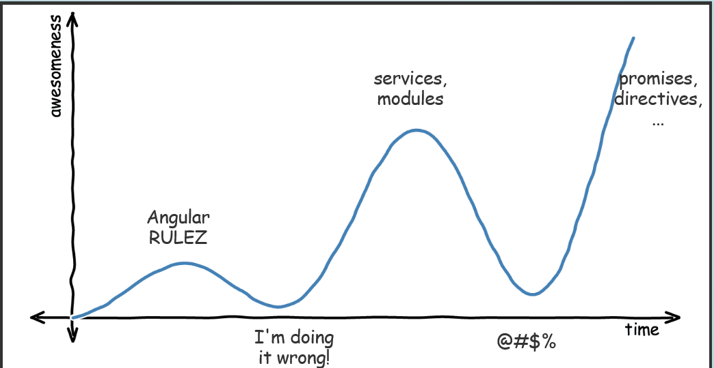
Overview
http://alicialiu.net/leveling-up-angular-talk/#/

Slide 4
AngularJS – The why
Framework. NOT a Library
-Contains everything you need for SPA
Broken into components
Controllers, view, models, services, etc
MVC/MVVM Framework
Two Way Data binding
Enables test friendly code

Slide 5
AngularJS – The why NOT
Performance
Framework not a library
Functions, not computed properties
Directives
Powerful, not always intuitive
Documentation

Slide 6
Demo 0 - Groundwork
Get AngularJS
https://angularjs.org/
Bootstrap
http://getbootstrap.com/

Slide 7
Demo 1 - Intro/Data Binding
Ng-app, ng-model
Magical {{}}
Filters
http://docs.angularjs.org/api/ng#filter

Slide 8
Demo 2 - Controllers
Ng-controller
http://docs.angularjs.org/api/ng.$controller
Magical $scope
View model
Object context
Both controllers and directives have access to scope, but not each to other

Slide 9
Demo 3 –RepeaT
Directives
HTML Dom markers (attributes, css class, etc)
http://docs.angularjs.org/guide/directive
Ng-repeat
http://docs.angularjs.org/api/ng.directive:ngRepeat
Ng-filter
http://docs.angularjs.org/api/ng.filter:filter

Slide 10
Demo 4 – order
Order By
http://docs.angularjs.org/api/ng.filter:orderBy

Slide 11
Demo 5 – Functions
Custom Logic
Custom Filter function
$log

Slide 12
Demo 6 - Directives
Ng-show/ng-hide
http://docs.angularjs.org/api/ng.directive:ngShow#!
http://docs.angularjs.org/api/ng.directive:ngHide
Ng-click
http://docs.angularjs.org/api/ng.directive:ngClick
Directives
http://docs.angularjs.org/api/

Slide 13
Demo Lou – A brief Interlude
Binding Images
And something really cool

Slide 14
Demo 8 – Templates
Enable controlling of UX
Separate work large products
http://docs.angularjs.org/guide/templates#!

Slide 15
Demo 9 - Services
Encapsulate logic
Linked together via Dependency injection
http://docs.angularjs.org/guide/dev_guide.services.creating_services
Promises - $q
http://docs.angularjs.org/api/ng.$q

Slide 16
Demo 10 – Data binding
Create new elements!

Slide 17
Demo 11 – Routes
Ng-route JavaScript
Dependency Injection
$routeProvider and route creation
Introduce ng-view

Slide 18
Questions

Slide 19
Thank you!!
John Ptacek
Skyline Technologies www.SkylineTechnologies.com
jptacek@SkylineTechnologies.com
@jptacek / www.jptacek.com

