Slide 1
Master Thesis
Graduate in Aeronautical Engineering
Systems Area
An explainable data-driven framework for aircraft engine remaining useful life prediction and maintenance decision support
Amanda Schneider Bassani
Advisor: Prof. Dr. Antonio Celio Pereira de Mesquita
Co-Advisor: Dr. João Pedro Pinheiro Malere, MSc. Rodolfo da Silva Collares
October 5th, 2026

Slide 2
Agenda
1.
Introduction
2.
Literature Review
3.
Methodology
4.
Results and discussion
5.
Conclusion

Slide 3
Agenda
1.
Introduction
2.
Literature Review
3.
Methodology
4.
Results and discussion
5.
Conclusion

Slide 4
Motivation
The predictive maintenance is essential for improving reliability, safety, and cost efficiency in aerospace systems.
Remaining Useful Life (RUL) prediction enables proactive maintenance planning and failure prevention.
Machine Learning provides data-driven methods for health monitoring and prognostics.
The goal is to bridge the gap between predictive models and practical maintenance decision-making.

Slide 5
Objectives
Develop and validate a data-driven framework for predicting aircraft engine RUL that not only aims accuracy but also systematically manages the operational risks associated with prediction errors.
Specific objectives:
  To identify the significant degradation in sensor data;
  To identify the most accurate predictor;
  To develop a post-processing using a corrective health margin;
  To make a tradeoff between an improved health margin and a reduction in maintenance lead time.

Slide 6
Agenda
1.
Introduction
2.
Literature Review
3.
Methodology
4.
Results and discussion
5.
Conclusion

Slide 7
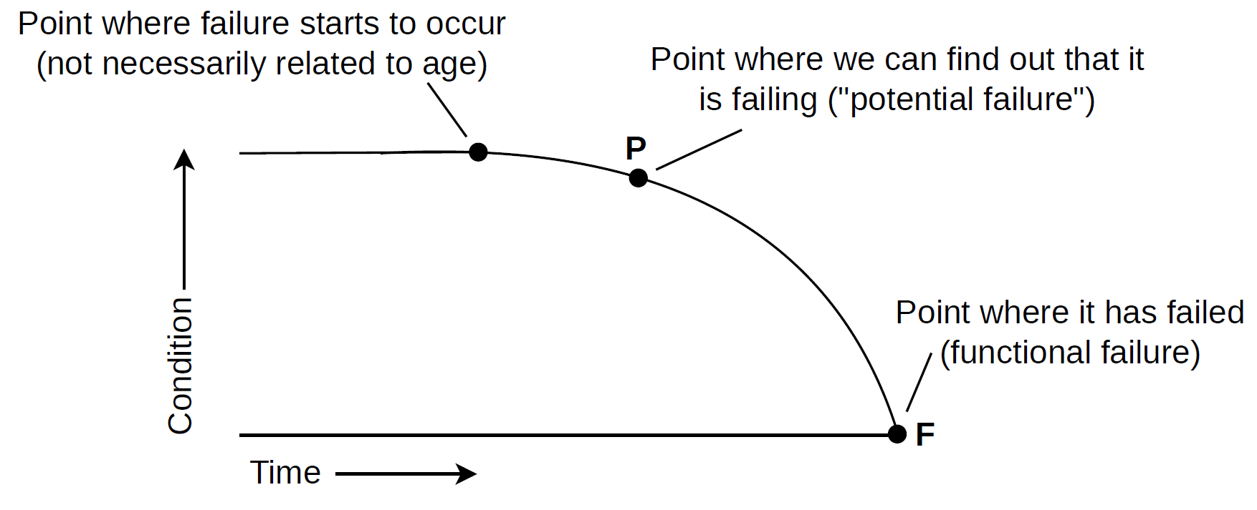
Aircraft Engine Prognostics and Maintenance

Slide 8
Machine Learning for RUL Prediction and Explainability
Significant improvements in prediction accuracy using machine learning.
Most works focus primarily on regression metrics and not on the operational consequences of prediction errors.
Aviation applications require transparent and interpretable models to support engineering and maintenance decisions.
Better explainability of classical machine learning models than deep learning approaches.

Slide 9
Identified Research Gaps and Proposed Contribution
Identified Research Gaps
Proposed Contribution
Fixed or predefined degradation onset
Automatic degradation onset detection
Limited focus on explainability for maintenance stakeholders
Explainable machine-learning prognostics
Limited consideration of RUL overestimation risk
Health-margin strategy to reduce late maintenance recommendations
Little integration between prognostic outputs and maintenance decisions
Maintenance-oriented decision-support framework

Slide 10
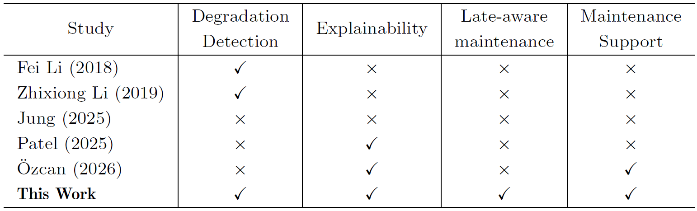
Identified Research Gaps and Proposed Contribution

Slide 11
Agenda
1.
Introduction
2.
Literature Review
3.
Methodology
4.
Results and discussion
5.
Conclusion

Slide 12
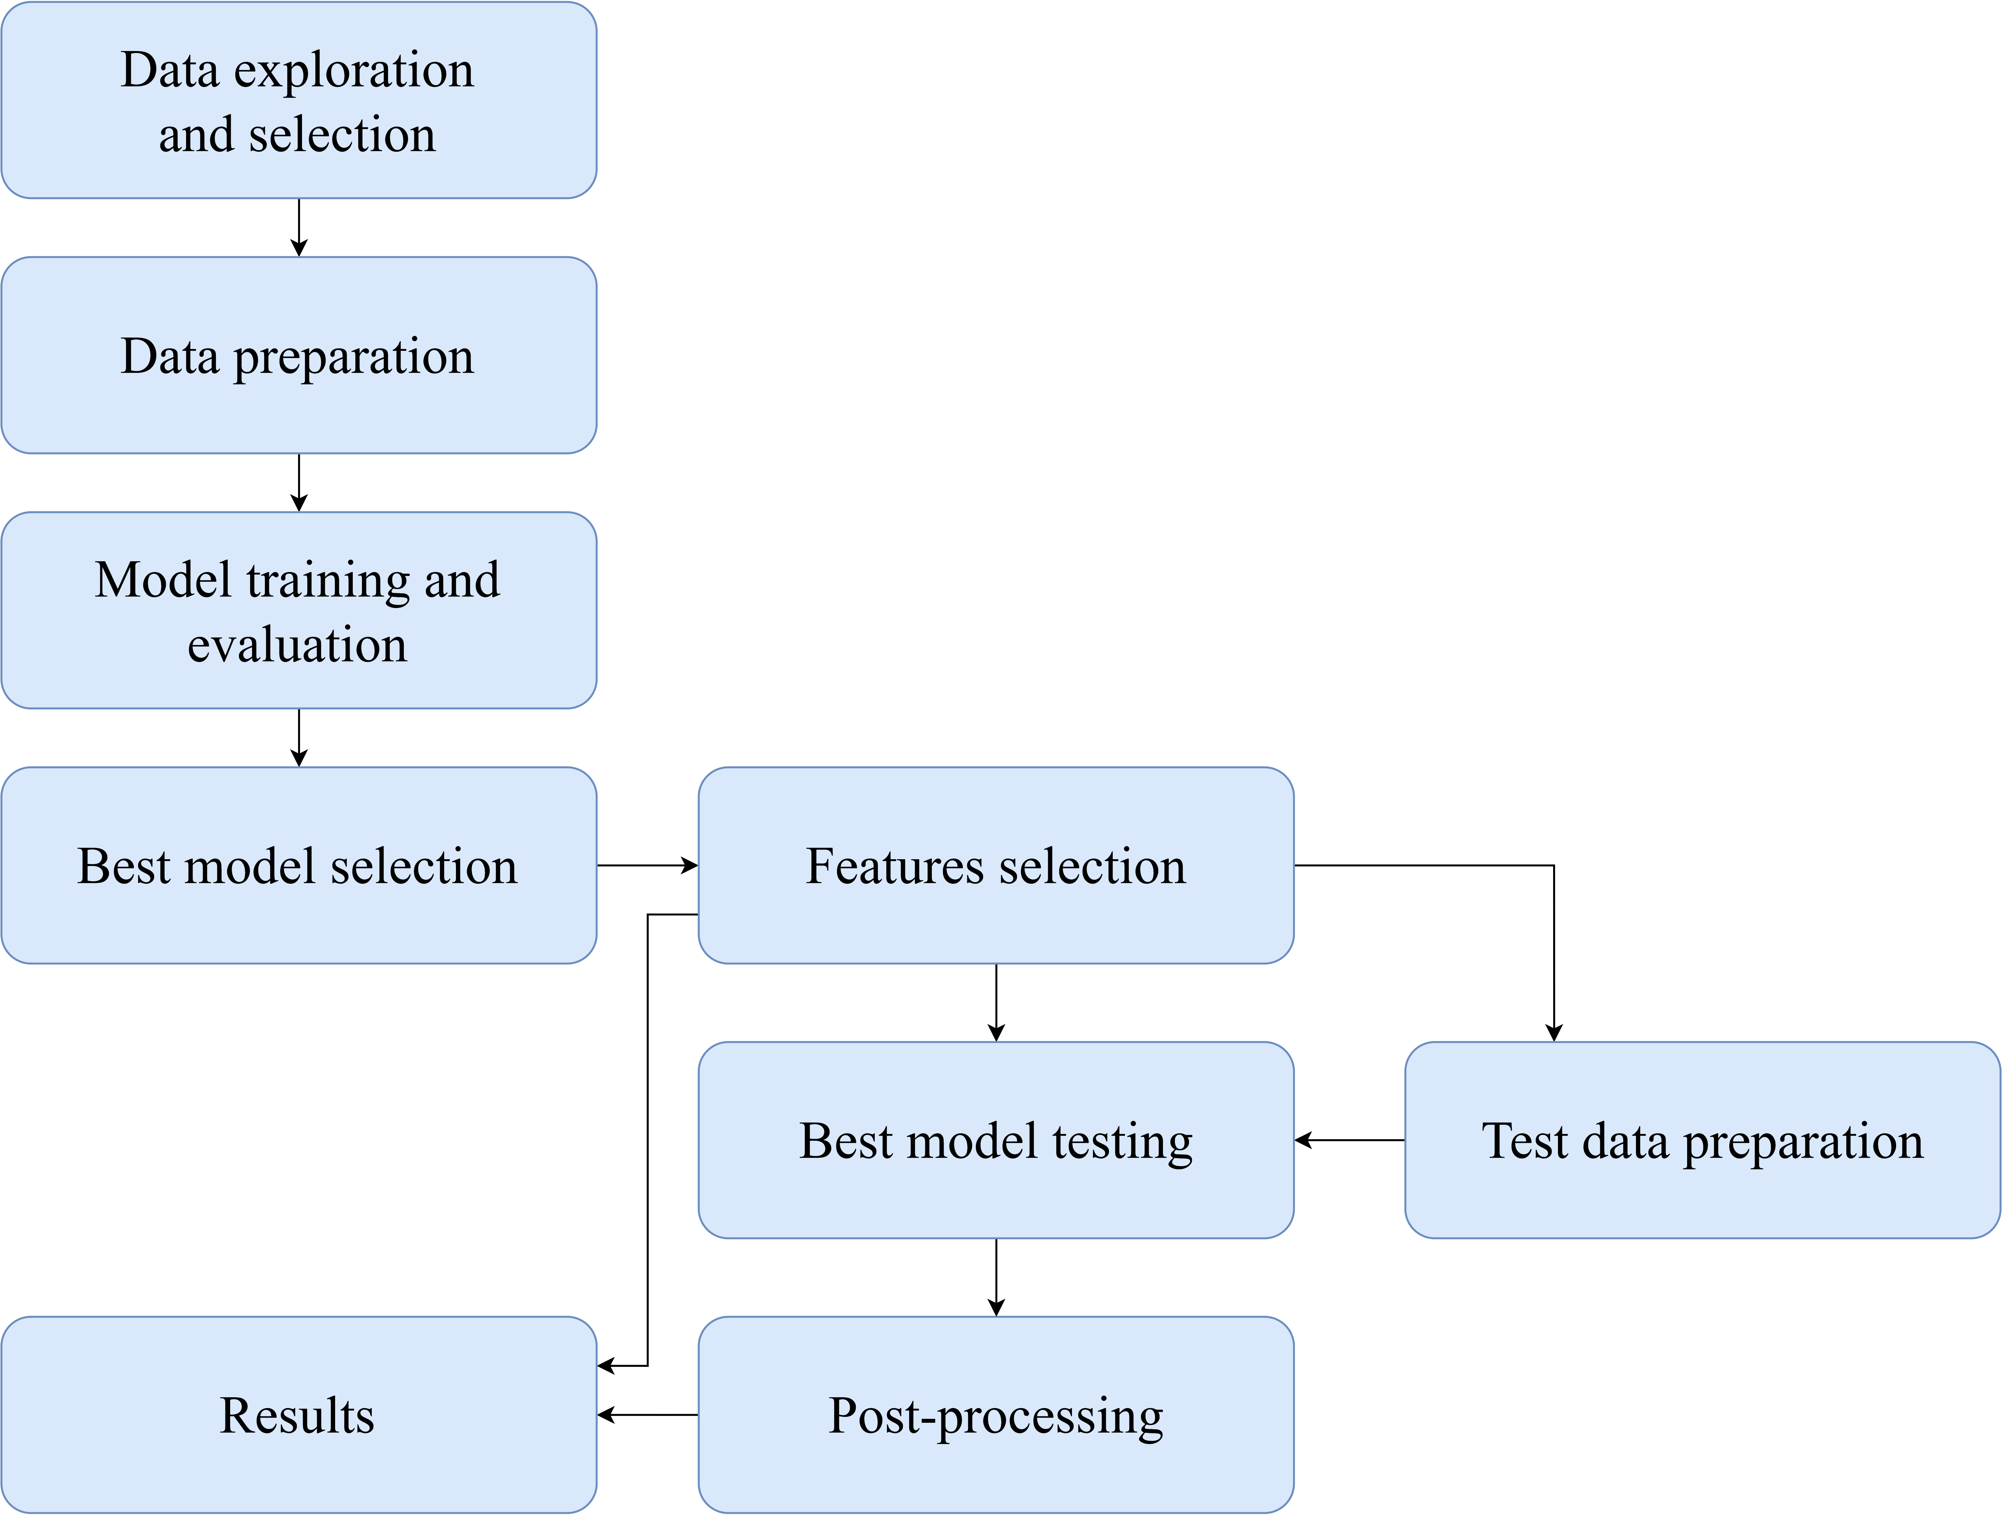
3. Methodology

Slide 13
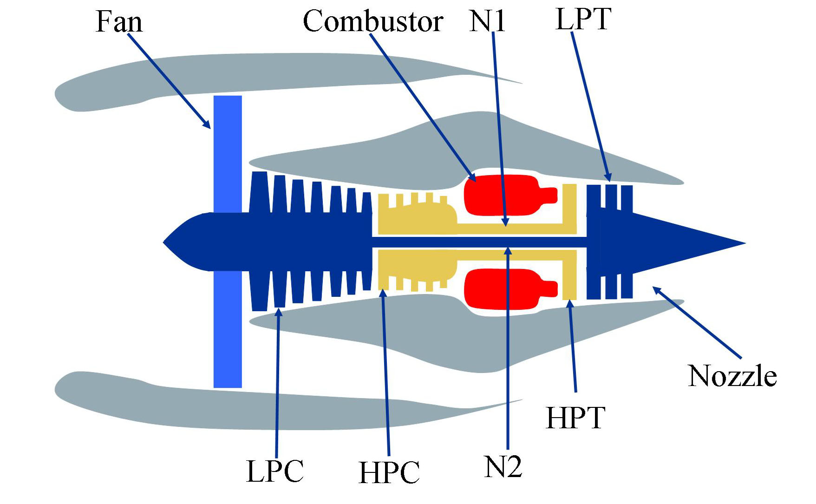
Data exploration and selection
C-MAPSS (Commercial Modular Aero-Propulsion System Simulation) dataset consists of time-series data representing the degradation and eventual failure of large commercial turbofan engines
  Train set
  Test set
  RUL set

Slide 14
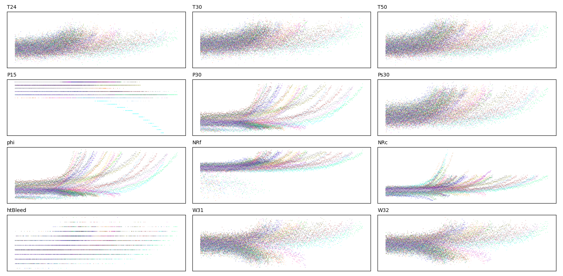
Data exploration and selection
Removal of multiple operating conditions (FD002 and FD004) datasets from the scope
Removal of columns based lacking significant variation and in operational conditions criteria

Slide 15
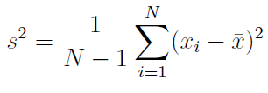


Data preparation
RUL calculation for training data
Application of moving average to sensors
Data normalization
Features calculation
  Variance:
  Skewness:
  Root Mean Square:

Slide 16
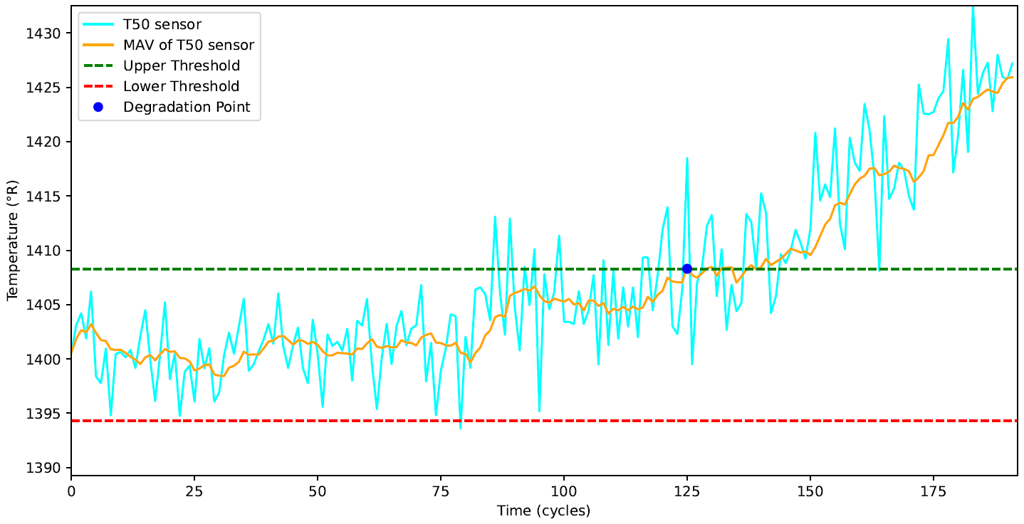
Data preparation
Definition of point P = start of degradation, based on the baseline period average and a tolerance range, the threshold
P point for engine will be the earliest sensor’s P point
EXAMPLE OF P POINT DETECTION IN LPT OUTLET TEMPERATURE SENSOR

Slide 17
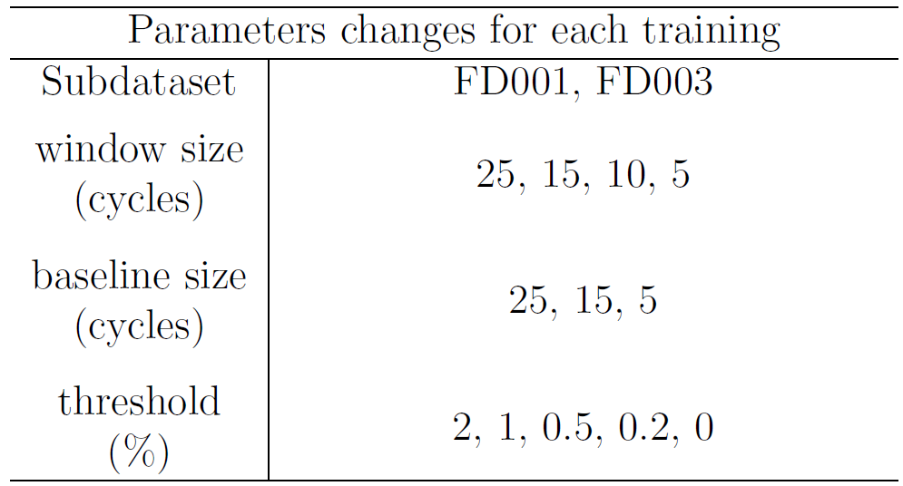
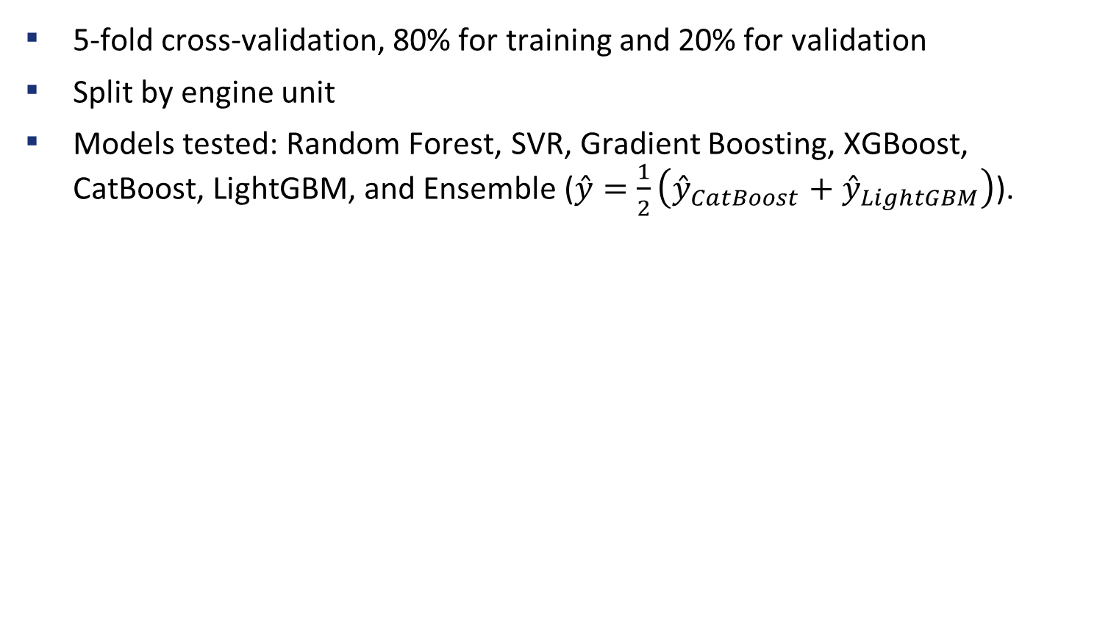
Model training and evaluation
5-fold cross-validation, 80% for training and 20% for validation
Split by engine unit
Models tested: Random Forest, SVR, Gradient Boosting, XGBoost, CatBoost, LightGBM, and Ensemble ($\overset{ˆ}{y}=\frac{1}{2}\left({\overset{ˆ}{y}}_{CatBoost}+{\overset{ˆ}{y}}_{LightGBM}\right)$).
*
* For each parameter combination, it was given a training ID

Slide 18
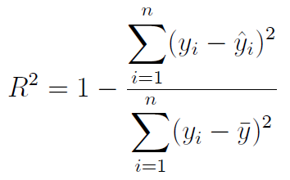
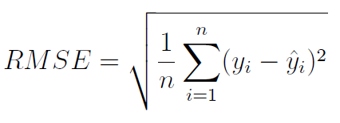
Best model selection
Metrics: Mean and standard deviation of RMSE and R²
Score:

Slide 19
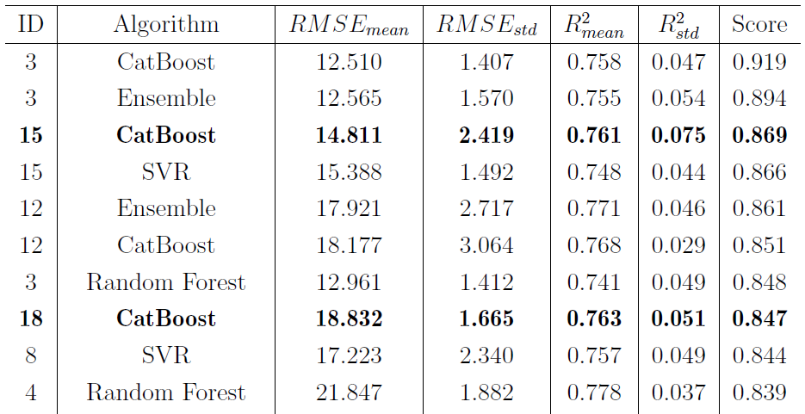
Best model selection
The driver was to choose the same algorithm and training parameters for both subdatasets
  ID 15: FD001, window size 15 cycles, baseline size 15 cycles, threshold 0.5%
  ID 18: FD003, window size 15 cycles, baseline size 15 cycles, threshold 0.5%

Slide 20
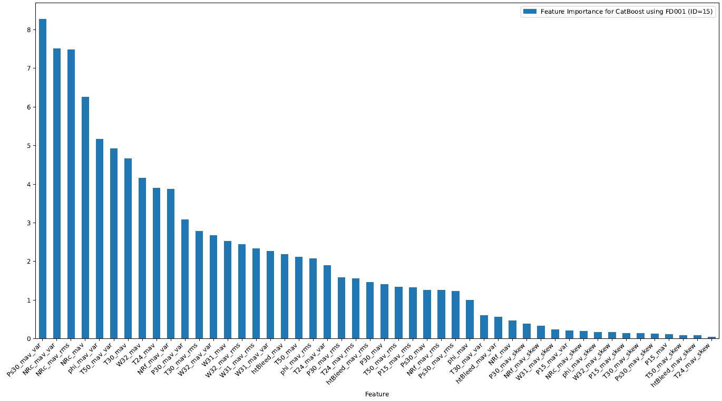
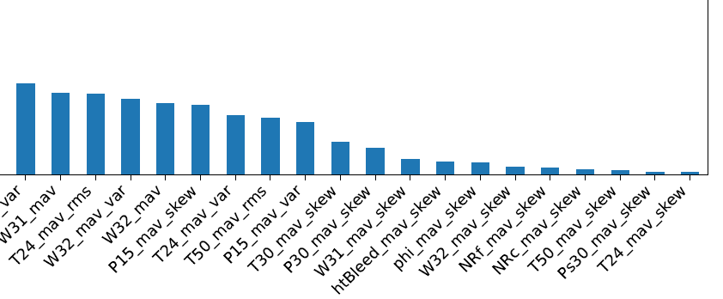
Features selection
FD001
FD003

Slide 21
Post-processing
Training data re-split: 80% for training and 20% for calibration
Error: Calibration RUL – Actual RUL
Calibration RUL
20
21
14
10
10
Actual RUL
EXAMPLE OF THE METHOD
APPLIED IN A 5-POSITION ARRAY
28
17
11
8
9
Error
-8
4
3
2
1

Slide 22
Post-processing
RUL prediction for test data (unseen units until this stage).
From the distribution of errors, quantiles from 60th to 95th, in increments of 5th, were evaluated to define a health margin.
Negative values for health margin were clipped to zero.
Error
0
1
2
3
4
EXAMPLES OF THE METHOD
APPLIED IN 5-POSITION ARRAYS
Using 75th quantile on this array, the health margin selected is 3.
Error
0
-4
-3
-2
-1
0
Using 75th quantile on this array, the health margin selected is 0.

Slide 23
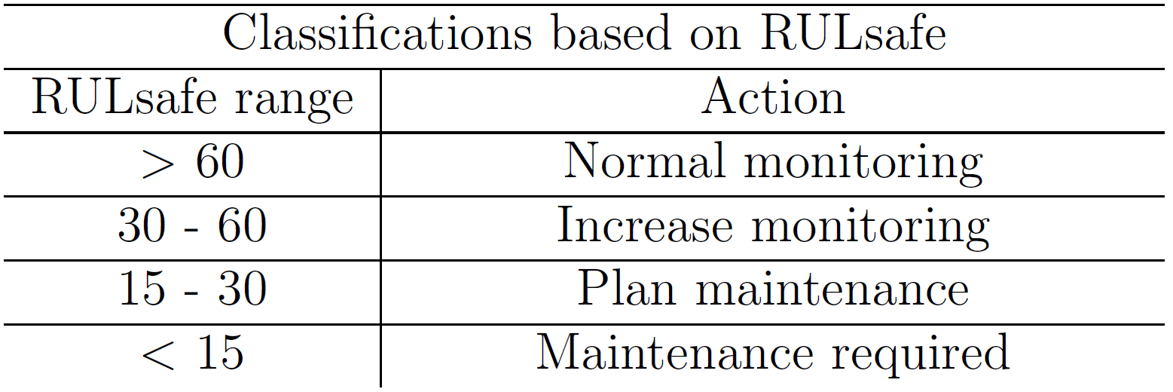
Post-processing
Subtract health margin and ensure final RUL ≥ 0
$${RUL}_{safe}=max\left({RUL}_{predicted}−health_margin,0\right)$$

Slide 24
Agenda
1.
Introduction
2.
Literature Review
3.
Methodology
4.
Results and discussion
5.
Conclusion

Slide 25
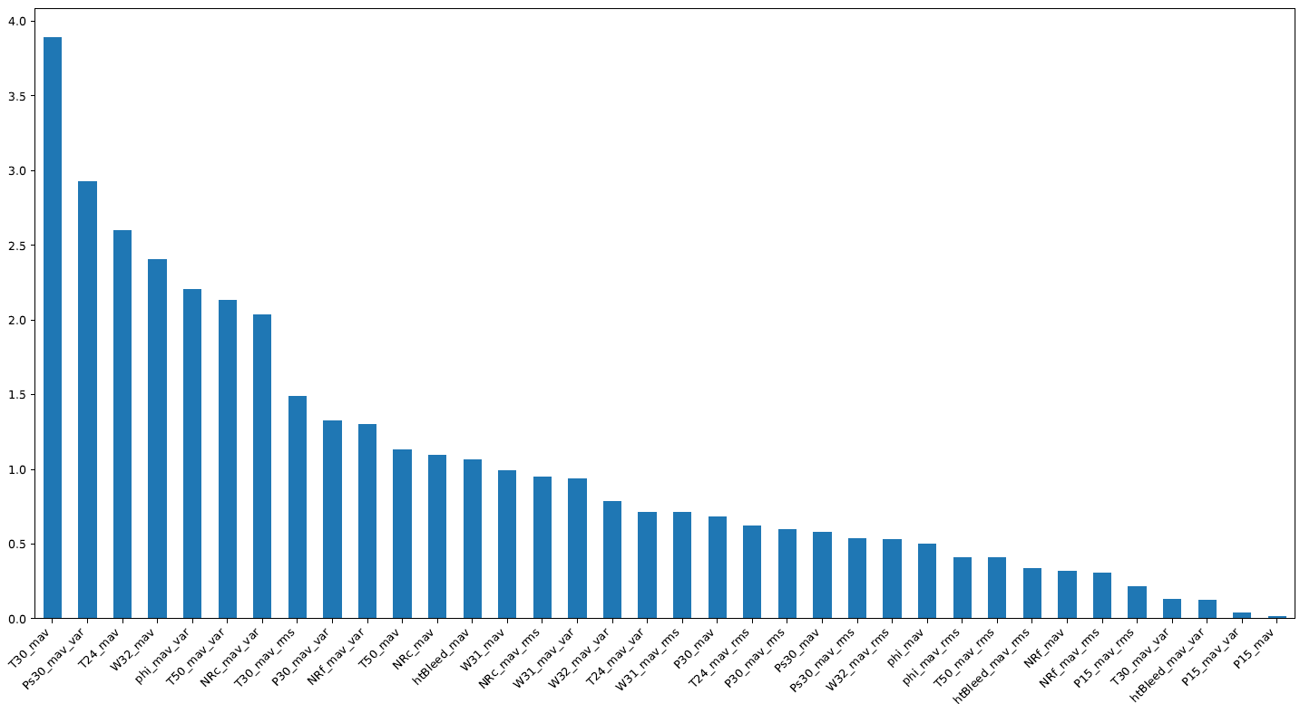
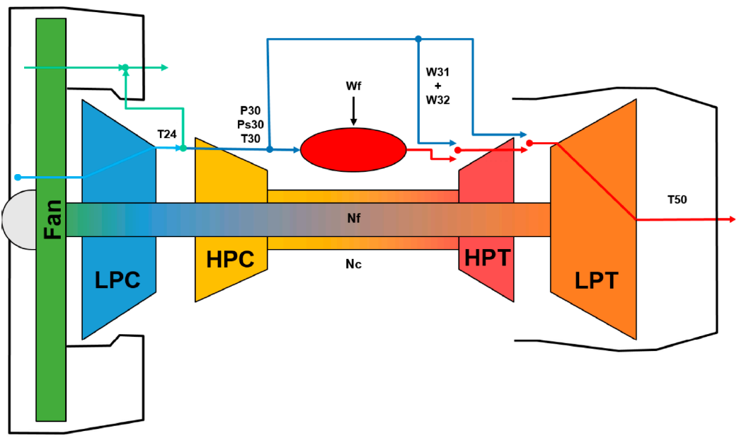


Explainability of the Models
EXPLAINABILITY OF CATBOOST INTO ONE OPERATING CONDITION AND ONE DEGRADATION MODE
(FD001)
Notes:
P30, Ps30, T30, NRc, and
Phi

Slide 26
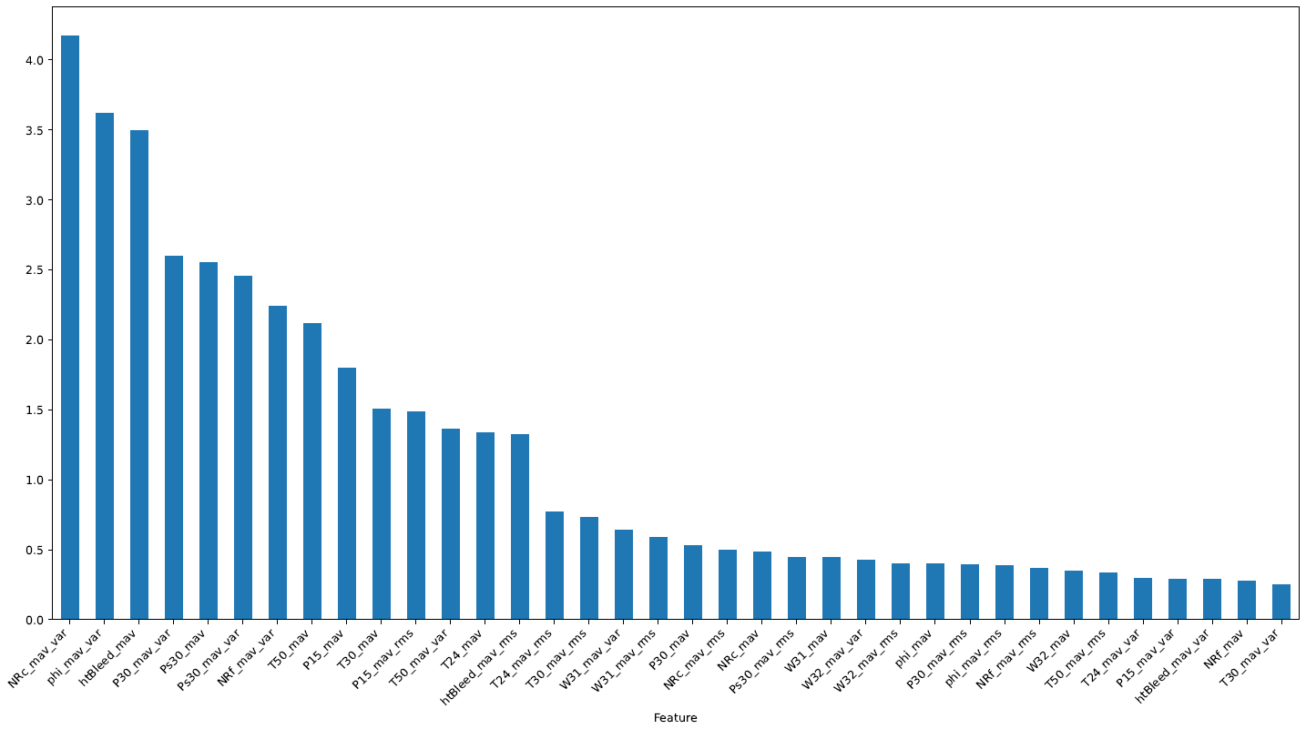
Explainability of the Models
EXPLAINABILITY OF CATBOOST INTO ONE OPERATING CONDITION AND TWO DEGRADATIONS MODES
(FD003)
Notes:
P30, Ps30, T30, NRc, and
Phi

Slide 27
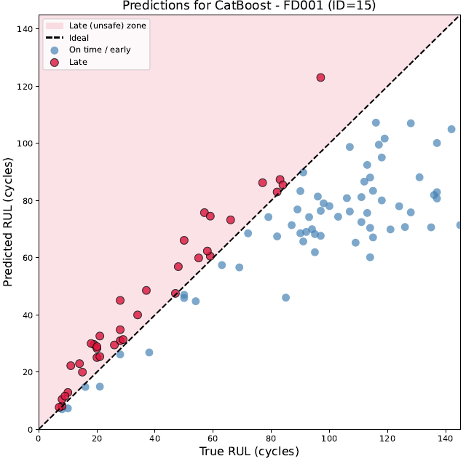
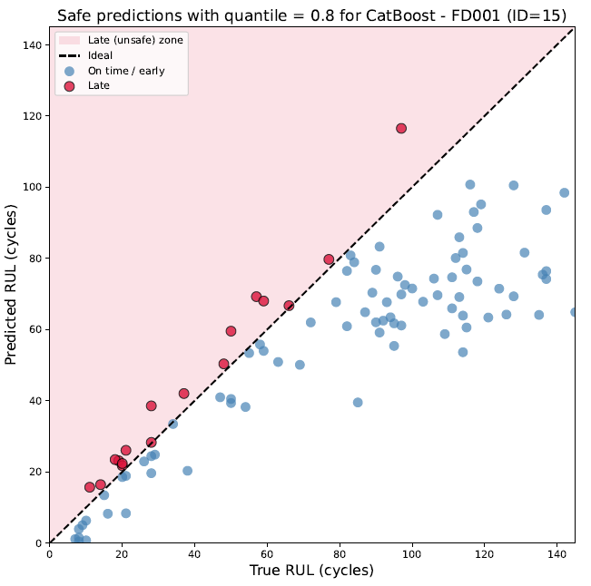
Evaluation of the Proposed Health-Margin Strategy
HEALTH MARGIN EVALUATION INTO ONE OPERATING CONDITION AND ONE DEGRADATION MODE
(FD001)

Slide 28
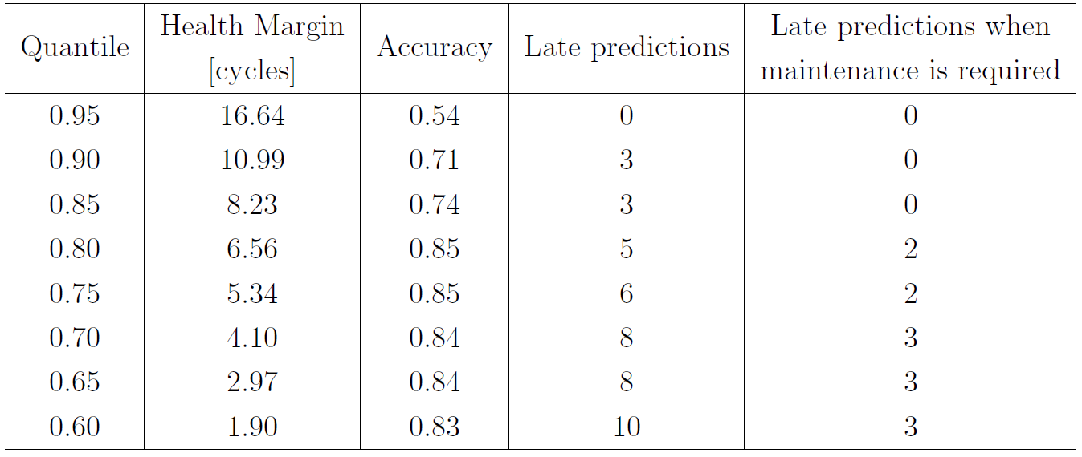
Evaluation of the Proposed Health-Margin Strategy
HEALTH MARGIN EVALUATION INTO ONE OPERATING CONDITION AND ONE DEGRADATION MODE
(FD001)

Slide 29
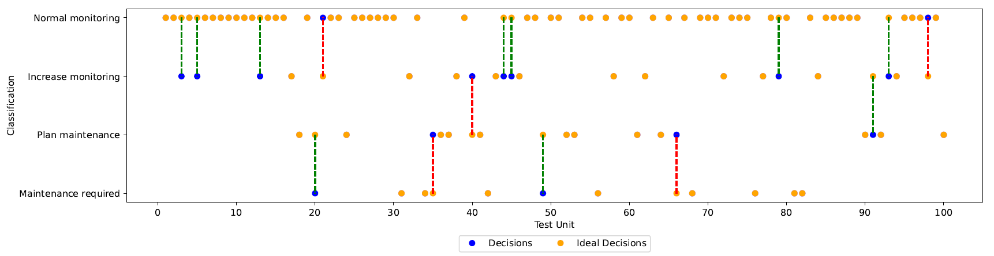
Evaluation of the Proposed Health-Margin Strategy
HEALTH MARGIN EVALUATION INTO ONE OPERATING CONDITION AND ONE DEGRADATION MODE
(FD001)

Slide 30
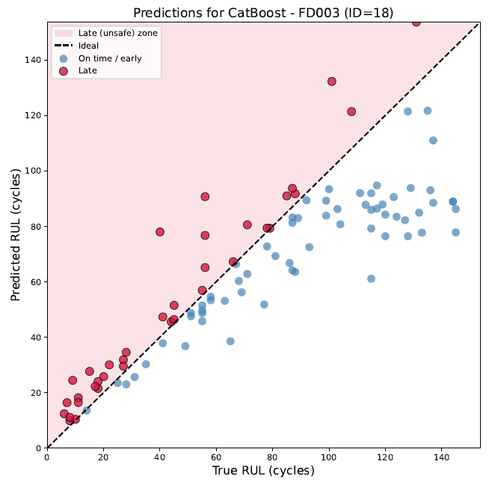
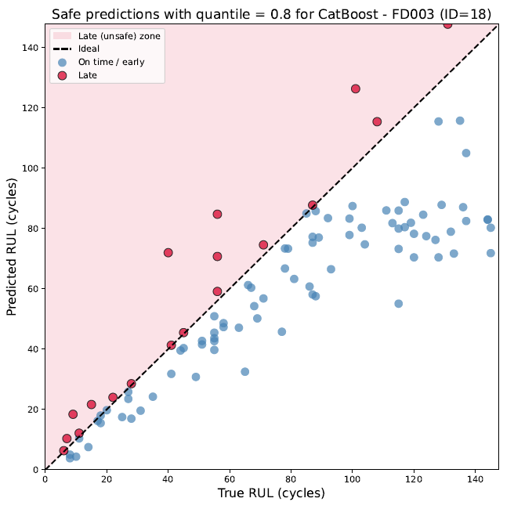
Evaluation of the Proposed Health-Margin Strategy
HEALTH MARGIN EVALUATION INTO ONE OPERATING CONDITION AND TWO DEGRADATIONS MODES
(FD003)

Slide 31
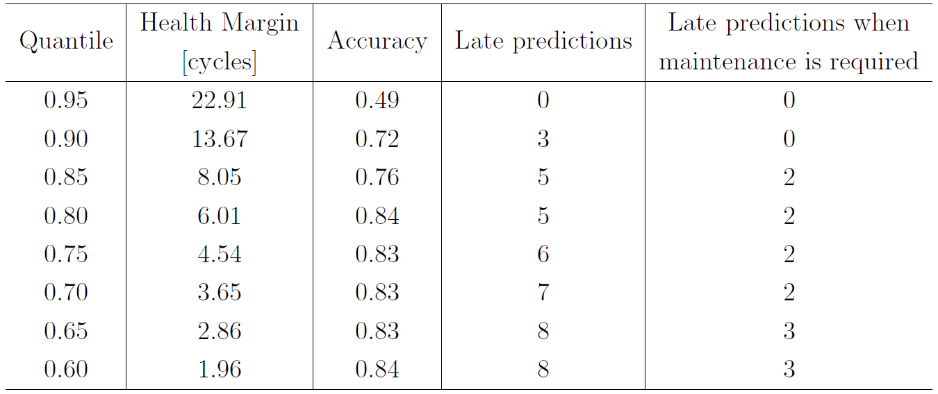
Evaluation of the Proposed Health-Margin Strategy
HEALTH MARGIN EVALUATION INTO ONE OPERATING CONDITION AND TWO DEGRADATIONS MODES
(FD003)

Slide 32
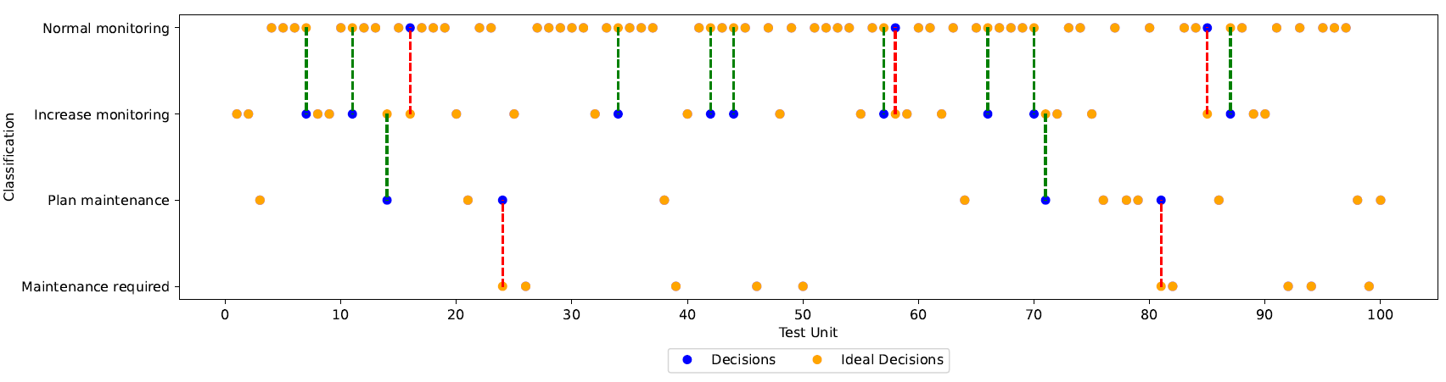
Evaluation of the Proposed Health-Margin Strategy
HEALTH MARGIN EVALUATION INTO ONE OPERATING CONDITION AND TWO DEGRADATIONS MODES
(FD003)

Slide 33
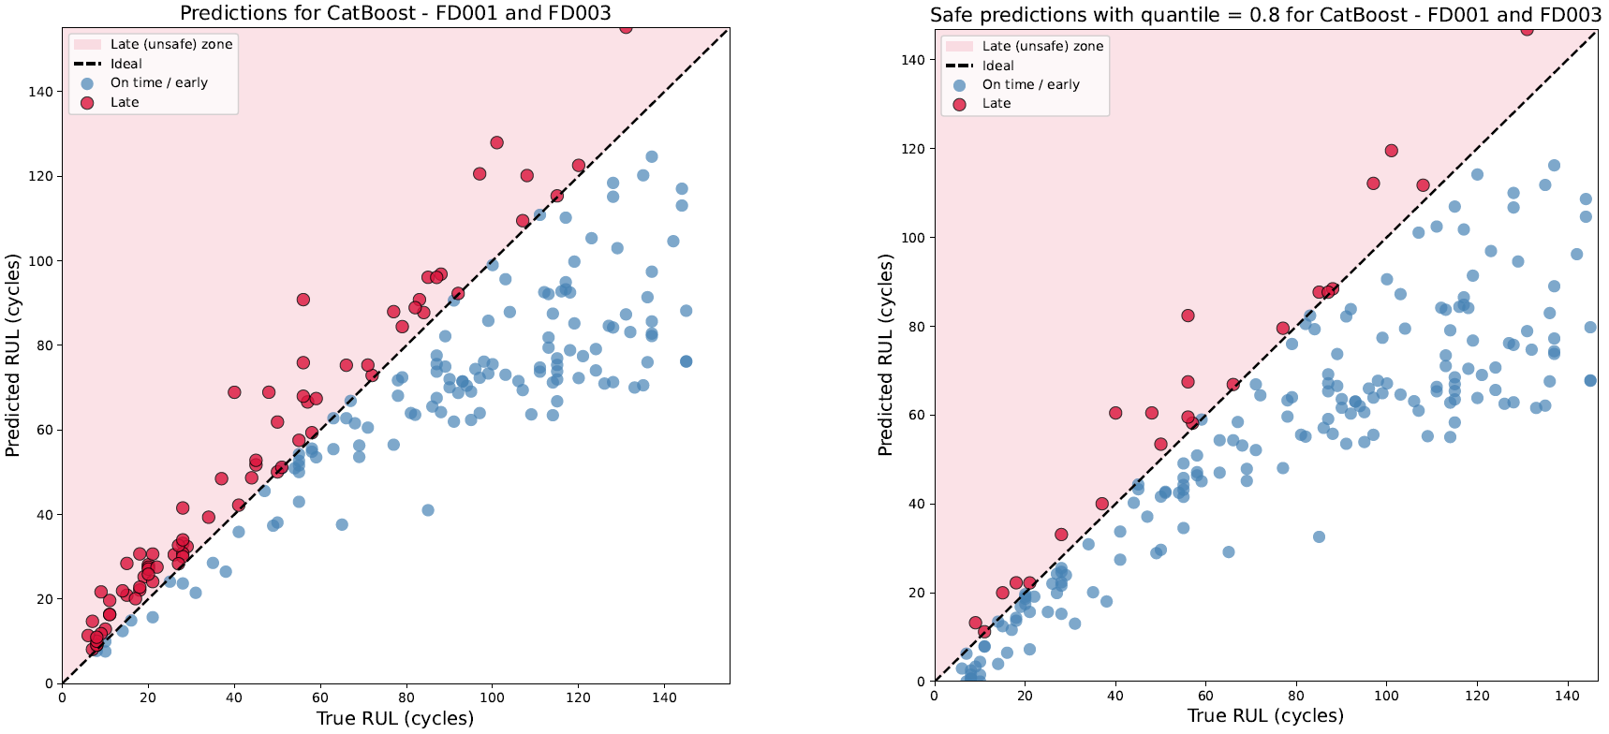
Evaluation of the Proposed Health-Margin Strategy
HEALTH MARGIN EVALUATION INTO ONE OPERATING CONDITION AND TWO DEGRADATIONS MODES
(FD001+FD003)

Slide 34
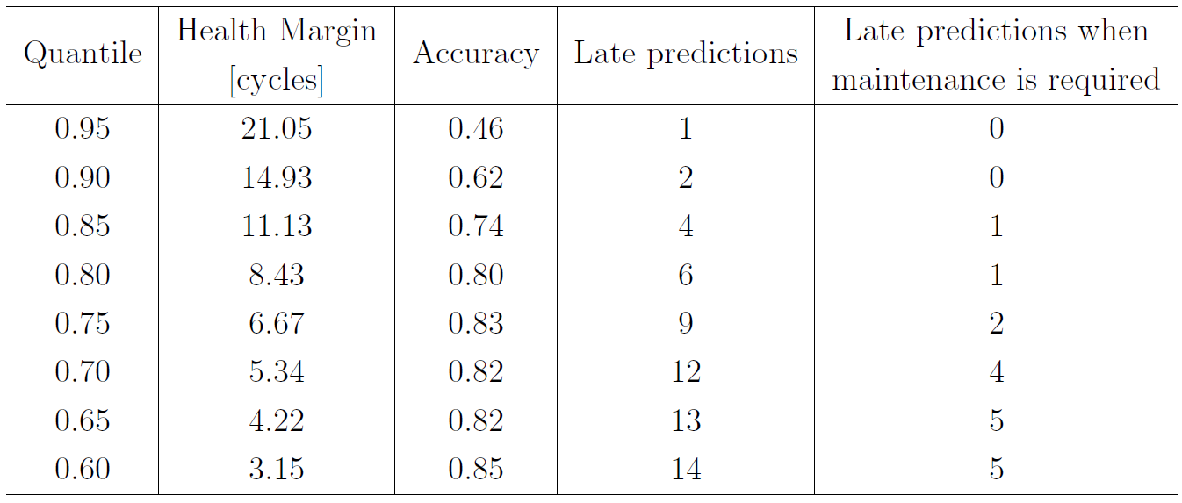
Evaluation of the Proposed Health-Margin Strategy
HEALTH MARGIN EVALUATION INTO ONE OPERATING CONDITION AND TWO DEGRADATIONS MODES
(FD001+FD003)

Slide 35
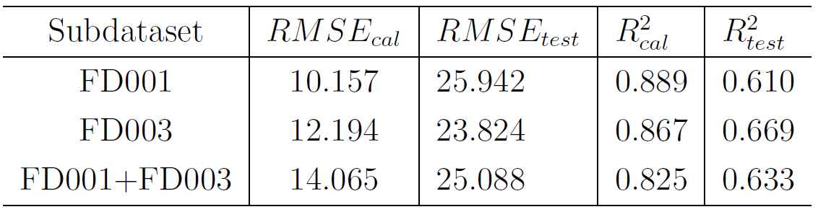
Regression results
TEST METRICS FOR EACH SUBDATASET
Notes:
P30, Ps30, T30, NRc, and
Phi

Slide 36
Agenda
1.
Introduction
2.
Literature Review
3.
Methodology
4.
Results and discussion
5.
Conclusion

Slide 37
Conclusions
Adaptive degradation onset detection proposed.
SHAP confirmed physically meaningful degradation indicators.
Health-margin reduced corrective maintenance recommendations.
Predictive models and practical maintenance decision-making were integrated.

Slide 38
Limitations & Future Work
Limitations
Future Work
Evaluated only on FD001 and FD003
Extend to FD002 and FD004
Single operating-condition datasets
Validate with real fleet data
Validation based on simulated data
Adaptive thresholding methods
No hyperparameter optimization
Cost-based maintenance optimization
Fixed maintenance thresholds
Certification-oriented explainability

Slide 39
Thank you!
Amanda Schneider Bassani

