Slide 1
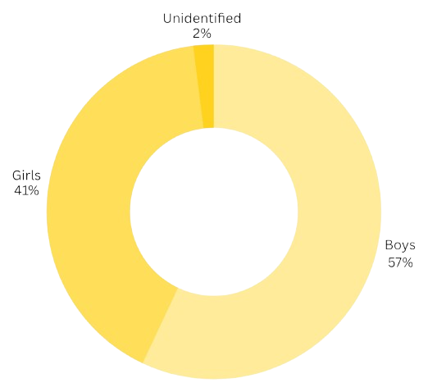
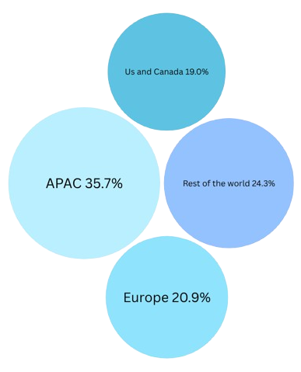
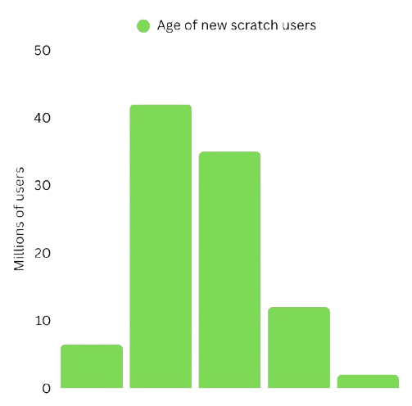
WHO WANTS
JAX BLOCKS!
People want To play fun games made by others everywhere in the whole world
Jack Box users based on gender
Roblox users by region
19.0%
Enjoying a fun social party game isn’t
limited to one gender
35.7%
24.3%
20.9%
There are always new people looking to get into game making regardless of age

