Slide 1

The Better RIT App
Cherri O’Connor
Kai Reed
Campbell Parks

Slide 2
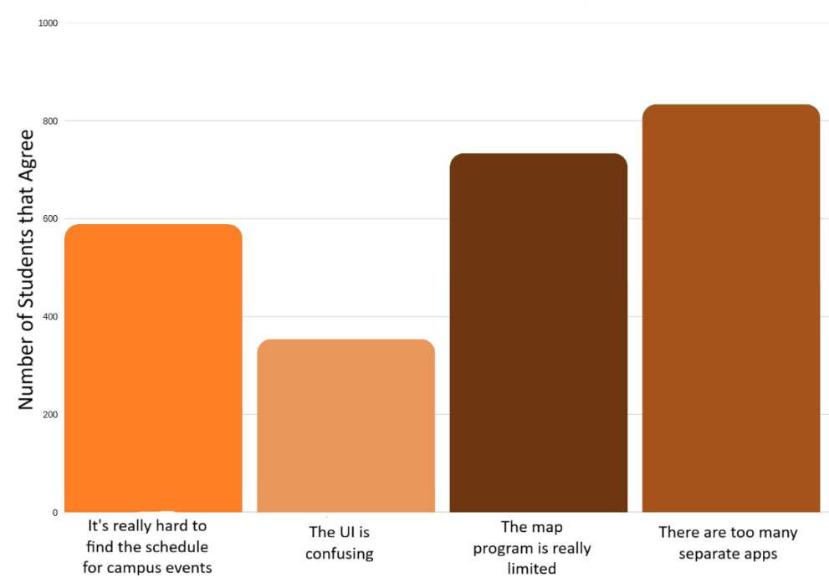
Problem
Too Many Apps
Limited Programs
Difficult to Navigate and Use
Overall Confusing

Slide 3
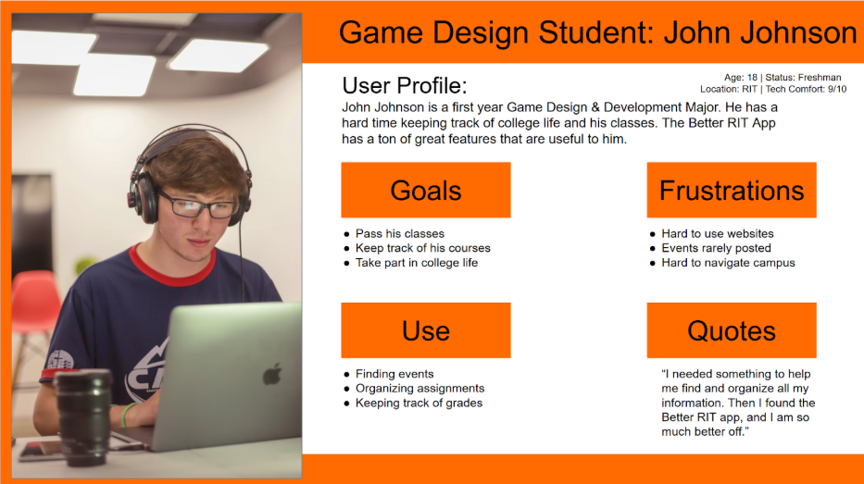
Average User

Slide 4
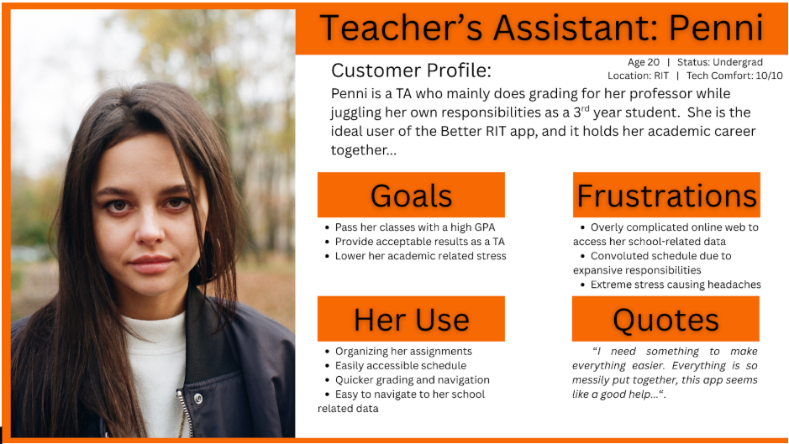
Power User

Slide 5
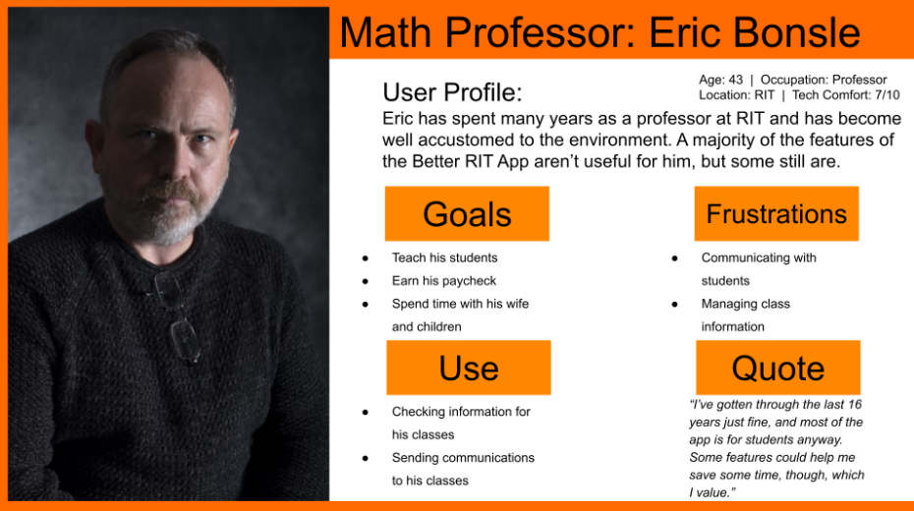
Casual User

Slide 6
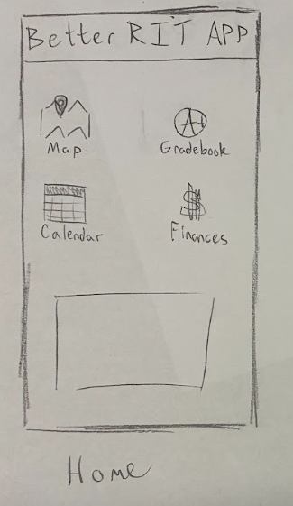
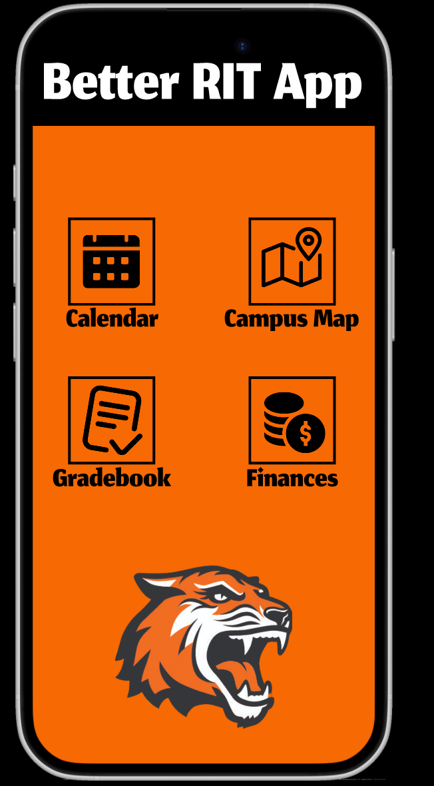

Slide 7
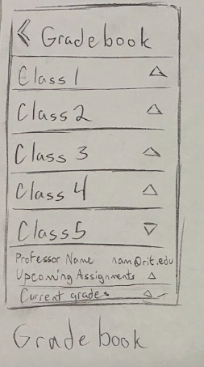
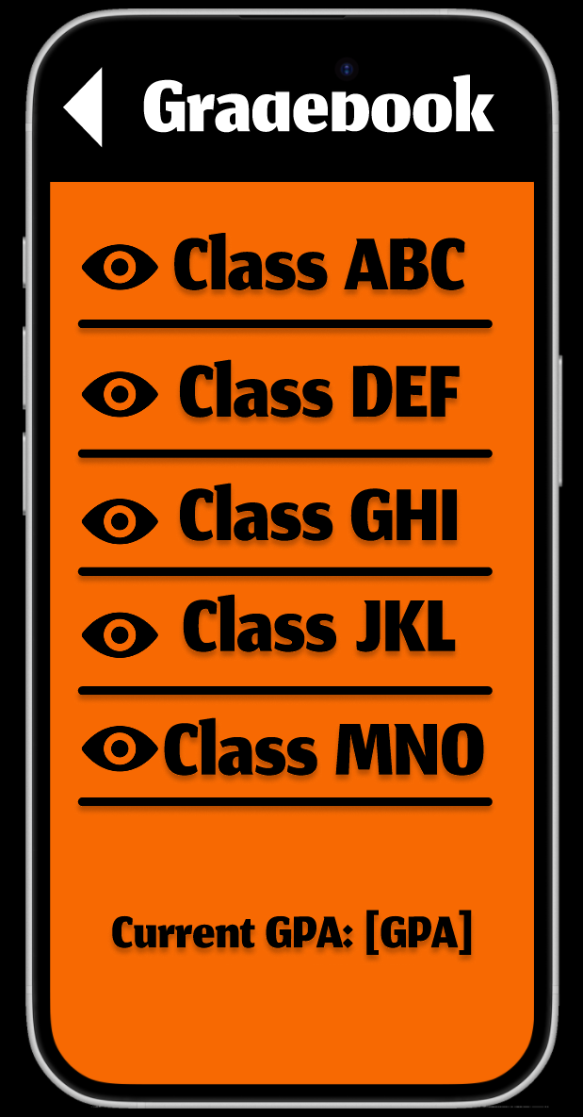

Slide 8
Live Demo
Digital Prototype
User Flows:
Find Contact Information for Class ABC’s professor
Find Directions to Residence Hall A
Add Funds to Dining Dollars

Slide 9

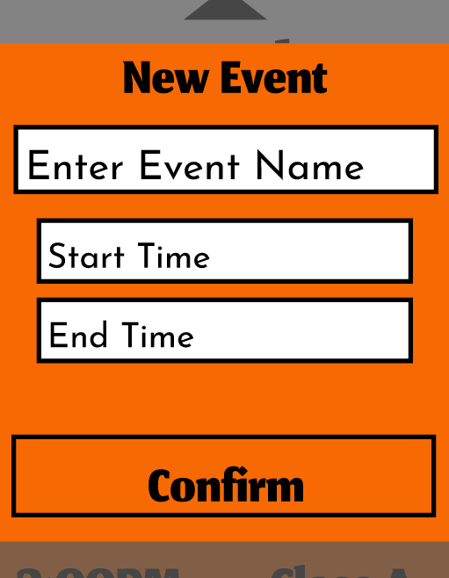
Testing and Iteration
Users hesitated upon first seeing the Home menu.
Users found certain overlaid menus overcomplicated.
Simple Icons
Uncluttered
Descriptive and Easy-to-Understand Text and Symbols
Clear Title
Clear Prompts
Simple Input Options

Slide 10
Conclusion

