Slide 1
Aperture Alarm
Who we are

Slide 2
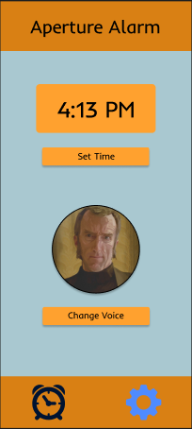
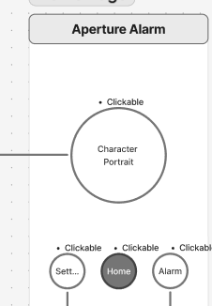

Slide 3
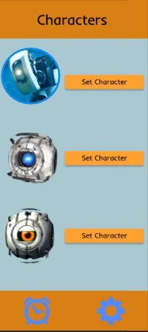
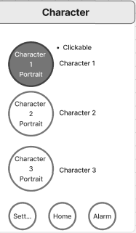

Slide 4
Quick Demo
https://www.figma.com/design/CPchBsZ5moZ5L1wjWmtslU/Aperture-Alarm---HiFi-Prototype?node-id=0-1&t=UOGFtfGL9Hk1uTk6-1

Slide 5
Testing and Changes
People found it confusing that you would click on the character portrait so we made a separate button
We converted the alarm screen and home screen into one
Re-ordered the alarm and accessibility settings

Slide 6
In Short
We at Aperture have curated the perfect alarm

Slide 7
Imagine if
No more morning grogginess
No more fatigue
No more tardiness

