Slide 1
JaxBlox Hi-Fi Prototype
By: Brandon Corker, Lev Gluzdov, and Nazar Emilov
Notes:
https://docs.google.com/document/d/1MHKGs6E_AOsgBCE7gBQPV5Th7nW3nDuguZwMVQdguPo/edit?tab=t.0

Slide 2
Team Members
Lev Gluzdov: Project Manager & Prototype Developer
  Delegated everyone’s tasks and helped with majority of working components.
Brandon Corker: Design Lead & Usability Tester
  Used skills from LinkedIn course to assemble the prototype to be aesthetically pleasing.
Nazar Emilov: Content Lead & Research Lead
  Researched how to make more complex components with clean animations
Notes:
Each team member introduces themselves

Slide 3
JaxBlox
JaxBlox is a user-generated-content driven party game platform. We find that most party games quickly become stale, and JaxBlox aims to solve this problem with UGC.
Developers use the JaxBlox devkit to create Jackbox style party games, and publish them on the JaxBlox store. It also allows players to always have a new experience without the cost of buying an entirely new game.
This prototype is focused on the average player’s experience interacting with the JaxBlox platform.
Notes:
Brandon

Slide 4

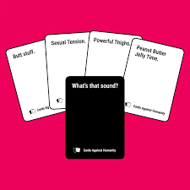
Target Audience
The target audience
is young people–primarily teens–who like to play party games with friends. For these users, party games like Cards Against Humanity and Heads Up are often repetitive and will quickly become stale.
Our UI design features a bright color palette aimed at a younger teenage audience
Notes:
Nazar

Slide 5
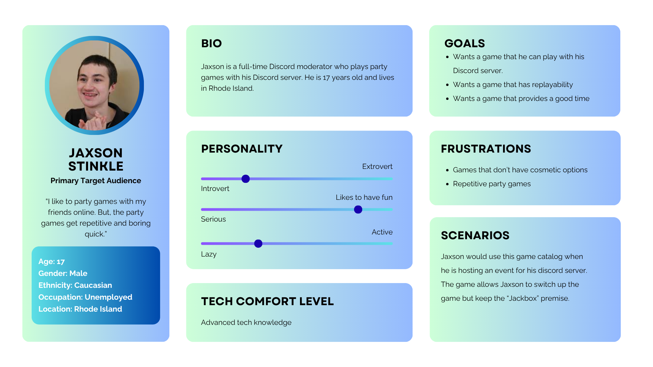
Personas - Jaxson Stinkle (Primary Target Audience)
Notes:
Brandon

Slide 6
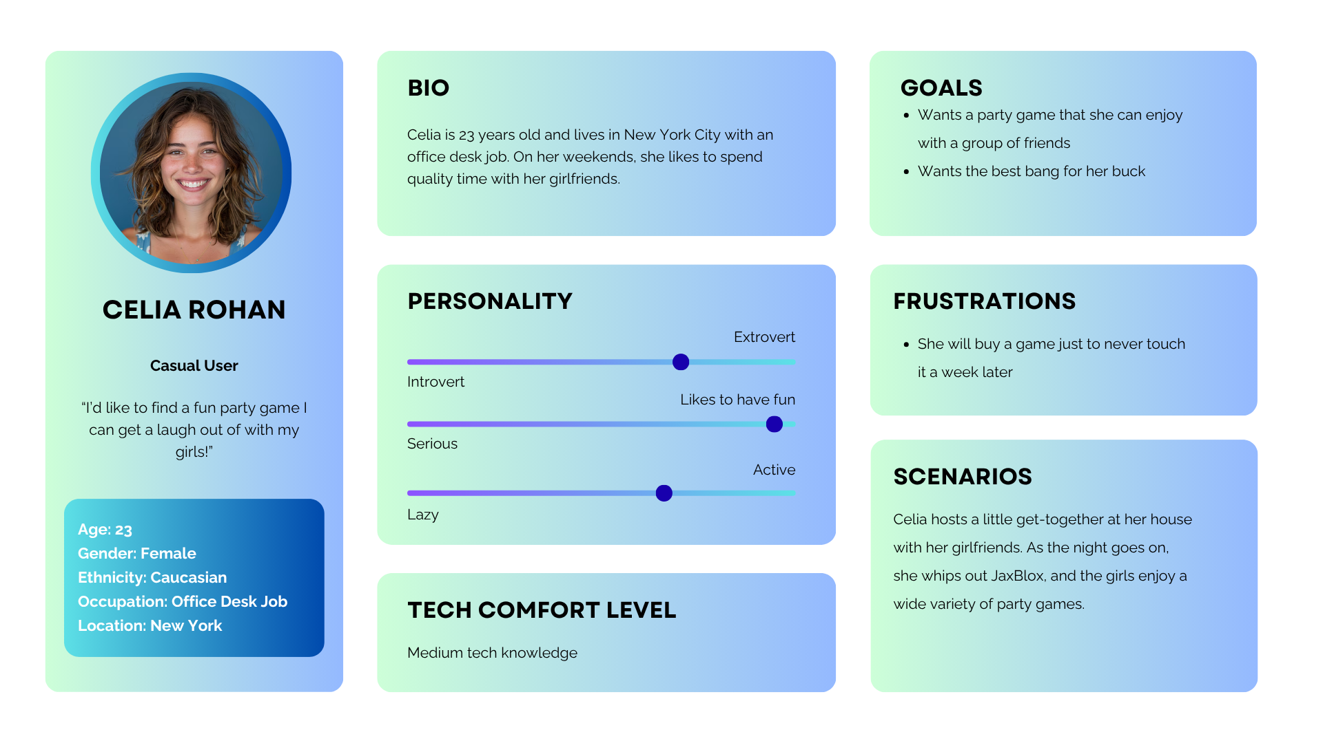
Personas - Celia Rohan (Casual User)
Notes:
Nazar

Slide 7
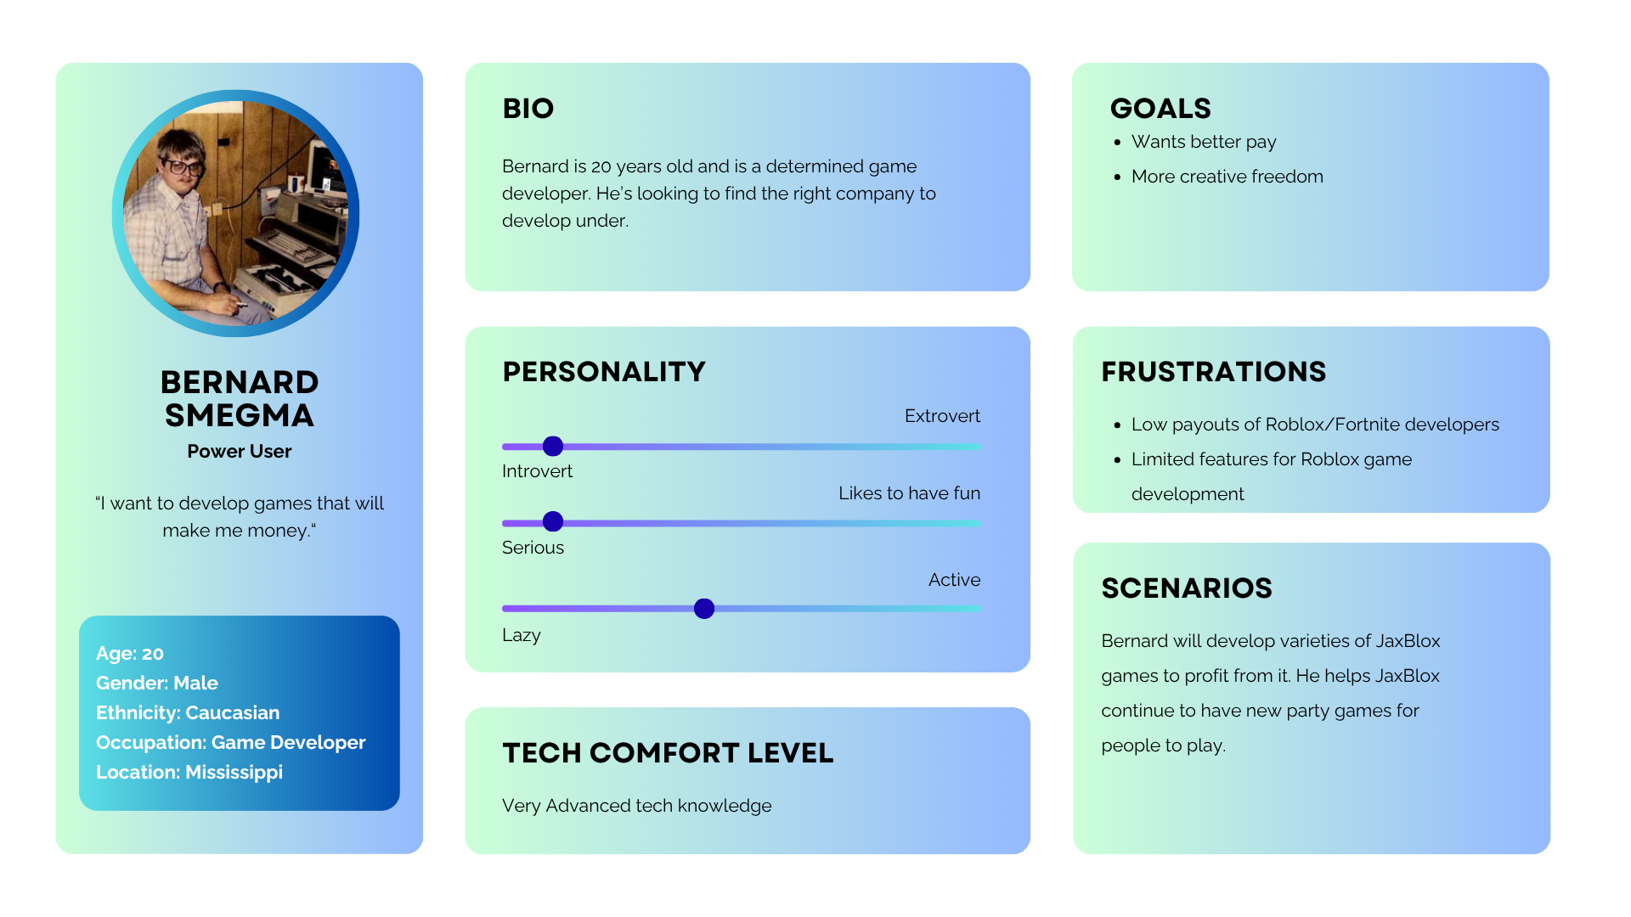
Personas - Bernard Smegma (Power User)
Notes:
Lev

Slide 8
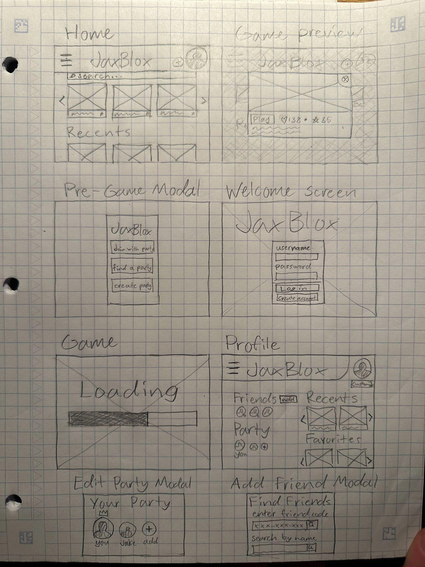
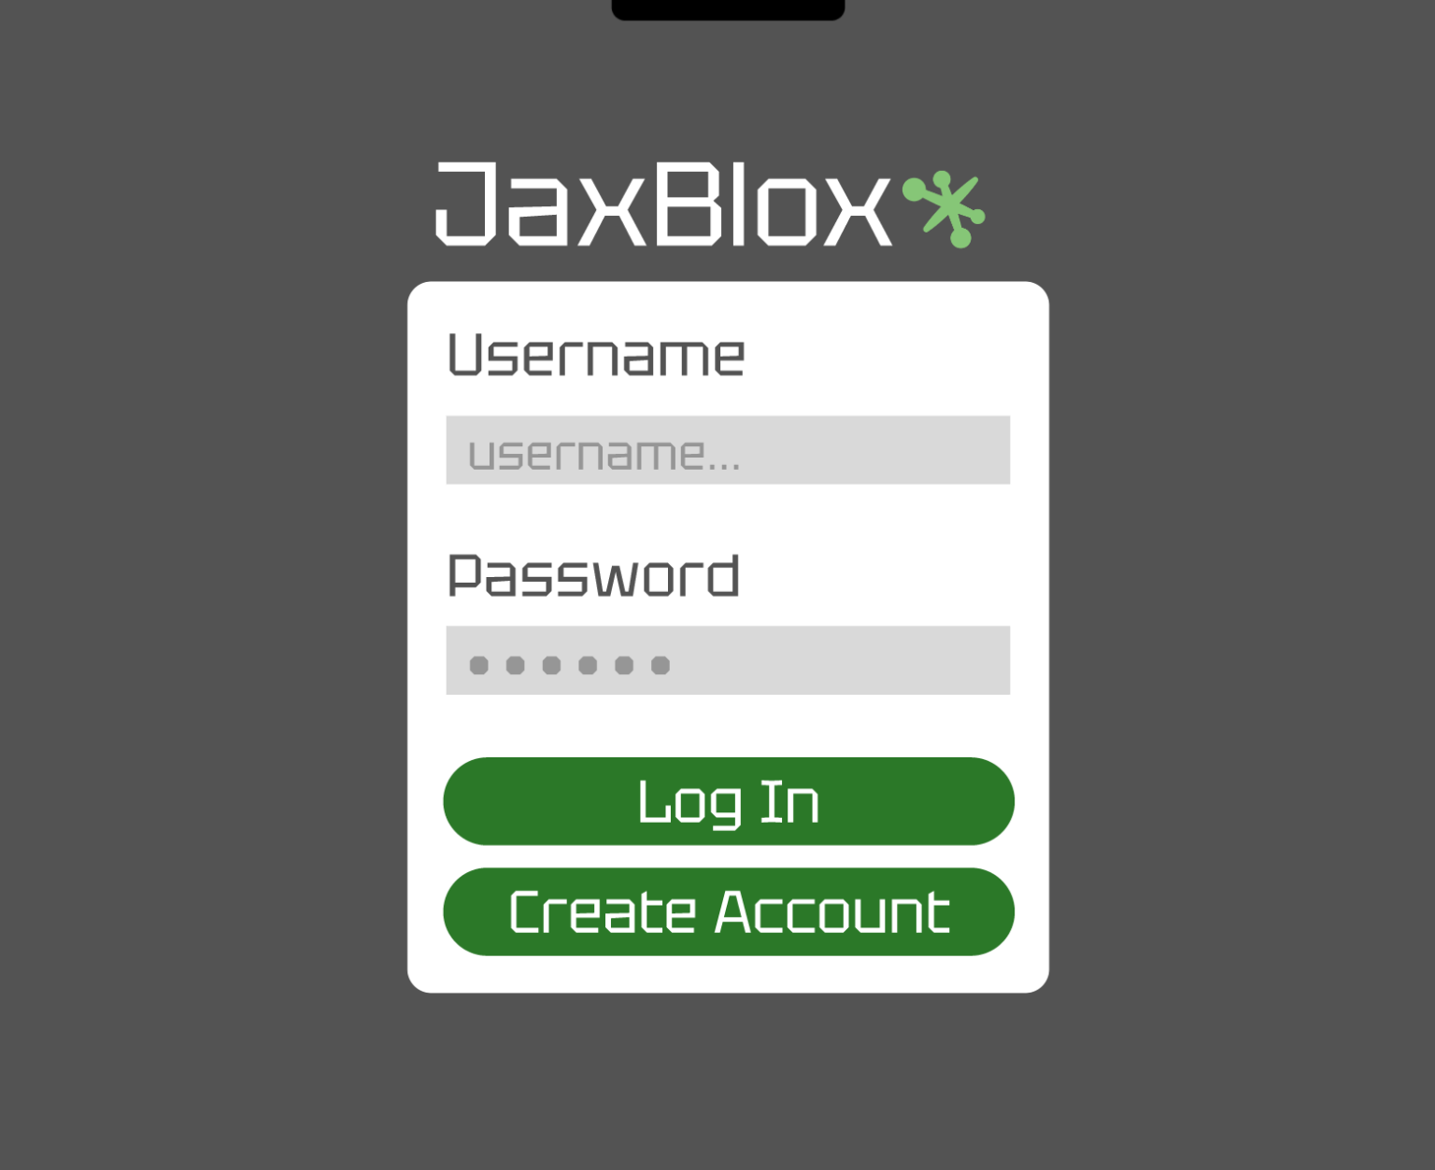
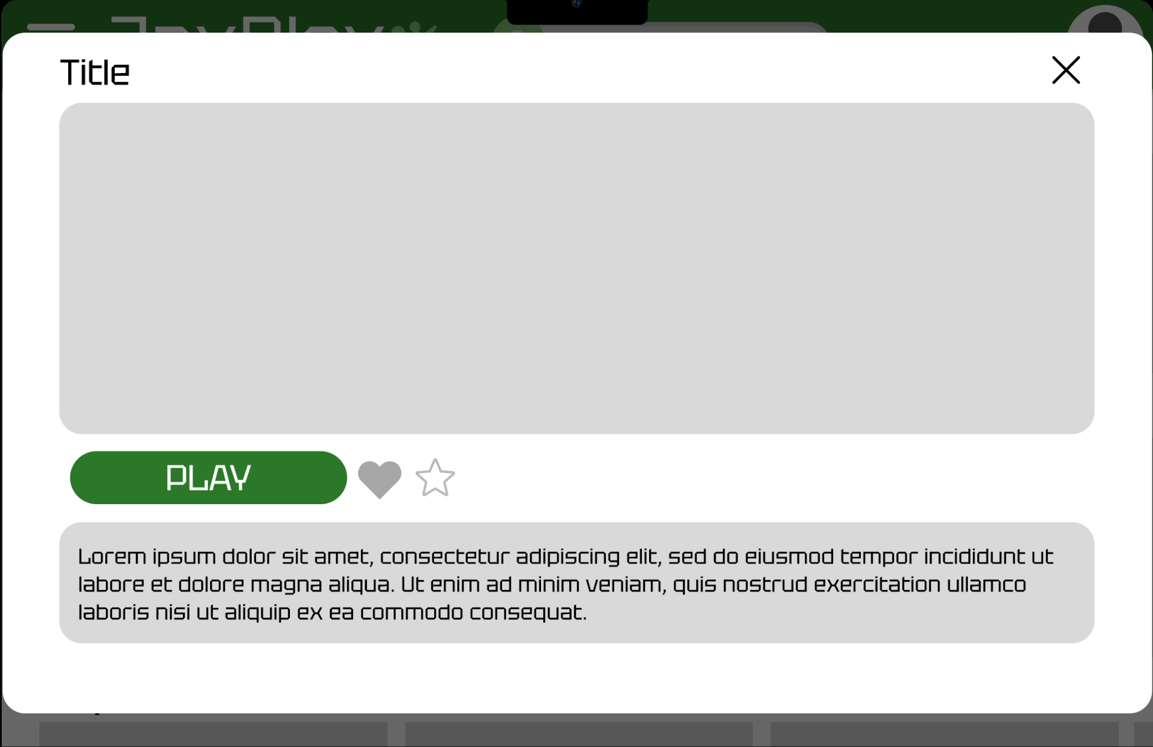
Lo-Fi Prototype
The home & Login screens were kept relatively the same as users were able to easily navigate them in testing
Notes:
Nazar

Slide 9
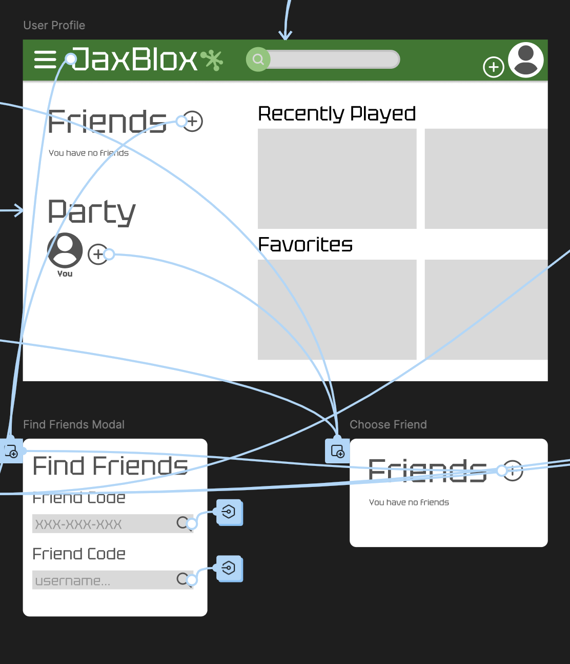
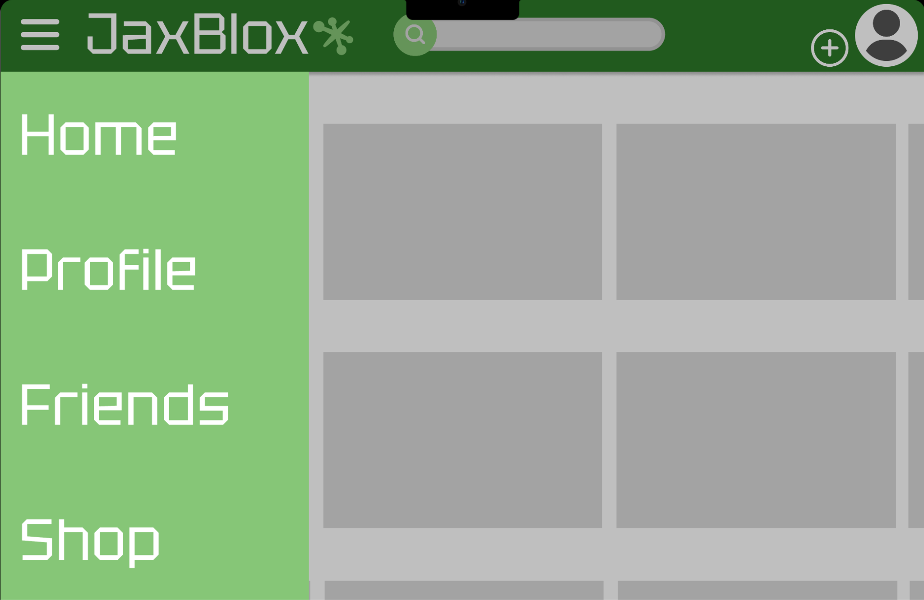
Design Evolution
Notes:
Lev: Most of the changes we made were actually in how you access different screens, allowing more ways to intuitively navigate the site

Slide 10
Live Demo
Flows
Side Menu > Add Friend > Profile > Add to Party
Add to Party > Add Friend > Select
Start game with friends - we removed the extra modal
Notes:
Brandon - design lead

Slide 11
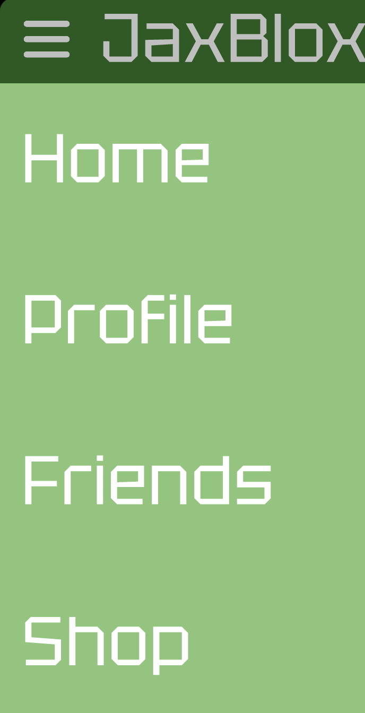
Testing & Iteration
User testing was done with paper
cutouts of the lo-fi prototype.
The main improvements we made:
Implemented sidebar
Removed pre-game modal
Allowed all attempted ways to add
friends & party members
Notes:
Lev
We weren’t totally sold on the side bar at first, but realized people expected one for navigation
Pre-game modal added an unexpected and unnecessary step to the flow
Allowed more ways people tried to add friends & party members

Slide 12
Conclusion
Completing this project showed us the importance of usability testing, and working as a team. The way users interacted with the lo-fi prototype was very different than we could’ve predicted, and the tests allowed us to make major improvements in UI design. Working as a team, it was important to understand of each other’s strengths to work effectively in our individual roles.
With JaxBlox, you will have an infinite variety of budget-friendly online party games at your fingertips.
Notes:
Nazar - say thank you and ask for questions at the end

