Slide 1
Video game industry
Jordi Pujol

Slide 2
The industry
€3.2B
€222.18B
€340.92B
Videogame community
Estimate in 2023
Estimate in 2028
Notes:
https://www.bankmycell.com/blog/how-many-people-play-video-games
https://www.mordorintelligence.com/industry-reports/global-gaming-market

Slide 3
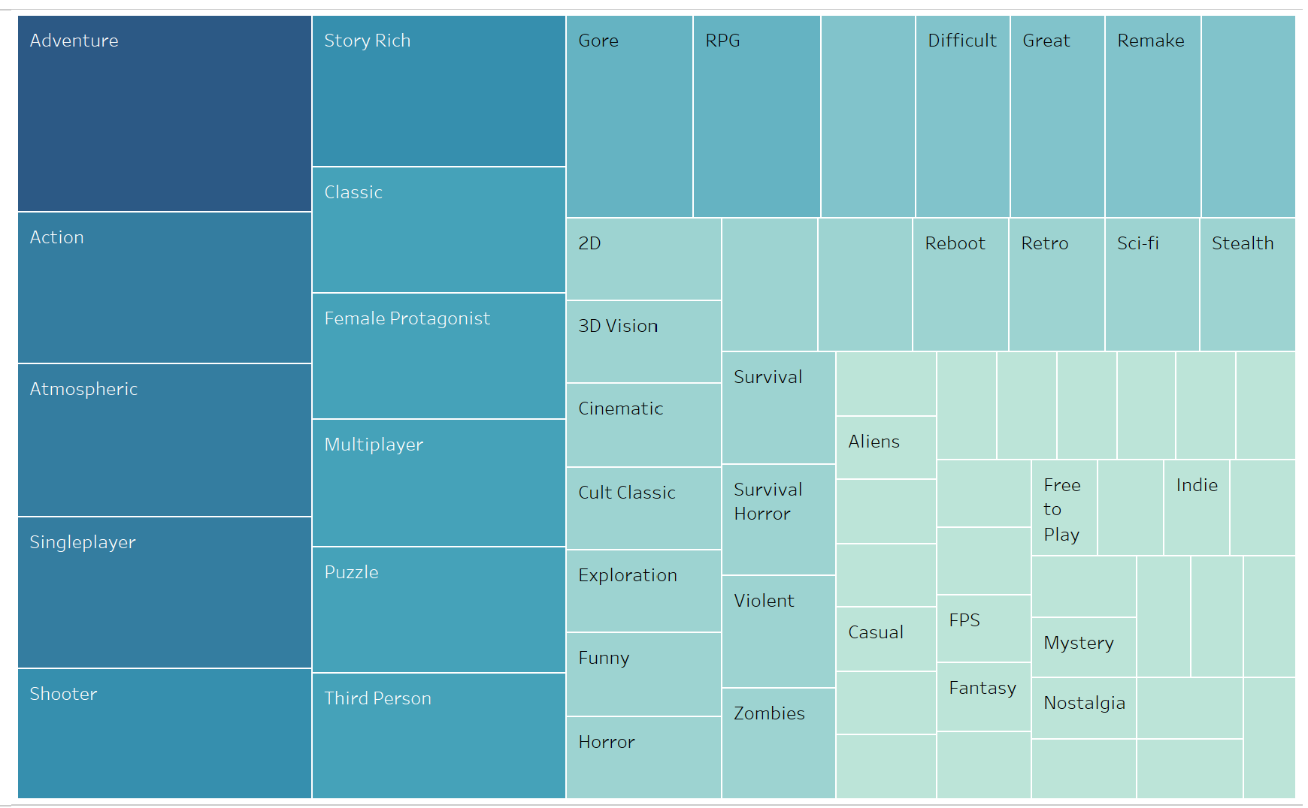

Most common tags 90s

Slide 4
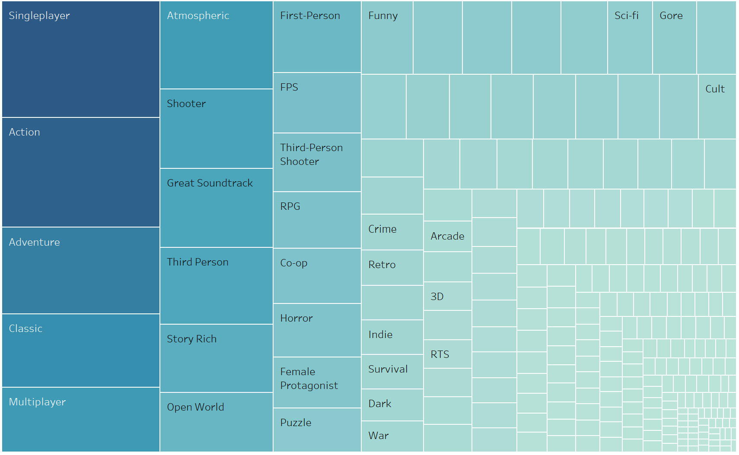
Most common tags 00s
Notes:
Single player goes up
Action and adventure lose
Story rich drops in the ranking

Slide 5
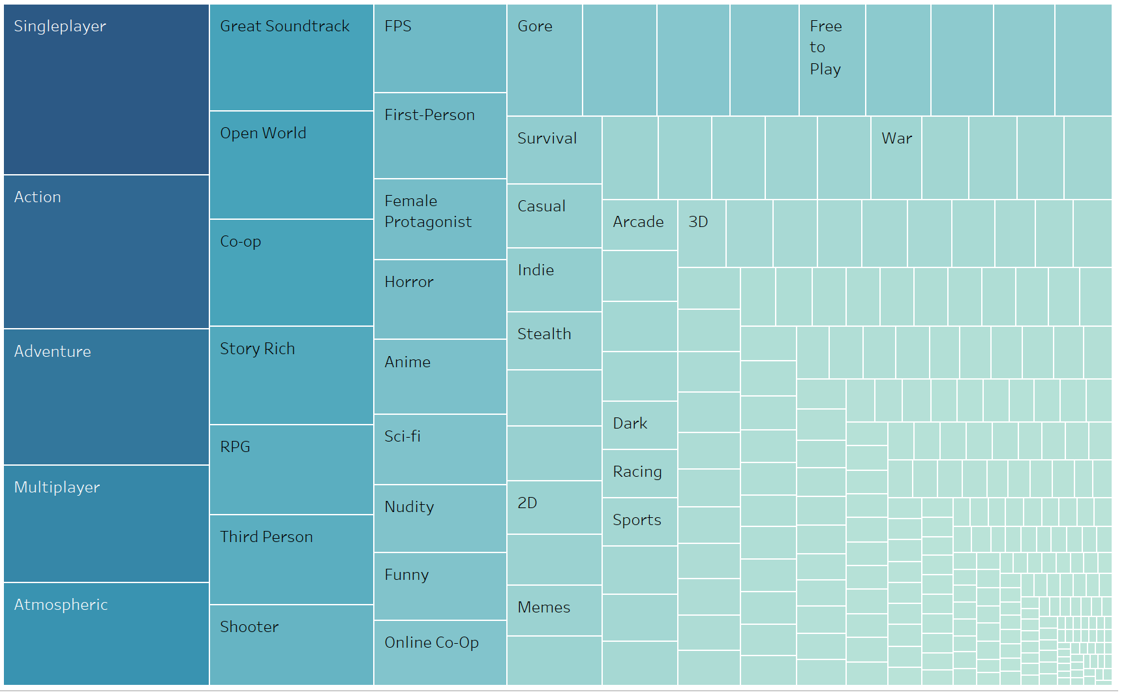
Most common tags 10s
Notes:
Multiplayer and online games gain popularity
Horror goes up
Female protagonists are portrayed more and more

Slide 6
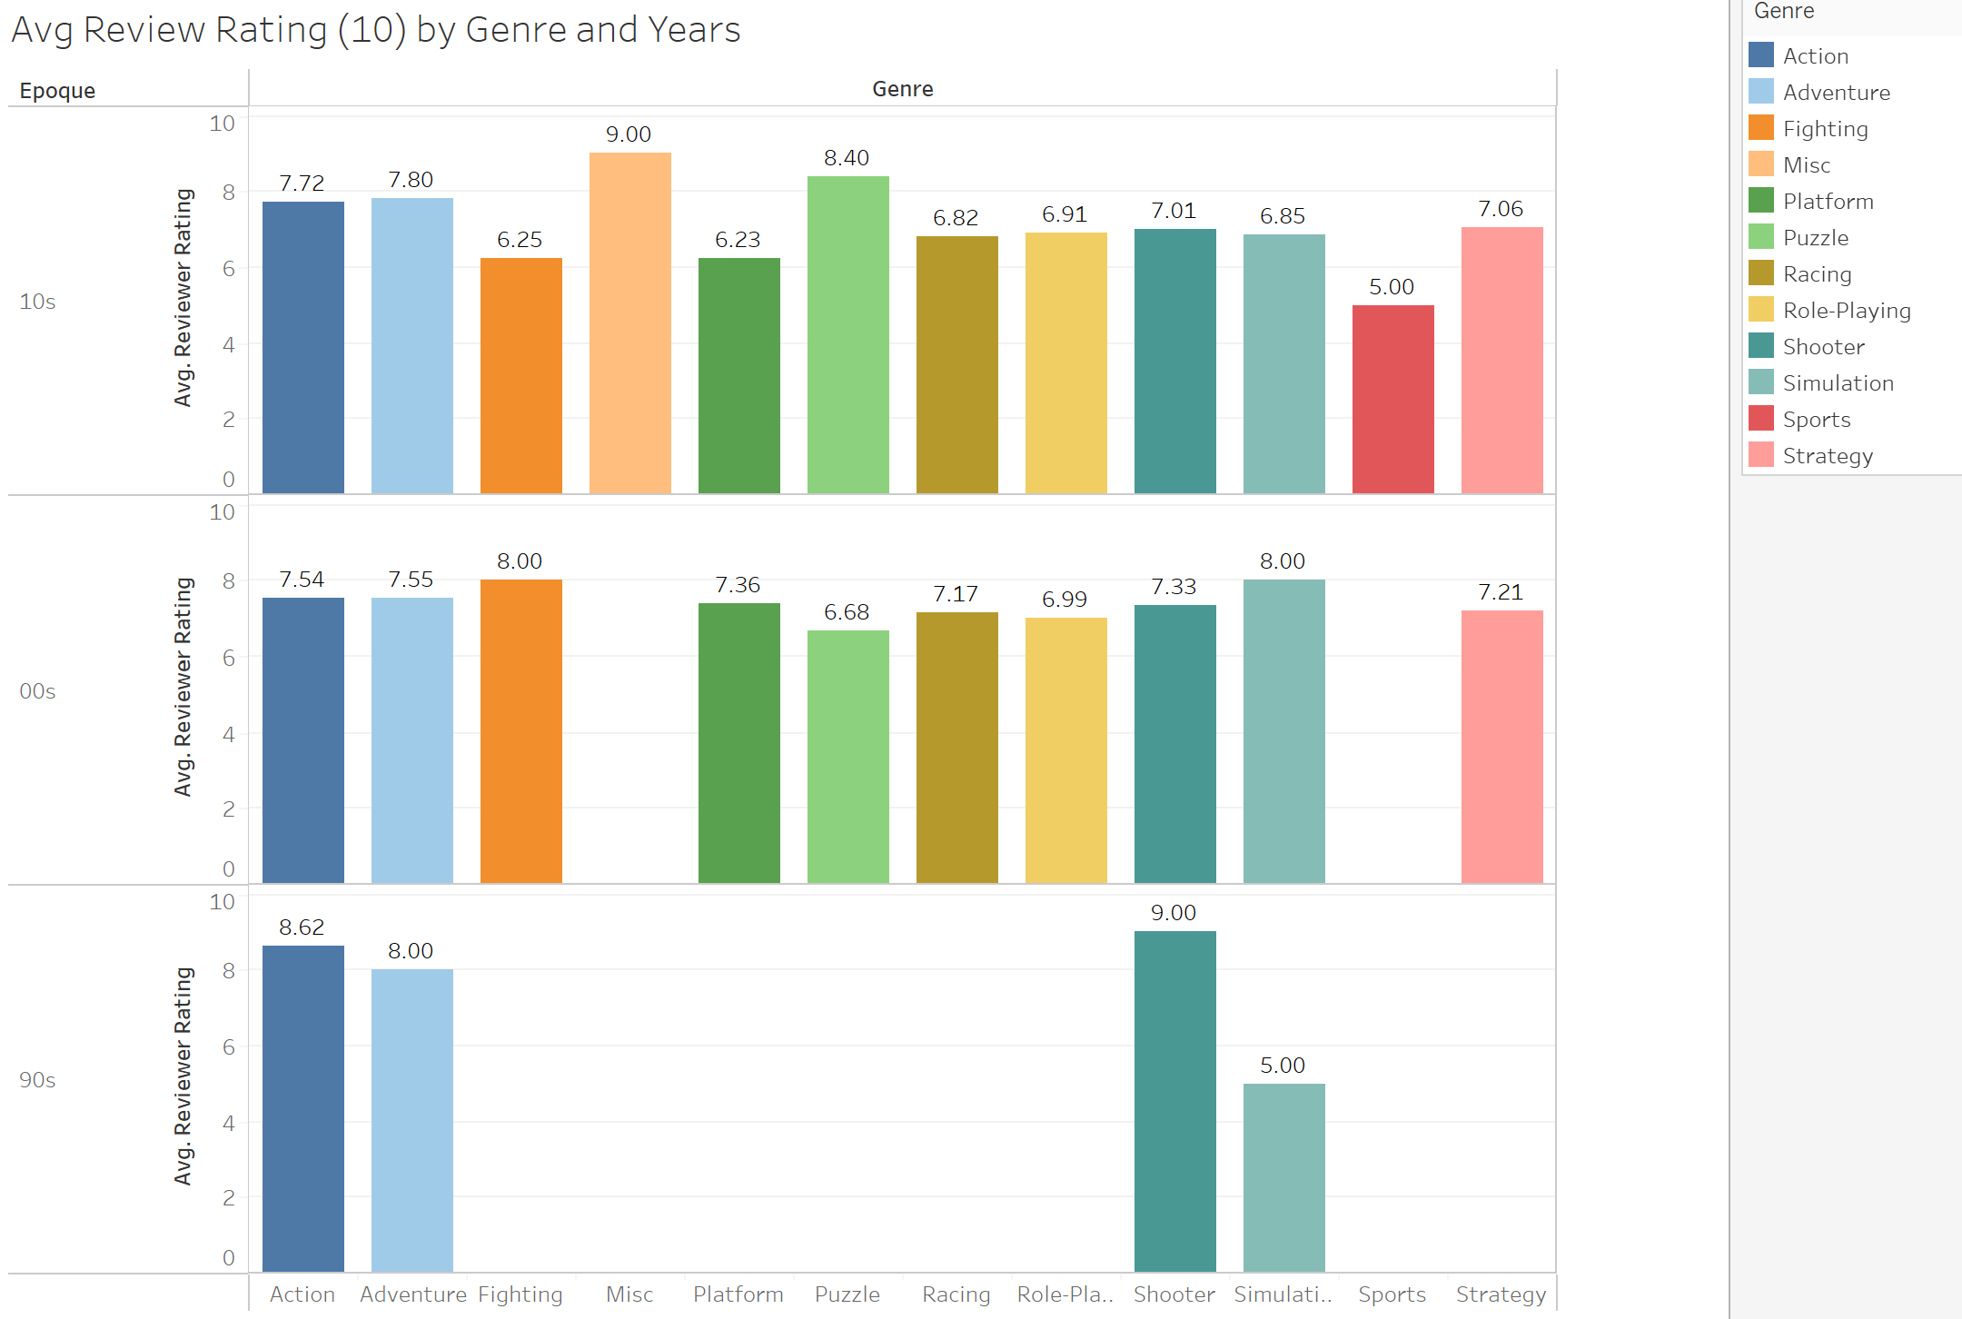
Games by genre
Notes:
Through the years we see a trend of category discoveries, where there is a lot of fluctuation
As games evolve, there is also a change in preferences
Fighting and simulation games lose their edge
Puzzle games have characteristics that are more enjoyable by the users
Miscelanous games could be anything like farming simlators, flight simulators – any game with a wide variety of tasks and pruposes

Slide 7
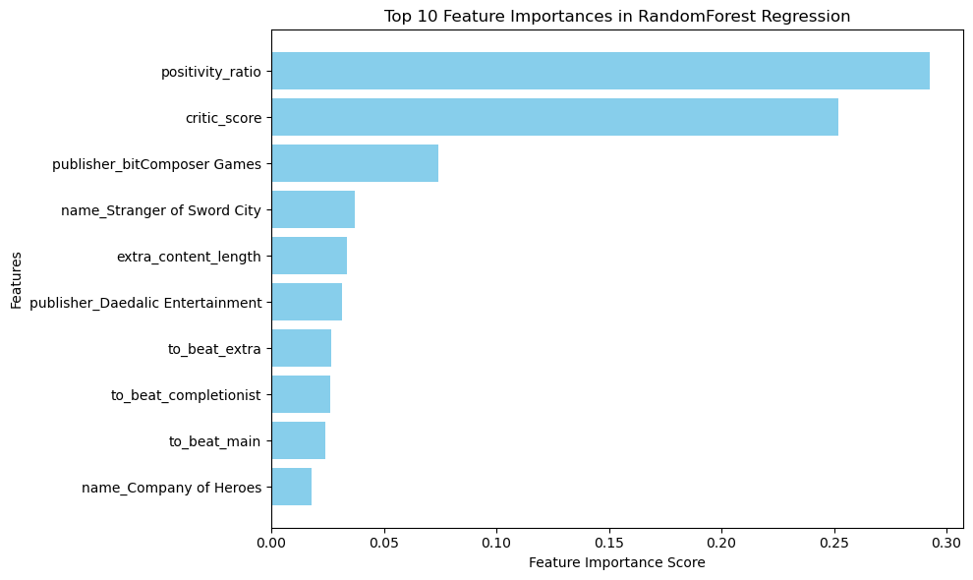
More significant features
Notes:
Although trends are also defined by sociocultural changes, within the gaming industry we can determine some factors seem to affect the rating given to games.
Positivity ratio which is the total number of positive reviews divided by the total number of negative reviews seems to be the main factor to influence a certain user-score. Same with the critic-score which is given by world know gaming magazines and media, followed by the publisher. The content of the game or tags, are less influential as the demand for types of games is so variable .

Slide 8
Learning exp
Initial idea
Similar as we saw with Spotify, connect to an API to recommend video games based on characteristics we like
Problem
API found had limited database
Although there were 500 datapoints, more than 90% of them were nulls
result
Spent too much time trying to get the API working
Change topic to a similar case
conclusion
The importance of a clear structure, meaningful data, and prioritization within time management

Slide 9
THANK YOU

