Slide 1
LinZ Geo QuiZ
7 April,2017- UI Design/Tech-Stack
Arora Ravdeep
Breitenfellner Marcel
Obermayr Christian
Punz Jürgen

Slide 2
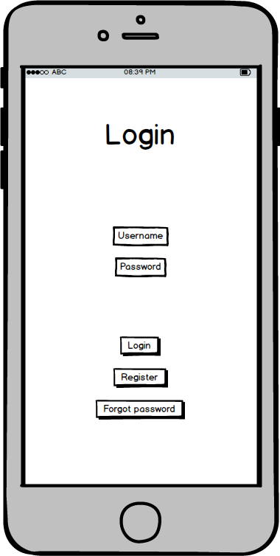

Slide 3
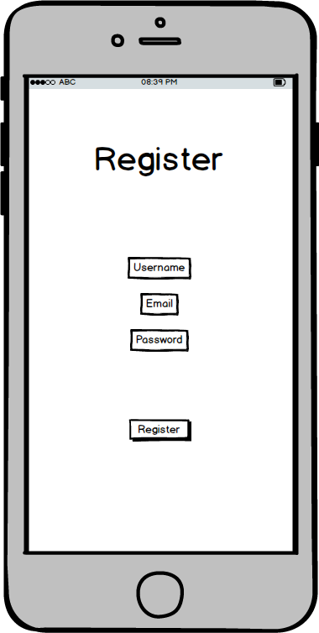

Slide 4
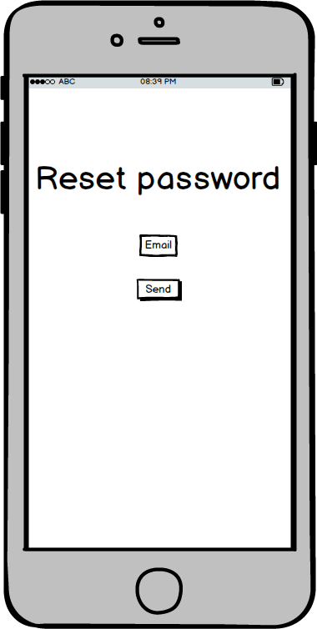

Slide 5
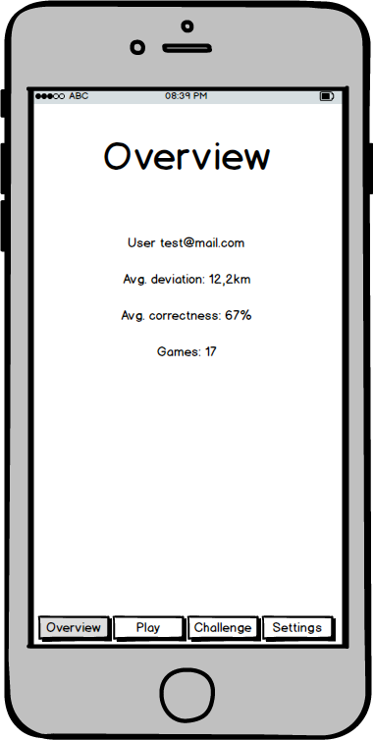

Slide 6
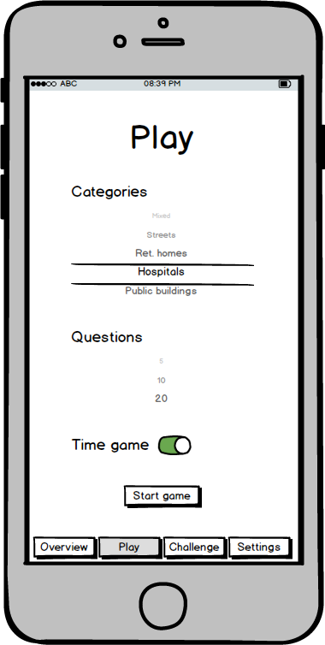

Slide 7
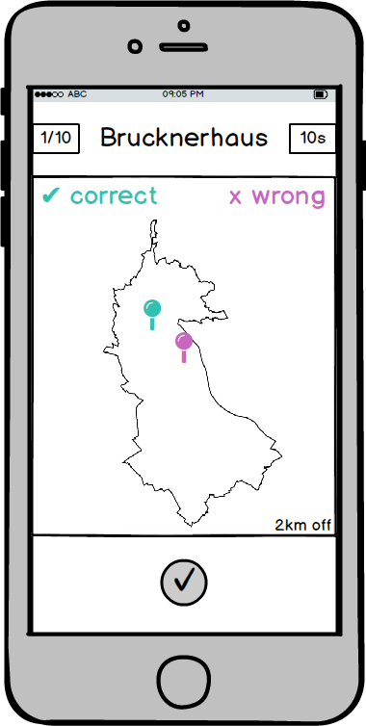

Slide 8
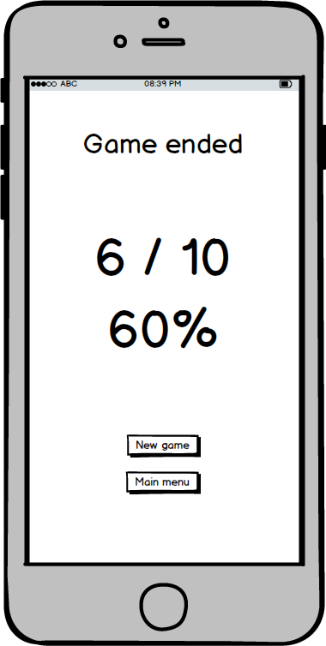

Slide 9
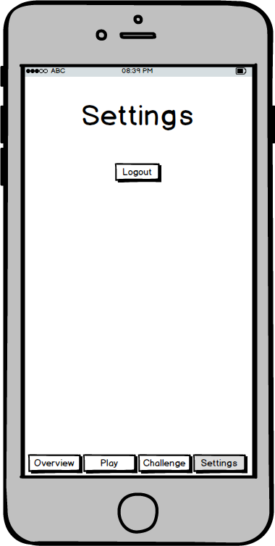

Slide 10
Tech-Stack
Xamarin Framework
Share code everywhere
Portable Class Libraries ”Build your own app logic as a PCL and use it everywhere”
Native Performance “Apps written in Java or Objective-C are easily transitioned to C#”
Xamarin Component Store :can integrate popular backends such as Microsoft Azure, Parse, Salesforce, and SAP, as well as add powerful security features such as authentication and encryption.
Xamarin.Forms :includes more than 40 controls and layouts,which are mapped to native controls at runtime.
PITFALL:
One thing that you cannot do with Xamarin ☹
*you cannot use it as a tool to port apps.
“You have existing apps running on various platforms, you cannot take those and port them to other platforms using Xamarin. This is possible only when new iOS and Android apps.”

Slide 11
Tech-Stack
Firebase :
1) To store and sync data across multiple clients.
2) Capable of handling the Real-time data updates
3) Stored in cloud so readily available everywhere
4) They Host the data. -Meaning if you are storing a lot of data, you don't have to worry about hardware.
Programming Language : C#
APIs and Integration:
Using google maps API for pinning locations.
Facebook API integration to share scores with friends etc.
User can login using Facebook Id, firebase login.
Streets and other geographical data is being managed in Firebase.

