Slide 1
Java Release Timeline
Java 8 – 11 and Beyond

Slide 2
Java Ecosystem
Oracle
  Oracle JDK
  OpenJDK
AdoptOpen JDK
  Certified implementation of OpenJDK
Lots of other implementations as well
https://en.wikipedia.org/wiki/OpenJDK#OpenJDK_builds

Slide 3
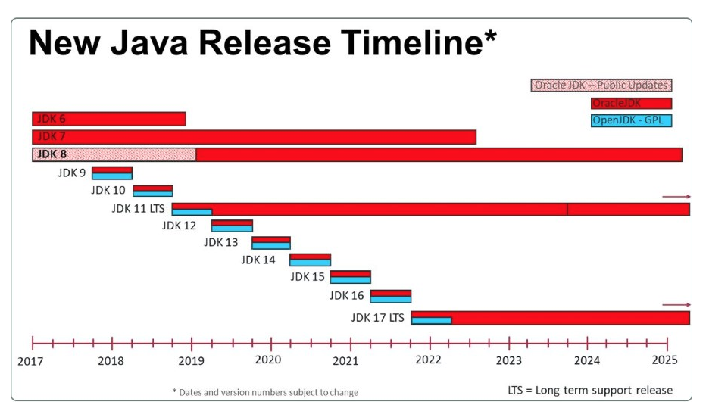
Java 8 and Beyond
What’s In the Releases?
https://dzone.com/articles/a-guide-to-java-versions-and-features
https://howtodoinjava.com/java-version-wise-features-history/
https://en.wikipedia.org/wiki/Java_version_history

Slide 4
Major Changes by Release
What’s new in
  Java 8
  Java 9
  Java 10
  Java 11 (LTS)
  As of this writing, Java 14 is available
  The following feature slides were taken from How To Do In Java
  https://howtodoinjava.com/java-version-wise-features-history/

Slide 5
Java 8
March 2014
Lambda expression support in APIs
Stream API
Functional interface and default methods
Optionals
Nashorn – JavaScript runtime which allows developers to embed JavaScript code within applications
Annotation on Java Types
Unsigned Integer Arithmetic
Repeating annotations
New Date and Time API
Statically-linked JNI libraries
Launch JavaFX applications from jar files
Remove the permanent generation from GC

Slide 6
Java 9
September 2017
Java platform module system
Interface Private Methods
HTTP 2 Client
JShell – REPL Tool
Platform and JVM Logging
Process API Updates
Collection API Updates
Improvements in Stream API
Multi-Release JAR Files
@Deprecated Tag Changes
Stack Walking
Java Docs Updates
Miscellaneous Other Features

Slide 7
Java 10
March 2018
JEP 286: Local Variable Type Inference
JEP 322: Time-Based Release Versioning
JEP 304: Garbage-Collector Interface
JEP 307: Parallel Full GC for G1
JEP 316: Heap Allocation on Alternative Memory Devices
JEP 296: Consolidate the JDK Forest into a Single Repository
JEP 310: Application Class-Data Sharing
JEP 314: Additional Unicode Language-Tag Extensions
JEP 319: Root Certificates
JEP 317: Experimental Java-Based JIT Compiler
JEP 312: Thread-Local Handshakes
JEP 313: Remove the Native-Header Generation Tool
New Added APIs and Options
Removed APIs and Options

Slide 8
Java 11
September 2018
LTS
HTTP Client API
Launch Single-File Programs Without Compilation
String API Changes
Collection.toArray(IntFunction)
Files.readString() and Files.writeString()
Optional.isEmpty()
Our version

Slide 9
Java 12
March 2019
Collectors.teeing() in Stream API
String API Changes
Files.mismatch(Path, Path)
Compact Number Formatting
Support for Unicode 11
Switch Expressions (Preview)

Slide 10
Java 13
September 2019
JEP-350: Dynamic CDS Archives
JEP-351: ZGC: Uncommit Unused Memory
JEP-353: Reimplement the Legacy Socket API
JEP-354: Switch Expressions (Preview)
JEP-355: Text Blocks (Preview)
A “JEP” is a Java Enhancement Proposal and it’s what defines proposed changes to the language

Slide 11
Java 14 (Mar 2020)
Helpful NullPointerExceptions (better messages)
Switch Expressions (Standard)
JFR (Java Flight Recorder) Event Streaming
Pattern Matching for instanceof (Preview)
Non-Volatile Mapped Byte Buffers (Incubator)
Packaging Tool (Incubator)
NUMA-Aware Memory Allocation for G1
Likely Most useful to you
Could be useful to you

Slide 12
Java 14, cont’d
Records (Preview)
Text Blocks (Second Preview) – multi-line string literals
Deprecate the Solaris and SPARC Ports
Remove the Concurrent Mark Sweep (CMS) Garbage Collector
ZGC on macOS (experimental)
ZGC on Windows (experimental)
Deprecate the ParallelScavenge + SerialOld GC Combination
Remove the Pack200 Tools and API
Foreign-Memory Access API (Incubator)

Slide 13
Java 15 (Sep 2020)
We may be able to explore this towards the end of this class

