Slide 1
Java 9’s Module System
A Useful Overview

Slide 2
JPMS
Java Platform Module System (JPMS)
  A way to assemble and distribute Java code, cleanly and securely
  Specifies
    A distribution format for collections of Java code and associated resources
    A repository for storing these collections, or modules, and identifies how they can be discovered, loaded and checked for integrity.
  Introduced to refactor (reorganize and clean up) the Java APIs, enabling innovation

Slide 3
Java Modules
Modules
  Are collections of packages
  State what other modules they depend
  State what they expose to consumers/clients/rest of world
We can choose to modularize our applications, or not
  If we choose to do so, we need to create a module descriptor file
  By convention, called module-info.java

Slide 4
Conceptual Diagram
module m1
package p1
package p2
package p3
class
p1.A
class
p2.A
class
p3.X
class
p1.B
class
p1.C
class
p2.D
class
p2.E
class
p3.Y
class
p3.Z

Slide 5
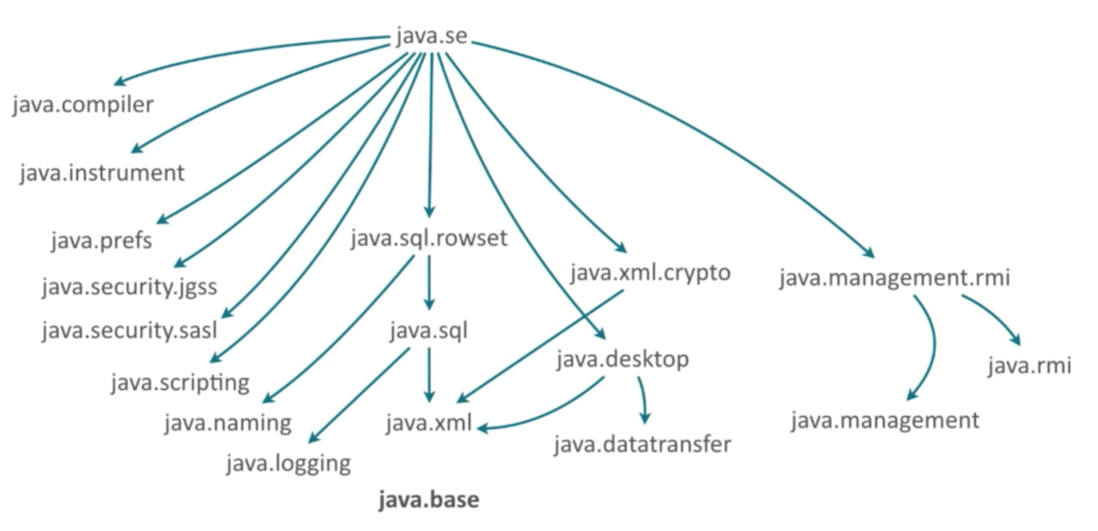
Java Platform Module System (JPMS)
Organizes 20+ years of the JDK development
JPMS modules has no intrinsic version

Slide 6
Module Types
System Modules
  Include the Java SE and JDK modules
  View via java -–list-modules
Application Modules
  What we usually want to build when we decide to use modules.
  Named and defined in the compiled module-info.class file included in the assembled JAR

Slide 7
Module Types
Automatic Modules
  We can include unofficial modules by adding existing JAR files to the module path
  The name of the module will be derived from the name of the JAR
  Automatic modules will have full read access to every other module loaded by the path
Unnamed Module
  When a class or JAR is loaded onto the classpath, but not the module path, it's automatically added to the unnamed module
  Catch-all module to maintain backward compatibility with previously-written Java code
  By default, everything is exported and open

Slide 8
Conceptual Diagram
module-info.java
module-info.java
module m1
module m2
requires
package p1
package p3
class
p1.A
class
p1.B
m2 requires m1 to work correctly
class
p3.A
class
p3.B
package p2
package p4
class
p2.X
class
p2.Y
exports
package p2
class
p4.X
class
p4.Y
m1 makes p2 available to use for the world at compile-time and run-time

Slide 9
Java Modules
Descriptor file
  module-info.java file, part of the compilation chain
  Presence of module-info.java makes your application “modular”
  See module keyword
  Contains
    Name – the name of our module
    Dependencies – a list of other modules that this module depends on
    Public Packages – a list of all packages we want accessible from outside the module
    Services Offered – we can provide service implementations that can be consumed by other modules
    Services Consumed – allows the current module to be a consumer of a service
    Reflection Permissions – explicitly allows other classes to use reflection to access the private members of a package

Slide 10
Java Modules Exports
exports (packages)
  By default, packages defined in a module are scoped to the module
  Use exports to make packages available to consumers at compile-time and run-time
  Public and protected features of exported packages are accessible. Private means private and private members are still inaccessible
  Non-exported packages are not accessible – and compilation will fail if your program uses them
exports to
  Provides the module’s API to an explicit set of other modules
    Restricts who can use the module’s exported packages
  Restricts who can use requires

Slide 11
Conceptual Diagram
module m1
module
m2
package p1
class
p1.A
class
p1.B
package p2
Nope
class
p2.X
class
p2.Y
exports to m3
package p2
module
m3
m1 makes p2 available to use only by m3

Slide 12
Java Modules Requires & Reflection
requires (modules)
  Modules must explicitly mention all modules on which they depend
  Only direct dependencies are stated
  Transitive dependencies are handled automatically
  Every module implicitly requires java.base
  Cyclic dependencies are not allowed
  Note that if your application is not modular (does not use a module-info.java file) but you need to access a module at compile-time and/or run-time…
    Use --add-modules switch with javac and java respectively
    We will use this to access JavaFX

Slide 13
Java Modules Requires & Reflection
Prior to Java 9 and modules, you could subvert a class’s access restrictions, e.g., access private fields, using Reflection
  Reflection is the runtime interrogation of instances (details beyond the scope of this course)
Many libraries use reflection to operate effectively
  Files in the face of modules and the strict encapsulation they provide

Slide 14
Conceptual Diagram
module-info.java
module m1
open allows run-time access to all packages within the module vis-à-vis reflection
package p1
open
class
p1.A
class
p1.B
Client using Reflection
package p2
class
p2.X
class
p2.Y

Slide 15
Conceptual Diagram
module-info.java
module m1
opens allows run-time access to specific packages within the module vis-à-vis reflection
package p1
opens
class
p1.A
class
p1.B
Client using Reflection
package p2
Nope
class
p2.X
class
p2.Y

Slide 16
Java Modules Open…
open
  Allowing runtime-only access to all packages in a module
  All the packages in the given module are accessible at runtime and via reflection to all other modules
opens
  Allows runtime-only access to a specific set of packages (vs. all, as in open)
  Indicates that a specific package’s public types (and their nested public and protected types) are accessible to code in other modules
  All types in the specified package (and all of the types’ members) are accessible via reflection
opens..to
  Exposes certain packages at runtime to an explicit set of consumers (other modules)
uses
  Applicable when consuming service and service providers (beyond the scope of this course)

Slide 17
Packaging
Most times, we put modules in modular JAR files
A modular JAR is a JAR file with module-info.class in the root
Place a modular JAR on the module path and it’s a module!
JAR without module-info.class on module path is an automatic module
  Implicitly requires all other modules
  All of its packages are exported and open
  Module name derived from JAR file name, e.g., commons-csv-1.4.jar -> commons.csv

Slide 18
Packaging
Important Note
  If your program is not modular…
    no module-info.java
  …but needs packages from a module to function correctly
    Use --add-module as part of the java command

Slide 19
Unnamed Module (Redux)
Even with modules, the class path still exists
Any package on the class path is implicitly placed in the unnamed module managed by the JDK/JVM
All of the packages in the unnamed module are exported and open, meaning they are available to the world at compilation, at runtime and can be reflected over
Maintains backward compatibility with existing code

Slide 20
Why Oh Why?
For this class, you can ignore modules most of the time
Covered because the JDK is modular – that’s the new normal in the Java JDK
We need to understand the basics to access JavaFX

