Slide 1
Streams
Where Functional Programming Becomes Reality

Slide 2
Functional Programming
A style of programming rooted in mathematical concepts
Key concepts
  Functions
  Pure functions
  Immutable data
  Internal iteration
Favors the what over the how

Slide 3
Functional Programming
Functions (General)
  An operation that maps zero or more inputs to a single output
Pure Functions
  Pure functions are those whose result depend exclusively on their inputs
  The same inputs always yields the same, predictable output
  Exhibit no side effects
    In a program, for example, no data structures or data stores would be changed
    Think “read only”

Slide 4
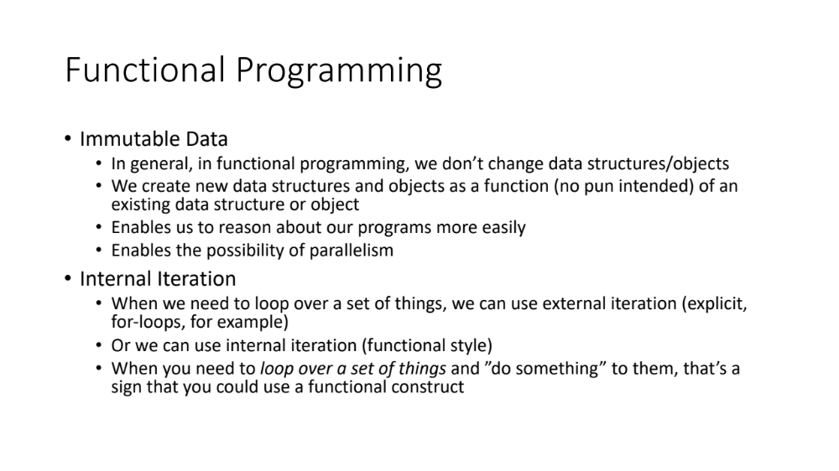
Functional Programming
Immutable Data
  In general, in functional programming, we don’t change data structures/objects
  We create new data structures and objects as a function (no pun intended) of an existing data structure or object
  Enables us to reason about our programs more easily
  Enables the possibility of parallelism
Internal Iteration
  When we need to loop over a set of things, we can use external iteration (explicit, for-loops, for example)
  Or we can use internal iteration (functional style)
  When you need to loop over a set of things and ”do something” to them, that’s a sign that you could use a functional construct

Slide 5
What vs. How
How
  Explicit
  Do this, then this, then this
  Typical imperative programming
What
  Declarative
  I would like this answer
  SQL is a great example
    SELECT u.fname, u.lname WHERE u.age >= 21 from Users u

Slide 6
Higher-Order Functions
In functional programming, functions take a front seat as first-class citizens
We can pass functions into methods
We can return functions from methods
This “passing functions around” enables us to compose sophisticated features elegantly
Let’s look at some examples to help solidify the main ideas
  HighOrderFunc example project

Slide 7
Streams package java.util.stream
Streams are constructs that enable us to process data element using functional programming techniques
  In mathematical terms, streams are realizations of a concept called a monad
  You do not need to understand monads to understand streams
They pull their data from a source, run it through a processing pipeline and produce a result

Slide 8
Streams
Turn source into Stream<T>
Data Source
init
intermediate op
intermediate op
intermediate op
terminal op
Array, file, List, database, etc.
Produces a final result and terminates the stream.
Upon termination, the stream is rendered unusable, meaning you cannot you the stream again. You need to create a new stream to process more data.
Process each element, e.g., look at it, change it, filter it, etc.
Each step’s output (a stream) is the next step’s input.
Intermediate operations produce streams for their siblings to consume
Always evaluated lazily (vs. eagerly)
Important conceptual note:
Think of the terminal operation as pulling the data toward itself vs. having the data pushed. This conceptual model aids in understanding some of the the stream’s capabilities.

Slide 9
Stream Characteristics
The classes Stream, IntStream, LongStream, and DoubleStream are streams over objects and the primitive int, long and double types
Streams differ from collections in several ways
  No storage. A stream is not a data structure that stores elements; instead, it conveys elements from a source through a pipeline of computational operations.
  Functional in nature. An operation on a stream produces a result, but does not modify its source.
  Laziness-seeking. Many stream operations, such as filtering, mapping, or duplicate removal, can be implemented lazily, exposing opportunities for optimization
  Possibly unbounded. While collections have a finite size, streams need not
  Consumable. The elements of a stream are only visited once during the life of a stream. Like an Iterator, a new stream must be generated to revisit the same elements of the source.

Slide 10
Common Stream Operations https://docs.oracle.com/en/java/javase/11/docs/api/java.base/java/util/stream/Stream.html
peek
  intermediate – enables element to flow through the pipeline – used mostly for debugging
forEach
  terminal - accepts each stream element and does something with it, e.g., print it
count
  terminal – produces a count of the elements
distinct
  Intermediate – produces a stream of unique elements taken from an original stream

Slide 11
Common Stream Operations https://docs.oracle.com/en/java/javase/11/docs/api/java.base/java/util/stream/Stream.html
filter
  intermediate – filters out elements that don’t pass a test (the test is expressed as a Predicate)
limit
  intermediate – governs the number of elements the stream processes
map
  intermediate – takes the elements of a stream, performs a function on each one, and produces a new stream with the output
flatMap
  intermediate – takes the elements of a nested data structure, allows you to perform a function on them, and then produces a ”flattened” stream of the result

Slide 12
Common Stream Operations https://docs.oracle.com/en/java/javase/11/docs/api/java.base/java/util/stream/Stream.html
map()
Original Stream
e1
e2
e3
e4
Mapping Function
f(e_{n}) = x_{n}
New Stream
x1
x2
x3
x4
Examples:
Turn Strings into their corresponding lengths (String -> int)
Convert String to all uppercase (String -> String)
Take an element from an object, e.g., Person birthday, and produce age (Object -> int)

Slide 13
Common Stream Operations https://docs.oracle.com/en/java/javase/11/docs/api/java.base/java/util/stream/Stream.html
List of Employees
Projects
New Stream
e1
p1
p2
p1
p2
p3
e2
p3
p5
p6
flatMap()
p5
p6
p2
e3
p2
p4
p6
e4
p1
p4
p6
p1
Original Data Structure
Examples:
Take a nested set of things and turn them into a single stream for processing
Taking all the words from pages of a book and turning them into a stream for processing

Slide 14
Stream Examples
Let’s go look at some examples
  Streams project
  When we get to the IntStream example, we’ll discuss Optionals

Slide 15
Parallel Streams
Parallel streams offer the most increase in performance when the computation is CPU-bound
(Beyond the scope of this course)
intermediate op
intermediate op
Turn source into Stream<T>
Data Source
init
Combiner
terminal op
Array, file, List, database, etc.
intermediate op
intermediate op
Sub-stream
Parallel Streams must be used only with stateless, non-interfering, and associative operations:
A stateless operation is an operation in which the state of one element does not affect another element
A non-interfering operation is an operation in which data source is not affected
An associative operation is an operation in which the result is not affected by the order of operands

