Slide 1
Core Java In a Nutshell

Slide 2
Java Buzzword Bingo
General purpose
  Can be used to solve lots of general computing problems
Strongly-typed
  Data items are of a known type always and cannot change type
Statically typed
  Types are known at compile time, making the program less error-prone at runtime
Object-oriented
  Solutions can be modeled with language constructs that match the semantics of the problem domain

Slide 3
Java Buzzword Bingo
Platform-neutral
  The same Java program can be run on Windows, Linux, MacOS, etc.
  Magic of the platform’s JVM
Dynamic
  New types can be loaded at run-time
  Interface with native libraries, e.g., C, C++
Networked
  You can use Java to create distributed application (applications that span physical processes and computers)
Secure
  The JVM checks to ensure the program doesn’t do bad things

Slide 4
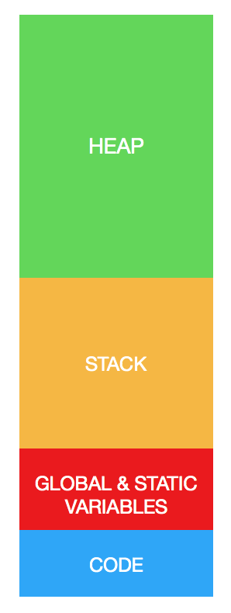
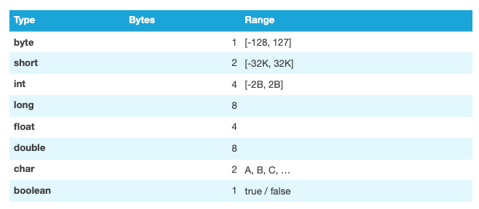
Primitive Types
Types native to Java
Let’s take a quick look at jshell

Slide 5
Strings
Ordered sequences of codepoints (think of codepoints as characters)
Implemented via the String type (java.lang.String)
Represents a string in the UTF-16 format (variable-length encoding)
Immutable
Support concatenation with +
Useful methods – let’s look at official doc
  https://docs.oracle.com/en/java/javase/11/docs/api/java.base/java/lang/String.html
  Learn how to read the doc and find your way around

Slide 6
Reference Types
All types that are non-primitive
String are an example
Implement state + behavior
Variables represent state and can be primitives or reference types
Methods implement behavior
Java SDK supplies hundreds of these
We can use 3rd party types
We can build our own
  This is the essence of being “object-oriented”

Slide 7
Arithmetic
Numeric signs (+/-)
()
+
-
*
/
%

Slide 8
Conditionals
Expressions are constructs that evaluate to a single value
We can use boolean expressions to make decisions and follow particular code paths
if
if…else / nesting
switch

Slide 9
Conditionals Comparisons
Expressions are constructs that evaluate to a single value
We can use boolean expressions to make decisions and follow particular code paths
!
==, != <, >
<=, >=
conjunctions: &&, ||

Slide 10
Loops
We often need to repeat the same steps over and over
for
while
do…while
break
continue

Slide 11
Arrays
Covered in book slides Chapter 7 & 8

