Slide 1
exceptions
when things go wrong

Slide 2
what is an exception?
An exception is an error that occurs in a program
Depending on the error…
  Sometimes we can prevent the error from ever happening
    By changing or improving our program
  Sometimes we can recognize the error and recover from it
    By ”handling” the exception gracefully
  Sometimes we can’t do anything and the program terminates
    and that’s just sad

Slide 3
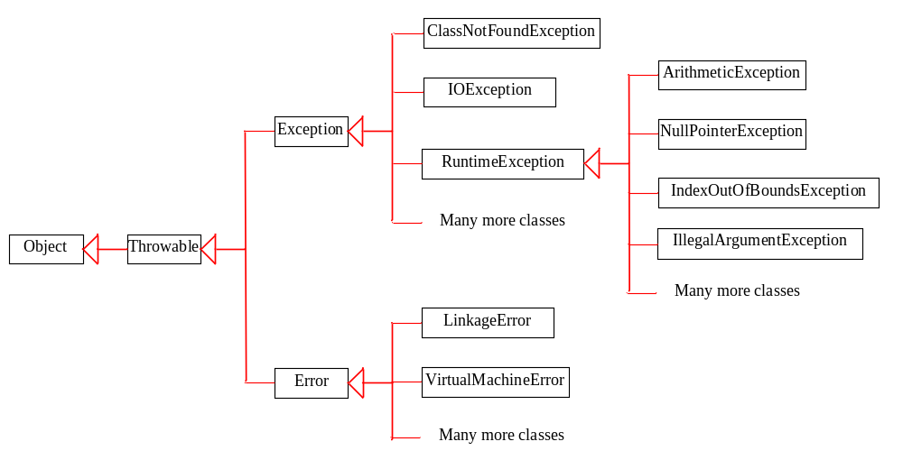
Exception Types
Problems that occur at runtime due to logic errors. Generally preventable via fixing your code.
Exception are arranged in a class hierarchy (via inheritance)
We’ll discuss class hierarchies and inheritance at length in a future class.
System error. Low-level issues that we can’t do anything about. Rarely happen.

Slide 4
Exception Types
checked exceptions
checked exceptions
  those that you must declare and/or handle in a method
unchecked exceptions
  those that can occur but for which you don’t need to declare
  keeps the code less cluttered
More classes
unchecked exceptions

Slide 5
terminology
When an exception occurs, we say…
  an exception was thrown or that the exception was raised
If we handle the exception in a block of code, we say…
  the exception was caught or that the exception was handled
The JVM/Java program might cause an exception to be thrown
We as programmers can create and throw our own exceptions in response to program conditions as well

Slide 6
java constructs
try {
// code (that could throw exception)
} catch (ExceptionClass) {
// handle exception
} finally {
// runs whether or not exception occurs
// generally used to clean up resources, e.g.,
// close opened files
}

