Slide 1
Random mating populations: Hardy-Weinberg Principle
Chapter 5:
Presentation by Caitlin Randall

Slide 2
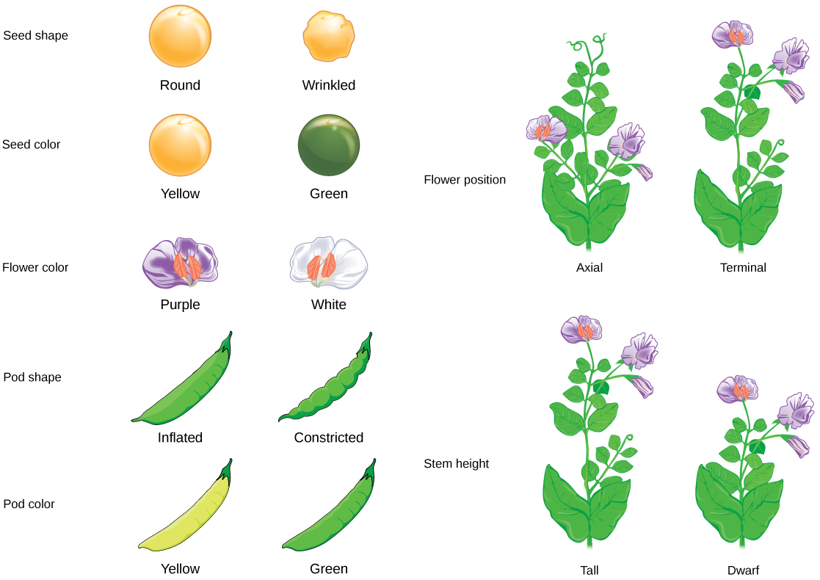
Establishing the Basics
What are Mendel’s laws of inheritance?
→ Mendel’s laws of inheritance include “the Law of Dominance
and Uniformity, the Law of Segregation, and the Law of Independent Assortment” (Lewis & Simpson, 2023)
Law of dominance and uniformity: some alleles, termed dominant alleles, “block” the expression of other alleles, which are referred to as recessive alleles
Law of Segregation: each parent contributes one copy of each allele to their offspring
Law of Independent Assortment: genes randomly assort during meiosis, with gametes each having an equal probability of receiving either allele
*often there are exceptions and conditions to these laws, although they can be used as a general guideline to understanding basic modes of inheritance
Notes:
https://www.genome.gov/genetics-glossary/Mendelian-Inheritance
https://pubmed.ncbi.nlm.nih.gov/32491444/#:~:text=These%20simple%20changes%20to%20the,the%20Law%20of%20Independent%20Assortment.
https://opentextbc.ca/biology/chapter/8-1-mendels-experiments/

Slide 3
Establishing the Basics
Allele frequency vs. Genotype frequency
Allele: a “version” of the same gene; for example, the “A/a” gene will have 2 variants, “A” and “a,” although both alleles code for the same type of information
Therefore, allele frequency means the frequency (probability of occurrence ranging from 0 to 1, or 0% and 100%) that a specific allele (variation of a gene) will be observed within a population
Genotype: the specific genotype found on each chromosome; for example, the “genotype” of an individual may be aaBbccDD, in which each individual character is an allele, each “type” of letter is a gene, and the sequence is the genotype
Therefore, genotype frequency refers to frequency (probability of occurrence ranging from 0 to 1, or 0% and 100%) that a specific combination of alleles, including heterozygous (both variants of a gene within a single organism) or homozygous (only one variant of a gene within a single organism, both copies can be dominant or both copies can be recessive)
Notes:
https://www.idtdna.com/pages/education/decoded/article/genotyping-terms-to-know

Slide 4
Models: Types & the pros and cons of using them
Two main types of models: Conceptual and Mathematical
Conceptual: used to “represent complex reality with words and in our thoughts” (Allendorf, et al., 2022)
Mathematical: used to “specify the relationship between empirical quantities that we can measure and parameters that we specify in our biological theory” (Allendorf, et al., 2022)
PROS | CONS
Used to define parameters, test hypothesize, extrapolate results and make future predictions Necessary for interpreting and attempting to understand the observed patterns of genetic change in populations | Sometimes not granular enough to accurately represent the myriad of factors, including those that are not yet known, that may be acting upon a system Even though this may be true, models are better than simply not trying to understand a system at all

Slide 5
What is the Hardy-Weinberg principle?
The Hardy-Weinberg principle is a mathematical model used in population genetics to calculate and simplify genetic variation (as a function of allele frequency) in a population across multiple generations, especially at a given locus or loci
Conditions of Hardy-Weinberg:
Random mating
No mutation
Infinite population size (no genetic drift)
No natural selection
No immigration/gene flow
= no evolution, all alleles have equal probability of inheritance, and “allele and genotype frequencies will remain constant from generation to generation” (Allendorf, et al., 2022)
= “genotypic frequencies after one generation of random mating will be a binomial function of allele frequencies” (Allendorf, et al., 2022)
Notes:
Random mating (as opposed to positive assortative mating, which is a preference from specific traits, or negative assortative mating, which is an aversion to specific traits in selecting a mate)
No mutation (although this is impractical, it happens on such a fine scale that in this simple model it is not given consideration as it has a negligible effect in the short term)
Infinite population size (obviously not the case in any situation, but intended to eliminate the possibility of genetic drift)
No natural selection (obviously not the case, although it is a fair assumption that even in real life populations natural selection will not be acting on every loci simultaneously at every given moment)
No immigration (no gene flow between populations)
= no evolution, ll alleles have equal probability of inheritance, and “allele and genotype frequencies will remain constant from generation to generation” (Allendorf, et al., 2022)
= “genotypic frequencies after one generation of random mating will be a binomial function of allele frequencies” (Allendorf, et al., 2022)

Slide 6
How can the Hardy-Weinberg principle be used in practical applications?
Generally, Hardy-Weinberg is mathematically represented using two allelic variations in the equation:
1.0=(p+q)² = p² + 2pq + q²
where… p is the probability of the major allele and q is the probability of the minor allele. When combined, the probability of observing these alleles will total 1.0.
With this information we can:
Determine the probability of either of the two (or more) alleles in a sample, which we can then extrapolate to represent the population
Compare observed and expected allele frequencies to determine whether a natural population is following HW proportions
If the allele frequencies observed are not what we would expect (thus we reject the null hypothesis), this may indicate:
There are alternate modes of inheritance at play (i.e. sex-linkage)
Other factors should be taken into consideration (i.e. geographical isolation leading to reproductive isolation or fragmentation due to habitat loss)
Errors have been made in genotyping (especially with low-coverage sequencing) and the data should be revisited

Slide 7
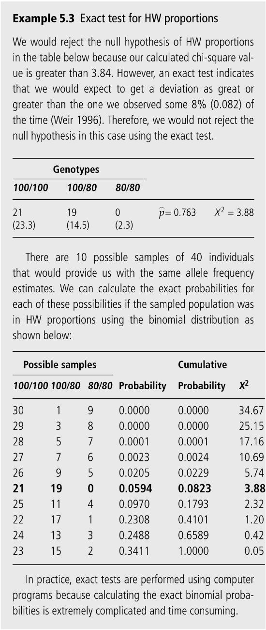
Limitations to using Hardy Weinberg proportions
Small sample size (which is sometimes a necessity in the case of populations with an already limited number of individuals)
Rule of thumb: “[don’t] use the chi-square test when any expected number is less than five.” (Allendorf, et al., 2022)
“Levene (1949) has shown that in a finite sample of N individuals, the heterozygotes are increased by a fraction of 1(2N-1) and homozygotes are correspondingly decreased (Crow & Kimura 1970, pp. 55-56)
However, exact tests, which “are performed by determining the probabilities of all possible samples assuming that the null hypothesis is true” can be used to circumvent this limitation of small expected numbers with the chi-square test (Allendorf, et al., 2022).

Slide 8

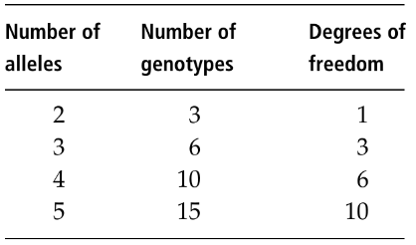
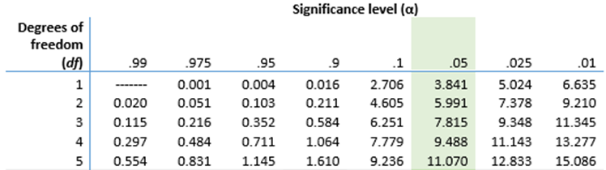
A closer look at example 5.3 + a bit of genetics review
Useful info for understanding example 5.1:
100 and 75 are used to designate alleles; 100/100 & 75/75 = homozygous; 100/75 = heterozygous
To test for HW proportions (before performing the exact test), you must:
Calculate expected frequencies of genotypes based upon the sample data by estimating the allele frequencies for p and q
Use these values and the HW equation to calculate the number of expected individuals with each genotype within the population
We then calculate the chi-square value using the equation:
and then determine the degrees of freedom based upon this chart:
using this data you would then utilize a chi-square table to reject
or fail to reject your null hypothesis
To perform an “exact test,” you would calculate the chi square of every possible sample ranging from a probability of 0 to 1.00. Notice that although our sample does not fall within the acceptable significance level, more probable samples do and therefore we are able to fail to reject (accept) the null hypothesis and conclude that our data is statistically significant and this population is in HW proportions
Green = “good” = fail to reject the null = population is in HW proportions :)
Red = “bad” (usually*) = reject the null = population is not in HW proportions :(
Notes:
Expected frequencies of genotypes can be calculated by estimating the allele frequencies based upon the sample data by using the equation p^=2(# of individuals homozygous for p) +(# of heterozygous individuals)/2(total # of individuals) and the same equation for q^, substituting q for p. Using these values we can then utilizing the HW equation (1.0=p²+2pq+q²) to calculate the number of expected individuals within the population, where the number of homozygous individuals for p can be calculated using (p^)²N, where p^ is the frequency we just calculated and N is the total number of individuals in the sample. The same can be done for q^ to determine the number of individuals who are homozygous for q^, and to determine the number of heterozygotes (carriers of both alleles), we will use 2(p^)(q^)N

Slide 9
Summary of additional limitations with using Hardy-Weinberg proportions & solutions
Loci with many alleles, such as microsatellite loci
Why? The probability of certain genotypes will be extremely low and exact tests for Hardy-Weinberg proportions with more than two alleles are incredibly complicated and time consuming
Solution: Permutation tests, which uses computer-based randomization to analyze data and provide “an unbiased estimation of the probability that the null hypothesis is true” (Allendorf, et al., 2022)
For every 100 tests of HW proportions in which we know all 100 tested loci are in HW proportions, the null hypothesis of HW proportions would be rejected 5 of those times due to the 0.05 p value (false-positive aka type I error), in spite of being in HW proportions
Solution: Bonferroni correction, which provides an appropriate adjustment to the significance level (p-value) based upon sample size, and thus a higher threshold for rejecting the null hypothesis (say only rejecting 2 out of every 100 instead of 5 out of every 100) and a lower probability of false rejections
Disclaimer: these corrections may increase the probability of a type II error (false negative)
Notes:
context must also be taken into consideration and discretion should be exercised where appropriate
Other correction methods may be used, including the Benjamini-Hochberg correction and the bootstrapping method; the type of correction method used may be more or less liberal but consistency is the most important factor across multiple tests
Q-value = false discovery rate correction; uses the distribution of p values to calculate q values, which are adjusted p values

Slide 10
Alleles and distinguishing genotype from phenotype
Types:
Dominant Alleles
Recessive Alleles
Null Alleles
Caused by substitutions at microsatellite loci, which prevents primers from binding and therefore no PCR amplification product
No protein product/no enzymatically functional protein product when located at allozyme loci/protein coding loci
Results in apparent excess of homozygotes based on HW proportions (heterozygous with a null allele results in undetection of the null)
Determining genotype and allele frequencies from observed phenotypes:
an expectation maximization (EM) algorithm is used to determine the genotypic frequencies within a sample based upon phenotype, which can then can be used to determine allelic frequencies using gene counting (homozygous = 2 of the same allele, heterozygous = 1 of each)
Notes:
Discuss null alleles vs recessive alleles in class and the blood type example

Slide 11
Sex-linkage
sex-linkage is responsible for the greater occurrence of recessive disorders and recessive traits observed in the heterogametic sex (when referring to the XY sex-determination system, this will be males, although this is not true for all heterogametic sexes)
There are many sex determining mechanisms that exist
Pseudoautosomal regions (PAR) are regions on the sex determining chromosomes that carry functional genes present on both variations of the sex chromosome
Relatively small in humans and Drosophila comparative to many other species

Slide 12
Sex-linkage (part 2)
Differences in allele frequencies between the heterogametic and homogametic sex for genes located on both sex chromosomes causes an excess of heterozygotes observed (compared to HW proportions in the heterogametic sex) (Clark 1988; Allendorf et al. 1994); this is especially true if that locus is closely linked to the sex-determining locus and can cause an excess of heterozygotes spanning several generations → certain alleles may be “fixed” to either sex chromosome
To help detect this aberration and identify this PAR, the genotypes of either sex should be examined individually

Slide 13
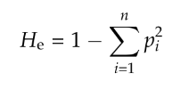
Genetic Variation
The average expected heterozygosity- which can be calculated by subtracting homozygosity from 1.0 (aka the total sum of all genetic variation) at n loci within a population provides the best estimate of genetic variation
“gene diversity”
Works best at measuring genetic variation when used with many loci
Small sample size, ploidy, and differing reproductive methods does not generally pose a problem
Also a good measure of the expected response of a population to natural selection and individual F_{IS}
Total # of alleles at a locus is a good measure of genetic variation and can be used to compliment H_{e}
Provides an important measure of the long-term evolutionary potential of populations (Allendorf 1986)
dependent upon sample size to draw meaningful comparisons between samples → allelic richness takes into account sample size
The proportion of polymorphic loci in a population is another measure of genetic variation that compliments H_{e} and allelic richness as well
Less useful in studies of highly variable (polymorphic) loci

