Slide 1
Chapter 8
Natural Selection
Notes:
Until now we’ve been looking at allele probability as if natural selection isn’t happening– but it is!
Exploring why local adaptations are important and how that effects conservation

Slide 2
Why is genetic variation important to localized populations?
Different alleles and genotypes can affect a population’s ability to thrive in their specific environment
If genetically distinct individuals are introduced into a population to increase genetic diversity, but they don’t have any locally-adapted traits, they’re unlikely to survive and the effort is ultimately unsuccessful
Even worse, gene flow between these unfit individuals can be detrimental to the rest of the population because those local adaptations are at a greater risk to be lost

Slide 3
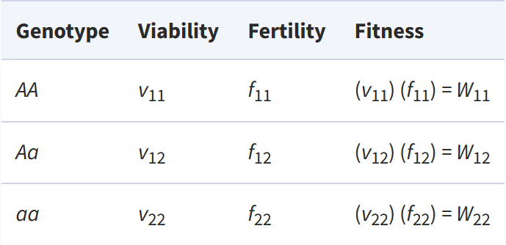
fitness
Fitness: average number of offspring produced by individuals of a certain genotype
Life history components that drive selective differences between genotypes:
Viability: probability of survival to reproductive age
Fertility: average number of offspring per individual that survives to reproductive maturity for a particular genotype
Calculated as the product of viability and fertility for an individual genotype
Notes:
Image: how to define fitness at a locus with 2 alleles

Slide 4
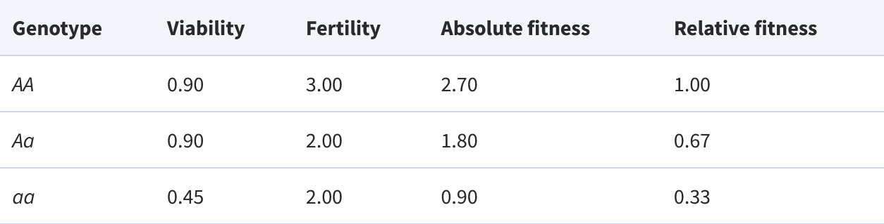
relative fitness
Based on the total number of expected progeny for each genotype
In this example, the relative fitness of heterozygotes is 0.67 because heterozygotes have 0.67 times as many progeny as AA homozygotes (on average)
Notes:
Fitnesses have been standardized by dividing by the genotype with the highest fitness (AA)
Not sure where these values come from?

Slide 5
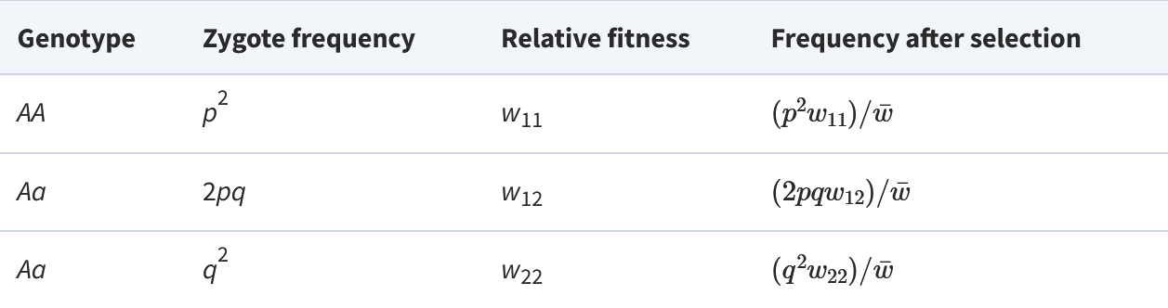
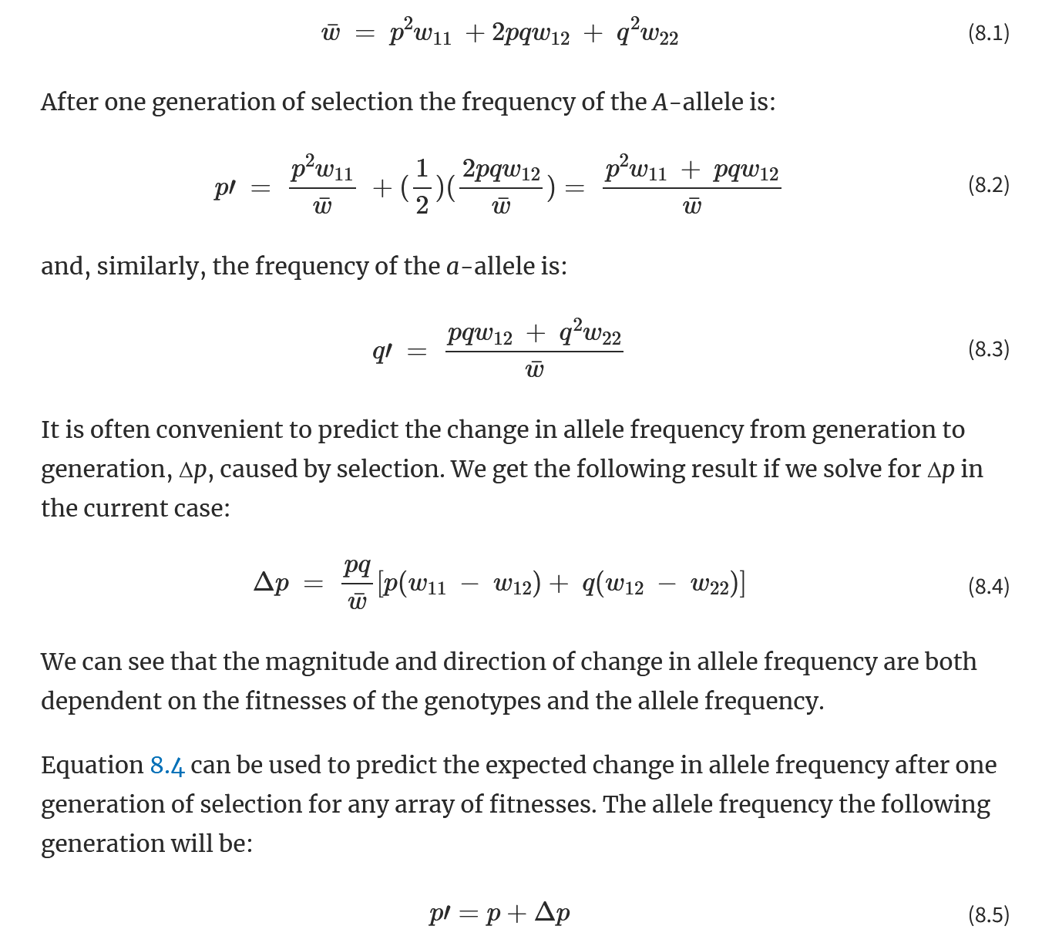
Single locus with 2 alleles
Modeling changes caused by viability selection (differential survival)
HW expected frequencies after 1 generation
w is the average fitness in the population
Average fitness of population = fitness of each genotype weighted by its frequency
Notes:
In this example, all HW assumptions are valid except that this population has random mating
Hardy-Weinberg proportions

Slide 6
Three methods of natural selection
Directional selection
Heterozygous advantage (overdominance)
Heterozygous disadvantage (underdominance)
Notes:
3 methods of natural selection with constant fitness

Slide 7
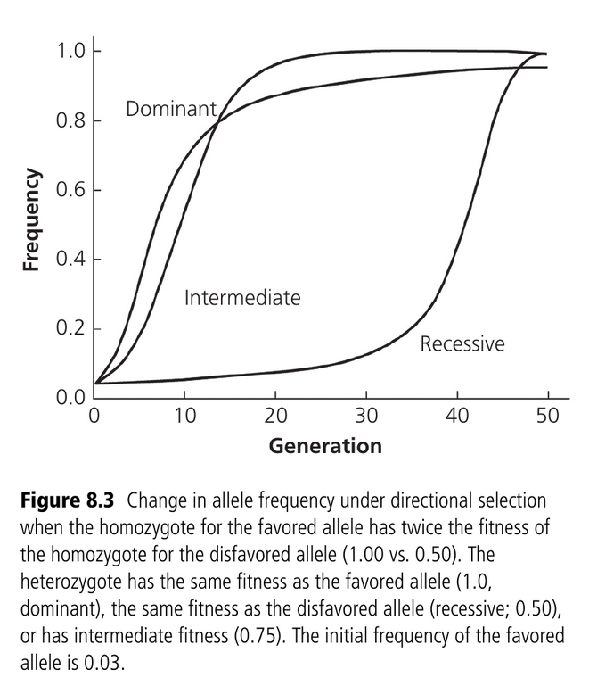
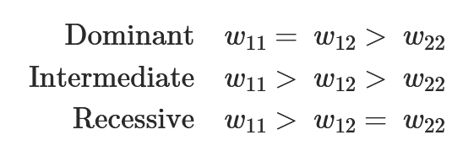
Directional selection
When one allele is always at a selective advantage
Allele can be dominant, intermediate, or recessive
Notes:
Advantageous alleles will become fixed via natural selection
The dominance of the allele doesn’t matter bc they’re all going to end up fixed if the allele is advantageous
But! The rate of change in allele frequencies IS affected by dominance – ex. Selection on a recessive allele is ineffective when the allele is rare, because the allele remains “hidden” due to the majority of their presence being in heterozygotes

Slide 8
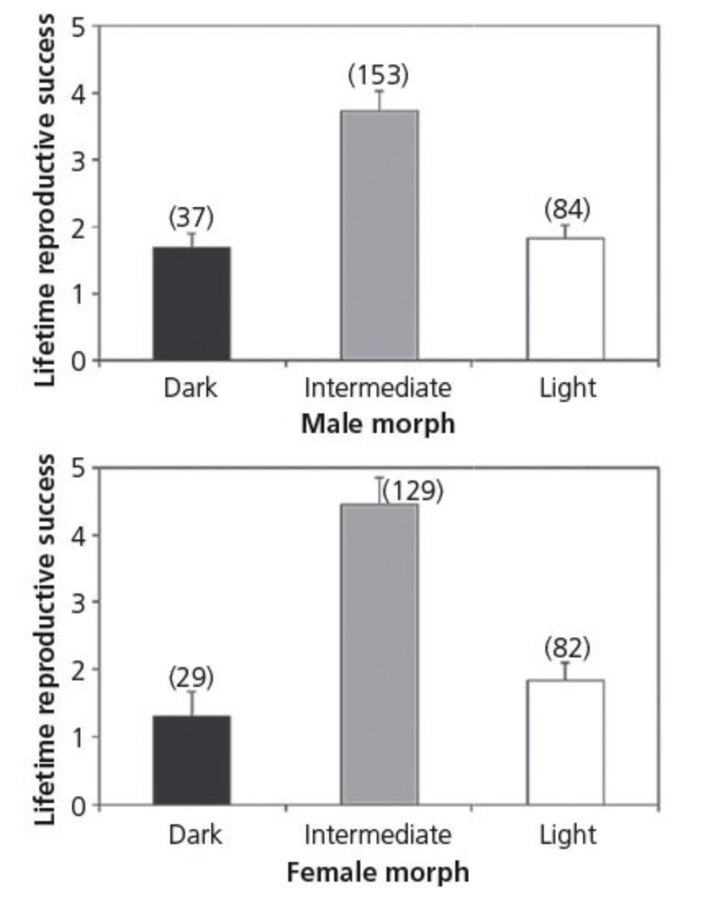
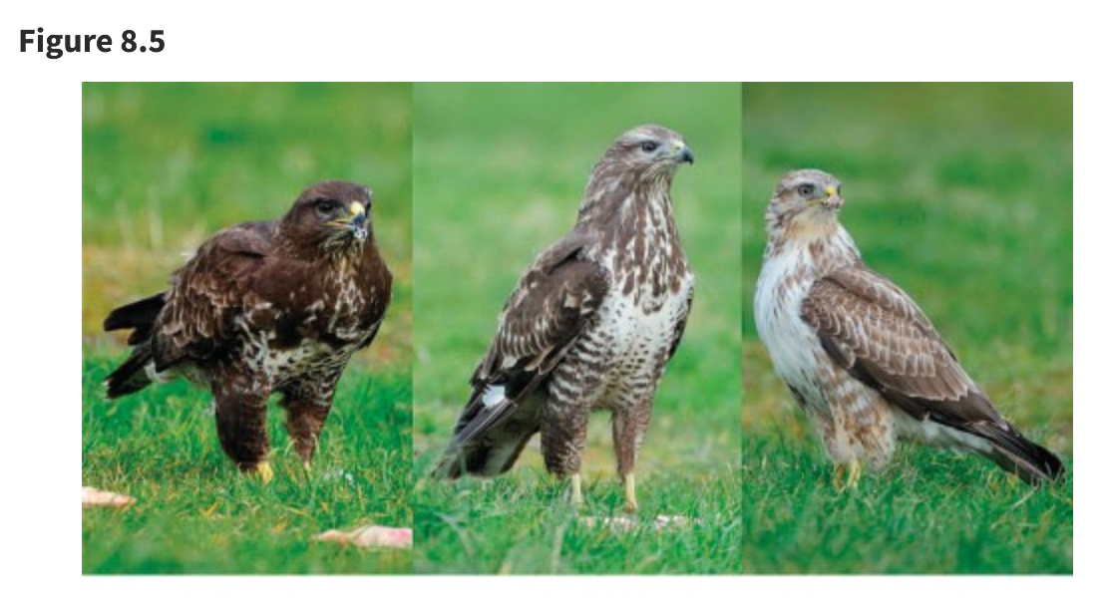
Heterozygous advantage (overdominance)
When the heterozygote has the best fitness
w₁₁ < w₁₂ > w₂₂
Expected to maintain both alleles in a stable equilibrium
Example 8.2: heterozygous advantage for color polymorphism in the common buzzard
Heterozygotes have a higher rate of reproductive success, therefore the heterozygotes have a selective advantage
Notes:
Stable equilibrium: where allele frequencies will always return (frequencies want to be in equilibrium)
Example: observations of 162 individuals and their offspring produced results that the intermediate-colored birds had a higher rate of annual survival, and significant differences in levels of aggression, habitat preference, and parasite load. This intermediate color was due to a heterozygous allele at a single locus, so it’s a good example for heterozygous advantage

Slide 9
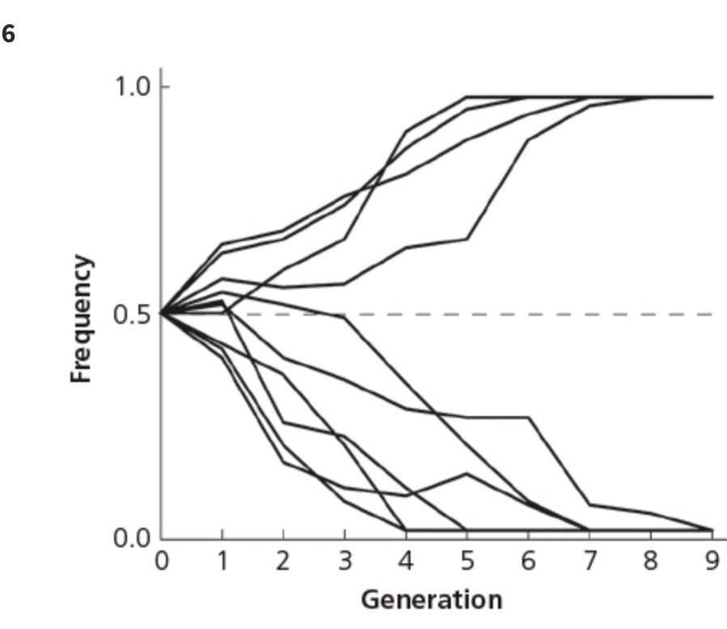
Heterozygous disadvantage (underdominance)
When the heterozygote is least fit:
w₁₁ > w₁₂ < w₂₂
Produces an unstable equilibrium, which will result in homozygotes becoming fixed
Notes:
Unstable equilibrium: allele frequencies will move away from equilibrium once they’re changed. Frequencies will move to extremes on either end and become fixed, which isn’t good for genetic variation
Figure shows an experiment where fruit flies were put into cages: 10 populations, each with a starting amount of 20 individuals. homozygotes had equal fitness that was approximately twice that of heterozygotes. because of genetic drift alleles quickly became fixed.

Slide 10
Selection and hardy-Weinberg proportions
Just because there’s a lack of departures from HW proportions in a population, doesn’t mean that a particular locus isn’t affected by natural selection
Differences in fertility won’t affect HW proportions; only differential survival can be tested for by testing for HW proportions
Sometimes even strong differences won’t cause deviations from HW proportions; at a locus with 2 alleles, differential survival doesn’t cause a departure from HW proportions as long as the product of the fitness of the 2 homozygotes equals the square of the fitness in the homozygotes
“Goodness of fit” test for HW proportions isn’t able to detect deviations from HW proportions that are caused by differential survival
Notes:
Differential survival: differences in rates of survival between individuals in a population

Slide 11
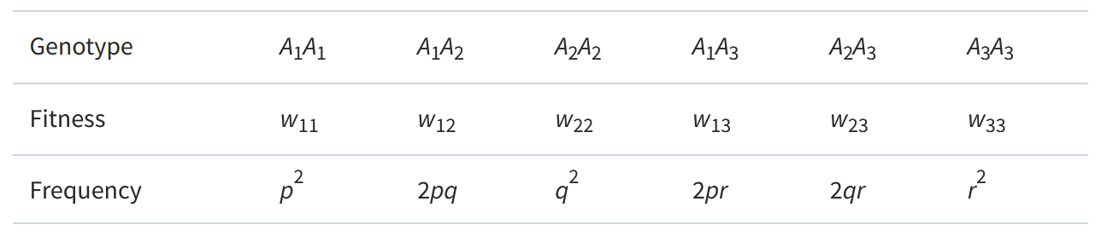
Multiple alleles
Analyses of the effects of natural selection become increasingly complicated when a locus has more than two alleles
We can extend our equation to 3 alleles, but there are no set rules for 3 alleles at a single locus like there is for 2 alleles
Notes:
Example: with just 5 alleles at a single locus, there are 15 different genotypes possible

Slide 12
Helpful tips
There is at most one stable equilibrium for two or more alleles
A stable equilibrium will be reached from any starting point that contains all three alleles
If a stable polymorphism exists, the average fitness of the population exceeds the fitness of any homozygote; if a homozygote like this were to exist, it would become fixed
Heterozygous advantage isn’t necessary for a stable polymorphism to be present
Notes:
Tips the textbook provides to help when analyzing a locus with 3 alleles
Stable polymorphism: a polymorphism that’s maintained at a locus through natural selection

Slide 13
Frequency-dependent selection
When fitness is not constant in a population, either in response to environmental changes or changing allele frequencies
Notes:
This is realistically what populations are like– fitness doesn’t stay constant under real-life conditions
Can be a powerful way to maintain genetic variation in natural pops

Slide 14

self incompatibility locus in plants
S₁, S₂, and S₃ alleles have equal probability (0.33)
Mutated allele (S₄) has great selective advantage because it’s able to fertilize every plant
Over time the frequency of S₄ would increase until it reaches equilibrium with the other S alleles (all would be 0.25)
Notes:
Three most likely causes for frequency-dependent selection are sexual selection, predation and disease, and competition
Extreme example of frequency-dependent selection is that of the self-incompatibility locus (S) in plants : fantastic way to maintain genetic diversity
Any new S mutation is expected to have high selection advantage at the start
Important to keep in mind that S4 is also likely to be lost due to genetic drift– so the actual number of S4 alleles would be the amount lost and the amount gained together

Slide 15
Complimentary sex determination in invertebrates
Many invertebrate species have a haplodiploid mechanism of sex determination
Homozygous diploid at csd develop into infertile males
Rare alleles are advantageous because they’re less likely to produce sterile homozygous males
Small populations are especially susceptible to producing more sterile males because genetic drift reduces allelic diversity at csd locus
An increase in males being produced means a decrease in females being produced, which may cause the population to decline
This can increase the probability of the extinction of small populations
Notes:
Females are haploid, males are diplodis
Large pops don’t have to worry about producing too many diploid males

Slide 16
Natural selection in small populations: genetic drift
Genetic drift in small populations has 2 effects:
Natural selection becomes less effective
The effects of natural selection become less predictable

Slide 17
Directional selection
Genetic drift hinders the effects of directional selection
It can cause the effects of random genetic drift to outweigh the effects of natural selection, meaning advantageous alleles can be lost
Alleles at a selective disadvantage may become fixed
Notes:
Genetic drift reduces the ability for deleterious alleles to be lost and advantageous alleles to be gained

Slide 18
Underdominance and drift
Chromosomal rearrangements are, for the most part, selected against, even if homozygotes for that chromosomal rearrangement have higher fitness
Genetic drift can cause alleles that are always selected against to remain present in a population
When allele frequency becomes unstable, natural selection kicks in to “fix” the chromosomal rearrangement
Factors that make a species susceptible to becoming threatened are the same factors that suggest high chromosomal variability between groups
Notes:
Chromosomal rearrangements suffer from underdominance, in that they’ll always be selected against regardless of their advantageousness
Chromosomal variation and evolution are why translocating individuals from one population to another can sometime be detrimental to conservation efforts

Slide 19
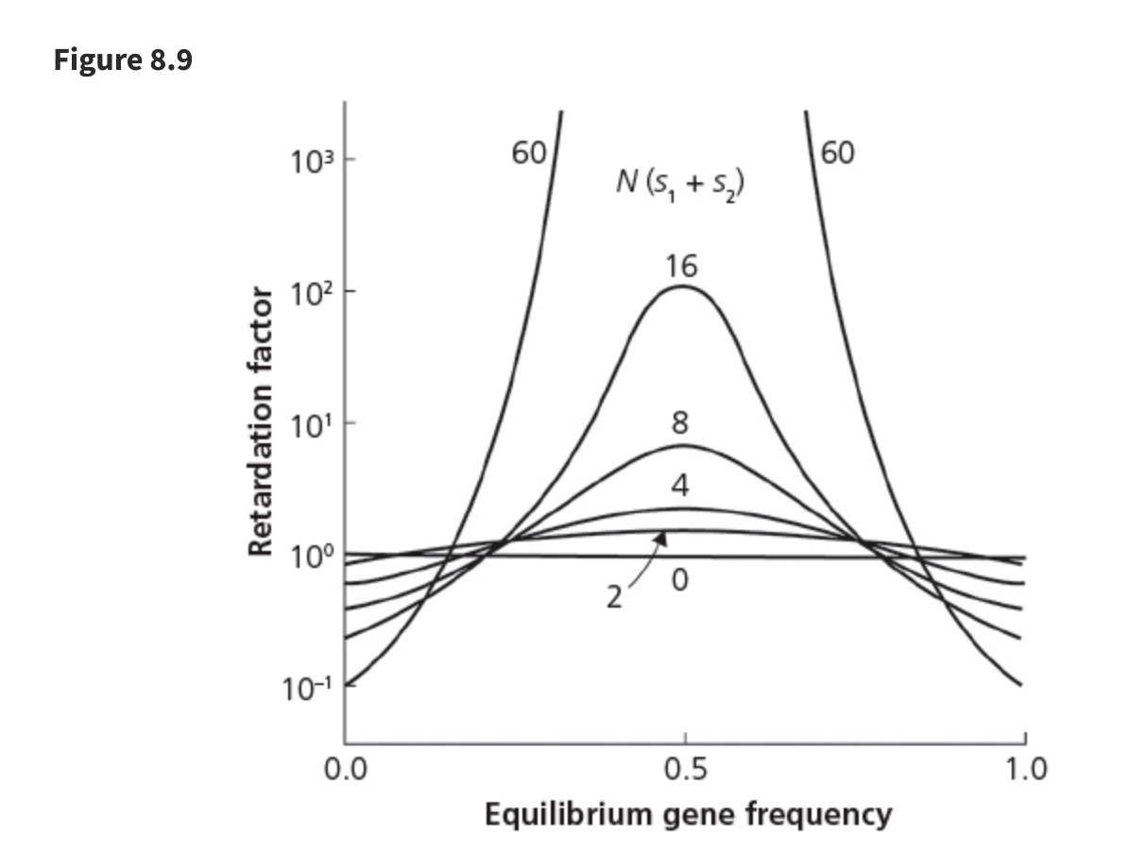
Heterozygous advantage and drift
Overdominance can accelerate loss of genetic variance if equilibrium frequency of an allele is near zero or one
Notes:
Essentially overdominance is only good at keeping alleles with high frequencies around

Slide 20
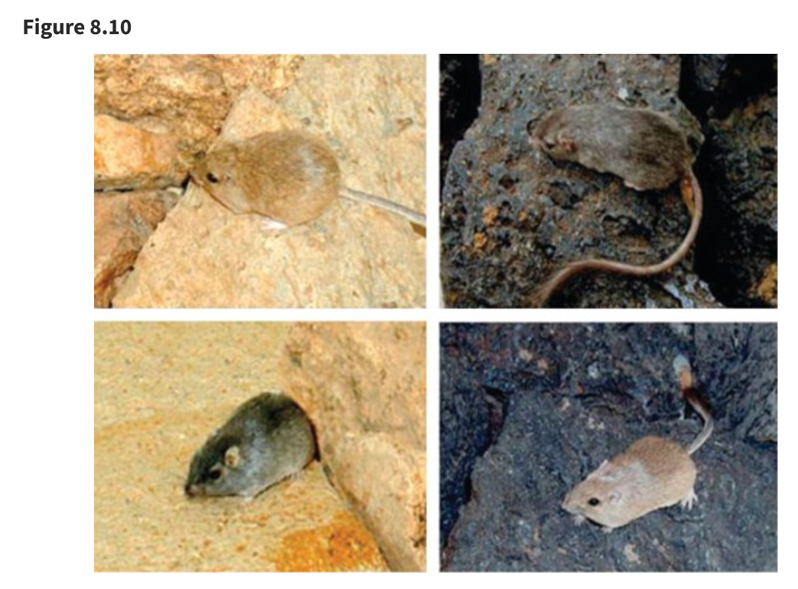
Detection of natural selection
Study by Nachman et al. (2003) examined rock mice and found that the darker mice have a mutation on a certain gene at a certain locus, where the light color mice don’t
Local adaptations can be hard to find because they aren’t always present
Notes:
Image from study by Nachman et al (2003)
A classic example of what we consider evidence for natural selection on phenotypes: fur color has adapted to the environment to produce a camouflage effect
Somehow this phenotypic mutation has evolved differently in different populations, despite existing for the same reason
Local adaptations are usually only present during events of extreme environmental conditions

Slide 21
Guest box: winter storms and genetic changes in green anole lizard
Green anoles were originally found in sub-tropical Cuba, and now occupy temperate areas in the south-eastern US
Local populations have local adaptations to varying winter conditions
Winter 2013-2014 saw uncharacteristic extreme snow in Texas and Oklahoma
Results of genetic testing showed differences on multiple genes that are responsible for cold-tolerance before and after the storms, and those that survived the winter had a higher cold tolerance, suggesting that the storms induced an amount of selection on individual lizards

Slide 22

Natural selection and conservation
Local adaptations have a higher presence in large populations
Small populations have a lesser ability to evolve to changing environments, which is crucial to their survival
Notes:
Local adaptations are important!!

