Slide 1

RAD Experimental Design
Improving de novo assembly with a MiSeq library
Enzyme Choice
B@G 2018

Slide 2
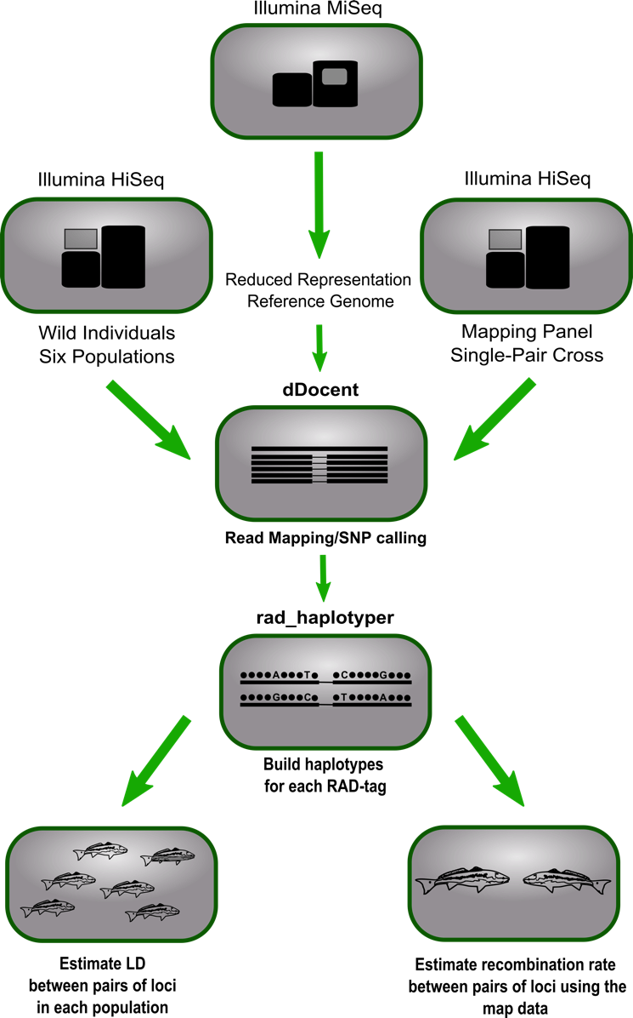
Improving de novo assembly
Our lab is now starting to use a single MiSeq run of 300 bp PE to help generate a more accurate set of reference contigs
B@G 2018

Slide 3
The Power of MiSeq
5’
3’
3’
5’
B@G 2018

Slide 4
The Power of MiSeq
5’
3’
3’
5’
B@G 2018

Slide 5
Using a MiSeq Reference
Our lab is now starting to use a single MiSeq run of 300 bp PE to help generate a more accurate set of reference contigs
So far we have had a significant improvement to the number of reads that map to the MiSeq contigs relative the HiSeq derived reference contigs.
One MiSeq run can also genotype ~20 individuals
B@G 2018

Slide 6

Choosing the right enzyme
Number of genomic fragments sampled
Genome size
Enzyme choice
Size selection
Take the time to plan make informed enzyme choices
B@G 2018

Slide 7
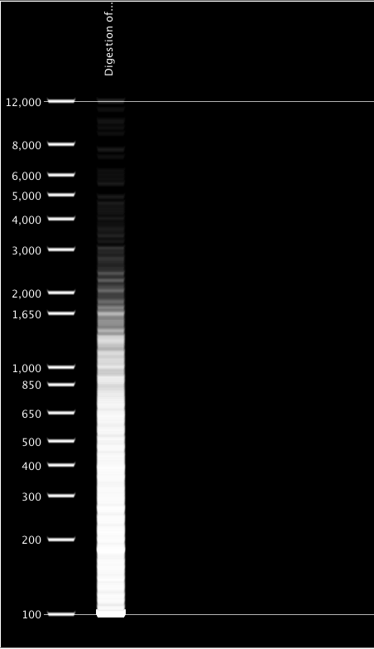
Choosing the right enzyme
If you have a close reference genome
SIMULATE
Geneious
SimRAD R package
Webcutter
http://rna.lundberg.gu.se/cutter2/
B@G 2018

Slide 8
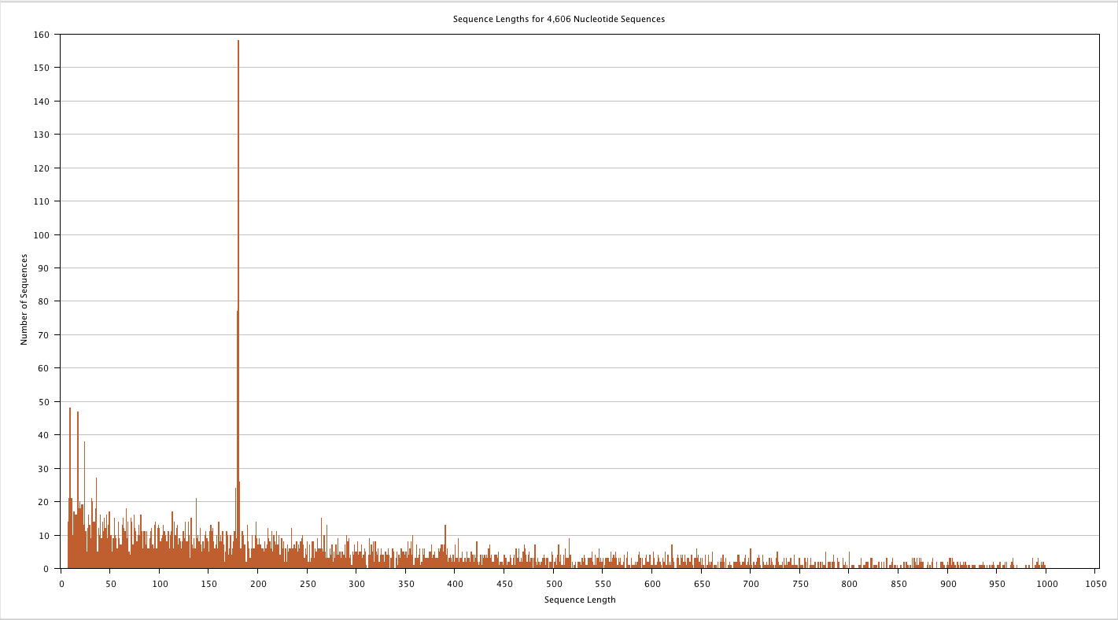
Choosing the right enzyme
If you have a close reference genome
SIMULATE
Geneious
BioEdit
Webcutter
http://rna.lundberg.gu.se/cutter2/
B@G 2018

Slide 9
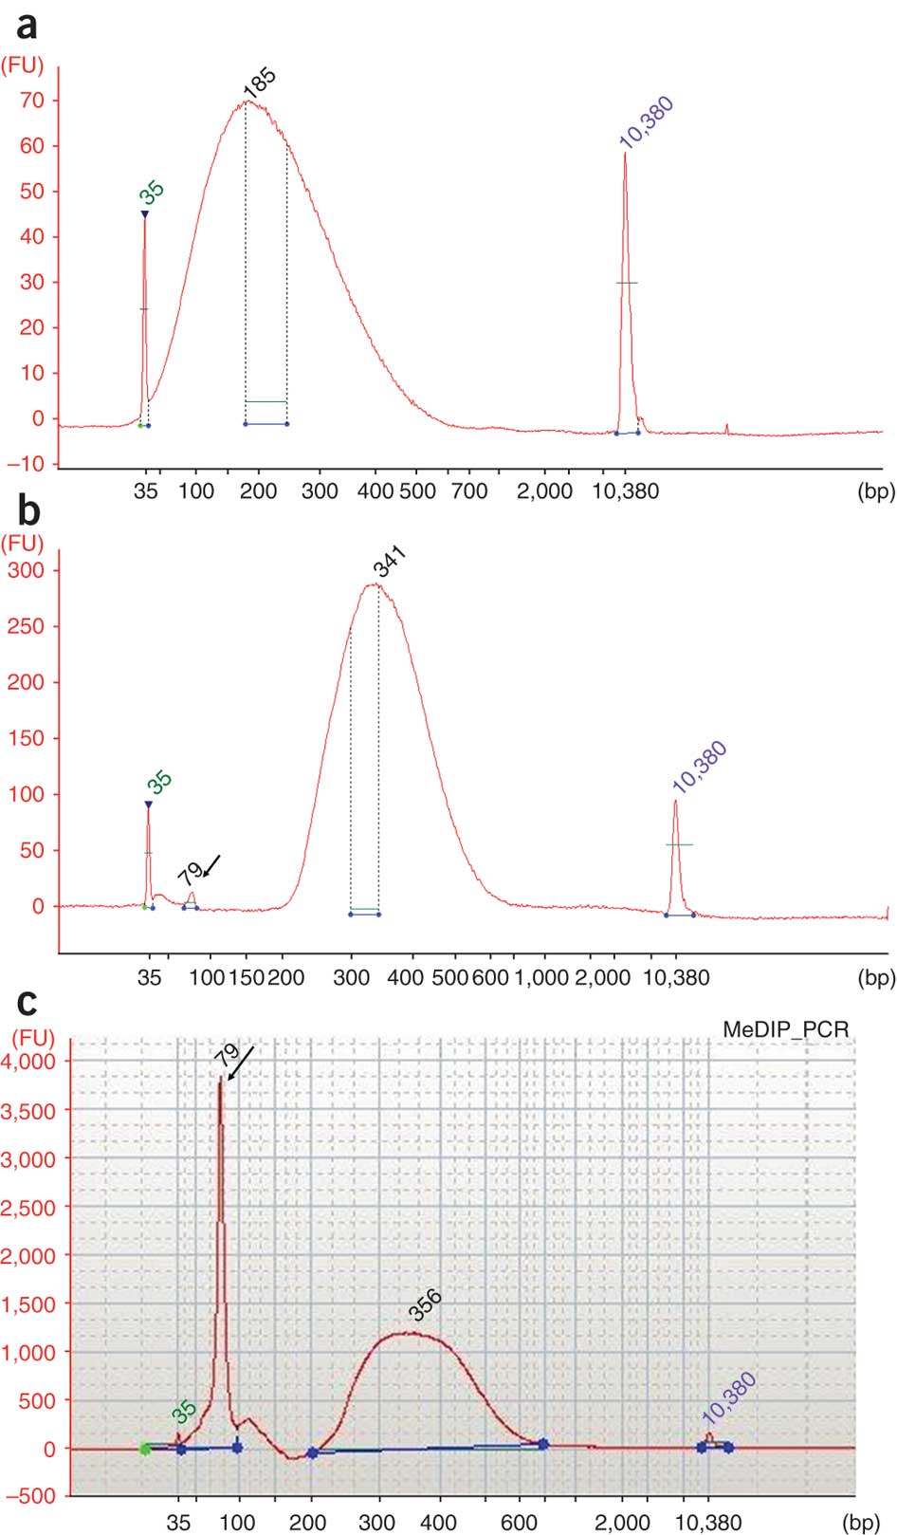
Let’s be honest...
You probably don’t have a genome
An educated guess
Calculate the probability of the cut sequence in your genome
Should be adjusted for GC content
Multiply this probability by the size of your genome
Divide by half for ezRAD
Experiment
Combine trials and fragment analysis
See protocol at https://docs.google.com/document/d/1QY0LndEUywyGmOBCF7xDQeI_f5MNB_T3lKwSSvbFtX4/edit
B@G 2018

