Slide 1
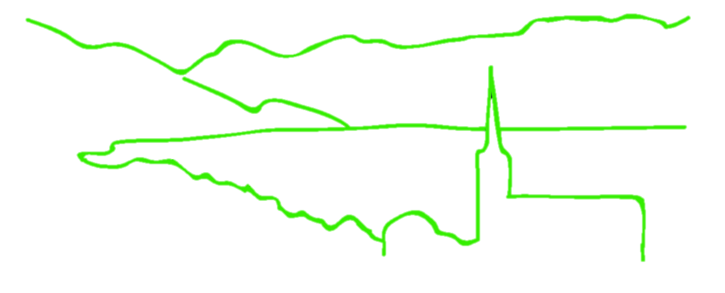
These aren’t the loci you are looking for: principles of effective SNP filtering
B @ G⁴
i
o
i
n
for
o
r
m
a
t
i
c
s
d
a
p
t
a
t
i
o
n
e
n
o
m
i
c
s
Jonathan B. Puritz
University of Rhode Island

Slide 2

SNP Filtering
Use the
Fear
Of
Reaching
Conclusions
Erroneously
B@G 2018

Slide 3
SNP Filtering
VCF files output directly from genotyping software are often filled with false positives
Most software is focused more on the power to detect variants rather than accuracy
This helps to ensure that all possible variants in a data set are recovered
Filtering is required to remove false positives
B@G 2018

Slide 4
Principles of SNP Filtering
What do you need to filter?
Low coverage genotypes
genotype depth
Low coverage individuals
INDELs
*Low minor allele frequency*
loci present in only a few individuals
Loci that are not called in a majority of individuals
HWE
B@G 2018

Slide 5
Principles of SNP Filtering
What do you need to filter?
Loci with skewed allelic balance at heterozygotes
Loci with abnormally high depth
SNPs that are called from both Forward and Reverse reads
Loci without matching paired read status
Loci with skewed ratios of read mapping qualities
Loci with artificially high quality scores
B@G 2018

Slide 6
SNP Filtering Software
VCF files can be filtered using grep, awk, and sed for particular filtering flags
http://www.1000genomes.org/wiki/Analysis/Variant%20Call%20Format/vcf-variant-call-format-version-41
vcfilb
https://github.com/ekg/vcflib
vcfallelicprimatives
important to decompose complex variants
VCFtools
http://vcftools.sourceforge.net
rad_haplotyper
https://github.com/chollenbeck/rad_haplotyper
B@G 2018

