Slide 1
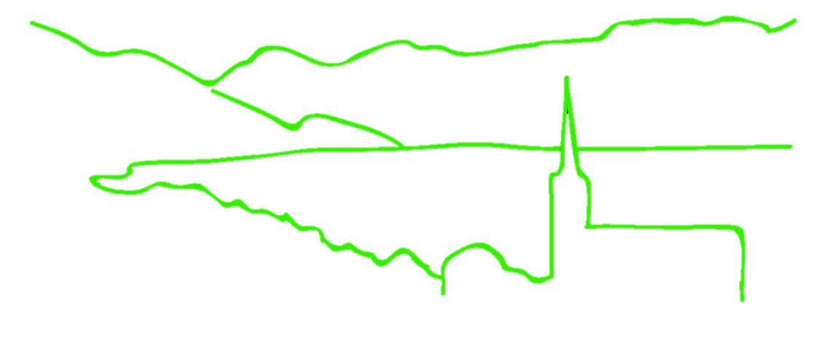
These aren’t the loci you are looking for: principles of effective SNP filtering
B @ G²
i
o
i
n
for
o
r
m
a
t
i
c
s
d
a
p
t
a
t
i
o
n
e
n
o
m
i
c
s
Jonathan B. Puritz
Marine Science Center
Northeastern University

Slide 2

SNP Filtering
Use the
Fear
Of
Reaching
Conclusions
Erroneously
B@G 2016

Slide 3
SNP Filtering
VCF files output directly from genotyping software are often filled with false positives
  Most software is focused more on the power to detect variants rather than accuracy
  This helps to ensure that all possible variants in a data set are recovered
  Filtering is required to remove false positives
Raw VCF files are also going to contain variants that are not informative for population genomics
  SNPs that only appear in a single individual
B@G 2016

Slide 4
Principles of SNP Filtering
What do you need to filter?
  Low coverage genotypes
    genotype depth
  Low coverage individuals
  INDELs
  Low minor allele frequency
    loci present in only a few individuals
  Loci that are not called in a majority of individuals
  HWE
B@G 2016

Slide 5
Principles of SNP Filtering
What do you need to filter?
  Loci with skewed allelic balance at heterozygotes
  Loci with abnormally high depth
  SNPs that are called from both Forward and Reverse reads
  Loci without matching paired read status
  Loci with skewed ratios of read mapping qualities
  Loci with artificially high quality scores
  *Optional* Distance between SNPs
    Important for STRUCTURE or NeEstimator
B@G 2016

Slide 6
SNP Filtering Software
VCF files can be filtered using grep, awk, and sed for particular filtering flags
  http://www.1000genomes.org/wiki/Analysis/Variant%20Call%20Format/vcf-variant-call-format-version-41
vcfilb
  https://github.com/ekg/vcflib
  vcfallelicprimatives
    important to decompose complex variants
VCFtools
  http://vcftools.sourceforge.net
B@G 2016

